Slide 1
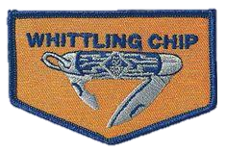
109 Whittling Chip

Slide 2
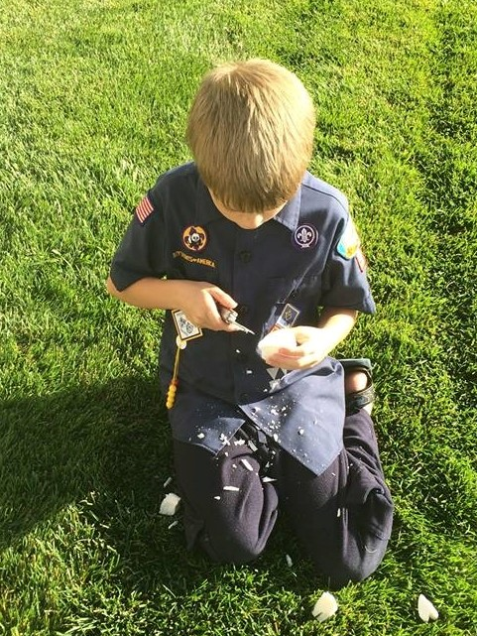
What is Whittling Chip
Certifies that the youth has earned the right to carry a pocket knife
    To designated Scouting functions
    By completing the requirements of the Whittling Chip

Slide 3
Whittling Chip?
Know the safety rules for handling a knife and show, using these rules, that you know how to care for and use your pocketknife safely.
Make a carving with a pocketknife. Work with your den leader or other adult when doing this.
Read, understand and promise to abide by the “Pocketknife Pledge.”

Slide 4
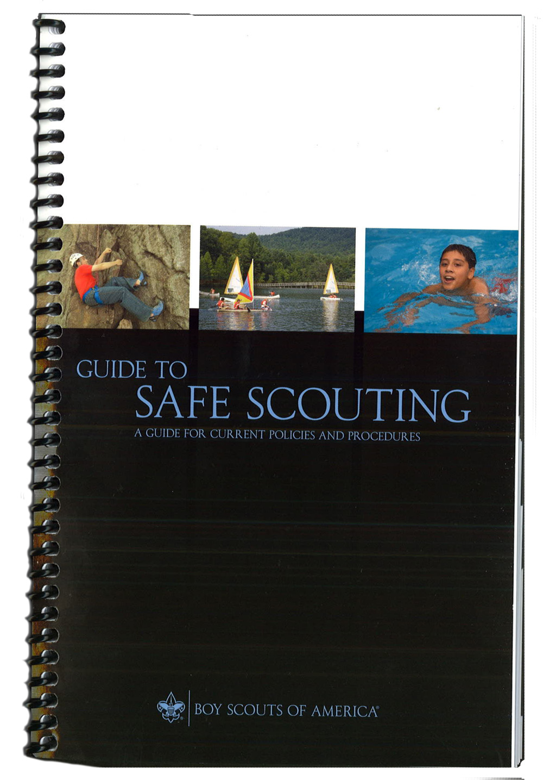
Guide to Safe Scouting
Tools | Lion | Tiger | Wolf | Bear | Webelo/AOL
Axes | No | No | No | No | No
Bow Saws | No | No | No | No | Yes
Hand Ax | No | No | No | No | No
Hand Tools | No | Yes | Yes | Yes | Yes
Pocket Knife | No | No | No | Yes | Yes
Notes:
Knives
A sharp pocketknife with a can opener on it is an invaluable backcountry tool. Keep it clean, sharp, and handy. The BSA believes choosing the right equipment for the job at hand is the best answer to the question of what specific knife should be used. We are aware that many councils or camps may have limits on the type or style of knife that should be used. The BSA neither encourages nor bans fixed-blade knives nor do we set a limit on blade length. Since its inception, the BSA has relied heavily on an outdoor program to achieve its objectives. This program meets more of the purposes of Scouting than any other single feature. We believe we have a duty to instill in our members, youth and adult, the knowledge of how to use, handle, and store legally owned knives with the highest concern for safety and responsibility.
Remember—knives are not allowed on school premises, nor can they be taken aboard commercial aircraft.

Slide 5
Safe Guide to Scouting
Knives
A sharp pocketknife with a can opener on it is an invaluable backcountry tool. Keep it clean, sharp, and handy. The BSA believes choosing the right equipment for the job at hand is the best answer to the question of what specific knife should be used. We are aware that many councils or camps may have limits on the type or style of knife that should be used. The BSA neither encourages nor bans fixedblade knives nor do we set a limit on blade length. Since its inception, the BSA has relied heavily on an outdoor program to achieve its objectives. This program meets more of the purposes of Scouting than any other single feature. We believe we have a duty to instill in our members, youth and adult, the knowledge of how to use, handle, and store legally owned knives with the highest concern for safety and responsibility. Remember—knives are not allowed on school premises, nor can they be taken aboard commercial aircraft. References: Scouts BSA handbooks, Fieldbook, Bear Handbook, and Wolf Handbook

Slide 6
EDGE Method
EDGE is used to teach concepts. The key to making EDGE work is to use it for all teaching opportunities. Make it a habit.
Explain – Trainer explains how something is done
Demonstrate – Trainer demonstrates while explaining again.
Guide – Learner tries the skill while the trainer guides them through it.
Enable – Learner works on his own under the watchful eye of the trainer. The trainer’s role in this step is to remove any obstacles to success, which enables the learner to succeed.

Slide 7
Where to Train Whittling Chip
Large enough to allow Safe Zones
Are Knives allowed?
Should be an area where other kids will not be playing
On a campout or at a Den Meeting

Slide 8
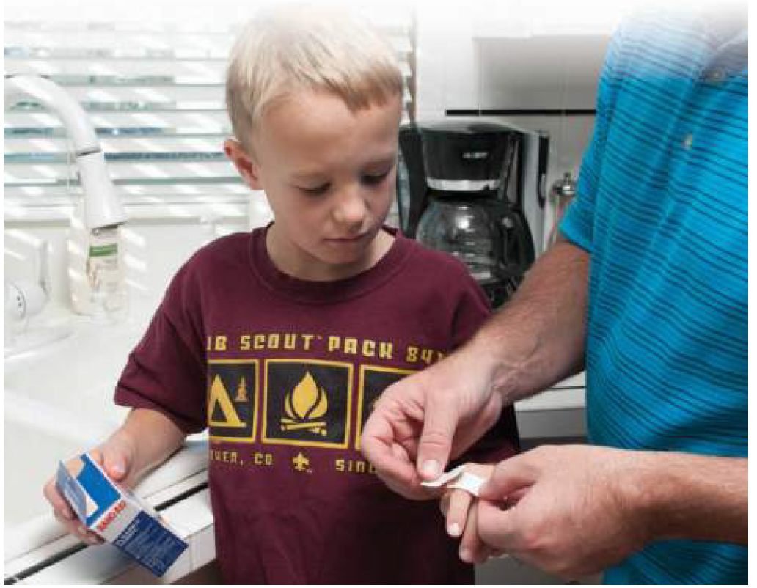
FIRST AID KIT
Plenty of Band-Aids
Most likely to occur when opening or closing the knife

Slide 9
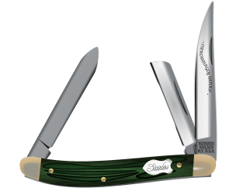
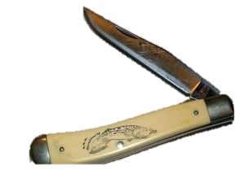
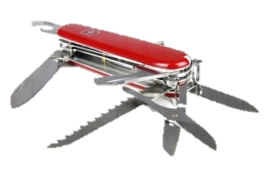
Types of Knives
Pen Knife Jack Knife Multi-Tool
Notes:
The pen knife has hinges and blades on both ends of the knife. Often, they will have two or three blades at each end. They are also smaller than the other two types.
The jack knife is only hinged on one end, but it may have more than one blade. Outdoorsmen such as hunters, campers and fishermen tend to like these knifes.
The multi-purpose knife is popular because there are so many different things they can have on them. Obviously, they'll have a knife blade, but they can also have a file, scissors, tweezers, can or bottle openers and even a mini-saw blade.

Slide 10
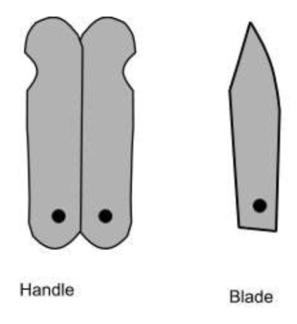
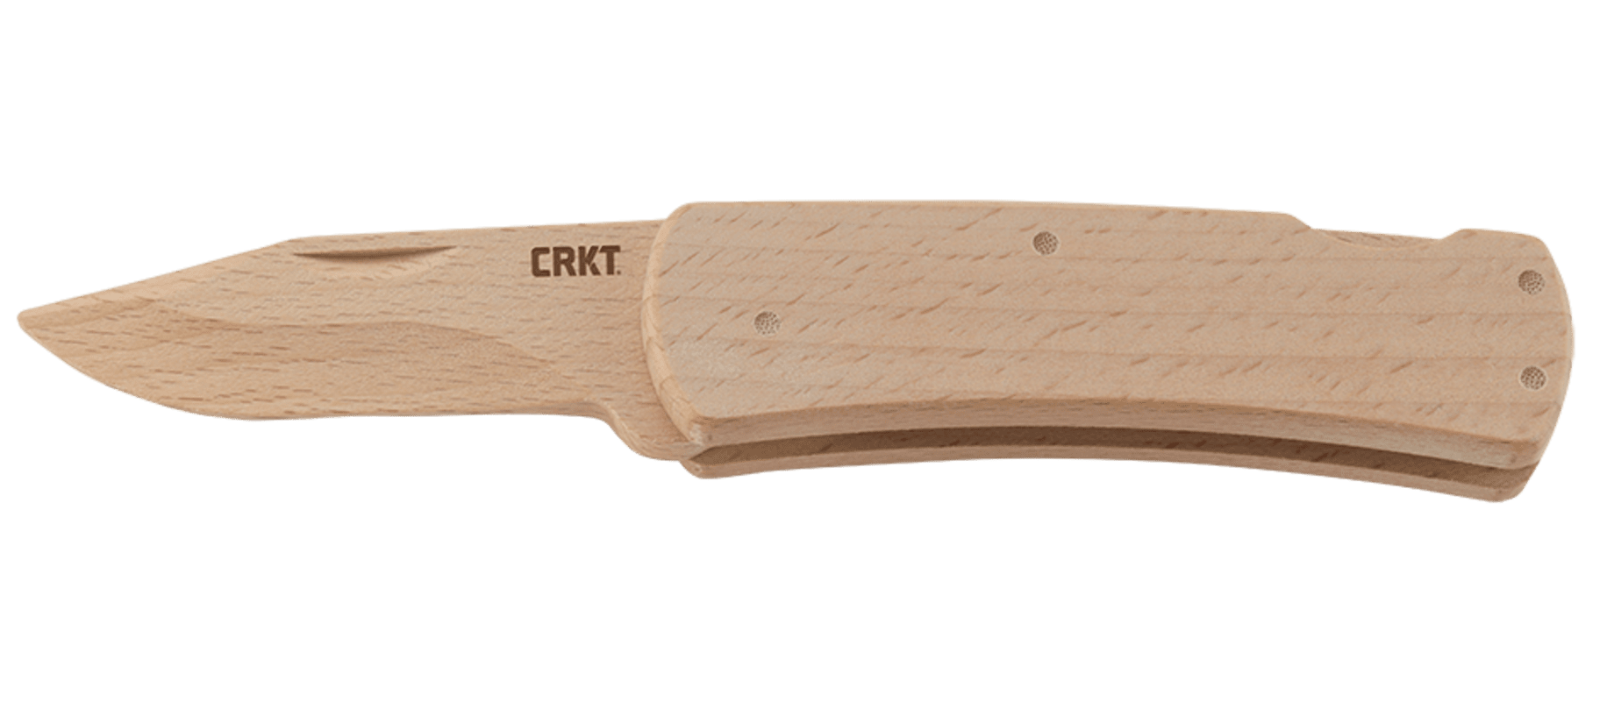
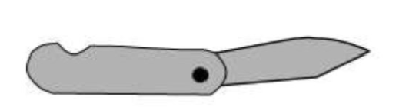
Practice Knives
Wooden Knife Paper Knife

Slide 11
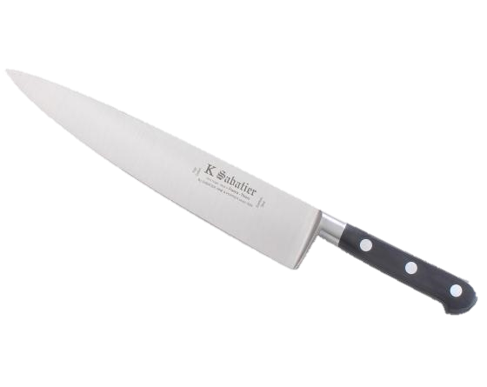
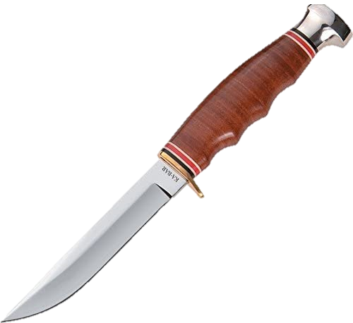
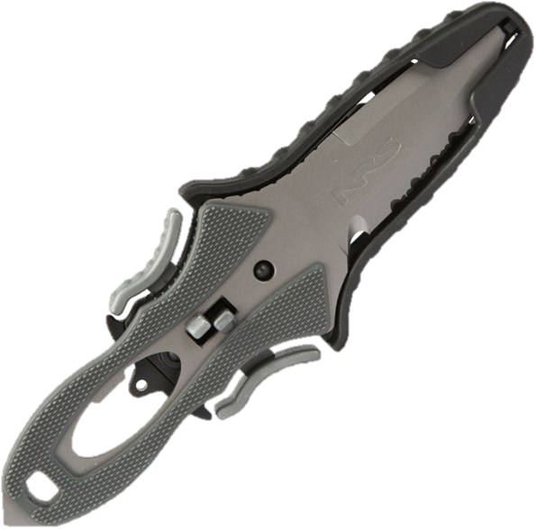
Other Types of Knives
Sheath Knife River Knife Kitchen Knife
Notes:
The pen knife has hinges and blades on both ends of the knife. Often, they will have two or three blades at each end. They are also smaller than the other two types.
The jack knife is only hinged on one end, but it may have more than one blade. Outdoorsmen such as hunters, campers and fishermen tend to like these knifes.
The multi-purpose knife is popular because there are so many different things they can have on them. Obviously, they'll have a knife blade, but they can also have a file, scissors, tweezers, can or bottle openers and even a mini-saw blade.

Slide 12
Sheath Knives
Q. What is the official BSA regulation on carrying sheath knives?
A. The Boy Scout Handbook, Bear Handbook, and Webelos Handbook contain the program for the safe and responsible use of knives. The BSA believes choosing the right equipment for the job at hand is the best answer to the question of what specific knife should be used. We are aware that many councils or camps may have limits on the type or style of knife that should be used. The BSA neither encourages nor bans fixed-blade knives nor do we set a limit on blade length. Additional information is found in the Guide to Safe Scouting.

Slide 13
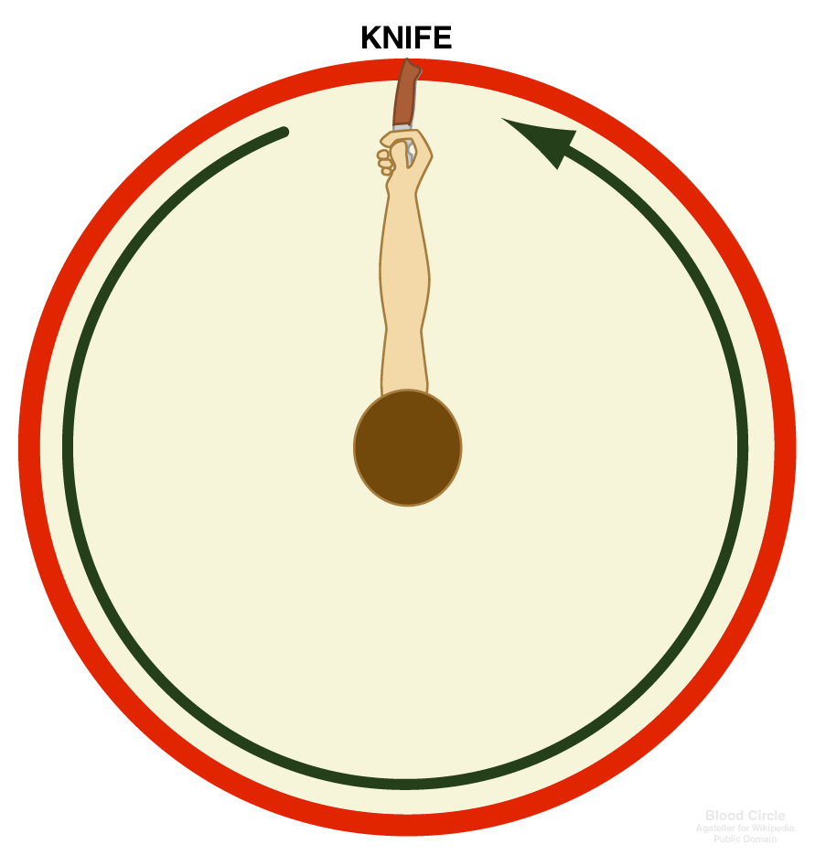
Knife Safety
Establish a “Safety Circle”
Knife in Hand, Turn in a Circle
If Knife Touches Anyone, You are Not Safe
Be Alert

Slide 14
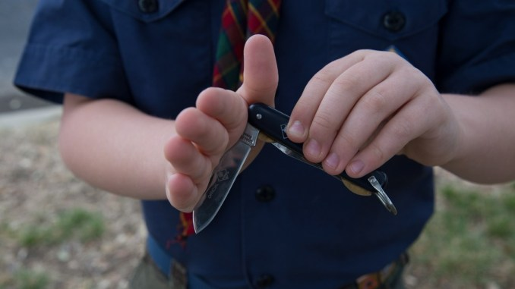
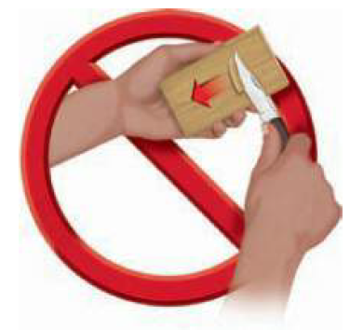
Knife Safety
Closing a Knife
  Use the Palm of your hand
  Be Careful with the Blade Lock
Always Cut with the Knive Away From You
Never Carry an Open Pocket Knife
Always Walk
Keep Your Knife Sharp
Make Small Shavings
Put Your Knife Away, Do Not Leave out

Slide 15
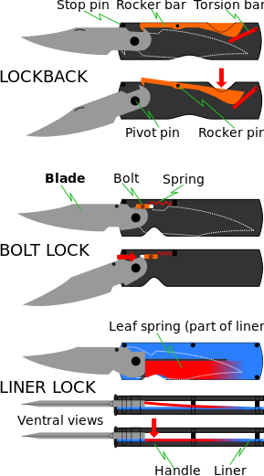
Knife Blade Locks

Slide 16
Caring for Your Knife
A knife is a tool, not a toy.
Never use your knife on something that will dull or break it - Never use your knife to cut living trees or plants, or poke it in the dirt. Moisture and dirt will ruin your knife.
Keep your knife out of the fire. The heat will ruin the temper of the steel making the knife-edge soft and useless.

Slide 17
Caring for Your Knife
Do not carve your initials into anything that does not belong to you
Keep your knife dry and keep the blade clean. Wipe the blade before closing it.
Clean your knife by hand; the heat and steam of the dishwasher can dull and damage the knife

Slide 18
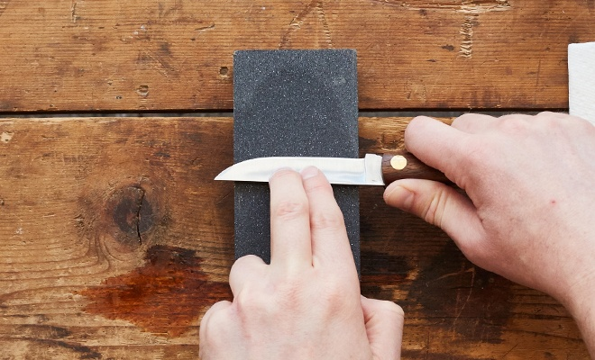
Sharpening A Kife
https://www.youtube.com/watch?v=Ks8pVWR_-Zg&feature=youtu.be

Slide 19
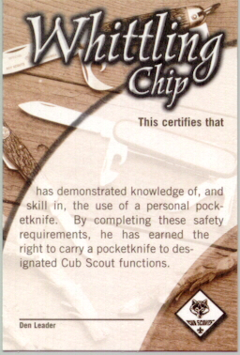
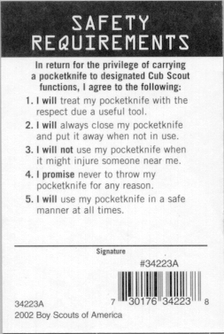
Whittling Chip Card
Notes:
This certifies that Scouty has demonstrated knowledge of , and skill in, the use of a personal pocket knife. By completing these safety requirements, he has earned the right to carry a pocketknife to designated Cub Scout functions
In return for the privelage of carrying a pocketknife to designated Cub Scout functions, I agree to the following
I Will treat my pocketknife with the respect due a useful tool
I Willl always close my pocketknife and put it away when not in use
I will not use my pocketknife when it might injure someone near me
I promise never to throw my pocketknife for any reason
I will use my pocketknife in a safe manner at all times

Slide 20

How Do We Teach In Today’s World

Slide 21
Virtual Whittling Chip
Zoom, Microsoft Teams
Must include parents at home to assist scouts
  Send parents a Whittling Chip email with what will be taught
Provide Scouts with materials in advance
  Carving Supplies
  Fake Knife
  Whittling Chip and Bear Claws workbooks
Use YouTube videos to break up the lecture

Slide 22
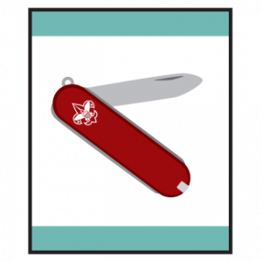
Bear Claws Adventure
Learn three Common Designs of Pocket Knives
Learn Knife Safety & Earn your Whittling Chip
Do one of the following
  Using a pocket knife, carve two items
  With a Pocket Knife safely perform each of these tasks
    Demonstrate how to cut a piece f rope, twine or fishing line;
    Open a sealed box without damaging the contents;
    Open a can with a can opener tool on a pocket knife;
    Remove and replace the screws on an object with the screw driver tool on a pocket knife;
    Open a letter.

Slide 23
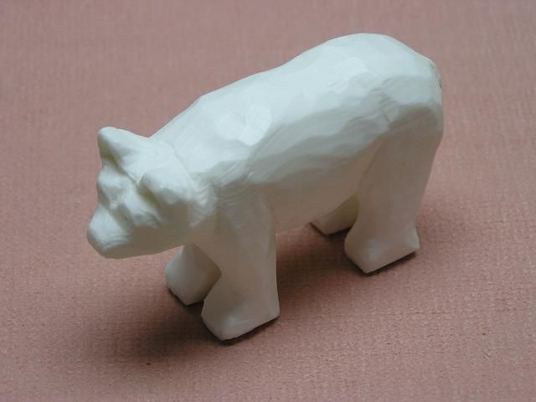
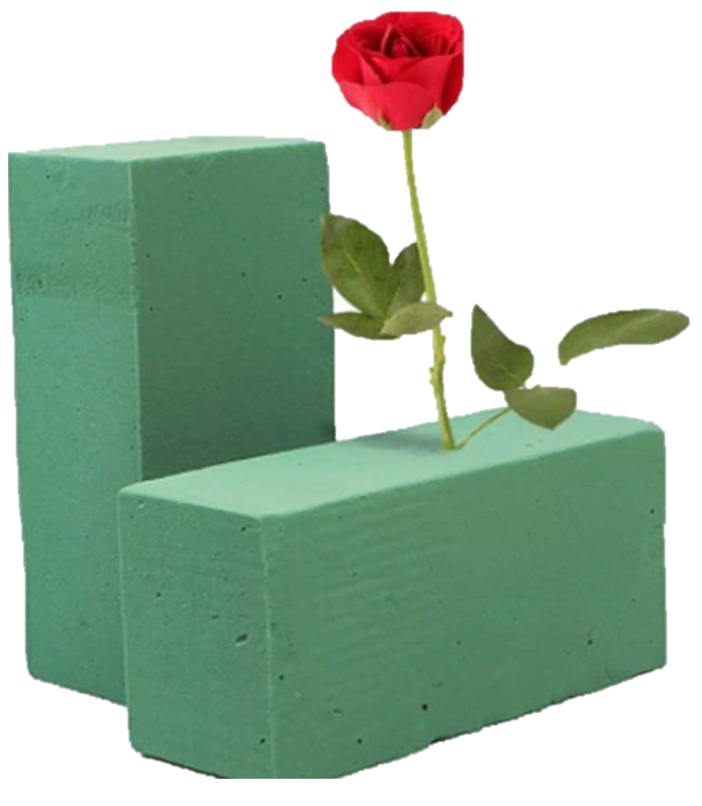
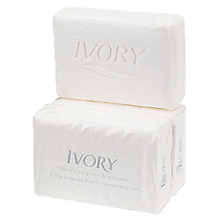
Carving
Ivory Soap Bars or Floral Foam or Wood
Stencils
Wood Sticks to Carve

Slide 24
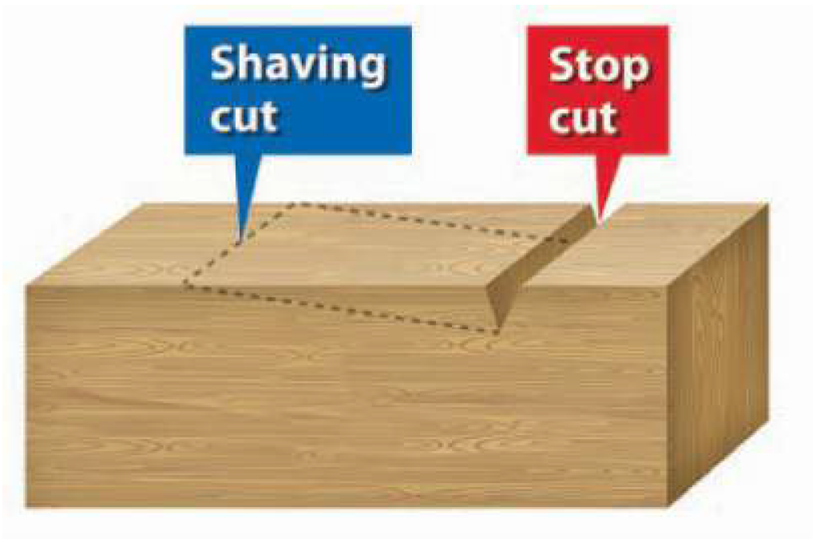
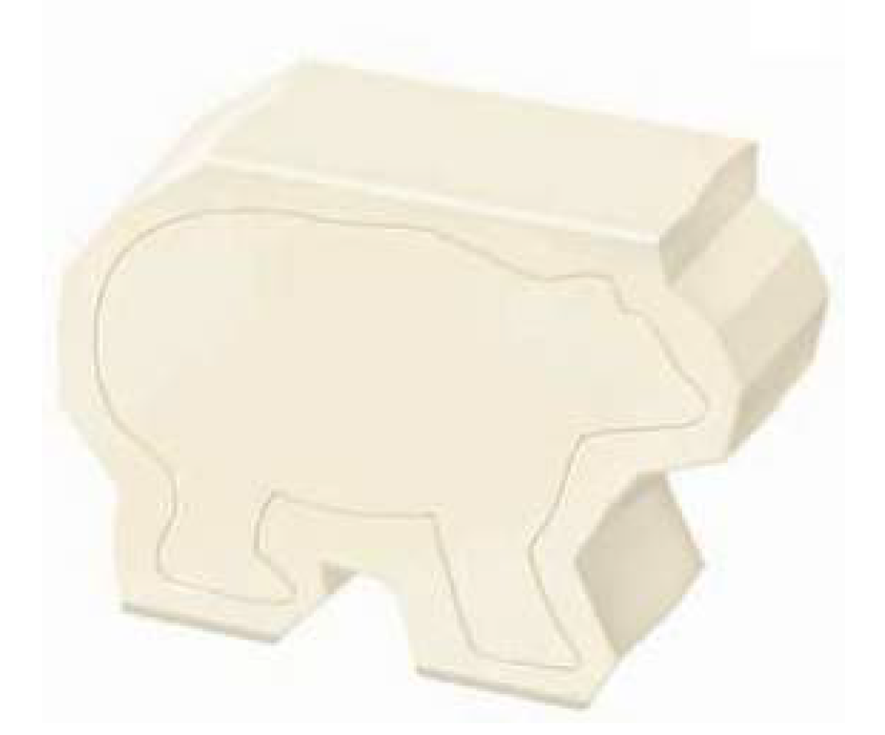
Using the Stop Cut

Slide 25
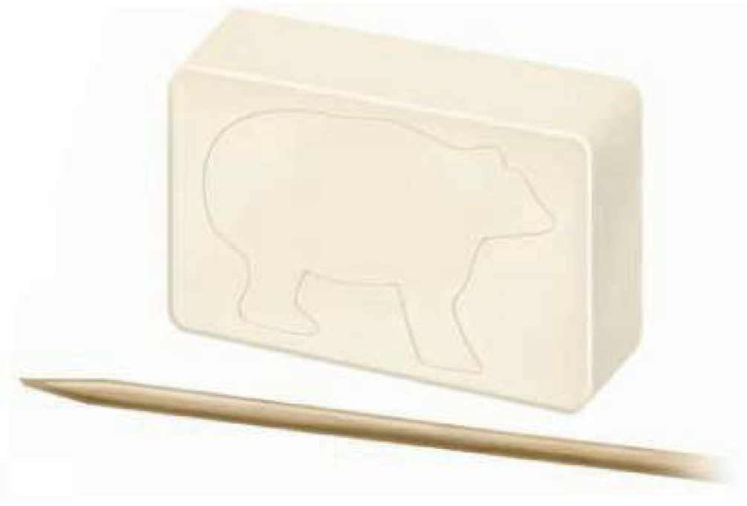
Trace Your Design on the Soap

Slide 26
