Slide 1

Winter Sports Safety
SLIDE SUB-TITLE
Class # 314
Winter Sports Safety; description: Learn the basics of avalanche safety, how to spot and avoid terrain hazards, and what to do when wild weather hits. Will also touch on the proper use of equipment and clothing. Great for everyone from experienced winter sports enthusiasts to beginners.

Slide 2
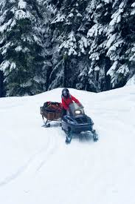
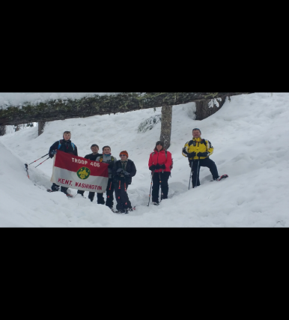
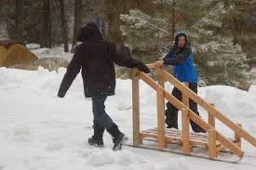
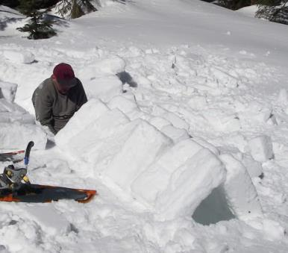
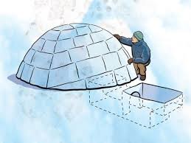
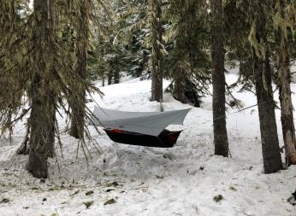
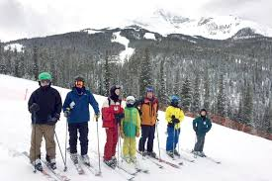
Winter Sports / Activities
SLIDE SUB-TITLE

Slide 3

OBJECTIVES
At the end of this session you should understand
How to have a safe and fun Winter Sports Outing / Activity:
Plan for the unexpected (there should not be any unexpected).
Select the correct gear for the conditions
Have the Scouts safely plan and execute a Winter outing
Learn what to do and what not to do in Avalanche conditions and how to look for
and spot avalanche terrain / conditions.

Slide 4
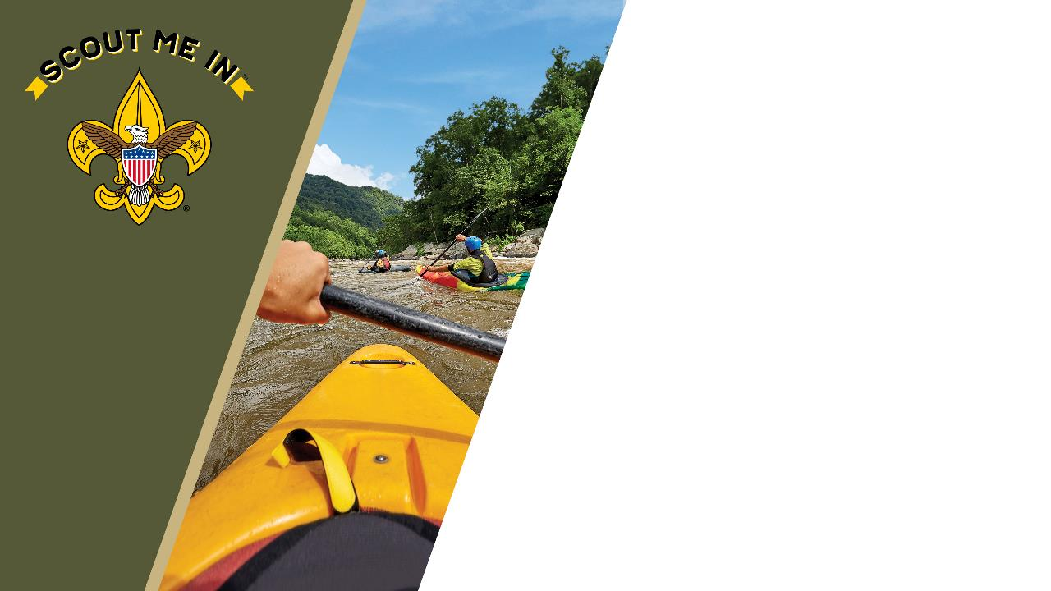
10 Essentials
Map and Compass
Sun Protection
Extra clothing
Headlight / Flashlight
First Aid Kit
Knife / Multi-tool
Matches / Fire Starter
Water
Trail Food
Rain gear

Slide 5
Clothing
Base layer
  Moisture wicking / breathable
  Looser fitting
    Polyester, Polypropylene or nylon

Slide 6
Clothing
Insulation layer
  Purpose
    Traps warm air next to body
  Best fabrics
    Wool, down, synthetic fill, or fleece

Slide 7
Clothing
Shell layer
  Purpose
    Provides protection from wind and precipitation
  Best fabrics
    Nylon with water resistant coatings like Gore-Tex or others.

Slide 8
Clothing
Why?
  Choose layers based on activities
    Snowshoeing, limited insulation to keep from overheating
    Camping, light insulation while active (building shelter) and heavy insulation during low activity times (Meal prep)
    Cotton Kills! Wet clothing will suck the heat out of your body
    Extras, bring extra socks, gloves, hat. Change before going to bed
    Don’t skimp on winter clothing, getting wet and cold on an outing is the best way for Scouts to not want to go on that outing again!

Slide 9
Winter Shelter
SLIDE SUB-TITLE
Winter Shelter
Winter Shelter

Slide 10
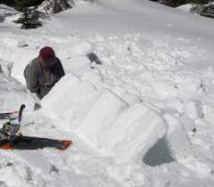
Winter Shelter
SLIDE SUB-TITLE
Winter Shelter
Snow Trench

Slide 11
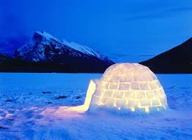
Winter Shelter
SLIDE SUB-TITLE
Winter Shelter
Igloo

Slide 12
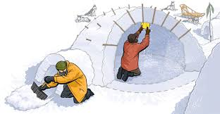
Winter Shelter
SLIDE SUB-TITLE
Winter Shelter
Quinzee

Slide 13
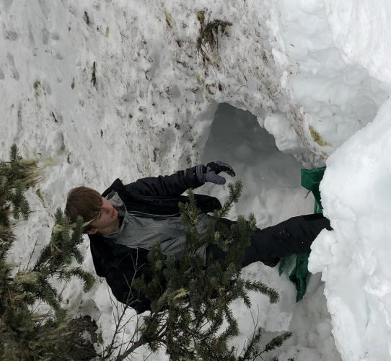
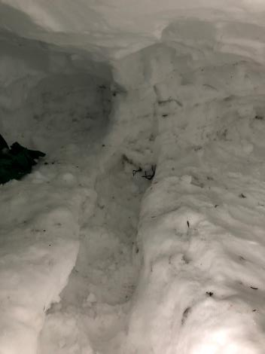
Winter Shelter
SLIDE SUB-TITLE
Winter Shelter
Snowcave

Slide 14
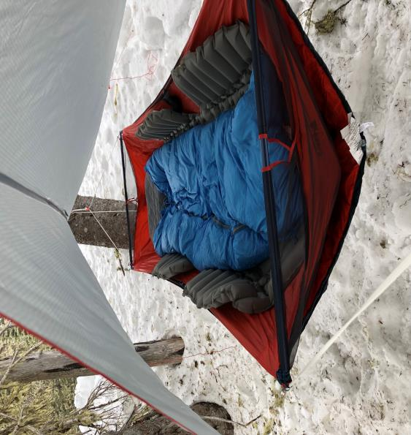
Winter Shelter
SLIDE SUB-TITLE
Winter Shelter
Hammock

Slide 15

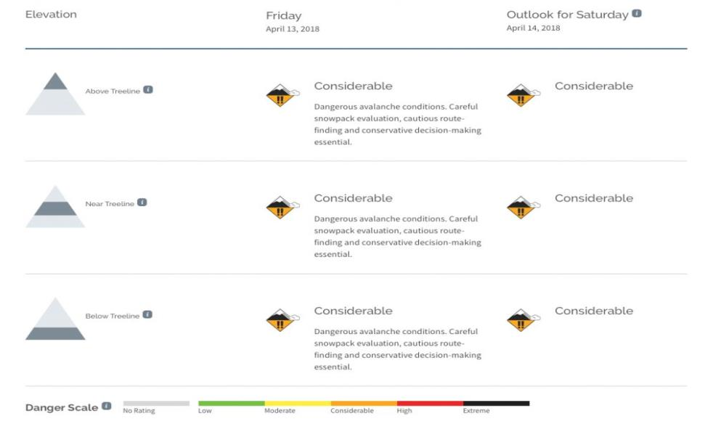
Before you go
SLIDE SUB-TITLE
https://www.nwac.us

Slide 16
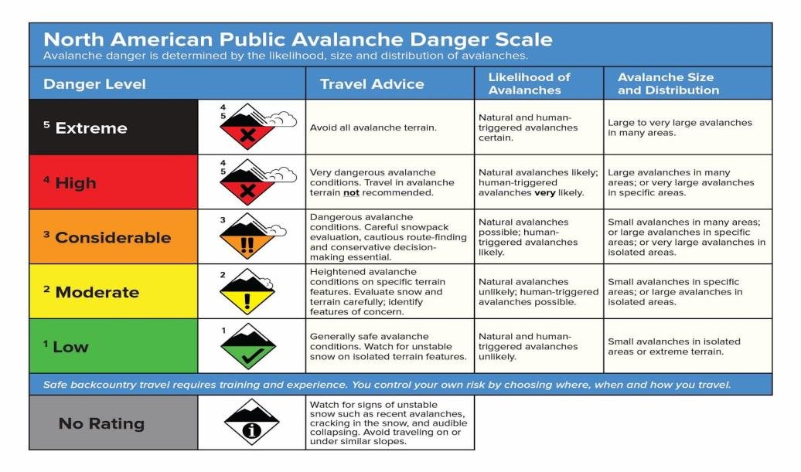
Before you go
SLIDE SUB-TITLE
https://www.nwac.us

Slide 17
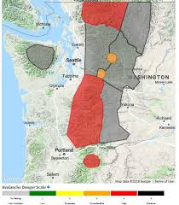
Before you go
SLIDE SUB-TITLE
https://www.nwac.us

Slide 18
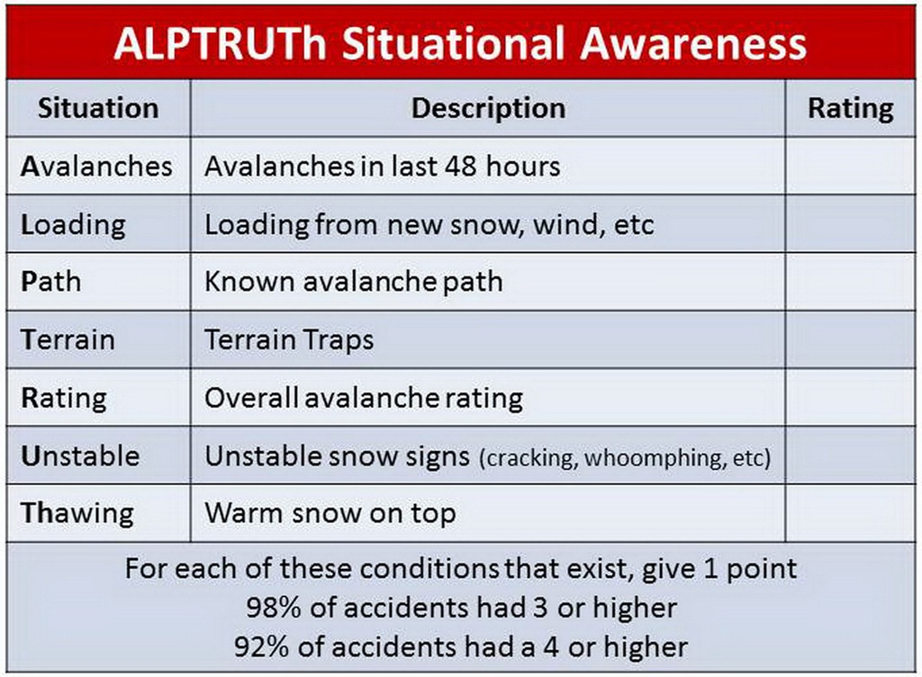
Avalanche Safety
SLIDE SUB-TITLE
ALPTRUTH

Slide 19
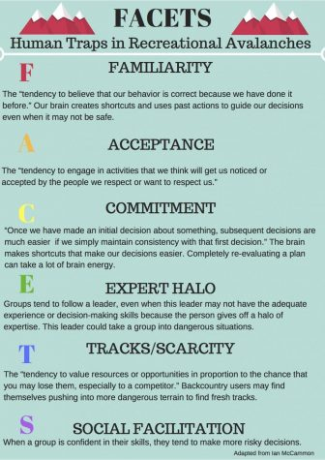
Avalanche Safety
SLIDE SUB-TITLE
FACETS

Slide 20
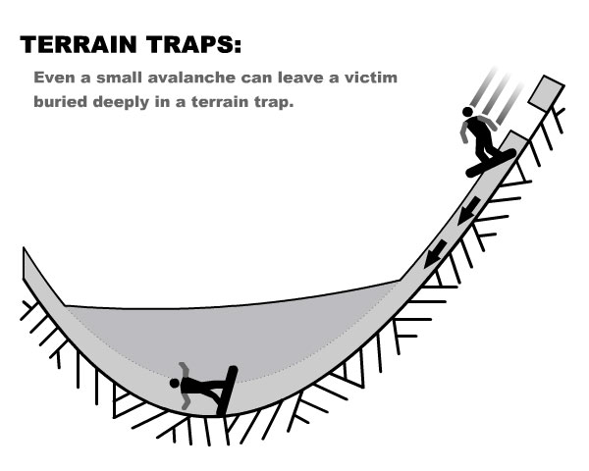
Avalanche Safety
SLIDE SUB-TITLE
Terrain Traps

Slide 21
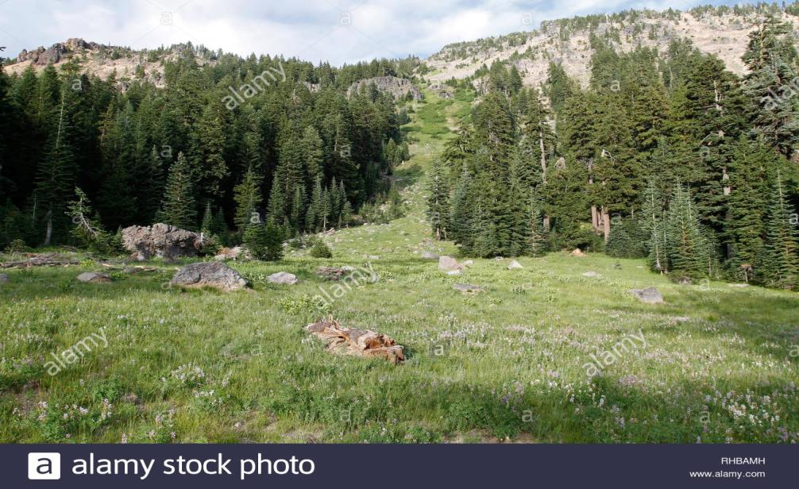
Avalanche Safety
SLIDE SUB-TITLE
Avalanche Chutes

Slide 22
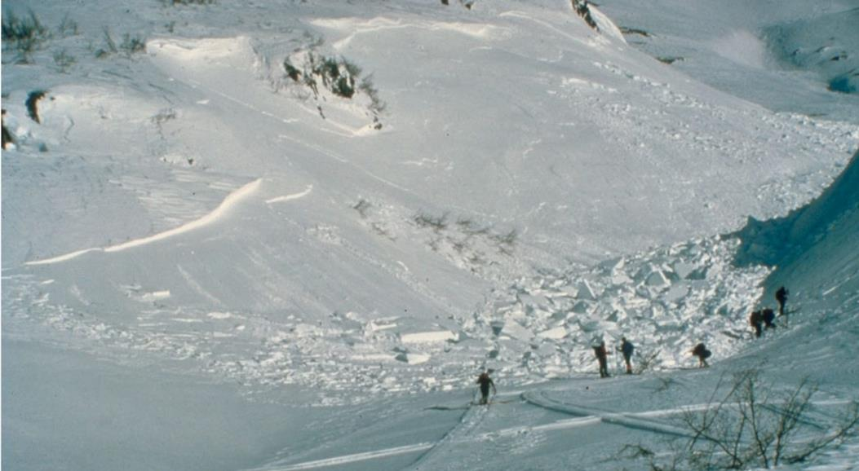
Avalanche Safety
SLIDE SUB-TITLE
Avalanche Chutes / recent

Slide 23
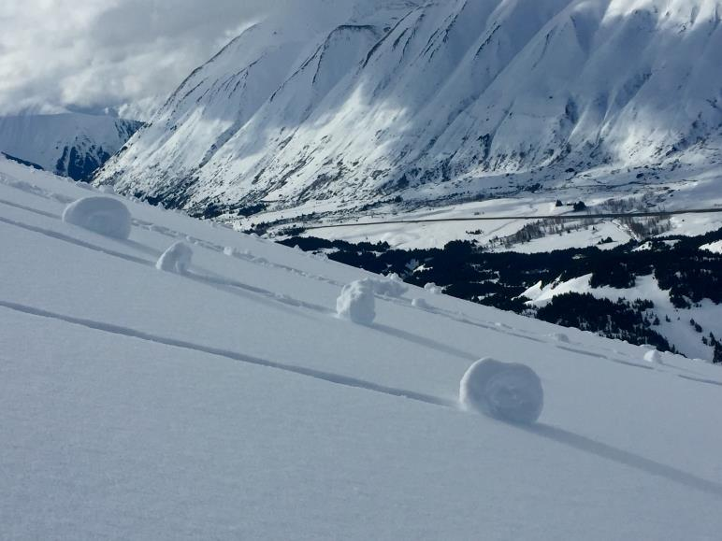
Avalanche Safety
SLIDE SUB-TITLE
Pinwheels / Rollerballs

Slide 24
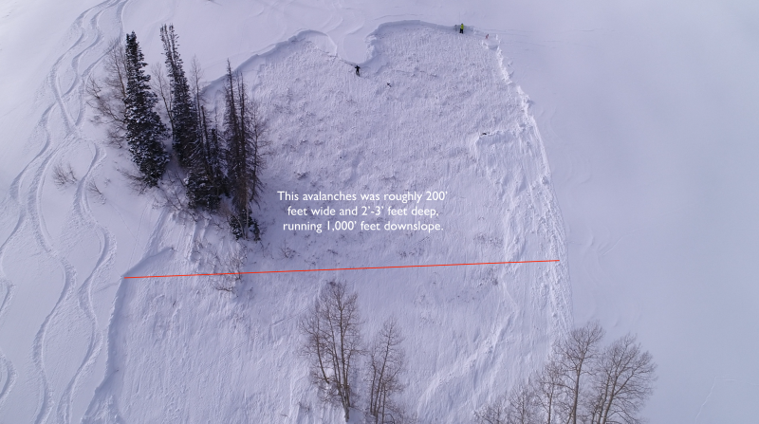
Avalanche Safety
SLIDE SUB-TITLE
Recent Avalanche

Slide 25
Avalanche Safety
SLIDE SUB-TITLE
Environmental risk factors
Risk factors
75% of Avalanches happen on a slope of between 34 and 49 degrees
Altitude plays a major role in risk. Higher elevations tend to mean colder temperatures and more wind. Lower elevations tend to mean warmer temps, and heavier loading (Rain / Wet snow).
Trees. Sparse trees are not good anchors, heavy tree coverage means good anchors.
Wind. Leeward sides of hills / mountains can create cornices or wind slabs. Wind can deposit snow 10 times more rapidly than snow falling without wind.
Sun. Weak layers tend to persist longer on the shady North facing slopes. As temps rise the South facing slopes will load more heavily and create wet avalanches

Slide 26

Gear
SLIDE SUB-TITLE
Gear
Recovery Gear, not Rescue Gear
  Use resources first, not gear!
  Snow Shovel. Durable metal, not plastic
  Avalanche Beacon / Transceiver
  Avalanche Probe 320CM or longer (320cm is about 10.5 feet)
  Avalanche backpack / Air bag backpack / Avalung vest
  Training and more training.
  Practice Annually
Notes:
Knowing that there will be times during the program that you need to be able to distinguish the gender of a troop or of a participant, use these terms for troops and these terms for individuals.

Slide 27
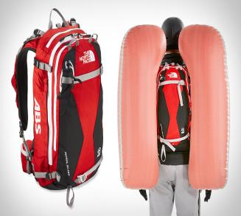
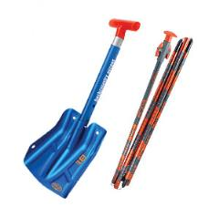
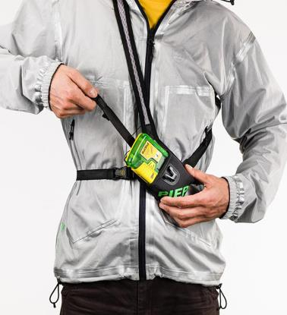
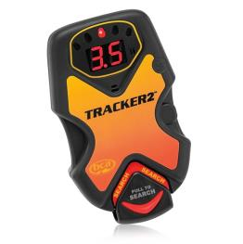
Gear
SLIDE SUB-TITLE
Gear
Notes:
Knowing that there will be times during the program that you need to be able to distinguish the gender of a troop or of a participant, use these terms for troops and these terms for individuals.

Slide 28
Challenge
SLIDE SUB-TITLE
Challenge
Scenario
6 mile Snowshoe day hike with your Troop / Crew. You are going to a backcountry location with very hilly terrain, and 24” of new snow in the last 3 days.
Choose from the following items and rank in order of importance and explain why. What would you add?
Snowshoes
Map
Compass
10 Essentials
Tent
Fire starter
Headphones
Hat
Shovel
Avalanche Beacon
Lunch
Water
Sweatpants
Avalanche Probe
Cell phone
Gloves
Extra Gloves
Axe
Dutch oven
Weather forecast
Sled
Avalanche forecast / report
Heavy insulated coat
Trail running shoes
Insulated boots
Bug spray
Rain gear
Notes:
Knowing that there will be times during the program that you need to be able to distinguish the gender of a troop or of a participant, use these terms for troops and these terms for individuals.

Slide 29
Q&A
SLIDE SUB-TITLE
Q&A
  Questions?
Notes:
Knowing that there will be times during the program that you need to be able to distinguish the gender of a troop or of a participant, use these terms for troops and these terms for individuals.

Slide 30

Resources
NW Avalance Center https://www.nwac.us
https://www.rei.com/learn/expert-advice/cold-weather-hiking.html

