Slide 1

Special Dietary Needs in Scouting

Slide 2
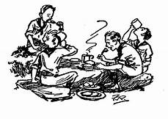
Agenda
The Importance of Sharing a Meal
What Are Special Dietary Needs?
Safety Practices
Strategies for Planning a Meal
Recipes
Resources

Slide 3
The Importance of Sharing a Meal
Not being able to sit down with your family or friends and eat the same foods can feel isolating.
Making someone else feel welcome and feeling welcomed by the group reinforces the strength and health of any team.
Every meal is an opportunity for your scouts to work together to make everyone feel wholly included and feed the group’s team spirit.

Slide 4
What Are Special Dietary Needs?
Special dietary needs encompasses restrictions on certain foods due to:
Allergies
Health Reasons
Religious or Cultural Reasons
Personal Priorities

Slide 5
What are your unit’s special dietary needs?

Slide 6
There is no such thing as “just a little.”
For anyone with true anaphylactic allergies, even “just a little’ in the smallest traces can be deadly.
Ignoring someone’s religious or personal beliefs and allowing “just a little” in the meal is entirely disrespectful.

Slide 7
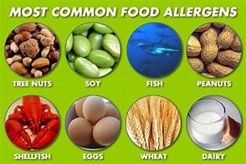

Slide 8
Hidden Allergens:
Consult with the scout and/or parent to identify safe ingredients.
Gluten can be hidden in products made from wheat, such as malt or soy sauce, or as fillers and emulsifiers in cheeses, processed meats, ice cream and many other processed foods.

Slide 9
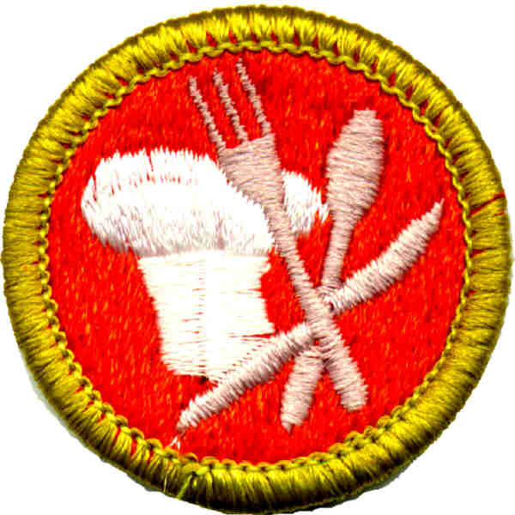
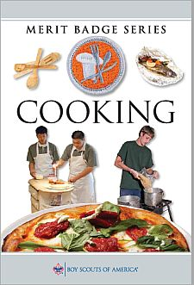
Common Dietary Restrictions and Special Diets:
Gluten Free
Halal
Kosher
Low-FODMAP
Whole Food Diets
Vegetarian
Vegan
Nut Free
Dairy Free
Diabetic

Slide 10
Safety Practices
Fill out the dietary forms completely. Don’t leave details out. Council camp staff depends on these to keep scouts safe and ensure they have meals on hand to keep scouts fed.
If you oversee the camp kitchen, read through the dietary forms fully and ask questions as needed.
Usually in a Troop environment, there is an event “pre-meeting” to discuss meals, tenting etc., perfect time to discuss special needs with the patrol for good grubmaster planning

Slide 11
Safety Practices
The camp cook in charge of preparing food must be very careful in their preparations. We want our scouts to feel safe and remain healthy so they can enjoy their scout activities.
Try to cook only safe foods for everyone in your group or establish a separate safe cooking station.
Avoid cooking directly on the campsite's grill, as it will likely have residue from previous meals.

Slide 12
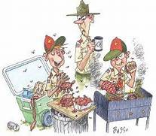
Safety Practices
Avoid Cross Contamination:
Establish a clean cooking and serving area.
Maintain clean utensils and cooking equipment.
Clean hands and towels.

Slide 13
Strategies for Planning a Meal
The goal is to help the scouts with special dietary needs feel included with the rest of the scouts and to give the other scouts the opportunity to be kind, courteous and helpful to their fellow scouts.

Slide 14
Meal Selection Strategies:
Choose only foods that are safe for the scouts with special dietary needs and have everyone in the group eat the same meal.
Choose customizable meals, where the ingredients are laid out and scouts can assemble their own serving.
Choose a meal with easy “swaps” for the dietary restriction and prepare the alternate food in a separate cooking station from the main meal.
Break into smaller groups for meal planning. For backpacking it may make more sense to have small groups of 2-3 scouts plan meals to share.

Slide 15
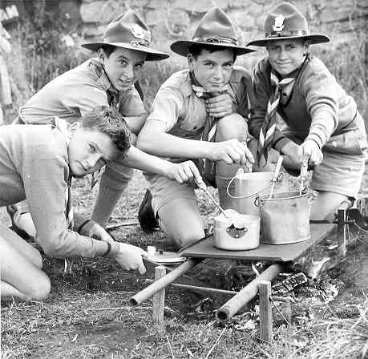
Strategies for Serving Meals:
Separate serving areas
Serve everyone together, when possible
Serve meals as alike as possible.

Slide 16
Simple Swaps:
Butter
Cheese
Chicken
Eggs
Gluten-free
Grain-free
Ground Beef
Hot Dogs
Milk, fresh or powdered
Peanut Butter
Soy Sauce
Tortilla
Vanilla Extract
Whipped Cream

Slide 17
Recipes
The recipes included in the PDF follow the BSA ScoutStrong nutritional guidelines. http://www.scouting.org/SCOUTStrongPALA.aspx
The meals were selected to accommodate a group with multiple special dietary needs.
There are many more recipes out there that can accommodate limited dietary restrictions, such as just vegetarian or just gluten free.

Slide 18
Breakfast:
Baking and Pancake mix
S’mores pancakes
Corn bread muffins
Blueberry Granola
Ketchikan couscous

Slide 19
Lunches/snacks:
Roll Ups
Greek red pepper dip
No bake Honey balls
Mountain Man bars

Slide 20
Dinners:
Chief Seattle Fry biscuits
Chili with quinoa
Fiesta chicken wraps
Tortellini soup
Enchilada casserole

Slide 21
Desserts:
Rocky road rice krispy treats
Super fudge brownies
Gluten free Dutch oven cobbler

Slide 22
Cracker Barrel:
Chocolate Fondue
S’mores with almond butter or banana
Apple S’mores
Banana boats
Gluten-free “Party Mix”
Nachos in foil

Slide 23
Resources
Cooking for Isaiah- Gluten and Dairy free recipes, by Silvana Nardone
Backpacker Magazine – Easily adaptable trail recipes can be found under Skills: Cooking.
www.backpacker.com
The Everything Guide to Living Gluten free– Gluten free recipes of all kinds, by Jeanine Freisen.

Slide 24
Another Fork in the Trail, by Laurie Anne March
Vegetarian and vegan backpacking recipes.
A big challenge I faced when finding recipes for this presentation was choosing ones that were simple and kid-appealing, so I also used a few Scout cookbooks, and did “safe ingredient” swap suggestions:
The Scout’s Large Groups cookbook”, and “The Scouts Backpacking cookbook” both by Tim Conners (and many other scout leaders)

Slide 25
Evaluations
The evaluation code for this session is 8680.
I will hand out event patches while I am receiving feedback forms.
Thanks for attending! Bonnie Dornfeld Troop 570

