Slide 1
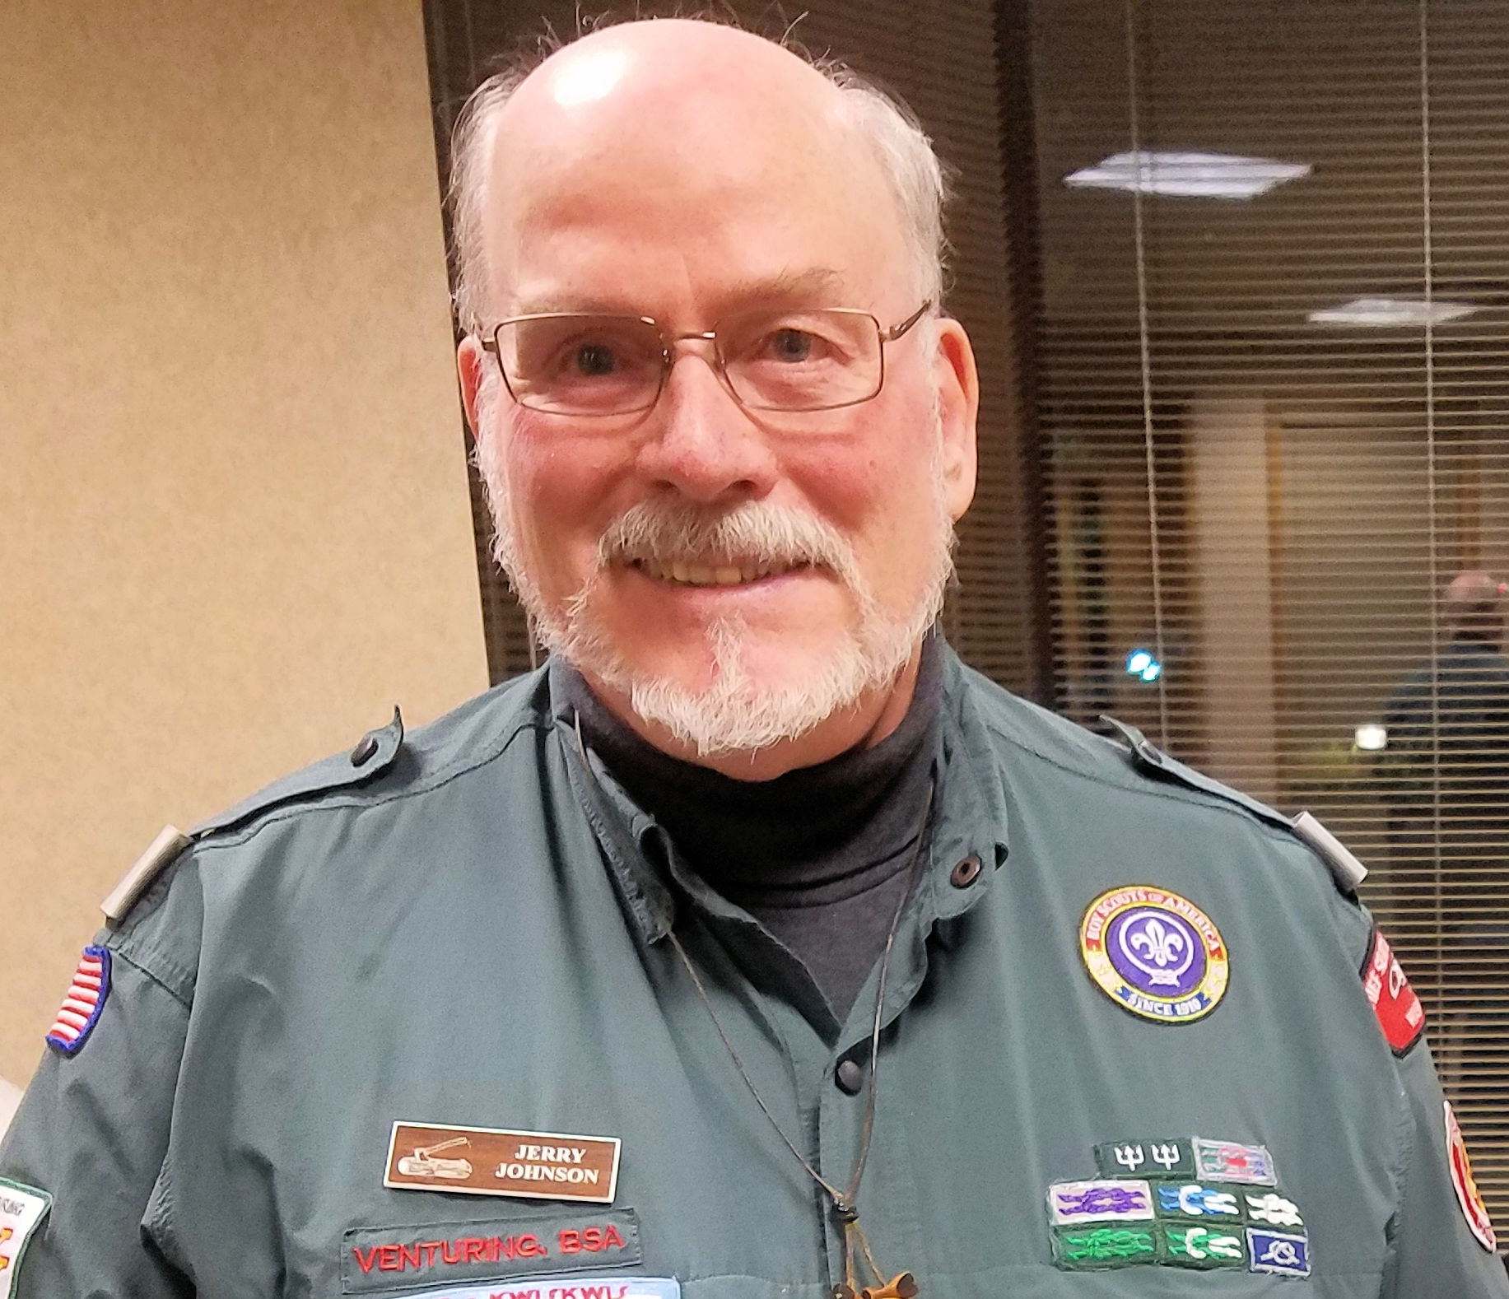

PTC Class 615
Welcome. Come in, sit down, and make yourself comfortable. We will get started, soon.
Notes:
Brief explanation of the presentation issues.
Please send feedback, if you think it will help us improve the subject, or PTC as a whole.
We can’t converse, but I will try to monitor the Q & A column so I can answer your questions and share your comments.

Slide 2
Coaching and Mentoring in Scouting
PTC Class 615
Jerry Johnson
Notes:
This is PTC Class 615, Coaching and Mentoring in Scouting.
Please think about someone who has been influential in assisting you in the discovery of an ability, skill quality, or talent you had not yet recognized in yourself. How did that experience affect you?
What you experience was probably a form of coaching and/or mentoring, a part of personal development.

Slide 3
HELLO!
My name is Jerry Johnson
I am currently a Unit Commissioner and District Activities Chair in Lake Shores District of Chief Seattle Council. I have been a Scouter for more than 50 years. I have served as SM, ASM, DC, Associate Advisor, Crew Advisor, OA Advisor, on Sea Badge and Wood Badge Staffs. I was WB Course Director in 1996.
You can contact me at 4oldbeads@comcast.net or 206-931-2620
Notes:
You may copy down my email and phone number for further questions.

Slide 4
Who are you?
Please answer the first poll.
Notes:
Post poll. “This will help me tailor the session to your needs.

Slide 5
Agenda
The stages of developing leaders
The difference between coaching and Mentoring
How each fits in the process of developing leaders
Coaching and mentoring relationships
Where does EDGE come in
Making it all work
Notes:
Here is a brief agenda for the day.

Slide 6
What is Coaching?
A coach is an individual who develops skills and capabilities in another person or in a group of people (a team). The coach can be another Scout or one of the unit’s leaders.
Coaching is a leadership behavior and skill.
The key concept that separates coaching from other leadership styles is letting go and enabling success. As individual capabilities grow, a coach may become a mentor to facilitate continued growth of an individual or stand aside as a team resource.
Notes:
Coaching focuses more on teaching a skill or set of skills and making sure the task gets done.
What Coaching is NOT
A quick-fix, one size fits all approach for your current challenges.
Therapy or counseling (please seek a licensed professional if this is what you need).
About giving you advice

Slide 7
Role of Coaching?
The role of the coach is to improve performance and impart skills as an individual accepts a new responsibility, by:
Training
Helping
Supporting
Advising
Guiding
Assisting
Notes:
The emphasis here is the coach initiates and controls.

Slide 8
What is Mentoring?
A mentor is an experienced Scout or adult leader who becomes a trusted guide and counselor to a less experienced individual. This trusting and caring relationship normally extends beyond Scouting skills into values, beliefs, and feelings. A mentor may be assigned, but often this relationship occurs naturally and is fostered between the individuals involved.
Adults often mentor youth in the program, but youth can also mentor each other.
You can even mentor someone your own age or older if you have a skill that person doesn’t have.
In some cases, we are there to help pick up the pieces when they fail (and we all fail sometimes). Failing safely is often the best way to learn.
Notes:
Another way of putting it is: “Mentoring is a fundamental form of development where one person invests time, energy, and personal knowledge in assisting another person to grow and learn.”
Odysseus, when leaving for the Trojan war, left his son, Telemachus, under the guidance of his friend MENTOR.
A Mentor is
A wise teacher
A guide
A friend

Slide 9
Role of Mentoring?
The role of the mentor is to support and guide the personal growth of the mentee, by:
Listening
Questioning
Suggesting
Praising
Being a Role Model
Being a Friend
Notes:
There is a relationship that occurs in successful mentoring:
Building rapport
Setting direction
Progression
Winding up
Moving on - - although the relationship may last forever

Slide 10
Are mentoring and coaching really the same thing?
 | Coaching | Mentoring
Goals | To teach or instruct | To support and guide growth
Initiative | The coach | The mentee
Focus | Immediate situation and learning opportunities | Long-term personal development
Roles | Heavy on telling with appropriate feedback | Heavy on listening, questioning, and suggesting
Notes:
Remember that there can be transitions both ways. This is not always a linear progression. The end goal is developing the scout or scouter’s personal growth.
A coach has some great questions for your answers; a mentor has some great answer for your questions.

Slide 11
Coaching and Mentoring Relationships
Scoutmaster and Assistant Scoutmaster
Unit Commissioner and Crew Advisor
Den Chief and Den Member
Scoutmaster and Senior Patrol Leader
Crew Vice President and Program Manager
Can you suggest other examples?
Notes:
Feel free to post other examples on the Q & A area.
All of these examples could be a coaching or mentoring relationship. It all depends on the individual’s needs and confidence.

Slide 12
EDGE and Mentoring
The EDGE method is great for teaching first aid and knot-tying, but it’s also a valuable part of the mentoring process. How could a mentor use EDGE to teach something like leadership or career discernment?
Explain: The mentor explains how something is done
Demonstrate: After the mentor explains, the mentor demonstrates while explaining again.
Guide: The mentee tries the skill while the mentor guides them through it.
Enable: The mentee works on their own under the watchful eye of the mentor. The mentor’s role in this step is to remove any obstacles to success, which enables the mentee to succeed.
Notes:
EDGE is not a separate thing. It permeates the entire personal growth continuum.

Slide 13
How does this relate to the leading and teaching EDGE?
Mentoring and coaching
A coach directs, tells, facilitates performance, learning, and development of the Coachee.
The coach directs and aligns the members of a team to achieve a goal and is responsible for their development.
EDGE
Explain
Demonstrate
Guide
Enable
Notes:
Note here, the coach is the active part of the equation.

Slide 14
How does this relate to the leading and teaching EDGE
Mentoring and coaching
A mentor supports and guides the personal growth of the mentee. The mentee is in charge of his or her learning and learns how to learn for life. The mentor provides a role model while making suggestions and connections
EDGE
Explain
Demonstrate
Guide
Enable
Notes:
Here, the mentee is the active part of the equation.

Slide 15
Good mentoring communication involves:
Mutual respect and trust — A relationship built on trust and respect eventually creates a secure and safe environment in which mentoring can take place.
Listening – Listening entails the ability and willingness to look at something from the other person’s perspective. Listening is also recognizing what is not being said.
Notes:
Communication is a key element in the entire continuum, but it is especially important in mentoring. Enlarge on the points.
The Learning Conversation
The goal of the mentoring process is to create a reflective environment where the mentee can address various issues. The various stages of the mentoring experience will dictate the flow of the learning conversation.
The learning conversation is especially useful in maintaining an effective mentoring relationship. The steps include:
1. Reaffirmation—The mentor and mentee establish connectedness, using more than just the normal social niceties. In a good relationship there will be a mutual recognition of emotional states and level of interest.
2. Identifying the issue—The issue to be discussed is articulated and the mentee’s desired outcome is identified.
3. Building mutual understanding—Through the use of open-ended questioning, the mentor encourages the mentee to explore the issue in depth. Direct questioning allows both participants to understand the situation and all of the elements involved more clearly. The mentor wants to avoid offering solutions or analogies to his or her own experience. When the conversation comes to a natural end, the mentor should summarize and determine that a mutual understanding has been achieved.
4. Exploring alternative solutions—This occurs when both the mentor and mentee allow themselves to be as creative as possible, looking for ways to move forward. The goal is to construct a range of solutions, from which the mentee will eventually choose, to take away for reflection. Guide the mentee to determine his or her own solutions. Don’t offer to do things mentees can do for themselves.
5. Final check—The mentor encourages the mentee to review what he or she is going to do and why, and what the mentee has learned about both the situation in question and himself or herself. This creates mutual understanding and places the responsibility for what happens next on the mentee.

Slide 16
Good mentoring communication involves (Cont):
Nonverbal communication — Nonverbal communication is particularly powerful in communicating issues of trust, affirmation, and empathy that are fundamental to a mentoring relationship.
Giving and receiving feedback — Effective feedback is another vital aspect of mentoring. The way in which feedback is administered can make or break a mentoring relationship.
Notes:
Enlarge on the points.
Just the expression on your face can change the whole message. Masks?
Giving and Receiving Feedback
Mentoring is about working together to identify and develop the leadership skills of the mentee. Effective feedback is a vital aspect of mentoring. The way in which feedback is administered can make or break a mentoring relationship.
Examples of Mentoring Feedback
It is up to the mentor and the mentee to determine the type of feedback that will be the most effective. Examples of feedback include:
Summarizing what the mentee has said and asking if the summary is accurate
Encouraging the mentee to examine the situation in a fresh way and to develop positive responses
Providing supportive evaluation of the overall effectiveness of the mentee’s progress
Principles of Giving Feedback
Mentors should be specific and realistic about feedback, referencing practical methods and specific areas in which the mentee can achieve the recommended changes.
Feedback must always be honest and genuine. Feedback must never be personal in nature and should address target areas for development.
Mentors should be observant of how the mentee handles feedback and adjust if he or she notices the mentee becoming upset.
Checklist for Mentors Giving Feedback
Always have the mentee’s best interests at heart.
Always start with positive feedback.
Prioritize feedback to avoid overload.
Be responsive to the mentee’s reactions.
Focus on facts and behaviors, rather than emotions and personalities.
Avoid blaming the mentee for every problem: Seek the “big picture.”
Acknowledge and summarize the mentee’s contributions.
Provide critical feedback in a supportive way.
Strike a balance between being overly positive and overly negative.
Work with the mentee to interpret the situations being discussed.
Examine the mentee’s responses to derive further insights.

Slide 17
Making the Mentoring relationship work
Communication—Both parties should communicate openly and honestly. Mentees should willingly indicate their needs and mentors should willingly share their strengths and knowledge.
Commitment—Both parties should be committed to making the relationship work. All individuals involved should live up to their responsibilities.
Trust—Trust is an underlying factor in a successful mentoring relationship. Building trust depends on simple actions such as keeping appointments, as well as more profound actions such as sharing successes and failures.
Notes:
Briefly hit the key words.
Remember: During all conversation be sure to practice good questioning and listening techniques:
Use open-ended questions:
Tell me more about that.
Explain how that made you feel.
Relate what you enjoyed most.
Avoid using close-ended questions:
Did you like the program? vs. What did you like about the program?
Ask questions that challenge the mentee to think in new ways.
Avoid asking the question “Why?”
Encourage the mentee to drive the conversation.
Listen more than you talk.

Slide 18
Dimensions of Personal Development
Coaching
Directive Influence
Mentoring
Guiding
Listening and Questioning
Intellectual Need
Challenging
Intellectual Need
Nurturing
Networking and Facilitating
Role Modeling
Non-Directive Influence
Notes:
This is the clearest description I can come up with for the Personal Development continuum. Note that what you do depends on the situation. Give examples. – Brand new vs trained but uncertain. Etc.

Slide 19

The delicate balance of
mentoring someone is not
creating them in your own image,
but giving them the opportunity
to create themselves
Steven Spielberg
Notes:
Please remember to complete your final poll

Slide 20
THANKS!
Any questions? Please type them in the Q & A que
There are some resources you can download posted in the Q & A que

Slide 21


