Slide 1
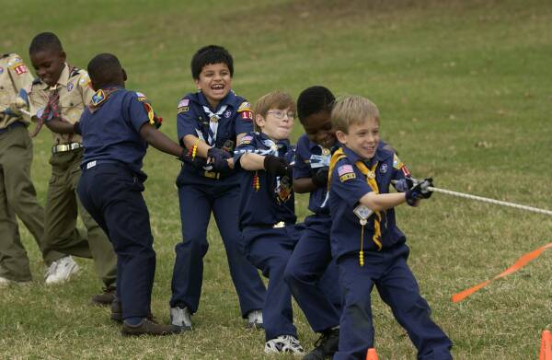

Games, Games, and More Games
2020 PTC
Chief Seattle Council

Slide 2
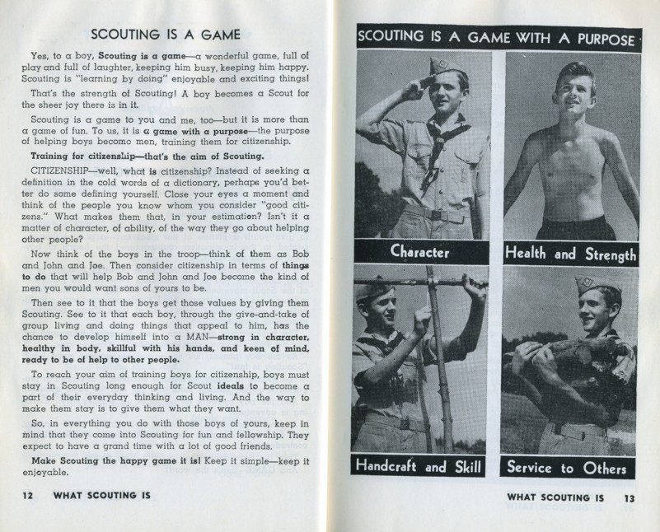
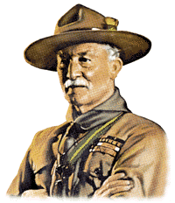
Scouting is a game with a purpose.
Games can develop character by practice and train for citizenship.

Slide 3

Trustworthy
Loyal
Helpful
Friendly
Courteous
Kind
Obedient
Cheerful
Thrifty
Brave
Clean
Reverent

Slide 4
Trustworthy
Loyal
Helpful
Friendly
Courteous
Kind
Obedient
Cheerful
Thrifty
Brave
Clean
Reverent
Learn to be a good loser

Slide 5
Trustworthy
Loyal
Helpful
Friendly
Courteous
Kind
Obedient
Cheerful
Thrifty
Brave
Clean
Reverent
Learn to be a good winner

Slide 6
Trustworthy
Loyal
Helpful
Friendly
Courteous
Kind
Obedient
Cheerful
Thrifty
Brave
Clean
Reverent
Learn to follow rules
Notes:
The road to crime is paved with small steps.

Slide 7
Trustworthy
Loyal
Helpful
Friendly
Courteous
Kind
Obedient
Cheerful
Thrifty
Brave
Clean
Reverent
Learn teamwork

Slide 8
Trustworthy
Loyal
Helpful
Friendly
Courteous
Kind
Obedient
Cheerful
Thrifty
Brave
Clean
Reverent
Try something new and challenging

Slide 9
Trustworthy
Loyal
Helpful
Friendly
Courteous
Kind
Obedient
Cheerful
Thrifty
Brave
Clean
Reverent
When the game is over every helps put the pieces away

Slide 10
Trustworthy
Loyal
Helpful
Friendly
Courteous
Kind
Obedient
Cheerful
Thrifty
Brave
Clean
Reverent
It’s the Super Bowl with 26 seconds to go and the Seahawks are second and goal at the one yard line.

Slide 11
What Makes a Good Game?
Age Appropriate (not too hard, not too easy)
Clear Rules (think of how you will explain the game)
Easy to Learn
The first or last player shouldn’t have a big advantage
No Early Elimination (or a short wait if eliminated)
Reasonable waiting time
There is a clear measure of success (no judgment calls from the adults)
Don’t change the rules in the middle of the game.

Slide 12
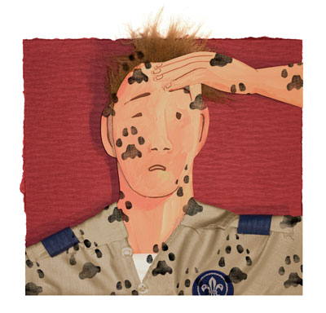
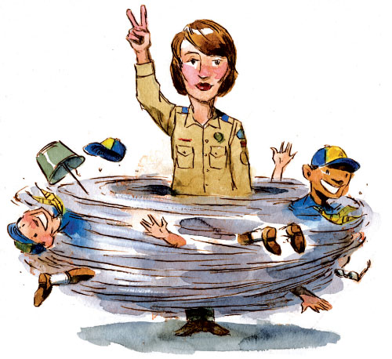
Discipline
Den Meetings
Me first! No, me first!
We have to be on the same team!
We don’t want him on our team
You didn’t say I couldn’t murder my opponent.
Pack Meetings
Signs Up!!!!!!
Notes:
First den meeting with bizarrely competitive scouts.
I want to go first! It’s better to go last. I want to go last!
I want ball number 4!!!!!!
I went up stairs & grabbed a pillowcase. From now on teams & order are selected with the Balls of Destiny.
Jar of marbles.
Pack meeting – utonium 232 space modulators & best den award

Slide 13
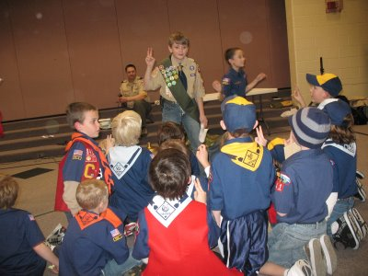
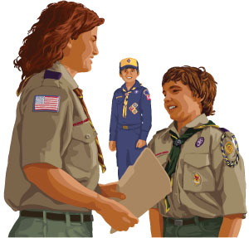
Gathering Activities
Idle hands are the Devil’s workshop.
If it’s a game where the last scout remaining wins you will still have idle scouts.
Den Chief
Notes:
As a den leader I was always trying to get things ready at the last minute.
Gathering Activities are a great way to keep them busy as they arrive.
Another adult or the Den Chief can run the game. The best game doesn’t require a leader.

Slide 14
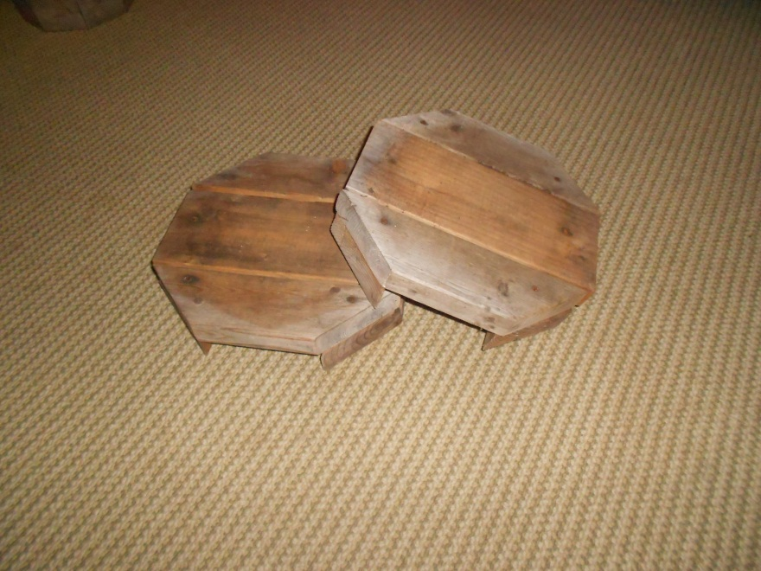
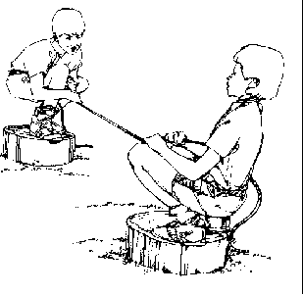
Hunker Down Game
It’s a game of the mind, not a game of strength.
Players start by holding the ends of the rope. Upon “GO” they pull the rope and try to pull their opponent off their box. Losing the rope or having any body part touch the ground loses the match
Build your own Hunker Boxes
.
.
.
.
Lay 2 2x4 and one 2x6 piece across the feet and nail into place.
2 – 2x6 13” long
8 – 2x4
.
.
.
.
13”
.
.
.
.
Lay Down the 2 Feet
Pre drill holes for the nails and let your Cub Scouts nail them together.

Slide 15
Hunker Box
https://www.youtube.com/watch?v=juITsYR8n7U&t=59s

Slide 16
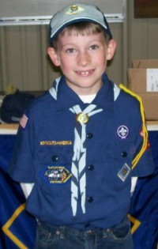
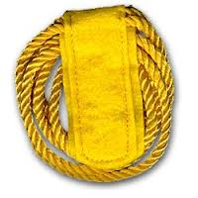
Denner Selection
Pocket Lint
Biggest Grin
Staring Contest
Notes:
After describing the Denner job and the “picked-last conundrum” with Denner selection….
Exercise with one of the dens: highest pile of pocket lint.

Slide 17
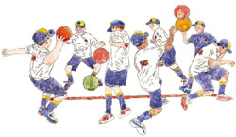
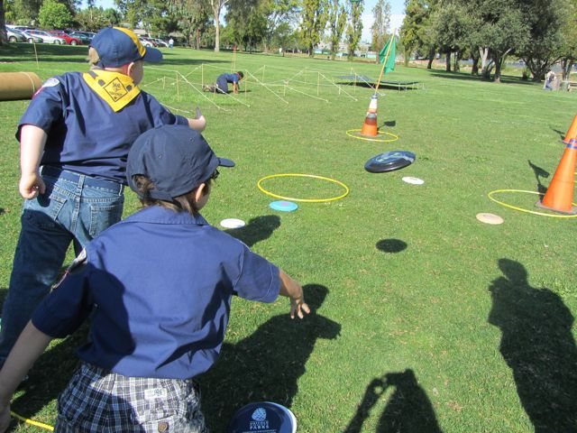
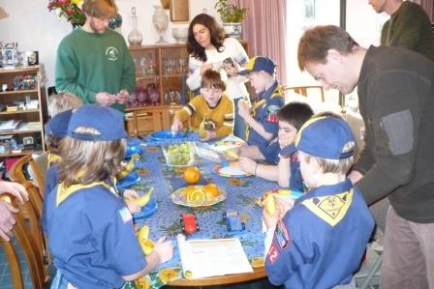
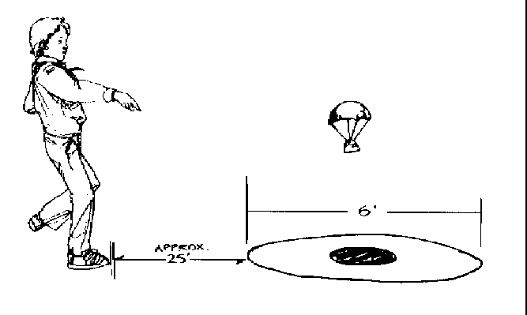
Den Games
Bocce Ball Blow Ball
Pop-It Vortex
Notes:
Games with heavy pool balls?
Marbles are smaller…… less damaging
Try a Den leader’s best friend: the bag-o-ping pong balls
Ask the audience to think of games to play with ping pong balls.
Blow Ball
Bubble Wrap
Timers
Vortex Generator

Slide 18
Zoom Games
Simon Says
Charades (private chat the word to “it”)
Taboo – “It” must get group to say a word without using any words from the “taboo word” list. Have word lists ready to cut & paste into chat. (eg. cat – dog, kitty, feline)
I Spy
Kim’s Game
Rock, Paper, Scissors (looses against “it” is out)
Detective – Pick detective who puts head down. Show name of “it” (or picture). Everyone mimics “it”.
Mad Libs https://www.squiglysplayhouse.com/WritingCorner/StoryBuilder/

Slide 19
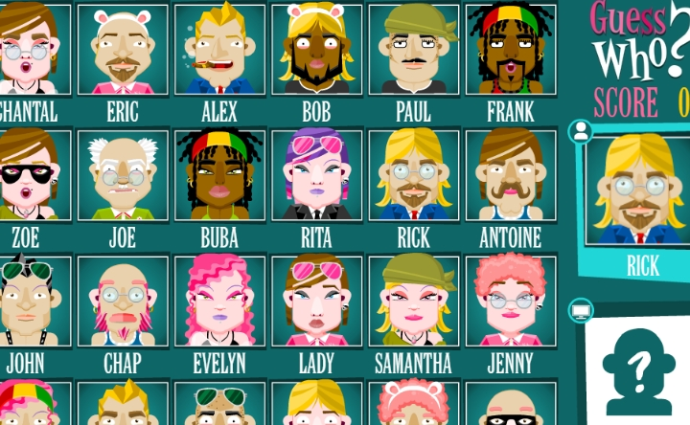
On-Line Games – Guess Who
https://www.crazygames.com/game/guess-who-multiplayer

Slide 20

On-Line Games – Go Fish

Slide 21
Bocce Ball
https://www.youtube.com/watch?v=9ORLRNf6UBU

Slide 22
Goofy Fun
https://www.youtube.com/watch?v=tZdJI2uNg-o

Slide 23
Blow Ball
https://www.youtube.com/watch?v=_CdZw4UZTis

Slide 24
Vortex
https://www.youtube.com/watch?v=N0x26QLsXps

Slide 25
Halloween
https://www.youtube.com/watch?v=qavSZOOEJbE

Slide 26
Backpack
https://www.youtube.com/watch?v=6zDfuBSBtlE

Slide 27
Nature Game
https://www.youtube.com/watch?v=W5NEwKDj2UE

Slide 28
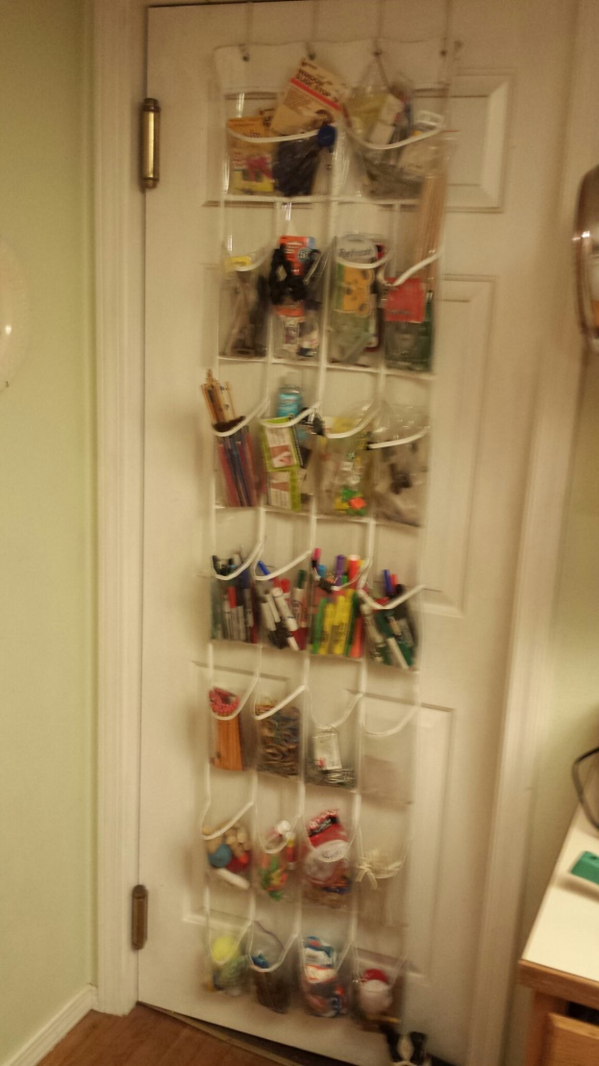
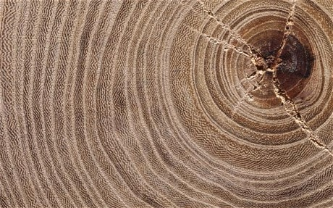
Learning Games
Wood Bubbles & Strength
Will it Float?
Notes:
Learning about density (a hard concept for kids)
Wood experiments as part of the WEBELOS forestry pin.

Slide 29
Wood
https://www.youtube.com/watch?v=IOUz5OYf_SY

Slide 30
Density
https://www.youtube.com/watch?v=bK535aTxtDw

Slide 31

Learning Games
GAME
Notes:
Some of the scouts refused to learn things for rank advancement. Once it was turned into a game they WANTED to learn.

Slide 32


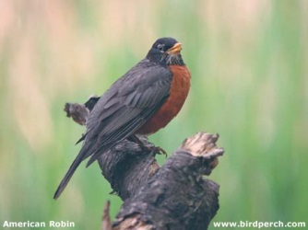
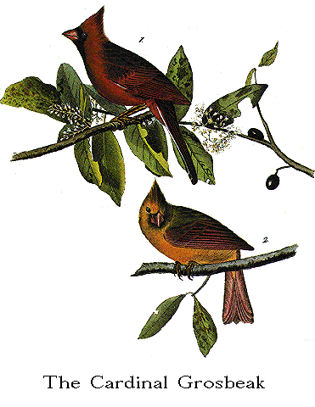
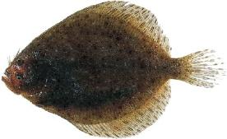


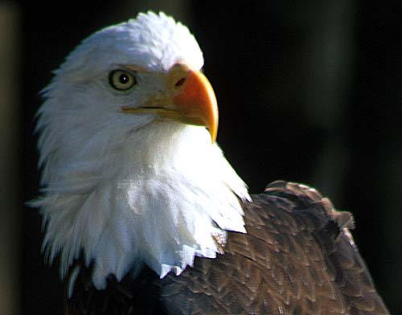
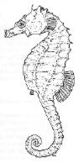
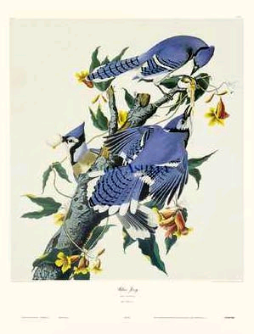


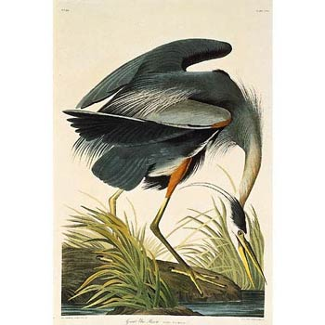
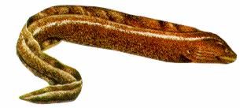
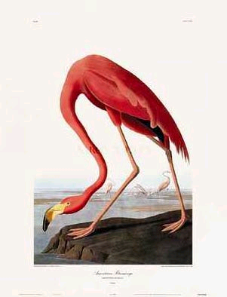


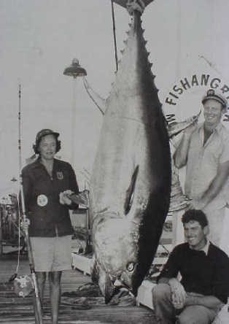

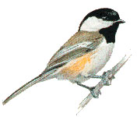


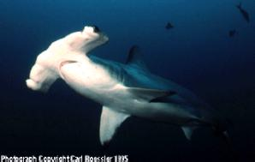
Birds
Fish
Flags
Notes:
Play bloody knuckles with pictures & sounds.

Slide 33
Bloody Knuckles Map Symbols
https://www.youtube.com/watch?v=01NId0SiYxY

Slide 34
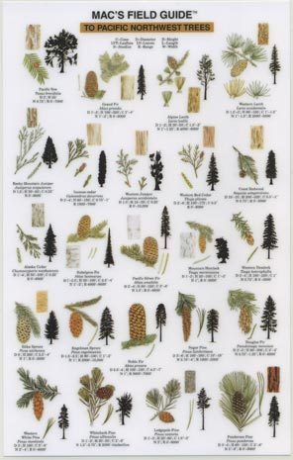
Map Symbols
Plant Identification

Slide 35
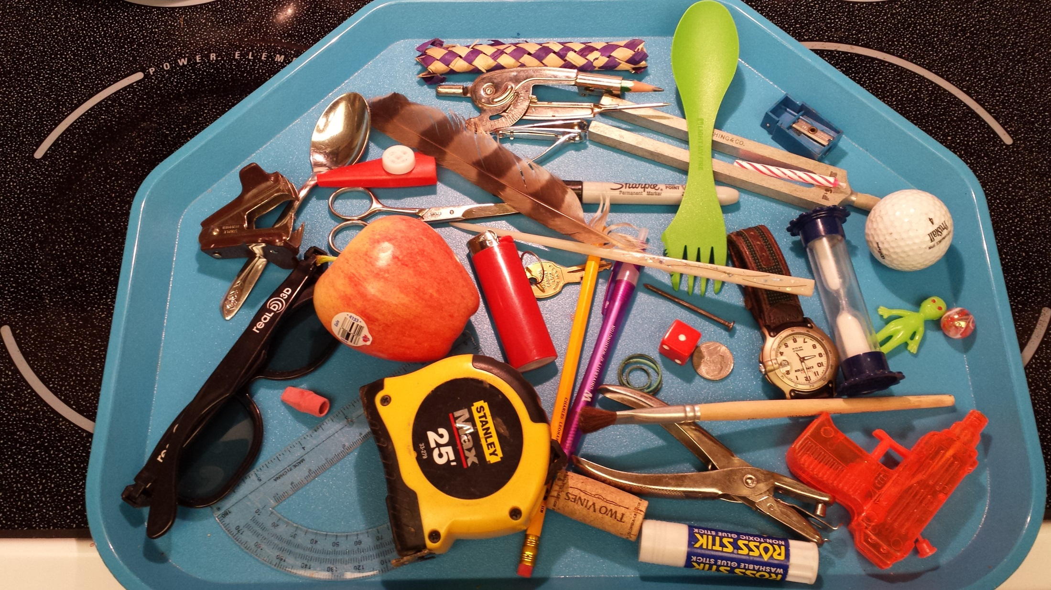
Kim’s Game
Notes:
Pack Meeting – King of all Kim’s Games

Slide 36
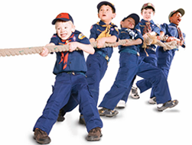
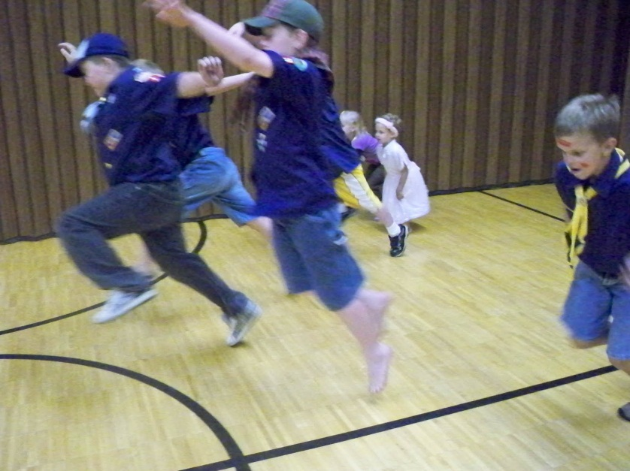
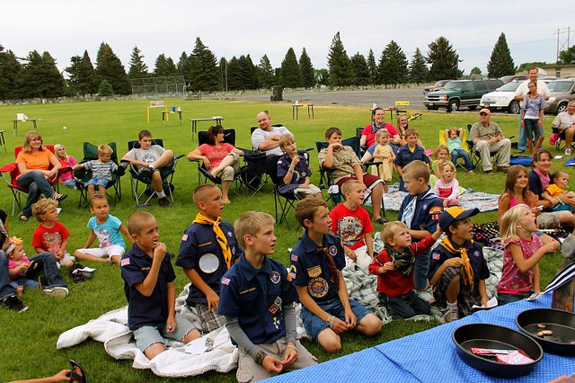
Pack Games

Slide 37
Balloon Head Relay
Organize players so that they’re into pairs and each team receives a partially inflated balloon. When the game starts, teams must race to a finish line carrying a balloon between their heads, remember don’t use your hands. On hot days try it with water balloons or through a sprinkler. You can even try an obstacle course.
Big Foot
Set up teams with each team assigned one pair of large rubber boots. These boots can be fishing waders and it would be helpful if the players could just slide their shoes right into the boots without taking off their shoes. Have teams line up behind the starting line. The first person on each team must put on the rubber boots, race down grass course and back, take off the boots and the next person on the team will do the same. When the last person on one of the teams crosses back through the starting line first, they are the winners.
Chimp Relay
Set up teams and play area. The first person on each team is to bend over with feet apart and grab their ankles. On “go”, they are to race down the course and back without letting go of their ankles. Each person on the team repeats the relay. The first team done is the winner.
Banana Olympics
Divide the group into teams of 8-10 players and give each team a banana. Each team will complete several series of different relays using their banana. Here are some ideas for those relays.
The banana under your armpit and hopping on one leg down a field and back.
Place the banana between the knees and hop down a field and back.
Two teammates tossing the banana back and forth down the field and back.
Place the banana on the ground and each teammate must roll across the banana.
Teammates line up in leapfrog formation and first player hops over players while holding banana and then tosses banana to next player in line to do the same.
Show the players all the relays that they’ll have to complete for the Olympics. You may have to write them on a large white board so that all players will know what relay is next. Once a team has completed all these relays someone on the team must eat the banana and the team that is done first is the winner.
Hoola Hoop Relay Space Derby
Balloon Battle Royal
Notes:
My least favorite derby is the Space Derby……….

Slide 38
Hoop Relay
https://www.youtube.com/watch?v=m0YWqGEmtkA

Slide 39
Balloon Battle Royale
https://www.youtube.com/watch?v=2kIQ1TZI4zM

Slide 40
Space Derby
https://www.youtube.com/watch?v=P0vQpwbH33w

Slide 41
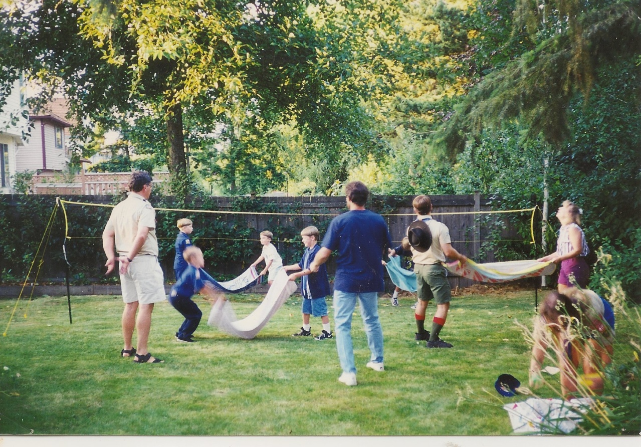
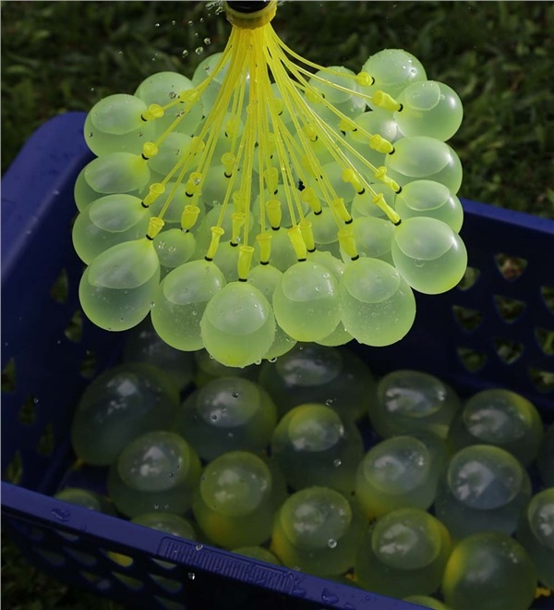
Summer Games

Slide 42
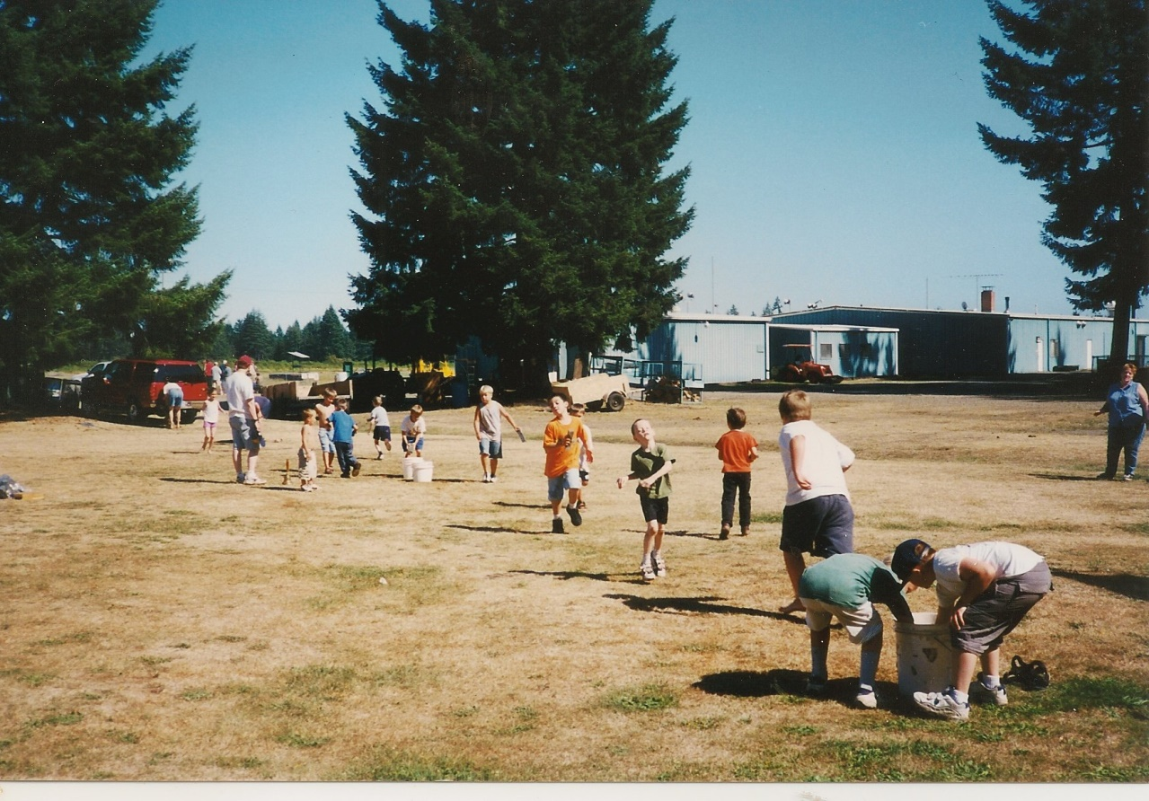
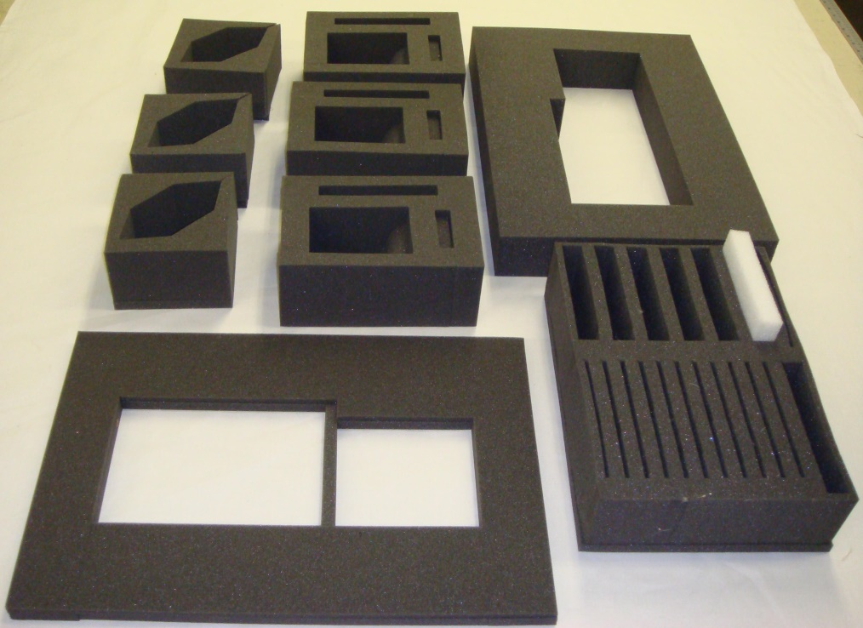
Summer Games

Slide 43
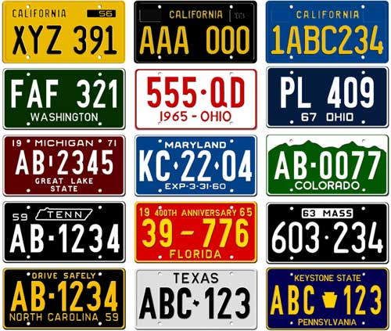
Travel Games
20 Questions
Videos
ABCDEFGHIJKLMN
OPQRSTUVWXYZ

Slide 44
Game 1: 2-Minute Tens
To play: Players take turns challenging the rest of the group to name 10 things in any category: cookie varieties, animated movies, dog breeds, female professional athletes, automobile models, and so on. The group has two minutes to complete the list. Give it a twist: Allow yourselves fewer than two minutes or require that items be listed in alphabetical order.
Game 2: Snoopy Sam
To play: An adult makes a list for each player of things people in other cars could be doing, such as sleeping, wearing a red hat, or eating an ice-cream cone. The first player to see everything on her list wins. Give it a twist: The player who spots a nose picker automatically wins!
Game 3: Car Colors
To play: Each player chooses a color from the cars that pass by in one minute. Everyone then tries to spot 25 objects of their chosen color. When an object is spied, the player calls it out so that others can verify it, then writes it down on his list. The player with the highest tally after a set time wins.
Game 4: Sing It Out
To play: The first player sings the entirety of a simple song, such as "Mary Had a Little Lamb." The next player repeats the song, leaving off the last word. The following player leaves off the last and second-to-last words. (It's surprisingly hard!) Players have to sing the song correctly on their first try or they're out. The singing continues around the car until all the words have been left out.
Game 5: I'm Thinking of a Person
To play: One player thinks of a person. The others take turns asking simple yes-or-no questions to help them guess the person's name: Is the person an adult? Is the person a female? Does she have red hair? The player who guesses correctly thinks of a new person.
Game 6: I Have Never
To play: Players take turns saying things they have never done, such as eaten spinach or been on a boat, with the goal of trying to name something that everyone else in the car has done. A successful "I Have Never" earns a player one point. The first to reach five points wins.
Game 7: Electric Light Brigade
To play: In this night-driving game, players find lights in order of the colors of the rainbow — red, orange, yellow, green, blue, indigo, violet. Players call out the colors when they spot them; the first to finish the list wins. A car with one headlight is a wild card, good for any color for the player who spots it. Give it a twist: Add such colors as brown or pink. During the day, look for colors on signs.
Game 8: Will We See Gophers?
To play: One player thinks of something the family will see or do at the vacation destination. The other players ask yes-or-no questions (Is it something we are going to eat?) to help them guess the item or activity. The first player to guess correctly wins. Give it a twist: Allow the guessers just 10 questions, or just five.

Slide 45
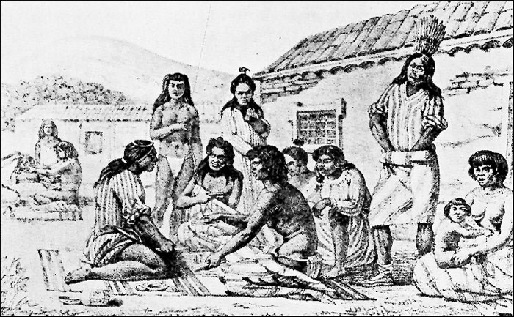
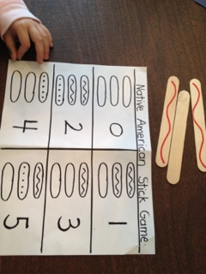
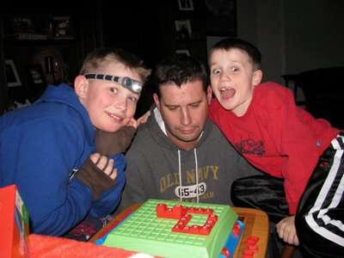
Quiet Games

Slide 46
Indian Stick Game
https://www.youtube.com/watch?v=sqq8dWa68v0

Slide 47
Shut The Box
https://www.youtube.com/watch?v=fsIL7wet3dQ

Slide 48
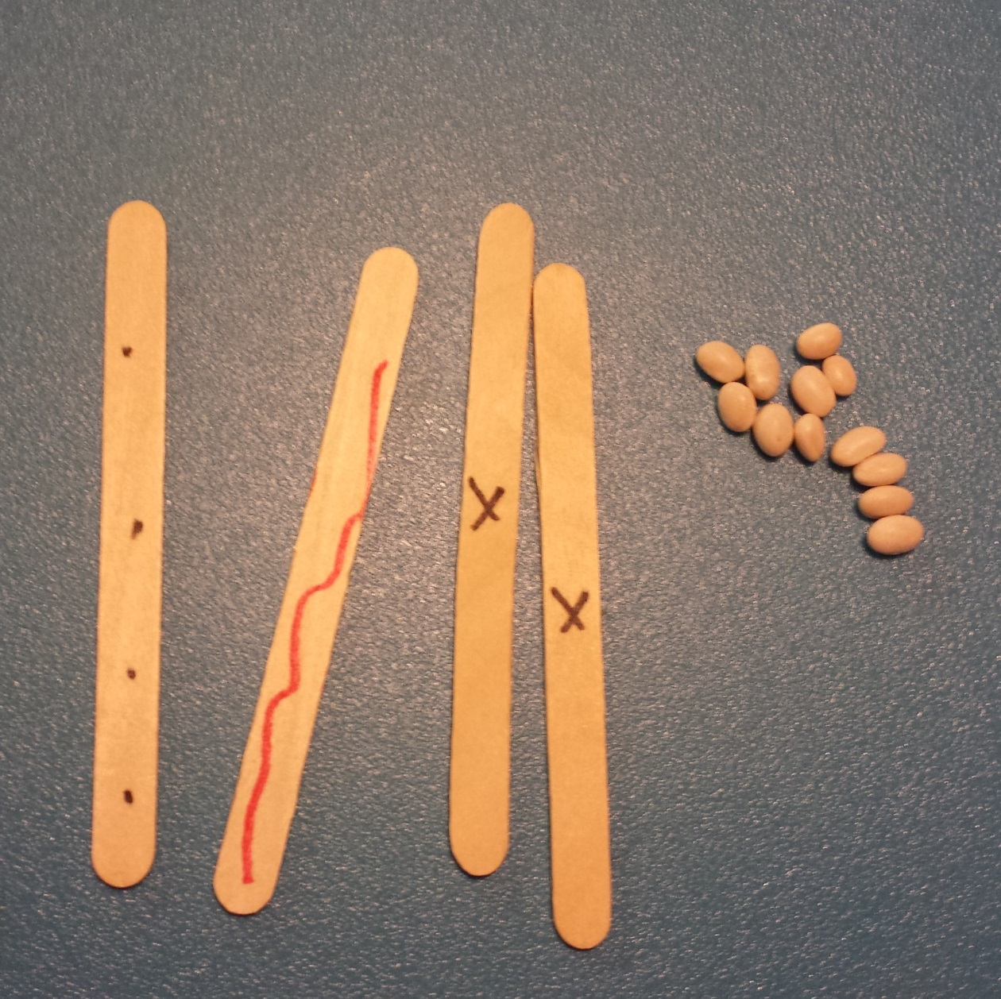
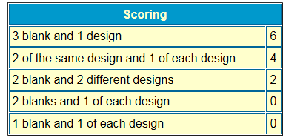
Two players or two teams
Roll and take markers from the pile
Once pile is gone take from your opponent’s pile
Team to get all the markers wins
Otherwise

Slide 49
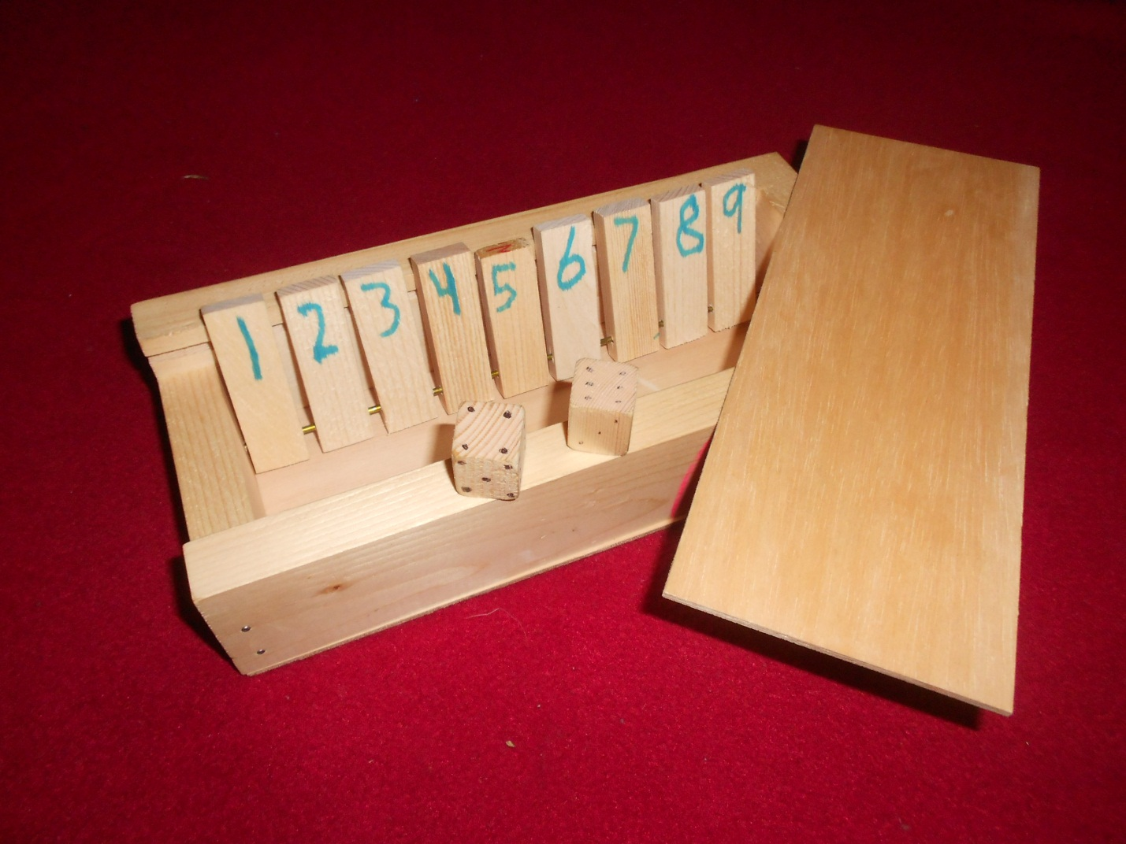
Shut The Box!

Slide 50
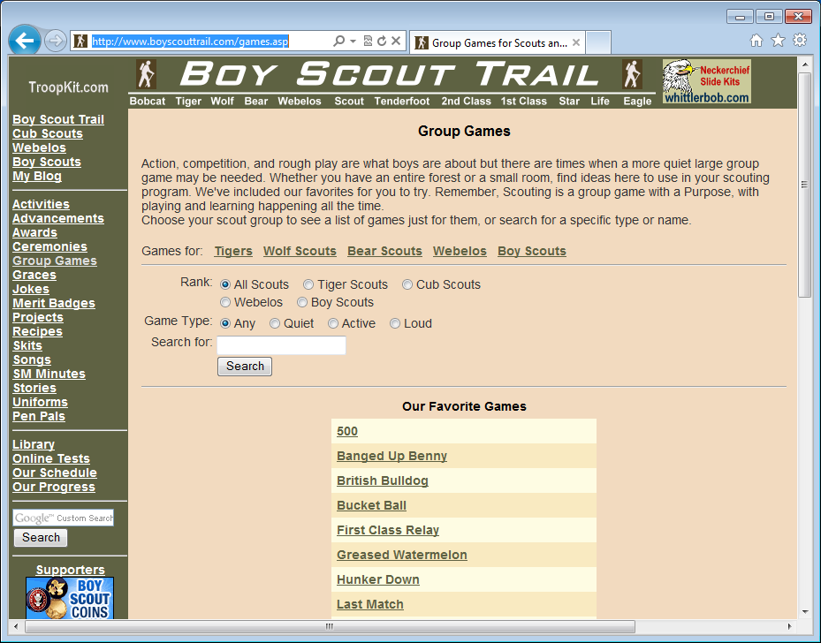

Slide 51

Notes:
Karnack
Hillbilly Billfold
Floating Dollar Bill
Big Trick

Slide 52
Random Number 1
https://www.youtube.com/watch?v=ERWOewANJDM

Slide 53
Disappearing Dime
https://www.youtube.com/watch?v=hp6-T0VZfYQ

Slide 54
Random Number 2
https://www.youtube.com/watch?v=KUTftRAYvCw

Slide 55
Hillbilly Billfold
https://www.youtube.com/watch?v=EChkJuFEIEc

Slide 56
Random Number 3
https://www.youtube.com/watch?v=Q9Lvpkz2jsM

Slide 57
Carnak the Magnificent
https://www.youtube.com/watch?v=D6Ju1lltPvo

Slide 58
Random Number 4
https://www.youtube.com/watch?v=3AnlHpDODas

Slide 59
Don’t Get Wet
https://www.youtube.com/watch?v=uYWtppbpD-Y

Slide 60
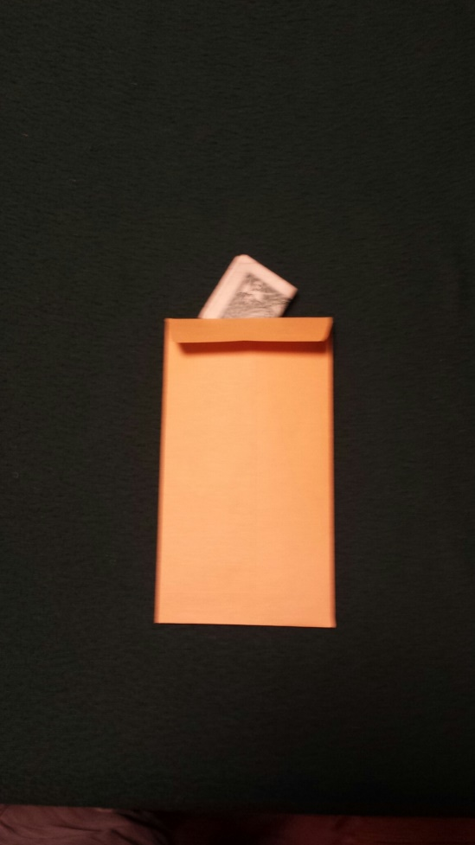
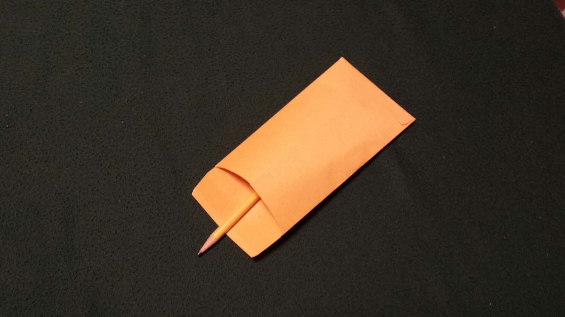
Mentalist Trick

Slide 61
Final Trick
https://www.youtube.com/watch?v=kCJNvJSdT-4

Slide 62
OK How was that trick done?

Slide 63
Closing
https://www.youtube.com/watch?v=pDLR3aX8rR0

Slide 64
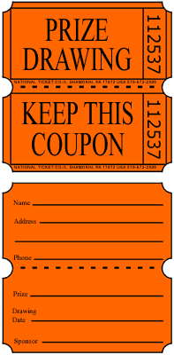
Notes:
Best Den Award
Utonium 232 space modulators
Shut the box game
Hunker Box
Hunker Box
Hunker Box
Vortex Generator

