Slide 1
Secret Envelope

Slide 2
The Effect
Have a volunteer come up with a dollar. Ask them to fold it half. Fold in half again. And fold in half again until it’s a small square.
Give them a small envelope. They look inside the envelope and see that it is empty. They place the folded dollar inside the envelope and seal it up.
Have them press the envelope against their forehead and think hard about the dollar.
You read their mind and “see” the serial number. Have someone write the number while you recite it.
While they hold the envelope, you cut it open with some scissors.
They pull out their dollar and read the serial number. IT MATCHES WHAT YOU SAID!!!
Note, you never touch the dollar.

Slide 3
The Secret
This trick is done using a special envelope that has two compartments. You have pre-loaded one compartment with a dollar whose serial number you’ve memorized. That’s the hard part. I look through many dollars until I find one with a number I can remember.
This secret compartment is glued shut so it is not apparent. It is only glued near the end. This glued part will be cut with scissors.
The other compartment is where the volunteer puts their dollar. Much of both sides of this compartment is painted with rubber cement. After this glue dries it’s not apparent. When the volunteer presses the envelope against their forehead the rubber cement sticks together and seals this compartment shut.
Cutting the end of the envelope allows the secret compartment to open.

Slide 4
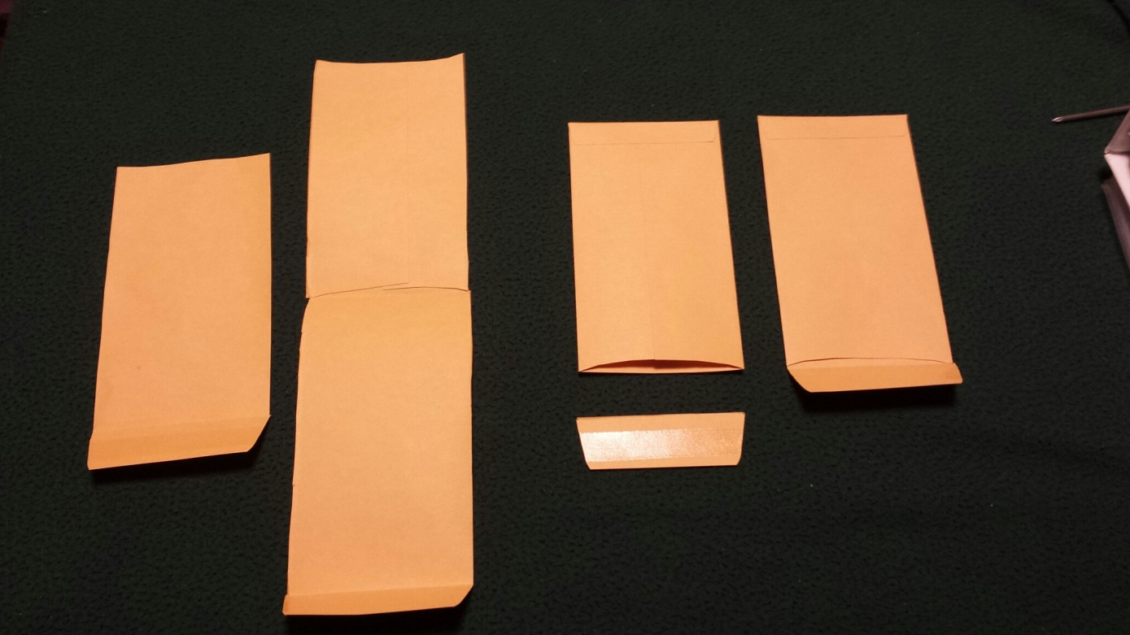
Construction
1
3
2
Start with two envelopes. 1. Cut the flap off of one envelope. 2. On the other envelope cut the side seams until it opens like a book. 3. Cut off the half of the envelope that does not have a flap.

Slide 5
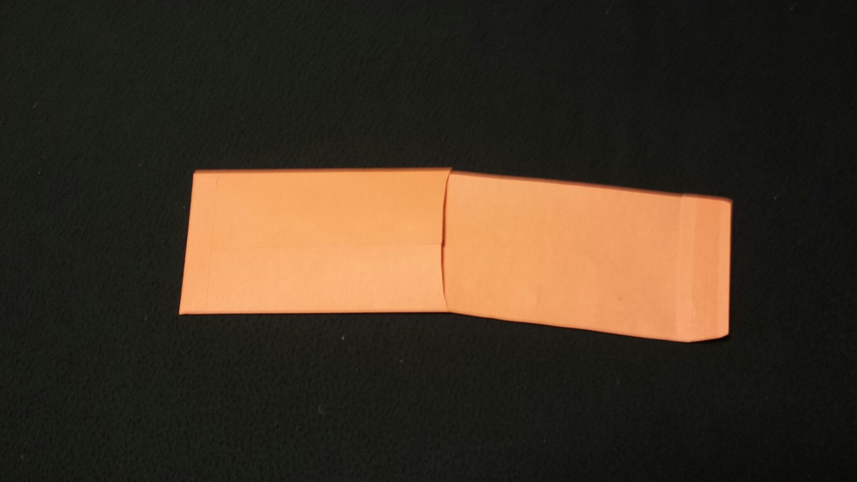
Construction
Slide the paper with the flap into the envelope without a flap. You may have to trim the paper to make it fit. With this envelope the front side of the opening is curved. Make sure the glue side of the flap faces this curved edge.

Slide 6
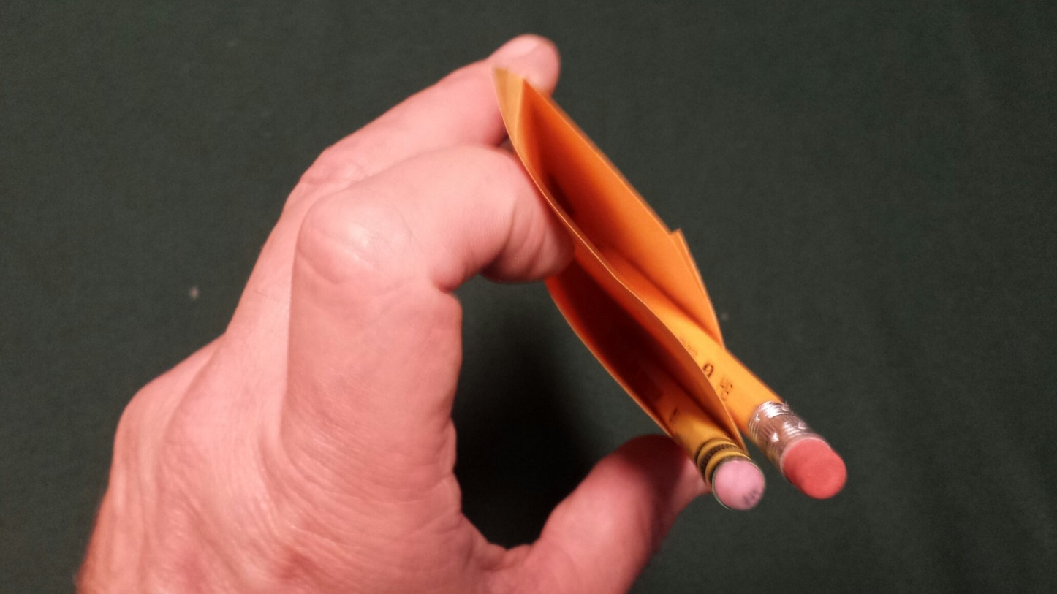
Construction
Here you can see the two compartments. One is behind the flap. The other is in front of the flap. I stuck in some pencils to hold them open for the picture.

Slide 7
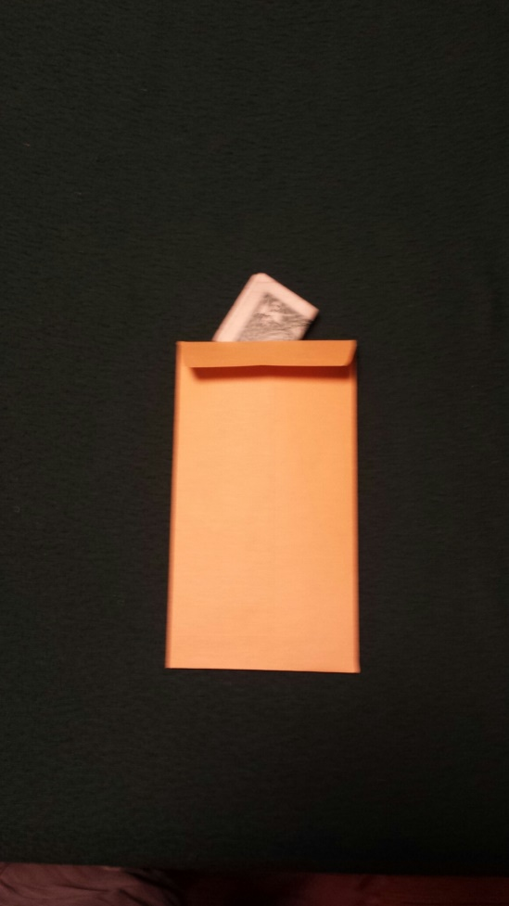
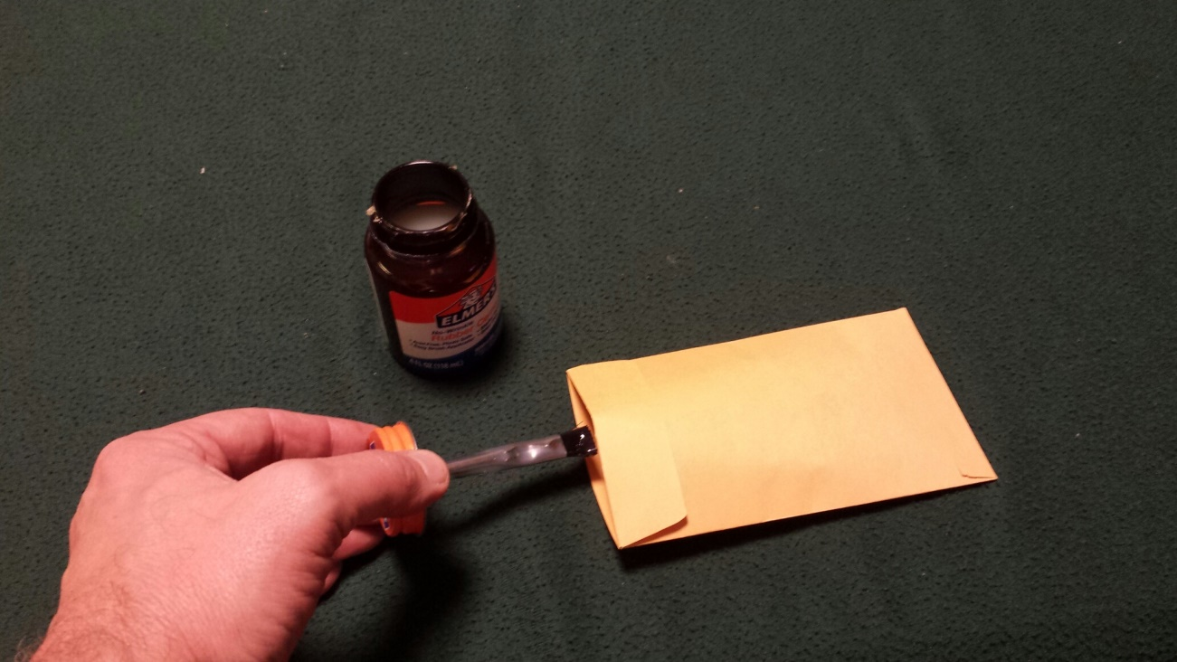
Construction
Load the secret compartment with a dollar whose serial number you’ve memorized. Apply a ¼ inch line of rubber cement across the opening edge of the secret compartment. Seal and let dry. You will cut this glued section off with scissors when doing the trick

Slide 8
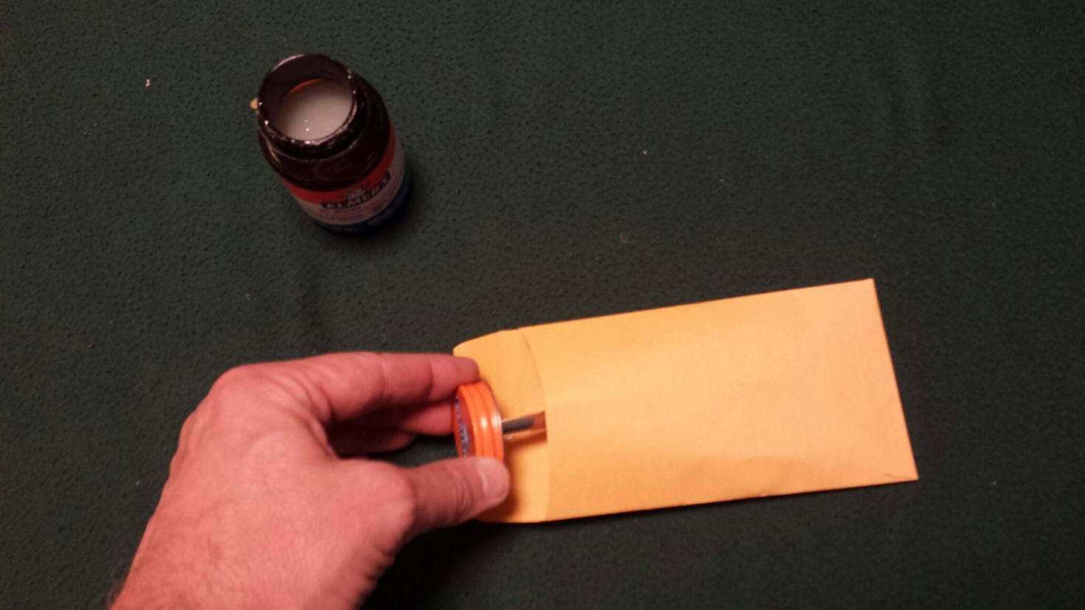
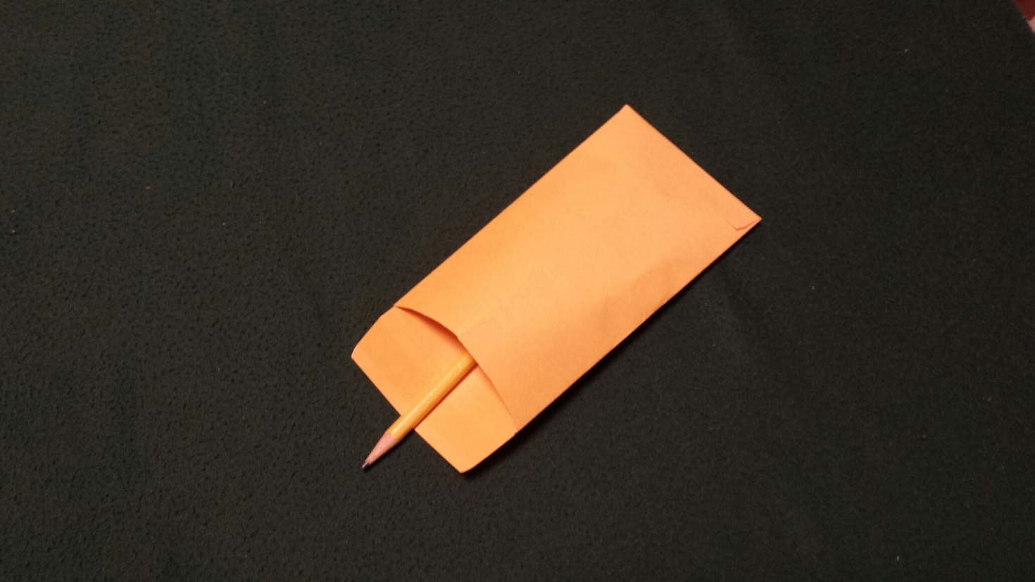
Construction
Paint the inside of the open compartment with rubber cement. Paint the top and bottom in the area between the red lines.
Put a pencil in the envelope to hold it open while it dries. Leave the pencil in the envelope until you are ready to do the trick. If the sides get pressed together the envelope is ruined

Slide 9
Hint
It is important that the volunteer presses the envelope against their forehead. Make it seem like your having trouble reading the number. Say, “I need you to press the envelope hard against your forehead.”
Their effort to improve your telepathy will seal the envelope.

