Slide 1
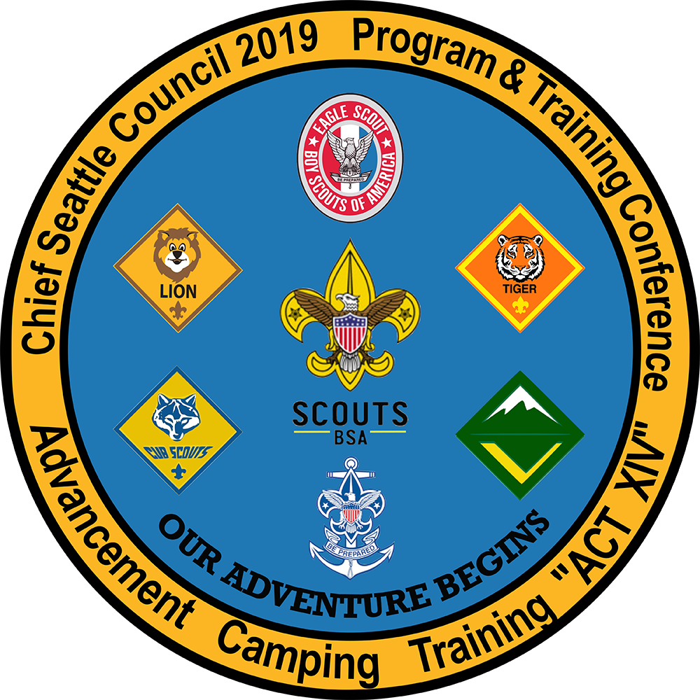

PTC Class 107
Notes:
Time – 10 minutes
This is crew committee challenge. After total completion of this course you will be able to add the training code WS12 to your leader’s training record. This course and Venturing Youth Protection training are the only 2 courses needed to be trained for a committee position.
1

Slide 2
Who Are We?
Notes:
Instructors for today are… (have each instructor introduce self and give a brief background of self).
How many of you are new to Venturing? How many are new to the Boy Scouts of America?
Have participants introduce themselves and tell the group what they are expecting to do as a member of the crew committee.
2

Slide 3
Agenda
Welcome
Aims and Methods of Scouting and Venturing
The Chartered Organization
Crew Leadership
Crew Committee Organization and Responsibilities
Selecting and Retaining Adult Leaders
Closing
Notes:
The Agenda for today is as written. This training focuses on the crew committee. As a result we will not be discussing in detail how to run the Venturing program. Those duties are the responsibilities of the Advisor, Associate Advisors and the “youth members”. If you would like to learn more about running the Venturing program you need to take the Venturing Advisor Position Specific Training.
3

Slide 4
What is Venturing
Youth and young adults
Definition clarifications
  Venturers
  Venturing
  Separate unit
Notes:
Time – 15 minutes
Venturing is a Boy Scouts of America program for youth from 14 (or 13 years old if completed the 8th grade) through 17 and young adults who are 18 to 20 years old. For the purpose of convenience of this training we will be using “youth” to indicate both the youth and young adult members. Because of the age group, Venturers (the youth) are able to do more and go further as a member of a Venturing crew than in other Scouting programs.
Before going on with training we would like to clarify some of the terminology.
Members of a crew are called Venturers, not Venture Scouts
The program is referred as the Venturing program.
A crew is a separate unit. It is not an extension of the Boy Scout troop.
As a result of this it is governed by separate rules and such.
A troop can have an older boy patrol but that is called a Venture Patrol.
It is part of the troop and is governed by the rules of the troop.
4

Slide 5
Aims and Methods of Scouting and Venturing
Aims and Methods of Scouting
  Aims of Scouting
    Character development
    Citizenship training
    Mental and physical fitness
Notes:
BSA promises to its members that Scouting provides life-changing experiences they can’t get anywhere else. We achieve that through our aims and methods. These are – character development, citizenship training, mental and physical fitness.
Divide participants into 3 groups, assign an aim for each group. Have each group define their aim to group.
Distribute copies of Methods of Venturing. Ask each group take a few minutes and discuss which of the methods supports the aim they have been assigned. (The Venturing methods are leadership and mentoring, group activities and adventure, adult association, recognition, the ideals, service and group identity.) Have each group report to whole conclusions.
The BSA has 3 specific objectives, commonly referred to as the aims of Scouting. Ask participants if they can recall the aims of Scouting.
5

Slide 6
The Venturing Program
  Adventure
  Leadership ALPS
  Personal Growth
  Service
  Youth run
  Uniform
Notes:
The Venturing program is carried out through a Venturing crew. Its purpose is to provide experiences that will affect the positive development of youth at a critical stage in their lives and to prepare them to become responsible and caring adults.
Venturing has four program areas, or “pillars”, around which program is built: (ALPS)
Adventure – New experiences that push Venturers to new personal heights, Adventures and activities provide the social benefits youth crave at this point of their development. The level of difficulty is variable and may be tailored to the crew’s skills and experience, and is defined by the individual and the crew. Adventure is the historic appeal of Venturing.
Leadership – Developing broad interpersonal leadership skills applicable to life situations. Youth need to meet societal growing expectations of leadership qualities, especially among a youth’s life influencers and with the level of difficulty escalating. Whether they are following, leading or mentoring, their participation leverages formal training and practical leadership experience (elected or appointed).
Personal Growth – Growth in the skills and ethical/moral foundations that support economic independence, lifelong learning and timeless values. Social/educational influences provide little positive guidance on key life, social, and moral/ethical skills – and youth know it. The focus is on goal development and personal planning with small formal “trainings” facilitating practical application.
Service – Developing behavior leading to an ongoing sense of responsibility. Because youth have limited control of their lives, they enjoy the opportunity to assert their values through the choice to serve. Service can be done on a crew or individual basis with a focus on Scouting and/or the community.
Youth join to gain insight through fun-filled programs and hands-on activities provided by the chartered organization, adult committee member volunteers, youth members’ parents, and other consultants from the community.
Crew is led by elected youth officers. They run everything from finances to activities. Adults are available on an advisory role.
Recommended uniform is the spruce green Venturing shirt with green epaulette tabs and gray pants. However, the uniform, if any is the choice of the crew. The Boy Scout tan shirt should never be worn with the green shoulder loops.
Summary – Our responsibility, as crew committee members, is to ensure that we stay true to the aims of Scouting as we assist the crew in achieving the program specific methods along age appropriate guidelines.
6

Slide 7
The Chartered Organization
What is Chartered Organization?
Responsibilities
Activity – Chartered Organization Relationship
Chartered Organization Representative
Crew Key 3
Unit commissioner
Notes:
Time – 15 minutes
BSA grants an annual charter to a community organization such as a business, service organization, school, labor group or religious institution to operate a Venturing crew. This organization is called the charter organization.
The chartered organization is responsible for selecting leadership, providing a meeting place and promoting a good program.
Crew committee works on behalf of the chartered organization to ensure the crew operates within the organization’s and the BSA’s policies.
Activity - Divide the participants into 2 groups.
1st group – brainstorm and list what the crew might expect from the chartered organization
2nd group – brainstorm and list what the chartered organization should expect from the crew
Have group share their insights. Possible answers
Crew – provide safe meeting place
Provide storage area for crew equipment
Assists with recruiting youth and adults Include crew in life of the organization (flag ceremonies, fundraising, projects, etc.)
Ensures crew conducts its program according to policies and regulations of chartered organization and BSA
Assists with crew charter renewal
Chartered organization--Responsible operation of crew Conscientious and courteous use of the facilities provided
Participation in appropriate chartered organization activities
Behavior and programs consistent with chartered organization’s goals and ideals
Activities that show chartered organization in positive light
Invitations to participate in crew activities
Chartered Organization Representative - Person who can make things happen. He/she is a member of the chartered organization and serves as liaison between your crew and the organization, and between the chartered organization and the BSA local council.
Functions as head of “Scouting department” in the chartered organization
Member of the crew Key 3
Secures the crew committee
Encourages training and participation in relevant activities
Maintains a close relationship with crew committee chair
Helps recruit other adult leaders
Assists with crew charter renewal
Encourages service to the organization
Serves as a voting member of the BSA local council
His/her primary responsibility is to recruit the crew committee. If the chartered organization has a pack, troop, team, ship, and/or crew, one representative serves them all.
Crew Key 3 – consists of crew committee chair, the Advisor and the chartered organization representative. This group usually meets once a month to discuss the crew, its challenges, upcoming events, progress toward completing their action plan and Journey to Excellence goals.
The unit commissioner serves as an advisor to the Key 3. He/she meets with them to support their efforts, to help with problem solving and keep the crew moving in sync with the district and council calendars.
Summary – When the relationship between the chartered organization and the crew is strong and the crew is involved in the life of the organization, the crew is nearly always successful in providing quality programs, recruiting and retaining members and making a difference in the life of the chartered organization and families involved. The crew committee is instrumental in fostering the relationship.
7

Slide 8
Crew Leadership
Position Descriptions
  Who does what and who helps?
Notes:
Time – 30 minutes
Let’s look at the crew leadership. In order to support the crew we need to know its structure and where the committee fits in. Rather than tell you about each position,, we are going to let you discover it on your own.
Activity - Break participants into groups of 3-4. Hand out a bag with slips of paper with titles and descriptions of the crew leadership positions. Have each group organize them so that each position description is matched up with a title. The participants should also categorize the positions into youth leaders, adult leaders and adult support leadership.
Take 10 minutes for this activity.
After all groups complete task hand out copy of Crew Leadership Positions handout. Give groups a few minutes to correct any errors they made. (5 minutes)
8

Slide 9
Crew Organization
  What do you notice about this chart?
  Why does the committee appear smaller?
Notes:
Distribute Crew Organization Chart handout to participants. Ask “what strikes you about the organization of the crew committee”. They should notice that the crew committee has significantly more direct contact with the youth than might be seen in a typical Scouting unit committee. Also the crew committee is often much smaller.
Why is this so?
Youth take much greater responsibility for many of the functions performed by the committees in packs and troops.
Crew Advisor and associate Advisors coach the youth to take on the training function for the youth officers and the committee chair and Advisor manage training function for adults supporting the crew.
Committee members are expected to assume a coaching role for the crew treasurer and secretary.
Consultant’s (a person 21 years of age or older, who has a special skill, talent or expertise in a particular area) role is unique to Venturing.
Keep in mind that Venturers are older and are able to take on greater responsibility for the planning, organization, management, and leadership of their programs. More importantly, though, Venturers want the responsibility for their activities and programs.
Summary – Leadership in the Venturing program falls on the youth members. You will notice that adults in the Venturing program are not referred to as leaders but as advisors. Adults in the Venturing program are there to coach and mentor the youth so they will grow in their leadership roles.
9

Slide 10
Crew Committee Organization and Responsibilities
What have we already learned?
Notes:
Time – 40 minutes
In the last session we looked at the crew leadership organization and learned how the committee fits within that structure. In this session, we will go into a little more detail into what the committee does.
Review – Let’s review what we have already learned about the crew committee. Ask someone to shout out a number between 5 and 10. Then tell the participants that it is their responsibility to come up with that number of facts they know or have learned about the crew committee. Have them shout out the facts and keep count of them until the designated number has been reached. Add any important information they may have forgotten and correct any erroneous information.
Facts should include:
Committee chair conducts monthly committee meetings and coordinates crew efforts.
Treasurer coaches the youth treasurer and assists with fundraising activities.
The secretary advises the crew secretary and takes committee meeting minutes.
Program Capabilities Inventory (PCI) is the responsibility of the committee.
Committee members assist youth activities chairs to carry out their responsibilities.
Consultants interact with the crew by providing technical expertise, special skills, equipment, facilities, or community contacts related to the crew program. They may be one-time participants.

Slide 11
Committee Organization
  Who makes up the crew committee?
  How many members does a crew committee have?
  Who runs the crew committee?
  How is a crew committee organized?
Notes:
The crew committee is composed of adult members such as parents, chartered organization members, and other interested adults – who support the crew program.
Crew committee is required to have a least three members. One member must be designated the committee chair, the second is usually the member who mentors the crew treasurer, and the third mentors the crew secretary. Emphasize that three is the minimum number, but there is no maximum.
Committee chair leads the crew committee and is responsible for the administration, oversight and support of the crew program.
Crew committees can differ in size, but each crew committee has number of functions to accomplish. Committees vary in the way they go about their tasks and how they fulfill their responsibilities. Some crew committees assign a specific responsibility to each committee member on an annual basis. Other crew committees operate on task force basis, with committee members agreeing to specific tasks on a month-to-month basis.
Using the handout from the previous session spend a few minutes to clarify the functions of the committee as needed. You may want to ask participants to explain their own roles on the committee as they understand them.
11

Slide 12
Crew Finances
  Elected crew treasurer
  Financial Set-up
  Fundraising
  Adult committee member mentor
Notes:
The elected crew treasurer is the crew’s financial officer. He/she maintains the records, monitors the crew’s budget, collects and disburses crew funds, and accounts for all monies coming into and out of the crew.
How the crew sets up its finances depends on the chartered organization and the committee. The key is to set up a process where the youth learn financial management and accountability, the youth are protected from financial harm, and the crew is confident that its funds are being responsibly managed.
Like other Scouting units, Venturing crews may conduct money-earning projects only when the chartered organization and local council have approved the project and it is consistent with BSA policies. Use the Unit Money-Earning Application.
An adult committee member mentors the crew treasurer and assists in ensuring the crew is fiscally responsible. Hand out Fiscal Policies and Procedures for BSA Units.
12

Slide 13
Recognition
  Awards, not ranks
  How can the crew committee offer supporting functions to ensure that the crew’s program offers youth the opportunity for recognition?
Notes:
Explain that if any of the participants have been on a troop committee, they will remember that maintaining advancement records, arranging boards of review, and conducting courts of honor were the responsibilities of the committee. Point out that in Venturing, the responsibility for recognition falls to the crew leaders and Advisors.
There are no ranks in Venturing but there are awards that Venturers may earn. (Note – Male Venturers who have earned the First Class rank in a Boy Scout troop may continue to work on the Star, Life, and Eagle Scout ranks in the crew. In this case, the crew committee will carry out an advancement role similar to how a Boy Scout troop would. For more info go to Guide to Advancement and www.Scouting.org/Advancement.)
While crew committee does not take an active role in awards, the committee still has a supporting function in ensuring the crew’s program offers youth the opportunity for recognition. How might they do this?
Cooperate with the crew Advisors on supporting goals for the crew.
Work together with the crew Advisors to ensure the youth are recognized properly and promptly for their achievements.
Provide expertise for consultants for the Venturing awards.
Serve on crew reviews for appropriate Venturing awards and boards of review for the Eagle Scout rank when asked.
Ensure advancement reports are submitted to the local council.
Help crew’s leaders to secure the awards and certificates.
13

Slide 14
Other Considerations
Training
Public Relations
Activities and Adventures
  Guide to Safe Scouting
My Scouting Tools
Notes:
Committee encourages crew leadership to attend ongoing training, such as roundtable, Program and Training Conference, outdoor skills training and Youth Protection training, so they remain current with program materials and updates. A member of the committee keeps track of the crew training records and submits updated trained leader reports to the district and council. While the crew Advisor is responsible for overseeing the training of the Venturers, the committee is responsible for overseeing the training of the adult leaders.
The committee coordinates with the youth leadership to provide crew news and announcements for newspapers, chartered organization bulletins and newsletters, social networks, websites, etc. The committee promotes and stimulates service projects, Scouting Anniversary Week, Scout Sunday or Sabbath, and family participation in crew events. Other responsibilities include promoting new membership and letting people in the neighborhood know that Venturing is available.
Committee is responsible for supervising, promoting and coordinating attendance at crew, district, and council camps and events. Members supervise youth leadership to arrange chaperones, transportation, tour and activity plans, facility/camp reservations, and first aid for all crew outings. Other responsibilities include approving all arrangements and documents, participating in council service projects, and taking advantage of district and council events/activities.
BSA provides a variety of online unit management resources via My.Scouting.org called My Scouting Tools, These tools are available to unit leadership to manage such things as rosters, training, advancement, recognitions, and more.
Summary – Experience shows that successful Venturing crew committees are often less formal, more flexible, and more involved in meetings and activities than other Scouting Committees. Each committee member’s first role is as a coach and guide to the Venturers. In general, committee members should consider themselves part of the partnership with the Venturers to lead the crew effectively, and not as supervisors over the Venturers.
Ask participants if they can sum up what a crew committee does in on sentence. The short answer might be “Supports the crew leaders in delivering quality program and handling crew administration.” Reveal poster.
14

Slide 15
Selecting and Retaining Adult Leaders
Responsibilities of crew committee
  Adult leadership
  Program Capability Inventory
  Equipment, facilities and program resources
  Review, support and approve crew’s program
Notes:
Time – 15 minutes
Let’s recap. Every crew committee has four basic responsibilities:
Provide adequate adult leadership
Complete and maintain the crew’s Program Capability Inventory
Secure equipment, facilities, and program resources.
Review, support and approve the crew’s program plans
We have already discussed how the committee supports the crew program (responsibilities 3 & 4); now let’s focus on the first two responsibilities.

Slide 16
Recruiting Adult Leadership
  Most important responsibility of committee
  Activity
Notes:
Single most important responsibility of the crew committee is recruiting adult leaders and volunteers. The quality of the crew program rests on the quality of leadership.
Small group activity – A key function of your crew committee is assisting in the selection of the crew Advisor. Form participants into groups of 2-4. They are to brainstorm qualities they would like to see in a crew Advisor. (3 minutes). Ask each group to name their top three items. Answers may include:
High moral standards
Commitment to the ideals of Scouting
Ability to relate to youth of Venturing age
Ability to keep a cool head under pressure
Organization skills
Ability to interact with adults
Flexibility and the ability to compromise
Planning skills
High energy level
Attention to details
16

Slide 17
Recruiting the committee
  Where do we find members?
  What if committee is small?
  Program Capability Inventory
“It’s far better to find 10 people who can do the work than it is to find one to do the work of 10.”
Notes:
Besides recruiting adult leaders to support the crew’s program, adults who work on the support and administrative functions must also be recruited. Where are possible places to recruit these peoples? Answers may include:
Church
Outdoor/sports stores
Military
Teachers
Activity/adventure clubs
Chartered organization
Service clubs
Parents
Graduating Scout leaders
If the crew is small and the program seeks to have the youth perform many of the functions, how might we get adults involved in a crew committee?
Serve as consultants
Become coaches for activity chairs
Support Friends of Scouting
Arrange for or provide transportation
Provide unique resources (cabin, boats, access to professional associations)
Distribute copies of the Program Capability Inventory (PCI). The PCI is an inventory of the program potential of selected adults connected with the crew, the charter organization and the community. It is the responsibility of the crew committee to maintain these forms in order to support the program.
Summary – The committee plays a very important role in the success of the crew’s program – it takes care of the supporting functions in order for the crew leadership to focus on the youth. For those parents who want to get involved, service on the crew committee may be a way to share their special expertise.
Keep this saying in mind: “It’s far better to find 10 people who can do the work than it is to find one to do the work of 10.”
Remember, everyone has something to contribute and may be waiting for you to ask for help. Please look carefully and plan for the future of your crew as well as its present.
17

Slide 18
In Conclusion
Resources
Questions?
How do you feel about your job?
.
Notes:
Time – 10 minutes
What sets Venturing apart from other youth adventure programs and clubs is that it is part of a much larger organization, the Boy Scouts of America, which is led by volunteers like you and supported by a staff of professional Scouters.
Your council and district are there to promote Scouting and provide program, training, and resources to help guarantee your success. This training is only one example. If you haven’t already done so please access www.Scouting.org and www.MyScouting.org for resources from national. This is where you can access the on-line Venturing Youth Protection.
A unit commissioner, which is provided by the district, can give direct coaching and consultation to your committee as needed.
Other resources are roundtables, council trainings, handbooks like the Venturing Advisor Guide.
Are there any questions?
Hand out certificates of completion
Reflection: Ask participants to share how they feel about their assignment to serve on the Venturing crew committee and one of the most helpful or important thing which they learned in today’s training.
“Successful Venturing crew committees provide support to the Venturers who are planning and executing program, rather than provide program for them. Keep in mind that Venturers are older and are able to take on greater responsibility for the planning, organization, management, and leadership of their programs.
More importantly, though, Venturers want the responsibility for their activities and programs. For those with previous Scouting committee experience, the role of the crew committee may differ in execution but not in broad principles. Nor does this change the need for a strong Venturing crew committee regardless of the size of the crew.
18

Slide 19
Remember to Record Your Evaluation and Attendance
Part 1 of 2 (107A)
To record your evaluation and attendance from a mobile device, go to http://seaptc.org and click "My Evaluation & Attendance."
The code for this session is 5070.
Part 2 of 2 (107B)
To record your evaluation and attendance from a mobile device, go to http://seaptc.org and click "My Evaluation & Attendance."
The code for this session is 7582.
Notes:
Hand out stickers if necessary

