Slide 1

basic scout knots
2019 Chief Seattle PTC
October 19, 2019
Session 216: Basic Scout Knots
Beth Carter, Nick Carter, Nick Heaton

Slide 2
ROPE BaSICS ….
Natural rope
  Holds a knot well
  Cheap
  Can be used as kindling to start a fire
  Tends to be “hairy” (can be removed by an open flame)
  Tends to be smelly
Man made fiber
  “Poly rope” floats
  Resists rot & mildew
  Ends can be sealed with heat
  Does not hold up well in heat
  May not hold a knot well
  Some will stretch
Regardless of which type you use … Store it well!!
Simple coil or skein is easy and keeps rope in good shape.
Longer lengths? Use a climbing rope coil.
Heavy ropes? Try chaining.
Keep all ropes of the same length together.
  Try color coding …Use RED 30’, BLUE 40’ BLACK 50’

Slide 3

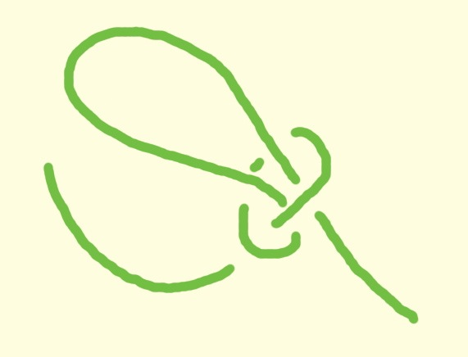
Overhand and slip knots
Overhand knot:
  Simple knot, sometimes called thumb knot
  Uses:
    form a stop at the end of a rope
    mark a length on a rope (boat speed, trail length)
    bundle objects together
  Basis for a slip knot
Slip knot:
  Starts like overhand, then loose end comes back through loop
  Use to tie rope to pole or make a bundle
  Not secure (it slips), can be made more secure
  with overhand knot in the running end

Slide 4
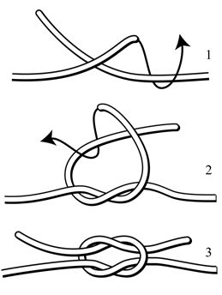
Square knot
  Also called “reef knot”
  Widely recognized “Scout knot”
  Easy to untie after being under tension
  (pull back on one end to break the knot)
  “Right over left, left over right, makes
  the knot ”tiny, tidy and tight”
  Makes granny knot if tied incorrectly
  Uses:
    Joining two equal ropes together
    Bandages (knot lies flat)
  Not good when not under tension

Slide 5
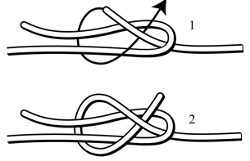
Sheet bend
For joining two unequal ropes together
Thicker rope always forms the loop
Make a loop with thicker rope
Loop other rope behind the first
Cross the leads of the second loop inside the first,
with one lead under and one over the first loop
Can increase stability by doubling the knot (looping
second rope twice around the first)

Slide 6
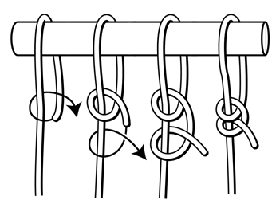
Two half hitches
  For tying an object to a pole
  More secure than a slip knot
  Can be made more secure by first
  taking another turn around the object
  “round turn and two half hitches”

Slide 7
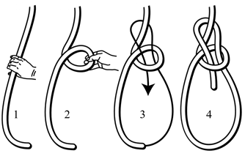
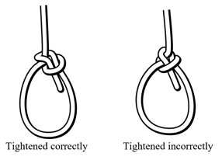
bowline
Forms non-slipping loop in a rope
Used for rescues or carrying
(figure 8 with loop is another option)
“Up the rabbit hole, round the tree,
back down the rabbit hole”
Make a “p” and pull the working
end up through the loop.
Move the working end up, around (behind) staff,
then back down and down through the loop of the “p.”
Secure with a hitch or overhand knot.
“Neat trick” … Some people tie with one hand:
start with running end over the standing rope
and down towards your belt buckle

Slide 8
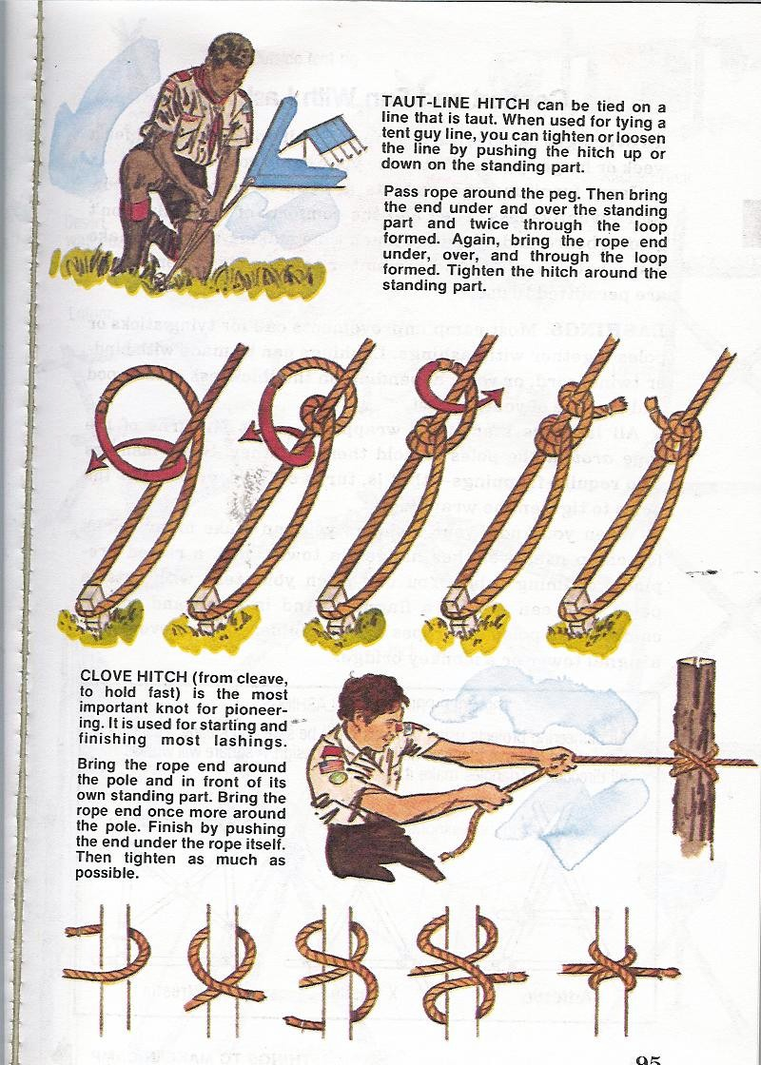
Tautline hitch
Secures an object with an easily
adjustable hitch
Typically secures a tent line to a
stake
Tie one end to the object you want
to secure, such as a tent rainfly
Loop the rope around the secure point, such as a tent stake
Move the line back up toward the object. Tie a half-hitch, then tie a second half
hitch below it (closer to the secure point).
If you have lots of rope left over, you can tie a second tautline over the first, or use an overhand or gathering knot to hold the extra rope.

Slide 9
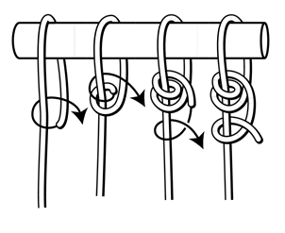
Tautline hitch
Another view
Same hitch, some find it easier to ti
this direction … ”upside down”
The TOP of this picture is the tent stake
The BOTTOM of this picture is the tent

Slide 10
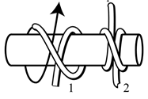
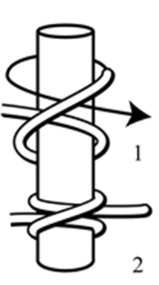
clove hitch
Useful to secure an object to a post,
such as tying an animal’s leash to a pole
Also used as the starting point
for a number of lashings
“Loop around and on top,
then around and underneath”
“Form a pair of glasses and
then fold them together”

Slide 11
Get your Patch … tell us how we did!!
Please complete your session evaluation:
  It’s online …Go to seaptc.org
  Click “Class Evaluation”
  You’ll need the evaluation code for each session (on class sticker)
  This is Session 216, evaluation code 7634
  You’ll also need the identification number printed on your badge
  Fill out each evaluation as you complete each session
  Show your final session instructor the confirmation page on your mobile device to receive …
  THE PATCH … tada!
  Thanks for coming to PTC 2019!!!!

