Slide 1
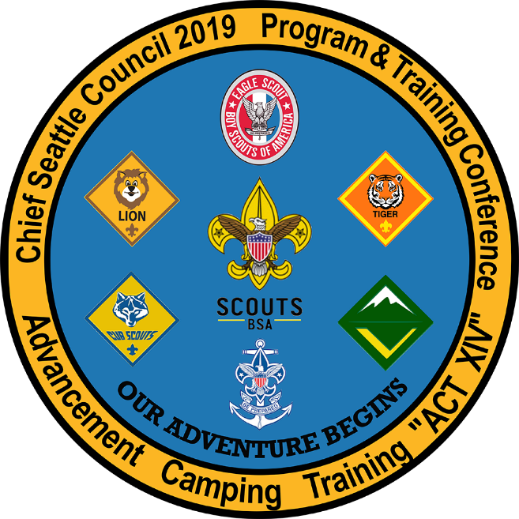
intermediate scout knots
2019 Chief Seattle PTC
October 19, 2019
Session 316: Intermediate Scout Knots
Beth Carter, Nick Carter, Nick Heaton

Slide 2
You should already know ….
Basic Scouting Knots …
Overhand knot
Slip Knot
Square Knot
Two Half Hitches
Bowline
Tautline Hitch
Clove Hitch
These knots are covered in the Basic Scouting Knots Class. If you’re not familiar with them, you can get the class materials (session 216) from the PTC web site,
!

Slide 3
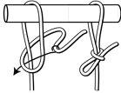
Hitching tie
Quickly tied, temporary way to attach
or secure something with a rope
Also a good starting point for the trucker’s
hitch, up next

Slide 4
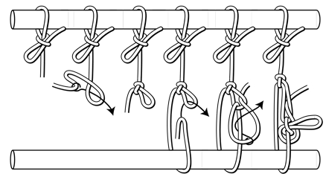
Trucker’s hitch
A pulley with a locking knot:
Use it to tie down a load (canoe), to
hang something (bear bag), or to
secure something (tarp). It can be an
an alternative to a tautline hitch.
Tie the hitching tie you just learned.
Tie a slip knot below the hitch where you’ll be able to reach it, and tighten it.
Pull a loop from the working end of the rope through the slip loop.
Pull the cord inside that loop, tighten to secure the whole hitch.
If you need to adjust the hitch, loosen the last two loops and the pulley will slide freely. Adjust as needed, then redo the two loops to secure the hitch again.

Slide 5
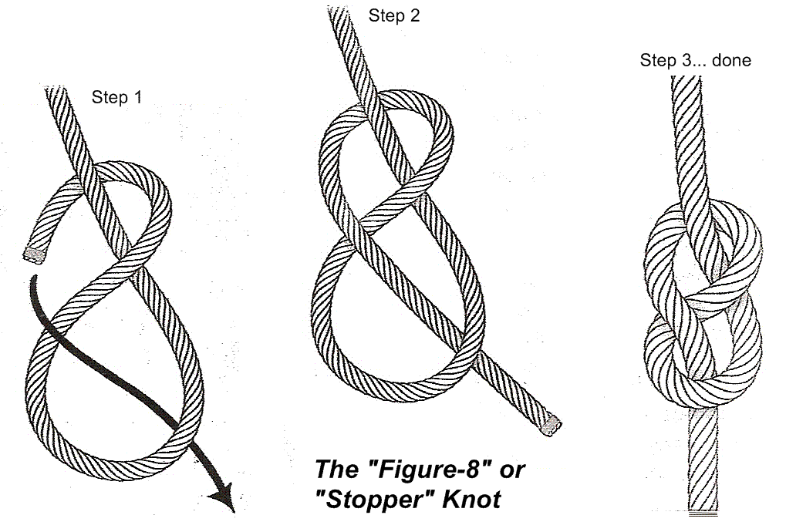
Figure 8 knot
Most often used as a stopper knot, like an
overhand. Figure 8 is stronger, easier to untie, and damages the cord less. Also called the Flemish Knot (in Ashley’s Book of Knots).
Make a loop like an upside down “p.”
Push the working end over and down through
the loop of the p, making a figure 8.
Tighten.

Slide 6
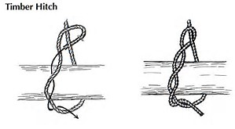
Timber hitch
Make a series of twists in the end of a line.
Insert the long end of the line through the
loop formed by the twists.
The timber hitch is used to secure a rope round a post or any cylindrical object. It is also known as Bowyer’s Knot because it can be used to attach the end of a bowstring to a longbow.

Slide 7
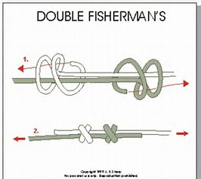
Double fisherman’s knot
Securely ties together the ends of one rope, forming a loop. Also useful to make a sliding knot such as for a necklace.
Tie an overhand knot with two loops in each end or cord. Insert the long end of each cord through the other knot.
You can tie an overhand knot at the end as a stopper knot.
Double the short end of each knot back over itself and through its own knot.

Slide 8
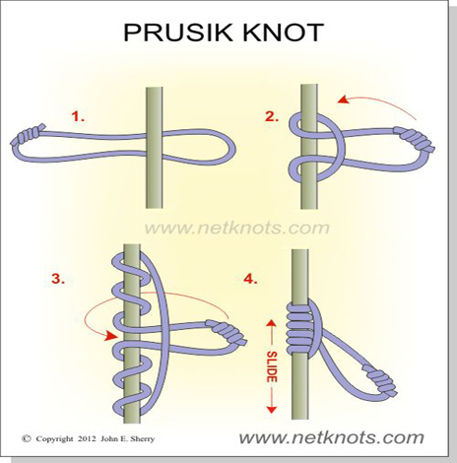
prusik knot(Hitch)
Slides up or down a stationary rope, but holds fast when weight is applied.
First, make a loop from a length of parachute cord or rope (hint: use the Double Fisherman’s Knot).
Wrap the loop around the main line three times. The prusik hitch will slide easily along the rope, but it will jam when a load (horizontal or vertical) is applied.
The prusik is great in self-rescue situations. Mountaineers use it for footholds while climbing a vertical rope. Campers use it for rigging rain flies or rescuing rock-pinned canoes in a river.

Slide 9
Get your Patch … tell us how we did!!
Please complete your session evaluation:
  It’s online …Go to seaptc.org
  Click “Class Evaluation”
  You’ll need the evaluation code for each session (on class sticker)
  This is Session 316, evaluation code 1143
  You’ll also need the identification number printed on your badge
  Fill out each evaluation as you complete each session
  Show your final session instructor the confirmation page on your mobile device to receive …
  THE PATCH … tada!
  Thanks for coming to PTC 2019!!!!

