Slide 1

PTC 2018 – Session 105
Troop Committee Challenge PLUS

Slide 2
Welcome!
Purpose of this course today:
  To provide BSA Training: Troop Committee Challenge
  To learn the role of the Committee in a BSA Troop
  To learn about the different jobs on the Troop Committee
  To share with each other
    Best Practices
    Worst Practices?
    Ideas, Tips, Tricks
    Diversity of experiences across different Troops
    Make connections, keep the conversation going
Notes:
Objectives and Overview
As a troop committee member, you have the opportunity to make a difference in the lives of youth by contributing to the effectiveness of the troop and the troop’s leaders. The job of any parent in a Scout troop is to figure out how to work with other people to create an excellent experience for their youth. You are building an intentional community that is centered around common values and common goals.
Another way of saying what the Committee’s job is:
To understand EVERYTHING about a Troop.
Make it all work smoothly, in a behind the scenes kind of way.
Administration – policies, tracking data, arranging logistics, ensuring leadership coverage, finances
Ensure a Quality Program (JTE)
Hiring
Communication
Training and understanding are paramount. For the bulk of it though, you adults have to teach yourself. You take this class and the online ones, and then you still have to read the Guide to Safe Scouting. You have to learn the details of insurance, fundraising and teenage behavior.
You will not walk out of here today knowing everything you need to know. You will have a lot of homework after you leave here. Don’t worry though, we have texts, classes, places and people to support you.

Slide 3
Agenda
Introductions & Objectives
Aims & Methods of Scouting
The Chartered Organization
Troop Leadership
Troop Committee Organization and Responsibilities
Selecting and Retaining Adult Leaders
Open Discussion & Experience Sharing
Closing
Notes:
Structure of the class
Designed for 2.5 hours
May not cover everything in detail – self study homework
We have extra time for discussion (the PLUS portion)
Open Q&A as we present
Activities for some sections
Break in middle
Open discussion

Slide 4
Introductions
Sean Wheeler – swsamwa@live.com
  ASM Troop 571 & Committee Chair Crew 20 in Sammamish
  Scouter for 10 years (Webelos 1 as a youth)
    Assistant Scoutmaster 5 years
    Crew Committee Chair 8 months
    Crew Associate Advisor 2 years
    Pack Committee Chairman 3 years
  My son is an Eagle Scout and President of Crew 20
  My wife was Den Leader for 5 years (Tiger – Arrow of Light)
    12 boys crossed over to troop
    Six are now Eagles

Slide 5
Introductions
Jason Herres – jrherres@gmail.com
  Committee Chair Troop 425 in Fall City
  Scouter for 11 years (Second Class Scout as a youth)
    Troop Committee Chair
    Wood Badge attendee (working tickets)
    Pack Committee Chair
    Cubmaster
    Den Leader
  My son is an Star Scout working on Life/Eagle

Slide 6
Introductions
Who are you?
What is your current position in your Troop?
What is your level of experience in Scouting?
First time at PTC?
Activity - What do you hope to learn today?
  Topics for the discussion portion of the class?
  Problems in your unit?
  Questions about your role?
Notes:
Tell us about yourself – anything you want us to know
Ordered general to specific
Three Post-It notes (2 minutes each):
Write what you want to get out of this training. What do you want to learn today?
What aspect/area of the committee do you want to learn more about or are most interested in?
What worries or concerns you about your new committee position?
After all 3 are done, ask each person to read #1, collect it on poster. Discuss as necessary.
Repeat until you have collect from each person.
Repeat for #2 and #3.

Slide 7
The Mission of Scouting
To prepare young people
to make ethical and moral choices
over their lifetimes
by instilling in them the values
of the Scout Oath and Scout Law.
Notes:
The Mission, Aims, and Methods of Scouting
15 minutes

Slide 8
The Aims of Scouting
Participating Citizenship
Growth in moral strength & character
Development of physical, mental & emotional fitness
Notes:
Create flip charts for the Three Aims

Slide 9
Methods of Scouting
Ideals
Patrols
Outdoors
Advancement
Adult Association
Personal Growth
Leadership Development
Uniform
Oath - Law - Motto - Slogan
Peer groups - Elected representation - Activities
Fun - Excitement - Leadership laboratory
Self-reliance - Ability to help others - Challenge
Image - Role model - Example
Good Turn - Service - Spirituality
Leadership instruction and practice
Commitment to aims - Identity
Notes:
Divide the participants into 3 groups – one for each Aim
Mix it up - people who not from the same units
For each Aim, the group should list which Methods help fulfill the Aim (1 minute)
Use Methods of Scouting slide
Spokesman for each group talks about why they listed each Method
Some possible answers:
Character development:
Ideals – this is how the Scout measure themselves for self improvement
Adult association – Scouts learn by the example set by the adult leaders
Personal growth – Scouts grow as the set goals and complete achievements
Leadership development - learn and practice leadership skills
Uniform - creates and instills a positive youth image
Citizenship training:
Ideals – Scout Law lists the qualities of a good citizen
Patrols - experience in group living and participating citizenship
Outdoors - Scouts share responsibilities and learn to live with each other
Personal growth – Scouts grow as they participate in community service projects and do Good Turns for others.
Leadership development - helps Scouts accept the leadership roles of others and guides them toward the citizenship aim
Personal fitness:
Ideals – The Scout Oath addresses this directly
Personal growth – This includes spiritual and emotional growth
Outdoors – some of the best exercise you can get – also good for emotional rejuvenation
Advancement – The advancement system helps a Scout grow in self-reliance

Slide 10
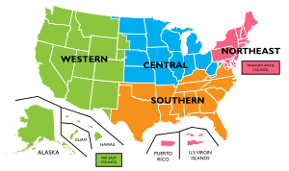
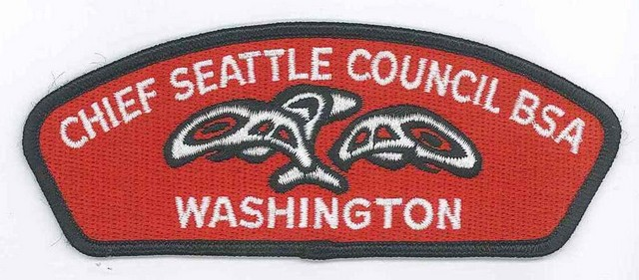


Structure of Scouting Organization
Administrative
National Council
  Chartered by Congress, four regions
  Professional staff – Volunteer directors
Local Council
  Chartered by the National Council
  A specific geographical area
  Professional staff – Volunteer Leaders
Scouting District
  A geographical area within the council
  Professional staff – Volunteer committee
  District Commissioner and Unit Commissioners
Chartered Organization
  Chartered by the local council
  “Owns” the troop, appoints a Chartered Org Rep
  Chartered Org Rep recruits the Troop Committee
  Troop committee recruits Scoutmaster and assistants
Notes:
The Chartered Organization
15 minutes
References:
—The Chartered Organization Representative Guidebook, No. 511-421
—Troop Committee Guidebook, No. 34505 (SKU 616928)
The BSA grants an annual charter to a community organization to operate a Boy Scout troop.
The troop is “owned” by the chartered organization.
Chartered organization is responsible for selecting leadership, providing a meeting place, and promoting a good program within the framework of the policies and standards of the BSA.
The troop committee works on behalf of the chartered organization to ensure the troop operates within the organization’s and the BSA’s policies.
The committee also supports the Scoutmaster in helping the troop succeed.

Slide 11
Troop Committee
Chartered Organization Representative
The Chartered Organization Representative is the direct contact between the Troop and the Chartered Organization.
This individual is also the organization's contact with the district committee and the Local Council.
The chartered organization representative may become a member of the district committee and is a voting member of the council.
The Chartered Organization Representative appoints the Troop Committee Chair.
Notes:
Chartered Organization Representative
The chartered organization representative is a member of the chartered organization who serves as a liaison between the troop, the organization, and the BSA local council. Primary responsibility is to recruit the troop committee and help it recruit a Scoutmaster and assistant Scoutmasters. The chartered organization representative sees to it that all adults involved serve the best interests of the chartered organization and the BSA.
In addition, the chartered organization representative:
Functions as head of the “Scouting department” in the chartered organization
Is a member of the troop’s Key 3
Secures district help if needed
Encourages training and participation in relevant activities
Maintains a close relationship with the troop committee chair
Helps recruit other adult leaders
Assists with the troop’s annual charter renewal
Encourages service to the organization
Serves as a voting member of the BSA local council
Activity – Fill in the TOP of the org chart

Slide 12
Structure of Scouting Organization
The Troop
THE SCOUT
A boy 11 to 17 years old.
A member of a patrol.
Elects Patrol Leader and Senior Patrol Leader
THE PATROL
6 to 8 Scouts who work together.
Led by the Patrol Leader
PATROL LEADERS COUNCIL
Assembly of patrol leaders
Senior Patrol Leader presides.
Plans troop activities.
YOUTH LEADERS
Senior Patrol Leader, Patrol Leaders,
Junior Assistant Scoutmaster,
Assistant Patrol Leaders, Scribe, Librarian,
Quartermaster, Troop Guide, Instructor,
Chaplain's Aide
Notes:
Troop Leadership
Time 30 minutes

Slide 13
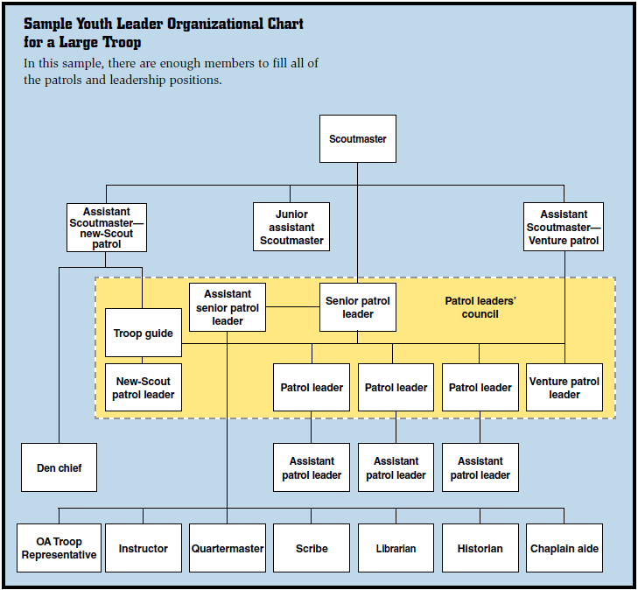
Structure of Scouting Organization
The Troop
Notes:
Explain the Key 3 Positions from the org chart
troop committee chair
the Scoutmaster
the chartered organization representative

Slide 14
Role of the Troop Committee
The Troop Committee is the Troop's Board of Directors
Supports the Troop's Adult and Youth Leaders in Delivering a Quality Program to the Troop's Scouts
Notes:
Troop Committee Organization and Responsibilities
Time 40 minutes
• Materials:
— Troop committee position descriptions cut out and pasted onto 4” x 5” notecards
(Appendix E)
• References:
— Troop Committee Guidebook, No. 34505 (SKU 616928)
• Handouts:
— Sample Troop Committee Meeting Agenda (Appendix G)

Slide 15
Role of the Troop Committee
The Committee supports the program planned by the scouts working with their adult leaders
  Logistics, finances, Boards of Review, chartering, etc.
The Scoutmaster, ASMs, and PLC run the Program
Committee can include parents, members of the chartered organization, or people recruited from the community at large.
  Most active committee members are parents
  The Scoutmaster and Assistants are not on the committee but should be included in meetings
Notes:
The troop committee supports the Scoutmaster in delivering a quality troop program.
Members ensure quality adult leadership is recruited and trained.
Handles troop administration and is responsible for finances, adequate funding, and disbursements in line with the approved budget.
Obtains, maintains, and properly cares for troop property.
Ensures the troop has an outdoor program with a minimum of 10 days and nights of camping per year.
Serve on boards of review and plan and conduct courts of honor.
Support the Scoutmaster in working with individual boys and handling problems
Provides for the special needs and assistance
Helps with the Friends of Scouting campaign
Handles charter renewal and advancement
Ensures adults are current with Youth Protection training

Slide 16
Troop Committee Ground Rules
Size: The minimum number is three adults
Age: Must be 21 or older
The first five positions are essential for quality Troop operations. Fill those positions first.
  Chairperson
  Treasurer
  Secretary
  Outdoor Activities
  Advancement
No maximum number of Troop committee members.
Notes:
The minimum number of committee members is three, one of whom serves as a committee chair.
There is no maximum number of committee members
Lots of other positions and opportunities for adults to help.
Troop Committee Meeting
Be prepared - the troop committee meeting should not last longer than an hour and a half.
The committee chair should ensure the meeting keeps moving.
Long meeting can discourage participation
See the sample meeting agenda in the guidebook and in Appendix G.
Annual Program Planning Conference
The PLC, not the adult leaders, is responsible for planning the troop’s activities
The Scoutmaster should submit the troop’s yearly plan to the troop committee for its support
The committee may make alternative suggestions for the patrol leaders’ council to consider
Avoid conflicts with the Chartered Org - clear the program calendar in advance with the COR

Slide 17

Troop Committee
Troop Committee Chairperson
The Troop Committee Chairperson is appointed by the Chartered Organization and registered as an adult leader of the BSA.
The Troop Committee Chairperson appoints and supervises the Troop Committee and Troop Leaders.

Slide 18

Troop Committee
Troop Secretary
The Troop Secretary is appointed by the Committee Chairman to keep minutes and records, send notices, and handle publicity.

Slide 19

Troop Committee
Troop Treasurer
The Troop Treasurer is appointed by the Committee Chairperson to handle troop funds, pay bills, maintain accounts, coordinate the annual Friends of Scouting (FOS) campaign, and supervise fundraising.

Slide 20


Troop Committee
Troop Advancement Chair
The Troop Advancement Chair is appointed by the Committee Chairperson to ensure that the troop has
  At least monthly Boards of Reviews
  Quarterly Courts of Honor
  Goals of helping each Scout advance a rank each year and for new Scouts to reach First Class rank during their first year
The Advancement Coordinator is also responsible for record keeping and submitting advancement reports.

Slide 21
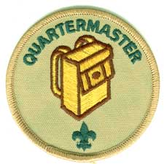
Troop Committee
Troop Equipment Coordinator
The Troop Equipment Coordinator is appointed by the Committee Chairman to work with the Scout Quartermaster and is responsible for inventory, storage, and maintenance of Troop equipment.

Slide 22

Troop Committee
Troop Outdoor / Activities Chair
The Troop Outdoor / Activities Chair is appointed by the Committee Chairman to:
  Secure tour permits and permission to use camping sites
  Serve as transportation coordinator
  Ensure a monthly outdoor program

Slide 23
Troop Committee
Troop Membership Chair
The Troop Membership Chair is appointed by the Committee Chairman to help ensure a smooth transition of new Scouts into the Troop and provide orientation for new parents.

Slide 24
Troop Committee
Troop Training Chair
The Troop Training Chair is appointed by the Committee Chairman to ensure
  Training opportunities are available
  Maintain training records and materials
  Responsible for BSA Youth Protection training.

Slide 25
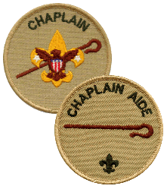
Troop Committee
Troop Chaplain
The Troop Chaplain is appointed by the Committee Chairman to:
  Provide a spiritual tone for troop/team meetings and activities.
  Give guidance to the chaplain aide.
  Promote regular participation of each member in the activities of the religious organization of his choice.
  Visit homes of the Scouts in time of sickness or need.
  Encourage Scouts to earn their appropriate religious emblems.

Slide 26

Troop Committee
Other Positions…
Troop Public Relations Chair
  Inform parents of their responsibilities in Scouting and with the chartered organization.
  Provide news and announcements about the troop to newspapers, bulletins of sponsors, web sites, etc.
  Promotes and stimulates service projects, Scouting Anniversary Week, Scout Sunday or Scout Sabbath, and family participation in troop events.
  Promotes new membership and lets people in the neighborhood know that Scouting is available.
Troop Friends of Scouting (FOS) Chair
  Work closely with the troop committee on public relations for FOS
  Conducts annual FOS campaign to enroll family members and adult leaders in FOS
  Gives recognition to contributors and enrollees.
Troop Scouting for Food Chair
  Coordinate an annual food drive for the troop and report the result to the district.
Troop Fundraising Chair
  Also called the "Popcorn Kernel" in some councils, supervises Fundraising and ensure that every youth member has the opportunity to participate in Popcorn sales or other council Fundraising events.
New Member Coordinator
  The New Member Coordinator shares the benefits of Scouting. Coordinates unit recruitment. Guides the joining and welcoming process for youth and their families.

Slide 27
Selecting & Retaining
Adult Leaders
On of the most important responsibilities of the committee: Provide adequate adult leadership for the troop
What are the attributes of a good leader?
How do you find good leaders?
How do you keep good leaders?
How do you plan for turnover?
Notes:
Selecting and Retaining Adult Leaders
Time
15 minutes
What are the attributes of a good leader?
High moral and ethical standards
Commitment to the ideals of Scouting
Ability to relate to youth of Scouting age
Ability to keep a cool head under pressure
Organizational and Planning skills
Ability to work well with the committee and other adults
Good communication skills
Flexibility and ability to compromise
Ability to coach and mentor youth and the assistant Scoutmasters
Attention to details
Commitment to training
How do you find good leaders?
Chartered organization
Outdoors/sporting goods stores
Colleges and universities (including Alpha Phi Omega chapters)
Local military units
Activity and adventure clubs
Churches and Service clubs
Graduating Scout leaders (e.g., a Webelos den leader could become an assistant Scoutmaster)
Parents
How do you keep good leaders?
Training - every youth deserves a fully trained leader
Advanced training – PTC, Wood Badge, WFA, etc.
Show commitment to the program – more likely to stay involved
How do you plan for turnover?
Plan for it – talk with leaders about multi-year commitment
Know when a leader’s scout is aging out

Slide 28
Group Discussion and Experiences
IMHO*
* In My Humble Opinion…
Notes:
This begin the PLUS part of the class.

Slide 29
IMHO
Committee Chairperson
Most committees operate by consensus, formal votes are rare
Prepared agendas make for efficient meetings
Scoutmasters & Asst. Scoutmasters technically are not part of the Committee…But they should never be excluded from discussions that involve the boys or program
Keep your Committee meetings open to parents, but don’t necessarily invite or remind them. You’ll get requests if they want to participate, most are happy not to participate
You will lose volunteers if they feel their views are not considered
People who can help you
  Your Unit Commissioner
  District Executive
Troop Committee Guidebook

Slide 30
IMHO
Committee Chairperson (cont.)
Hold regular parent meetings, invite everyone
Use agendas to control discussion
Use the Committee to vet the agenda for the parent meetings
Give specific duties to specific individuals – SMART Goals!
  Specific, Measureable, Attainable, Relevant, Timely
Spread the load to avoid burnout
Volunteers rarely volunteer!
  Sometimes the first volunteer isn’t the best volunteer
  Most people will step up (or step down) when you approach them 1-on-1
  Explain why you believe they will be successful in the role you need
  Provide clear direction for next steps (SMART!)
  Give them names of people who will help (not just who can help…)
Definition of a Leader? Someone to do the job when nobody else will!

Slide 31
IMHO
Treasurer
Use a dual signature checking account for troop funds
Put at least three names on the signature card with the bank (treasurer, committee chair, scoutmaster, or others)
Treasurer should not be part of the same household as the Scoutmaster or Committee Chair
Establish some kind of approval procedure for major outlays – Vote!
Recipients of reimbursements should not be approving their own expenses
Consider establishing accounts for individual scouts to credit the families with reimbursements they are due (grubmaster, driving, approved expenses, etc.)
Keep reimbursements separate from fund-raising!
  Establish policies regarding such Family accounts
  What happens to the money when a boy drops out or moves out of the area?

Slide 32
IMHO
Treasurer (cont.)
Deposit cash receipts promptly
  Less chance of loss of cash and checks
  Less chance of bounced checks and closed accounts
  Happier Parents!
Use a receipt book that makes copies to account for currency received
Take the lead in establishing financial policies
  Camperships? Need a Troop policy on dispersing.
  Outings to be self-financing or subsidized out of general treasury?
Take the lead in establishing an annual budget
Provide monthly reports and quarterly reviews to the Committee
Make “Friends of Scouting” a separate committee position
Have specific adults responsible for Troop fund raising events and activities, just like for an outing
www.QuickBooks.com

Slide 33
IMHO
Outdoor / Activities Coordinator
  This is potentially a very big job
  Consider subdividing between camping activities and other activities
    We have a SOC group that focuses on High Adventure outings…
  Tour permits should be the responsibility of individual “trek leaders”
  Transportation coordinator should be a separate position
    Compile and maintain records on vehicles, insurance, and drivers
    Assist trek and activity leaders in arranging transportation when requested
  Establish a policy and procedure for program planning and event approval
    Scouts should participate fully in the planning process
    Committee should review and approve plans

Slide 34
IMHO
Advancement Coordinator
  Scoutbook is recommended – There are many others
  Consider making merit badge counselor list a separate responsibility
    Membership Coordinator or Troop Trainer
  Consider having a separate Eagle Coordinator to assist scouts after they achieve Life rank
  Make sure they get a lot of help before and during Court of Honor
  Team them up with an ASM responsible for advancement
  Do an audit of Council Records periodically – Eagle Application Issues!

Slide 35
IMHO
Equipment coordinator
  Should not do the job of the quartermaster
  Arrange for storage of equipment
  Assist quartermaster to:
    Develop policies regarding common equipment
      Standardize stoves? Fuel type?
      Should the Troop own their own tents?
      Cooking Gear?
      Patrol Boxes?
    Develop policies regarding use and maintenance of equipment
    Enforce these policies
    Develop budget for equipment purchases
    Select vendors and make purchases – ALPS www.HikerDirect.com
    Ensure equipment is safe to use

Slide 36
IMHO
Training Coordinator
  Needs to understand the different levels of training
  Monitor Council and District websites for upcoming training events
  Create and maintain records of training, working with Advancement Coordinator or Membership Chair
  Work with Scoutmaster to ensure that NYLT opportunities are made available to youth
  YPT Champion
  Use membership records to track YPT

Slide 37

Congratulations!
You have successfully completed
the Troop Committee Challenge!
FACT: (in 2012…)
Nearly 1.2 million volunteers donate an average of 20 hours per month to the BSA, totalling 280 million hours of time during the year.
THANK YOU!

Slide 38
Acknowledgements
I would like to thank Paul Schindler of Troop 570. This presentation is based on the one he created for PTC 2015.
I have updated it with a few bits of new information and adjusted it for my opinions and experiences.
Yours in Scouting,
Sean Wheeler

