Slide 1

International Scouting
#317 Audrey Oakes – Instructor/Guide

Slide 2

What is it? Why take part?
WOSM – World Organization of the Scout Movement
170 – NSO Member Countries - 50 Million

Slide 3
How?
Largest non-formal educational movement in the world serving 50 million!
Educating young people to play a constructive role in society
*Involving *Exciting *Empowering
A social force for positive change
A culture of peace
A constructive contribution

Slide 4
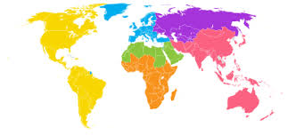
Worlds Largest non-formal education movement – serving 50 Million!

Slide 5
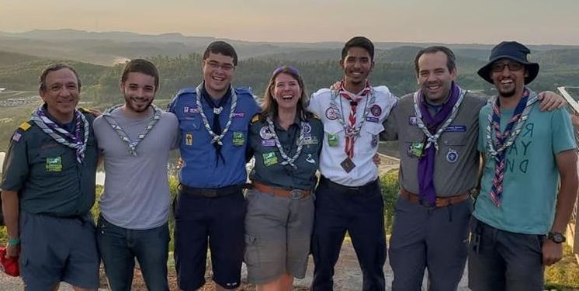
My why – what is yours?

Slide 6
Unit & Individual Involvement
World Events- Contingent or Staffing (IST)
  Jamborees – youth 14 up to 18 during event
  Moots – youth 18- 26 – Rover ages
  IST – 18+
Region Events – Contingent or Staffing (IST)
National Events – meet International Scouts – Jamboree 2021, VenturingFest 6/28- July 3rd
Youth – Youth Ambassador, Camp Staff, International Leadership Training
Council – International Camp Staff hosts, International Committee
Kandersteg - https://www.kisc.ch/ International Scout Center, Switzerland
World Scarf Day – August 1st.
JOTI/JOTA – now! 3rd full weekend in October yearly
Messengers of Peace projects - ongoing

Slide 7


Slide 8


Slide 9
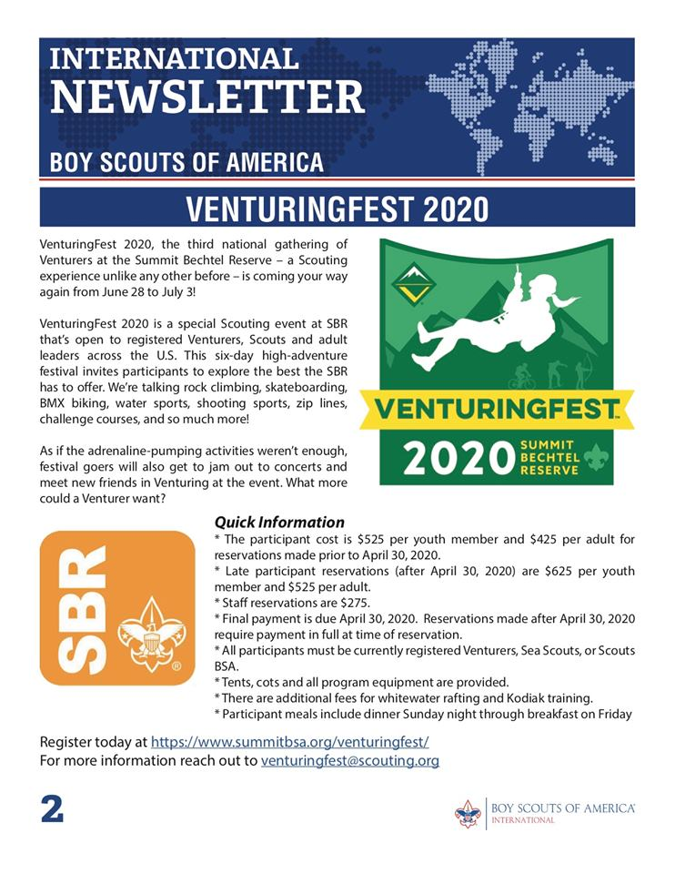

Slide 10
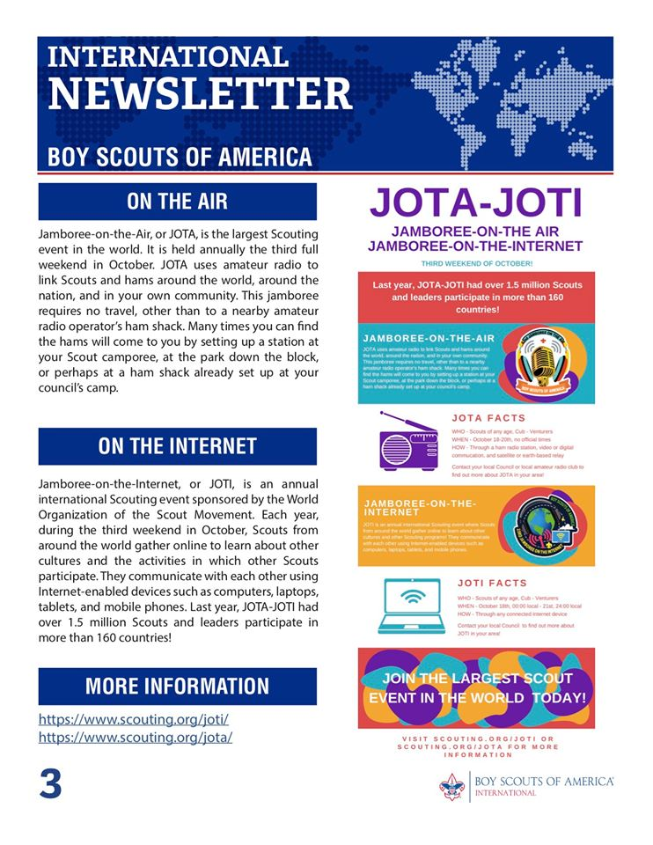

Slide 11


Slide 12
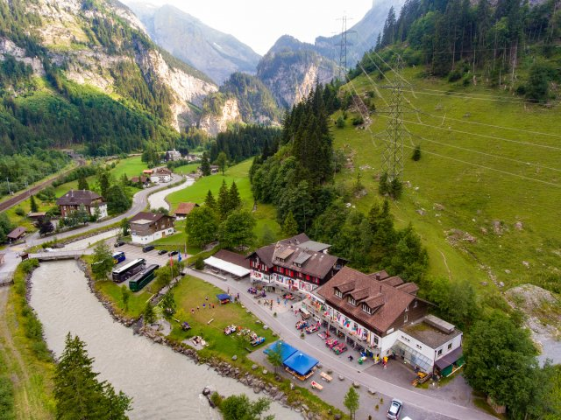
Kandersteg International Scout Center
https://www.kisc.ch/
*Stay as a unit *Stay as an individual
*Staff- Pinkies * Rover Week

Slide 13



Providing Scouting to those with few resources:
WOSM/World Scout Foundation
https://youtu.be/sXtFSnuKmsA
https://www.iscoutfoundation.org/en/ Order of the Condor
Scout Donation Platform https://donate.scout.org/
Bangledesh Scouts – street children..Ticket to Life

Slide 14
Resources to know:
Scouting.org/international – BSA international department website page
Scout.org - WOSM
International BSA -Facebook page, current updates
World Organization of the Scout Movement – WOSM – Facebook page, current
Kandersteg - https://www.kisc.ch/ International Scout Center, Switzerland

