Slide 1

Whittling Chip

Slide 2
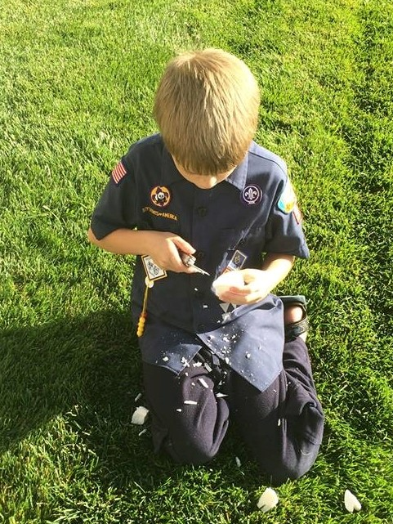
What is Whittling Chip
Certifies that the youth has earned the right to carry a pocket knife
    To designated Scouting functions
    By completing the requirements of the Whittling Chip

Slide 3

Guide to Safe Scouting
Tools | Tiger | Wolf | Bear | Webelo/AOL
Axes | No | No | No | No
Bow Saws | No | No | No | Yes
Hand Ax | No | No | No | No
Hand Tools | Yes | Yes | Yes | Yes
Pocket Knife | No | No | Yes | Yes
Notes:
Knives
A sharp pocketknife with a can opener on it is an invaluable backcountry tool. Keep it clean, sharp, and handy. The BSA believes choosing the right equipment for the job at hand is the best answer to the question of what specific knife should be used. We are aware that many councils or camps may have limits on the type or style of knife that should be used. The BSA neither encourages nor bans fixed-blade knives nor do we set a limit on blade length. Since its inception, the BSA has relied heavily on an outdoor program to achieve its objectives. This program meets more of the purposes of Scouting than any other single feature. We believe we have a duty to instill in our members, youth and adult, the knowledge of how to use, handle, and store legally owned knives with the highest concern for safety and responsibility.
Remember—knives are not allowed on school premises, nor can they be taken aboard commercial aircraft.

Slide 4
Where to Train Whittling Chip
Large enough to allow Safe Zones
Are Knives allowed?
Should be an area where other kids will not be playing
On a campout or at a Den Meeting

Slide 5
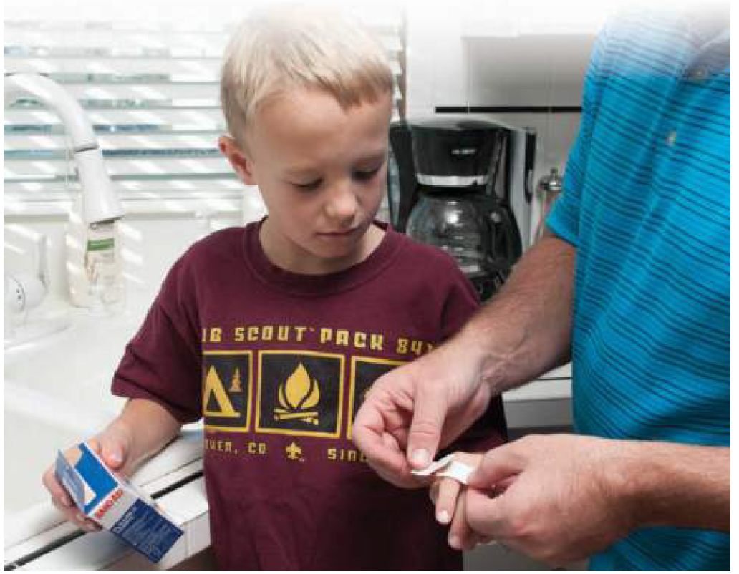
FIRST AID KIT
Plenty of Band-Aids
Most likely to occur when opening or closing the knife

Slide 6
EDGE Method
E – Explain
D – Demonstrate
G – Guide
E – Explain

Slide 7
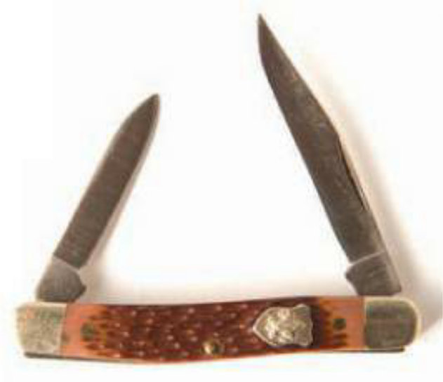
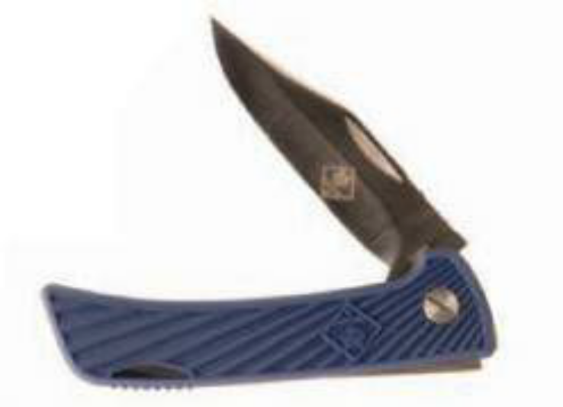
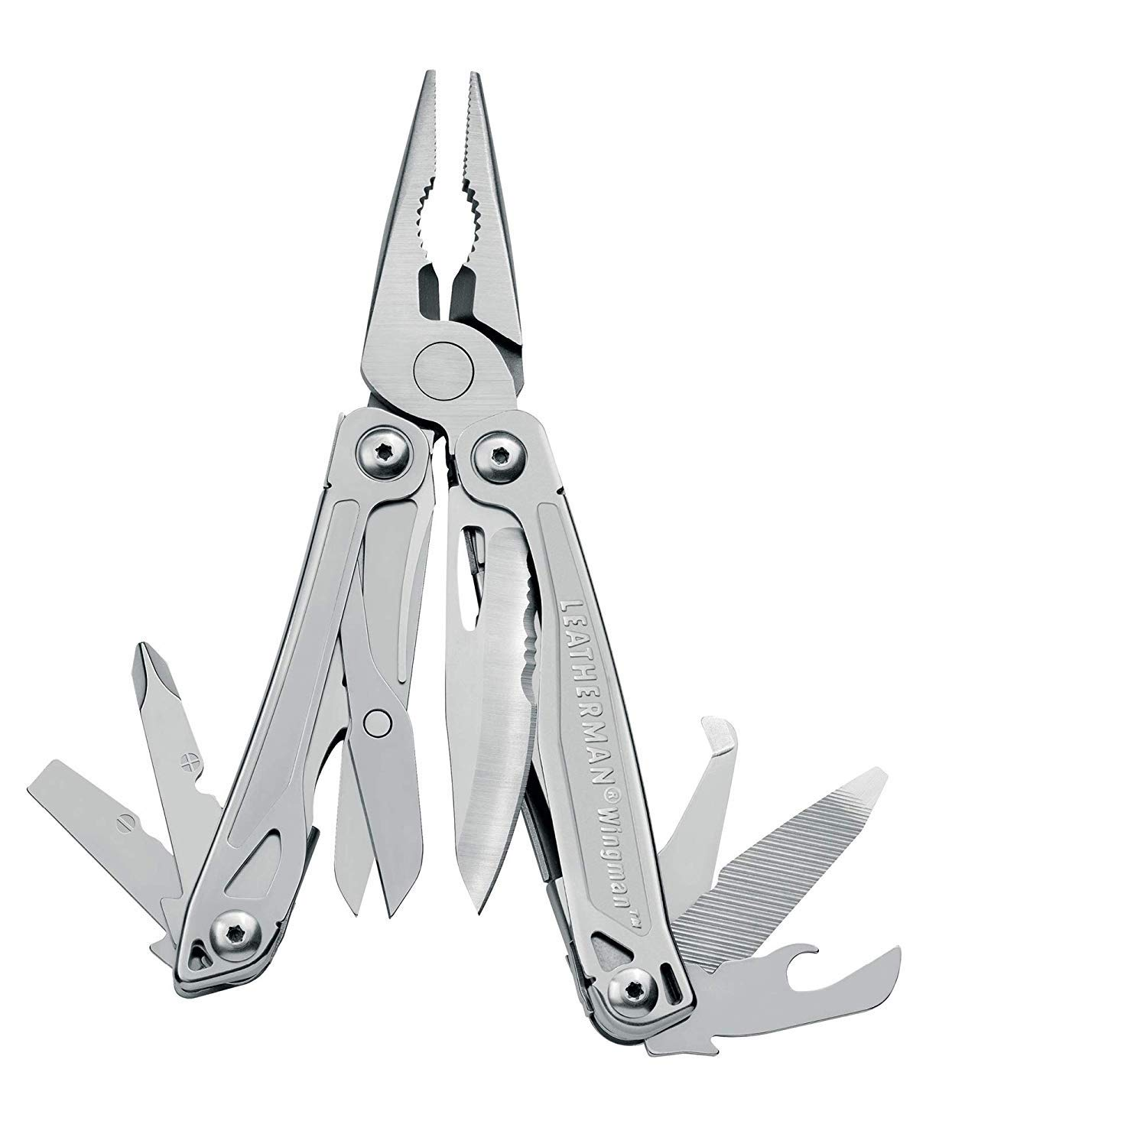
Types of Knives

Slide 8
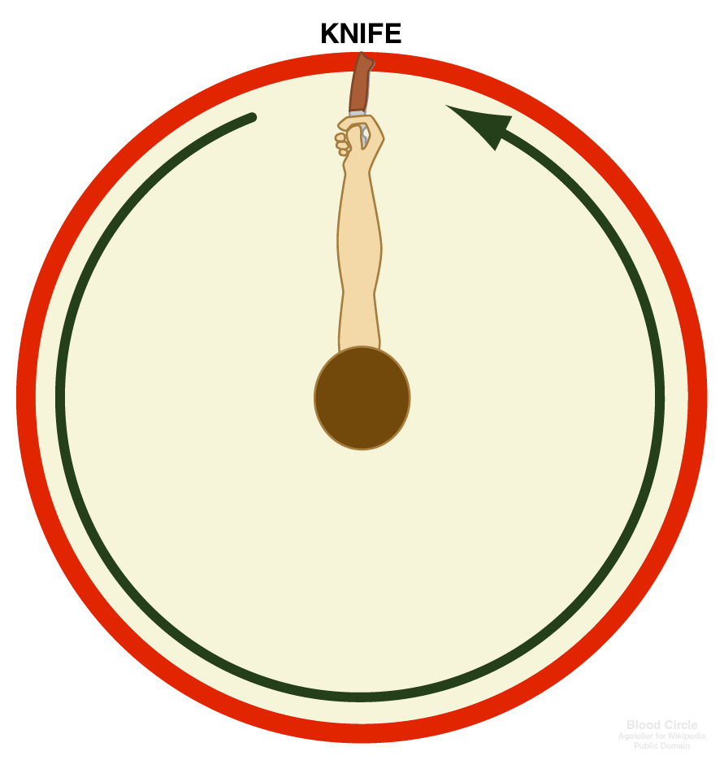
Knife Safety
Establish a “Safety Circle”
Knife in Hand, Turn in a Circle
If Knife Touches Anyone, You are Not Safe
Be Alert

Slide 9
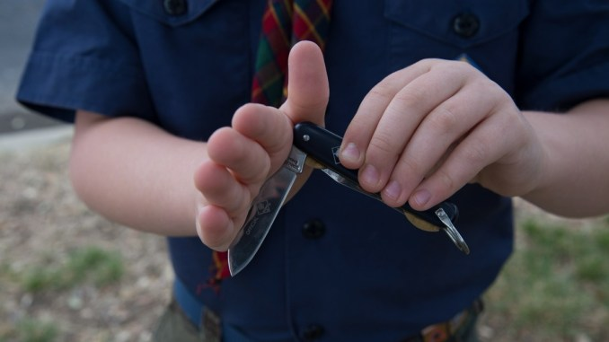
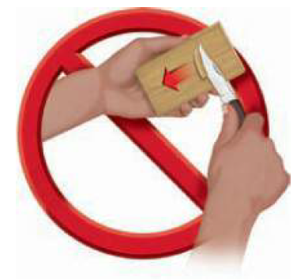
Knife Safety
Closing a Knife
  Use the Palm of your hand
  Be Careful with the Blade Lock
Always Cut with the Knive Away From You
Never Carry an Open Pocket Knife
Always Walk
Keep Your Knife Sharp
Make Small Shavings
Put Your Knife Away, Do Not Leave out

Slide 10
Caring for Your Knife
A knife is a tool, not a toy.
Never use your knife on something that will dull or break it - Never use your knife to cut living trees or plants, or poke it in the dirt. Moisture and dirt will ruin your knife.
Keep your knife out of the fire. The heat will ruin the temper of the steel making the knife-edge soft and useless.

Slide 11
Caring for Your Knife
Do not carve your initials into anything that does not belong to you
Keep your knife dry and keep the blade clean. Wipe the blade before closing it.
Clean your knife by hand; the heat and steam of the dishwasher can dull and damage the knife

Slide 12
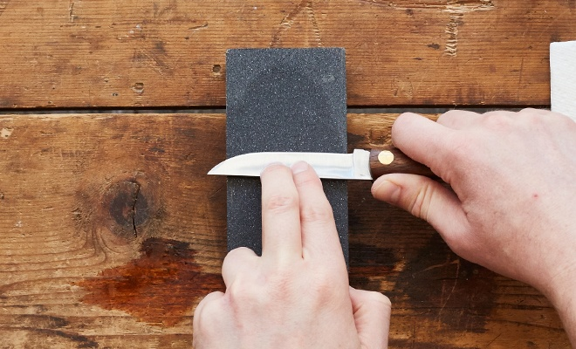
Sharpening A Kife

Slide 13
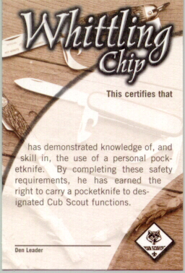
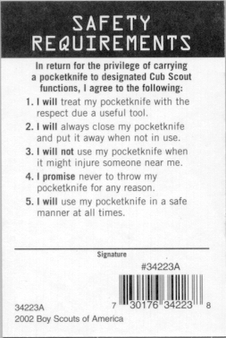
Whittling Chip Card
Notes:
This certifies that Scouty has demonstrated knowledge of , and skill in, the use of a personal pocket knife. By completing these safety requirements, he has earned the right to carry a pocketknife to designated Cub Scout functions
In return for the privelage of carrying a pocketknife to designated Cub Scout functions, I agree to the following
I Will treat my pocketknife with the respect due a useful tool
I Willl always close my pocketknife and put it away when not in use
I will not use my pocketknife when it might injure someone near me
I promise never to throw my pocketknife for any reason
I will use my pocketknife in a safe manner at all times

Slide 14
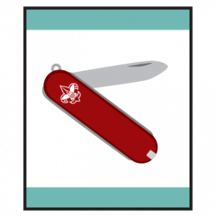
Bear Claws Adventure
Learn three Common Designs of Pocket Knives
Learn Knife Safety & Earn your Whittling Chip
Do one of the following
  Using a pocket knife, carve two items
  With a Pocket Knife safely perform each of these tasks
    Demonstrate how to cut a piece f rope, twine or fishing line;
    Open a sealed box without damaging the contents;
    Open a can with a can opener tool on a pocket knife;
    Remove and replace the screws on an object with the screw driver tool on a pocket knife;
    Open a letter.

Slide 15
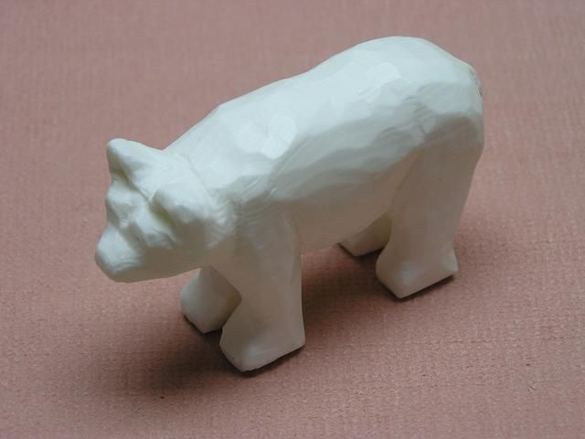
Carving
Ivory Soap Bars
Stencils
Wood Sticks to Carve

Slide 16
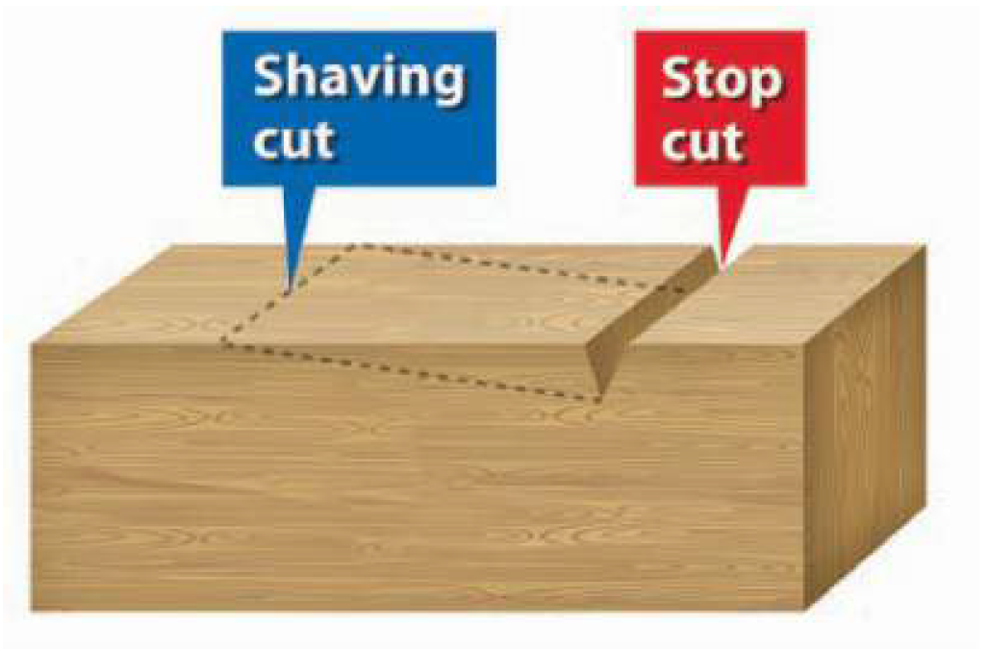
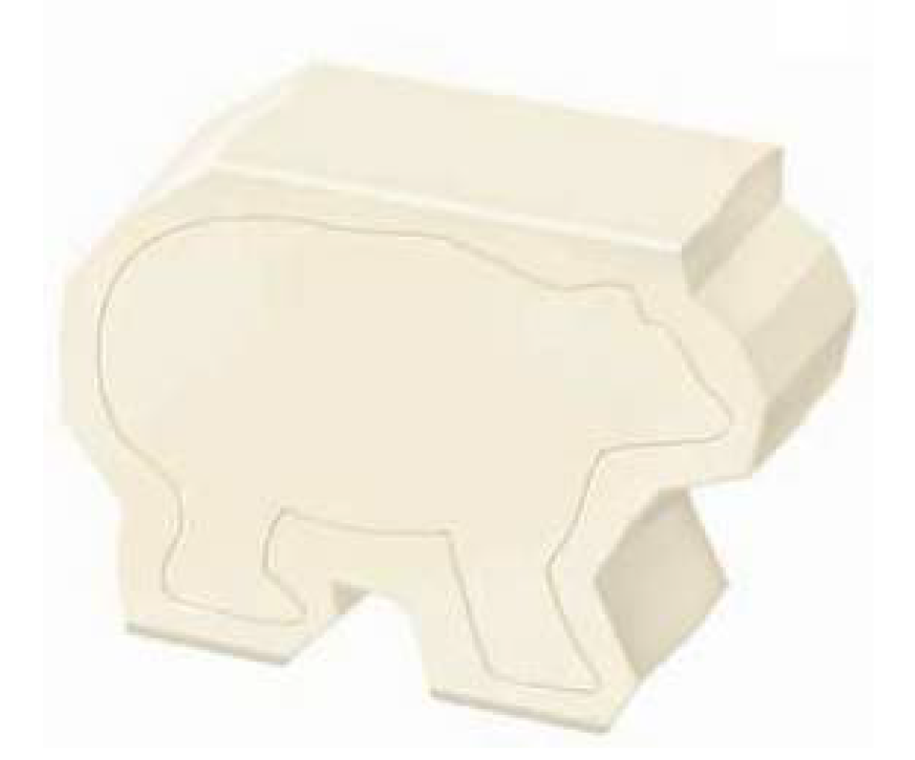
Using the Stop Cut

Slide 17
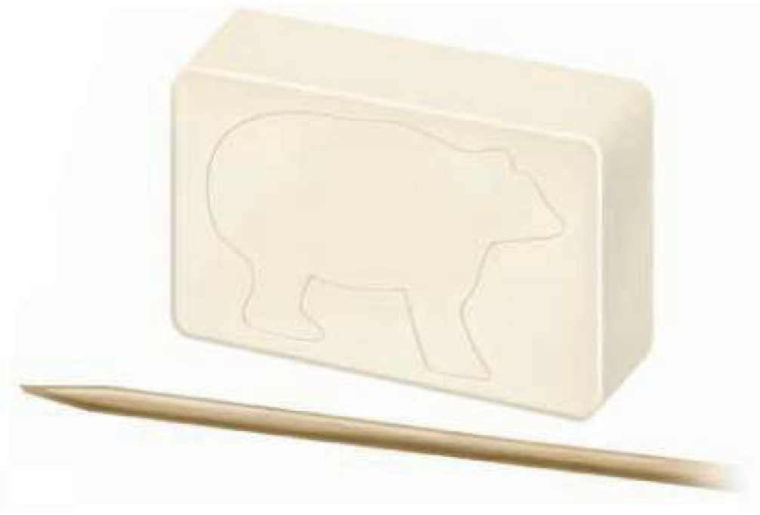
Trace Your Design on the Soap

Slide 18
