Slide 1
Teaching Internet Safety for Scouts
The BSA’s “Cyber Chip” program for Scouts Grades 1-12
Notes:
‹#›

Slide 2
Who am I and why am I standing up here?
Scouter for 7 Years
Father of 3, Ages 14, 11 and 11
IT/Tech Worker
Not a Security Expert or a Child Development/Safety Expert
Candor Disclaimer
Opinion Disclaimer
‹#›

Slide 3
Science Fiction ROCKS
What Sci-Fi Got RIGHT
  SPACE TRAVEL
  TELEVISION
  CREDIT CARDS
  CELL PHONES
  SKYPE
What Sci-Fi MOSTLY Got Right
  COMPUTERS
  INTERNET
  WORLD WIDE WEB
‹#›

Slide 4
Science Fiction MISSED STUFF
What Sci-Fi Mostly MISSED
  SPAM
  SCAMS
  EBAY
  AMAZON
  TWITTER
  YOUTUBE
  FACEBOOK
  BAD APPS
  CYBERBULLYING
  TROLLS
‹#›

Slide 5
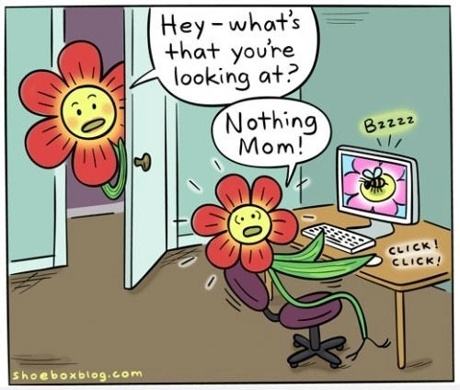
Science Fiction MISSED STUFF
  And Especially:
  Rule 34
‹#›

Slide 6
Complexity³
The complexity of the environment our kids need to learn to navigate has increased exponentially.
‹#›

Slide 7
Near-Instant Access to
  Every Picture
  Every Movie
  Every Song
  Every Book
  Every Game
  Every Store
  Billions of People
  Billions of People!
‹#›

Slide 8
Kids Face New Risks
Free Range Kids Disclaimer
Lots of Online Fear Mongering
BUT:
1 in 7 kids will receive an unwanted sexual solicitation online
Kids who engage in risky online behaviors are at higher risk of solicitations:
  posting personal information
  interacting with strangers online
  accepting “friend” invitations from strangers
65% of online sexual offenders use social networking sites to gather personal information i.e. school and home information
‹#›

Slide 9
Scouting Needs to Teach Kids New Skills
How to Navigate Online
find information
recognize unreliable content
recognize inappropriate content
seek “trusted adult” help
How to Protect Themselves Online
protect personal information
avoid/report predators
How to Behave Online
show good “netiquette”
discourage/report inappropriate behavior
discourage/report abuse or bullying
‹#›

Slide 10
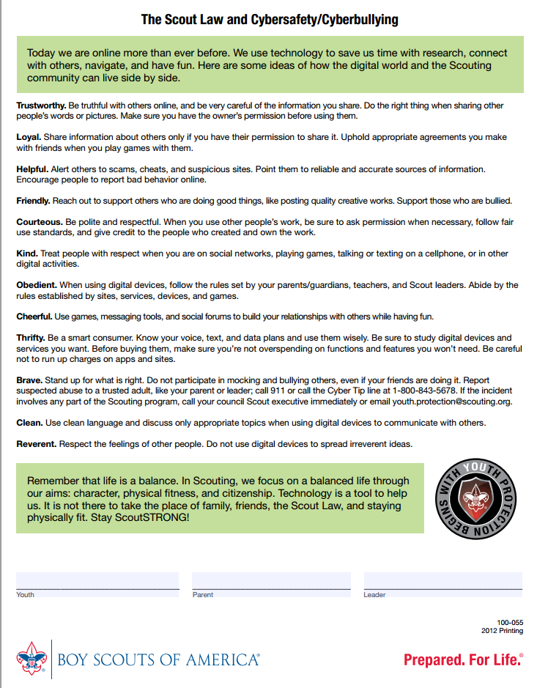
The Online Scout Law
‹#›

Slide 11
The BSA’s Cyber Chip
      Developed in Partnership with Netsmartz (Center for Missing & Exploited Children)
      Teaches Appropriate Online Behavior and Safety From Tiger Cub to Eagle Scout:
Grades 1-3
Grades 4-5
Grades 6-8
Grades 9-12
Increasing Level of Depth/Complexity
Annual Refreshers
‹#›

Slide 12
The BSA’s Cyber Chip
Tigers, Wolves and Bears:
Level I Internet Safety Pledge
Netiquette Video Online
Online Game/Quiz
Re-tell What They’ve Learned
‹#›

Slide 13
The BSA’s Cyber Chip
Webelos I & II:
Level I Internet Safety Pledge
Online Security Videos
Re-teach What They’ve Learned
Discuss w/Unit Leader: Appropriate Use of Devices
‹#›

Slide 14
The BSA’s Cyber Chip
Boy Scouts Grades 6-8:
Level II Internet Safety Pledge
Appropriate Use Agreement w/Parents
Online Friend Video and Two Others
Teach What They’ve Learned (EDGE)
Discuss w/Unit Leader: Appropriate Use of Devices
‹#›

Slide 15
The BSA’s Cyber Chip
EDGE: Four Step Method for Teaching a Skill:
Explain
Demonstrate
Guide
Enable
‹#›

Slide 16
The BSA’s Cyber Chip
Boy Scouts Grades 9-12:
Level II Internet Safety Pledge
Appropriate Use Agreement w/Parents
Discuss w/Parents Benefits & Risks of Social Media
Three Online Videos: Impact of Social Media Sites
Teach What They’ve Learned (EDGE)
Discuss w/Unit Leader: Appropriate Use of Devices
‹#›

Slide 17
Cub Scouts: Tigers, Wolves and Bears
Internet Safety Pledge:
I will tell my trusted adult if anything makes me feel sad, scared, or confused.
I will ask my trusted adult before sharing information like my name, address, and phone number.
I won't meet face-to-face with anyone from the Internet.
I will always use good netiquette and not be rude or mean online.
‹#›

Slide 18
Cub Scouts: Tigers, Wolves and Bears
Online “Netiquette” Video
Bad Netiquette Stinks
7 minutes
‹#›

Slide 19
Cub Scouts: Tigers, Wolves and Bears
Online Game / Quiz / Certificate
Router's Birthday Surprise
Cubs Must Complete the Game/Quiz
Print the Certificate
Adults can log in as “teacher” and navigate the map/game as they wish.
“Educator’s Guide” tab also has helpful information
‹#›

Slide 20
Cub Scouts: Tigers, Wolves and Bears
Retell What They’ve Learned
“Show and tell your family, den leader, den, or pack what you have learned.”
‹#›

Slide 21
Cub Scouts: Webelos
Same Internet Safety Pledge
Online Video: Good Password Practices
and one “elective” (video of their choice)
Demonstrate Internet Safety Principles to their Den Leader, Den or Pack using a “Teachable Recipe” (can be done solo or as a Den)
Discuss w/Unit Leader: Appropriate Use of Devices
‹#›

Slide 22
The BSA’s Cyber Chip
Boy Scouts Grades 6-8:
Level II Internet Safety Pledge
Appropriate Use Agreement w/Parents
Online Friend Video and Two Others
Teach What They’ve Learned (EDGE)
Discuss w/Unit Leader: Appropriate Use of Devices
‹#›

Slide 23
The BSA’s Cyber Chip
Boy Scouts Grades 9-12:
Level II Internet Safety Pledge
Appropriate Use Agreement w/Parents
Discuss w/Parents Benefits & Risks of Social Media
Three Online Videos: Impact of Social Media Sites
Teach What They’ve Learned (EDGE)
Discuss w/Unit Leader: Appropriate Use of Devices
‹#›

Slide 24
In a Nutshell
Kids Face New Challenges
We Need to Adapt Our Programs to Give Them the Skills They Need
The New Cyber Chip Programs Cover a Lot of Ground
‹#›

Slide 25
My Own Opinion
What Cyber Chip Misses:
Incomplete: Lots more information at netsmartz.org
Fluffy: More Candid Options Are Out There
Changing Security Risks i.e. Nickname Quizzes
Question All Information (snopes.com)
Great General Media Ratings at commonsensemedia.org
‹#›

Slide 26
QUESTIONS?

Slide 27
Links
  BSA Cyber Chip
  http://www.scouting.org/cyberchip.aspx
  NetSmartz Scouting
  http://www.netsmartz.org/scouting
  Common Sense Media
  https://www.commonsensemedia.org/
  Jo Langford / Be Heroes
  http://www.beheroes.net/
  National Sex Offender Public Website, Facts and Statistics
  https://www.nsopw.gov/en/Education/FactsStatistics#technology
‹#›

Slide 28
Class Evaluation
  Evaluate this class at:
  http://seaptc.org/eval
  Session code: 1977
‹#›

