Slide 1

“be prepared” with scout knots
2019 Chief Seattle PTC
October 19, 2019
Session 416: Intermediate Scout Knots
Beth Carter, Nick Carter, Nick Heaton

Slide 2
Every scout should be prepared
Each year in this class, we create practical objects appropriate to Scouting that transform very quickly to a length of rope. This year’s project is a chain sinnet bracelet that transforms into a pair of 7 foot paracord ropes.
A sinnet is a type of knot that allows for compact storage of a rope without a lot of tangling. Fortunately, many chain stitches are also attractive!

Slide 3
A bracelet isn’t very long
Making the bracelet will teach you how to work the knot. You’ll see it’s easy to apply this knot to larger projects if you want to be prepared with a longer rope.
Plan on one foot of rope, two ropes, for each inch of project. Then add one foot to each rope for starting and finishing.
Example: if you want to make a 15-inch hatband, plan on 2 ropes, 15 feet each, for the knotting, and add 1 foot for finishing. So, you’ll need 2 ropes, each 16 feet long.
You could make:
A belt
A lanyard to substitute for a neckerchief
A carrying strap

Slide 4
references
Some great resources for anything you want to know about knots are:
The International Guild of Knot Tyers (IGKT) at IGKT.net
Ashley’s Book of Knots, a well recognized reference book
Tying It All Together (TIAT), on YouTube, by JD Lenzen
Resources from the Scout Shop
The chain sinnet in this project is called “Idiot’s Delight” in Ashley(because it’s easy for anyone to learn …). The bracelet uses two cords to make it a 2-color project.
TIAT refers to this knot as a Thick Zippered Sennit. There is a video demo that is easy to follow.
You’ll also use a Carrick Bend and a Button Knot in this project. Both are common and historical knots. There are numerous videos of both knots available.

Slide 5
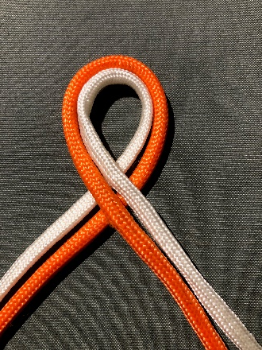
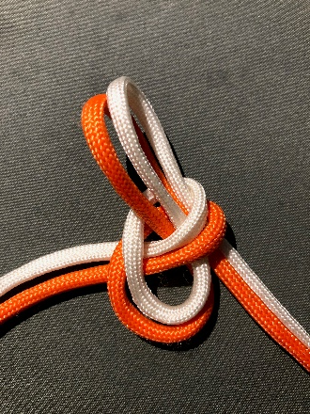
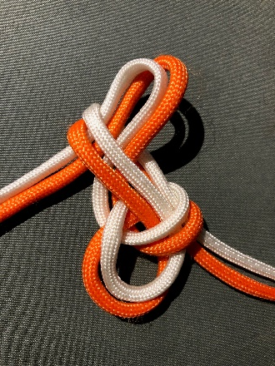
First steps: The setup
Pull the right leads up through this loop:
Pull the left leads up through the last loop:
Make a loop in the middle of the cords

Slide 6
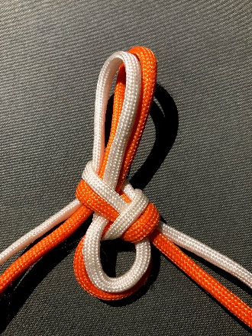
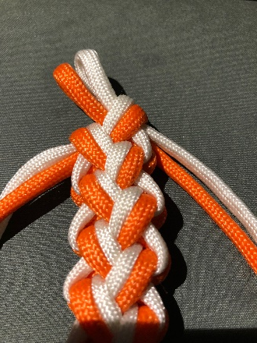
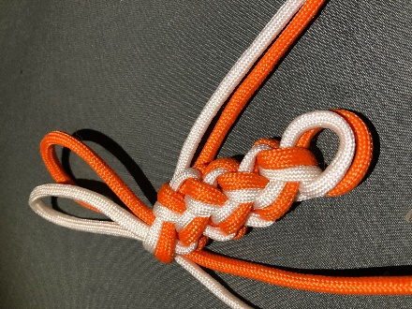
Work the length you need
Tighten the loops, keeping ½ inch at bottom
Use the leads on the right to make the next loop:
Then the leads on the left for the next loop. Alternate to length …

Slide 7
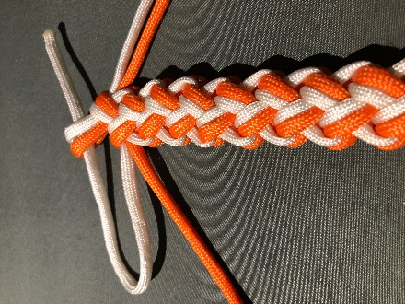
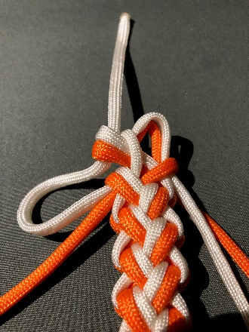
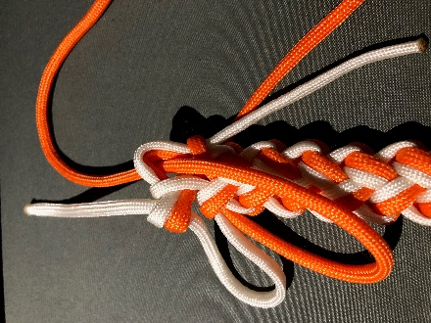
At the end of the bar …
Pull the upper left lead through the final loop
Spread the 2 cords holding the last loop. Pull cords through:
Pull the lower left lead through the bump you just made:

Slide 8
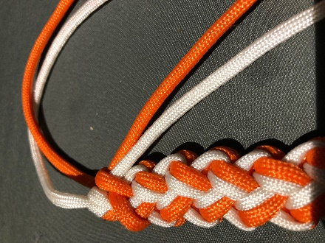
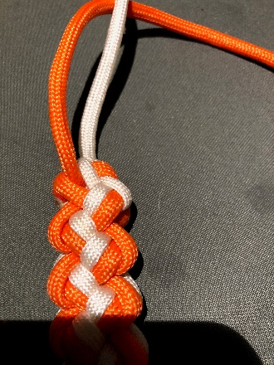
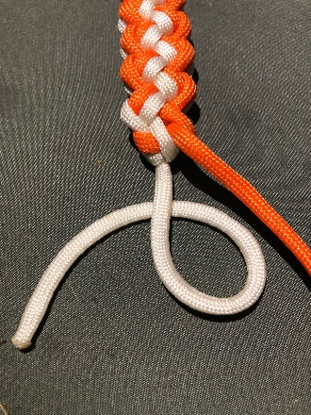
Finishing the bar …
Pull the right leads tight, trim and melt ends
Pull the remaining leads snugly:
To prepare for the button knot, turn work upside down:

Slide 9
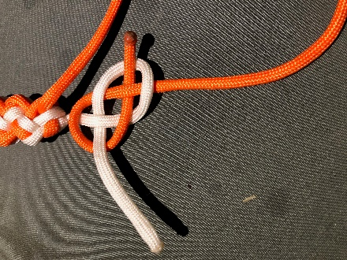
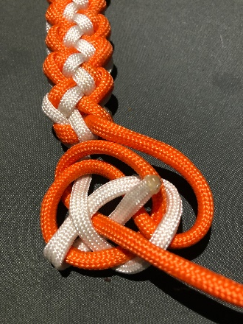
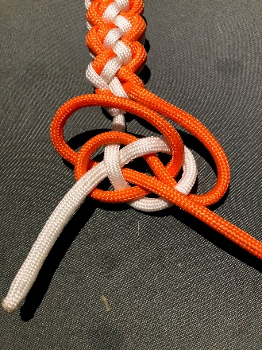
Making the button knot …
Carrick bend: make a p with left lead. Right goes under, over, behind and through the p:
Wrap the right lead up, around and behind the bend, then up through the center:
Wrap the left lead down, around and behind the bend, then up through the center:

Slide 10
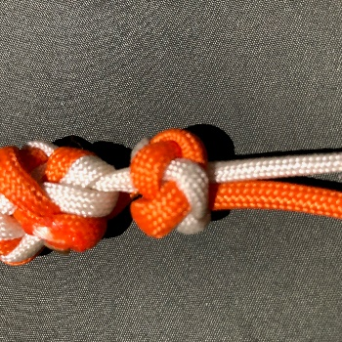
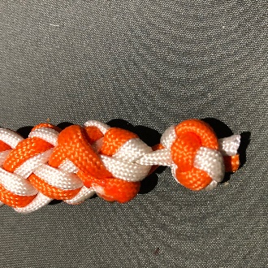
Making the button knot …
Gently pull the center leads, the bend will reshape into a button knot. Gently adjust the cords to make the knot neat:
Make sure the knot fits through the loop at the beginning of the bracelet. Adjust if needed.
Trim the ends and melt them to secure the button knot.
You’re done!

Slide 11
Get your Patch … tell us how we did!!
Please complete your session evaluation:
  It’s online …Go to seaptc.org
  Click “Class Evaluation”
  You’ll need the evaluation code for each session (on class sticker)
  This is Session 416, evaluation code 5965
  You’ll also need the identification number printed on your badge
  Fill out each evaluation as you complete each session
  Show your final session instructor the confirmation page on your mobile device to receive …
  THE PATCH … tada!
  Thanks for coming to PTC 2019!!!!

