Slide 1

Trail to Eagle
Chief Seattle Council
Program & Training Conference
October 19, 2019
Rod Gowdy, Council Advancement Chair
rodgowdy@msn.com

Slide 2
Trail to Eagle PTC Class
Session 1: Eagle Project Workbook
Session 2: Eagle Rank Application

Slide 3
You can download a copy of this presentation (and all PTC presentations) from www.seattlebsa.org/ptc
No need to write copious notes!
Except this web address ;)

Slide 4
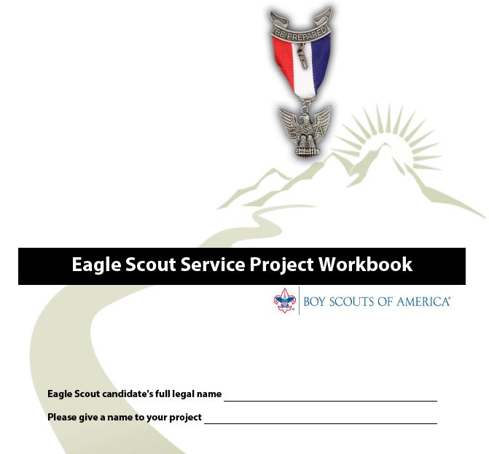
Current Edition: January, 2019
Download from Scouting.org!

Slide 5
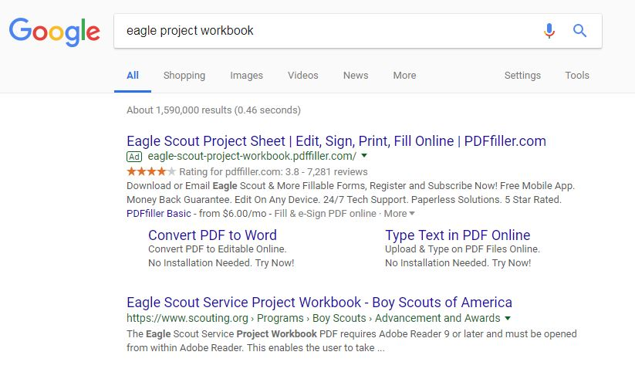
Use of third party services to fill out the PDF is not recommended. Will lead to unnecessary frustration and money spent!
No!
Yes!

Slide 6
Eagle Scout Requirement No. 5
While a Life Scout, plan, develop, and give leadership to others in a service project helpful to any religious institution, any school, or your community.

Slide 7
What types of projects are acceptable for Eagle Scout Service Projects?
Permanent improvements (construction, painting, etc)
Drives (food drives, clothing drives, hygiene drives, blood drives, etc.)
Park services (removing invasive species, new plants, etc)
Anything that benefits the community!

Slide 8
The project must benefit an organization other than Boy Scouting
Your project must be for any religious institution, any school, or your community. It is important to note, however, that the BSA has defined “your community” to include the “community of the world.”

Slide 9
• Routine labor is not normally appropriate for a project. This might be defined as a job or service you may provide as part of your daily life, or a routine maintenance job normally done by the beneficiary (for example, pulling weeds on the football field at your school).
• While projects may not be of a commercial nature or for a business, this is not meant to disallow work for community institutions, such as museums and service agencies (like homes for the elderly, for example), that would otherwise be acceptable. Some aspect of a business operation provided as a community service may also be considered; for example, a park open to the public that happens to be owned by a business, but primarily benefits the community.
• A project may not be a fundraiser. In other words, it may not be an effort that primarily collects money, even for a worthy charity. Fundraising is permitted only for securing materials and facilitating a project, and it may need to be approved by your council. See “Eagle Scout Service Project Fundraising Application” later in this workbook.

Slide 10
Are these acceptable Eagle Scout Service projects?
Building a wheel chair ramp for an elderly couple?
Collecting & retiring US flags?
Raising money to give to the local food bank?
Improving a park owned by a business?
Painting a shed for the local church?

Slide 11
There are three parts to the Eagle Project Workbook:
Proposal
Plan
Report

Slide 12
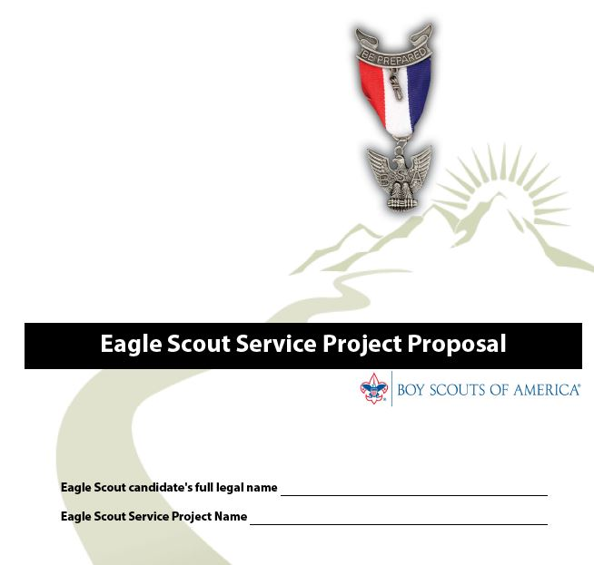

Slide 13
“Proposal Must Be Approved …Before You Start”
The Five Tests of an Acceptable Eagle Scout Service Project. The proposal is an overview, but also the beginnings of planning. It shows the unit leader and any representatives of a unit committee, council, or district, that the following tests can be met.
1.The project provides sufficient opportunity to meet the requirement.
2. The project appears to be feasible.
3. Safety issues will be addressed.
4. Action steps for further detailed planning are included.
5. The young man is on the right track with a reasonable chance for a positive experience.

Slide 14
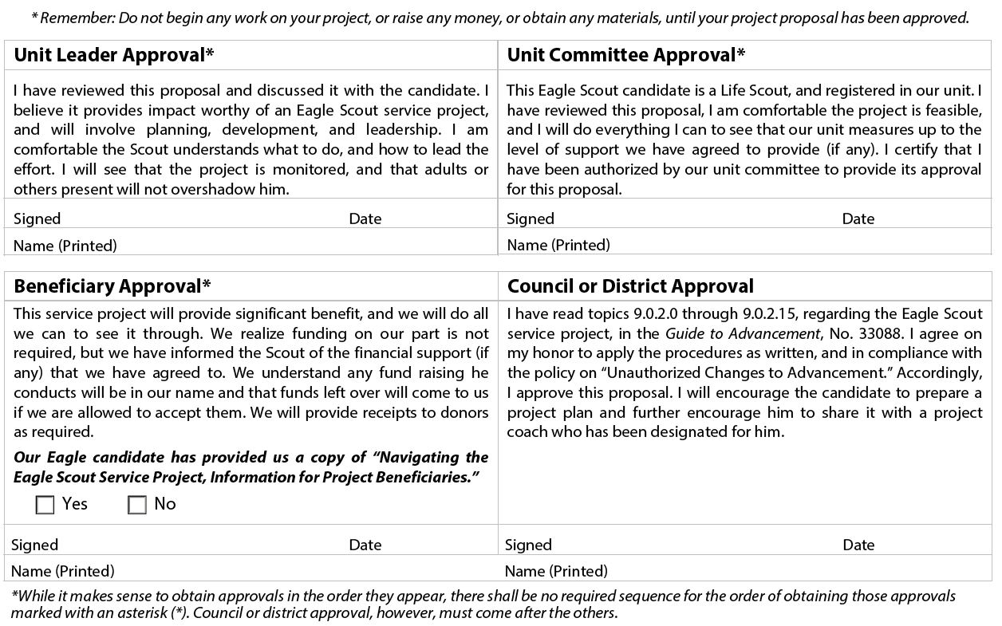

Slide 15
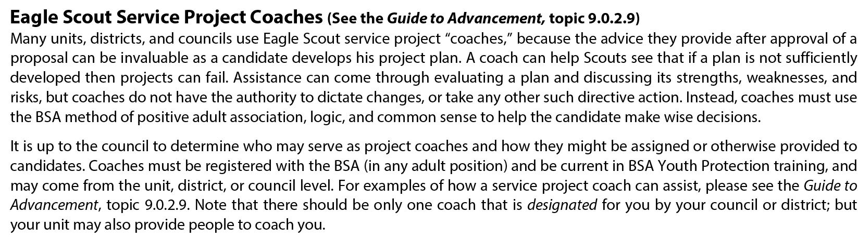
Not a requirement to use an
“Eagle Project Coach”.

Slide 16
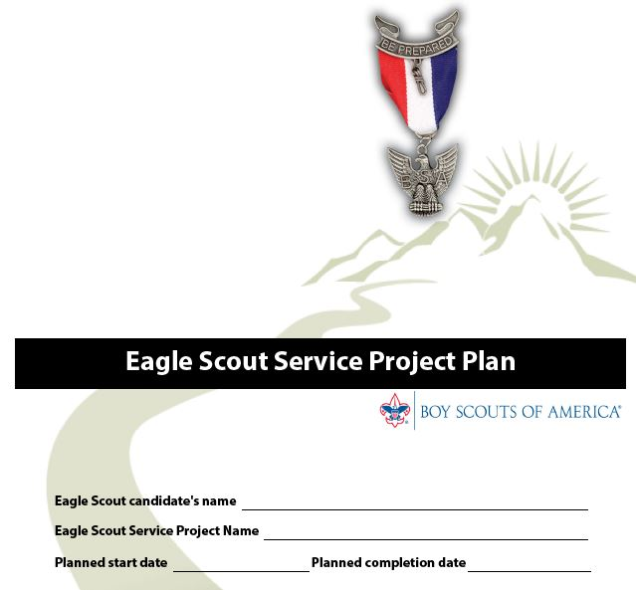

Slide 17
The “Plan” is completed and shared with the Beneficiary before work on the Project begins.
*The Plan is not approved by the District, Troop, etc.

Slide 18
Eagle Scout Service Project Fundraising Application
(completed as part of the “Plan”
Eagle Scout Service Project Fundraising Application must be used in obtaining approval for service project fundraising of monies and for in-kind donations of materials, supplies, tools, or other needs.*
*No application needed for donations from the Unit, Chartered Organization, or friends and relatives.
*In Chief Seattle Council, no application required to solicit up to $500 in material from local stores (lumber, food, toiletries, etc.)

Slide 19
9.0.2.14 Risk Management and Eagle Scout
Service Projects
All Eagle Scout service projects constitute official Scouting
activity and thus are subject to Boy Scouts of America
policies and procedures. Projects are considered part
of a unit’s program and are treated as such with regard
to policies, procedures, and requirements regarding
Youth Protection, two-deep leadership, etc.

Slide 20
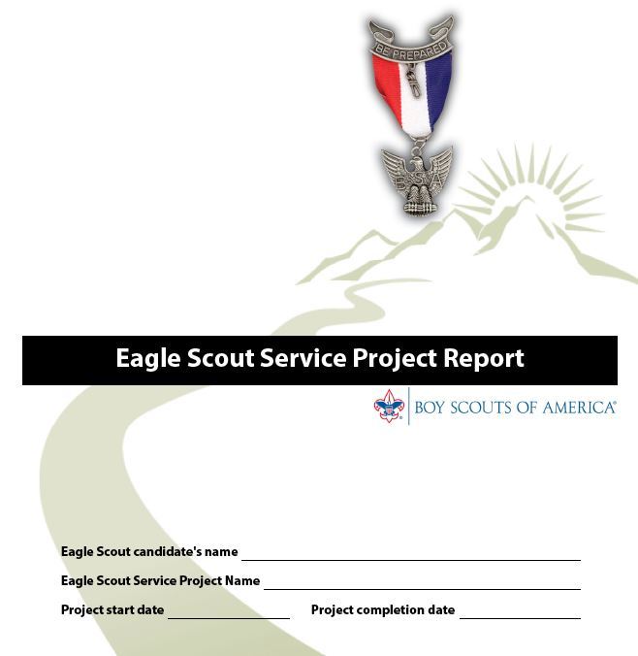

Slide 21
The “Report” is filled out after the project is completed.
Approval from Scoutmaster and Beneficiary required.

Slide 22
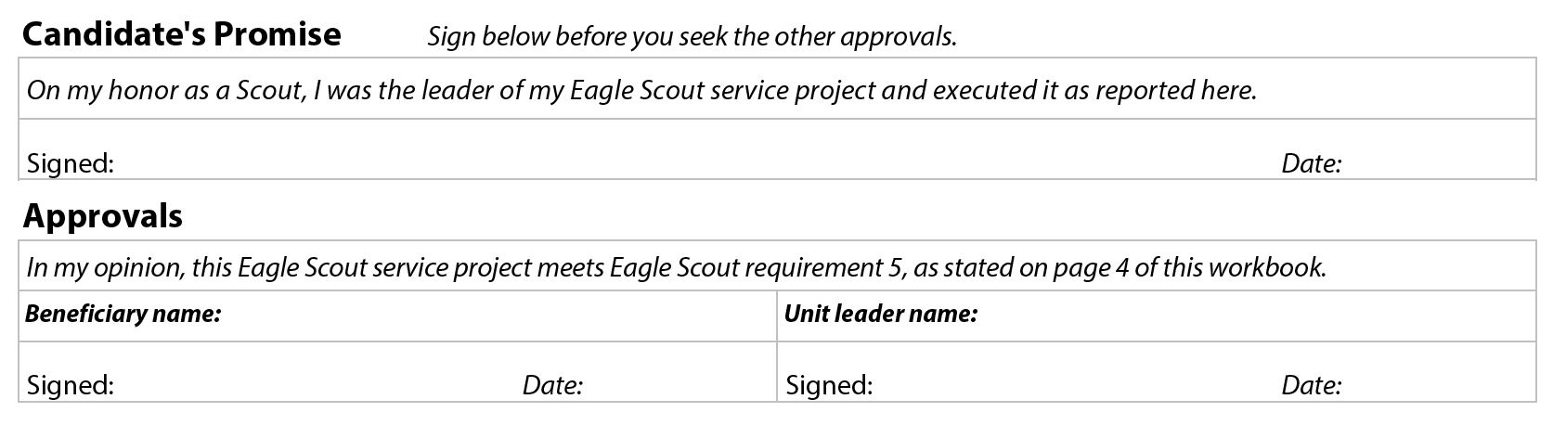

Slide 23
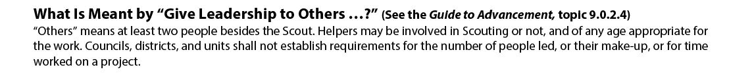
Leadership
“Others” means at least two people besides the Scout.

Slide 24
Evaluating the Project After Completion (See the Guide to Advancement, topic 9.0.2.13)
Eagle Scout projects must be evaluated primarily on impact—the extent of benefit to the religious institution, school, or community, and on the leadership provided by the candidate. There must also be evidence of planning and development. This is not only part of the requirement, but relates to our motto to, “Be Prepared.” However, in determining if a project meets requirement 5, reviewers must not require more planning and development than necessary to execute the project. These elements must not overshadow the project itself, as long as the effort was well led, and resulted in an otherwise worthy outcome acceptable to the beneficiary.

Slide 25
Why do adults always have the desire to add requirements?
Their own experience completing the requirements as a youth?
“Super Eagles”
Other?

Slide 26
This concludes Session 1.
To record your evaluation and attendance from a mobile device, go to https://seaptc.org and click "Class Evaluation.“
The evaluation code for this session is 2017.

Slide 27
Trail to Eagle PTC Class
Session 2: Eagle Rank Application

Slide 28

Current Edition: January, 2019
Download from Scouting.org!

Slide 29
Special Request from Mary Compton
Lead Registrar, Chief Seattle Council:
Please make sure your printing is legible!
Preferable to use the computer to fill out the application.

Slide 30
These must be completed before the scout’s 18th birthday.
Be active in your troop, team, crew, or ship for a period of at least six months after you have achieved the rank of Life Scout.
Demonstrate that you live by the principles of the Scout Oath and Scout Law in your daily life.
Earn a total of 21 merit badges
While a Life Scout, serve actively in your unit for a period of six months in one or more positions of responsibility.
While a Life Scout, plan, develop, and give leadership to others in a service project helpful to any religious institution, any school, or your community.
While a Life Scout, participate in a unit leader conference.

Slide 31
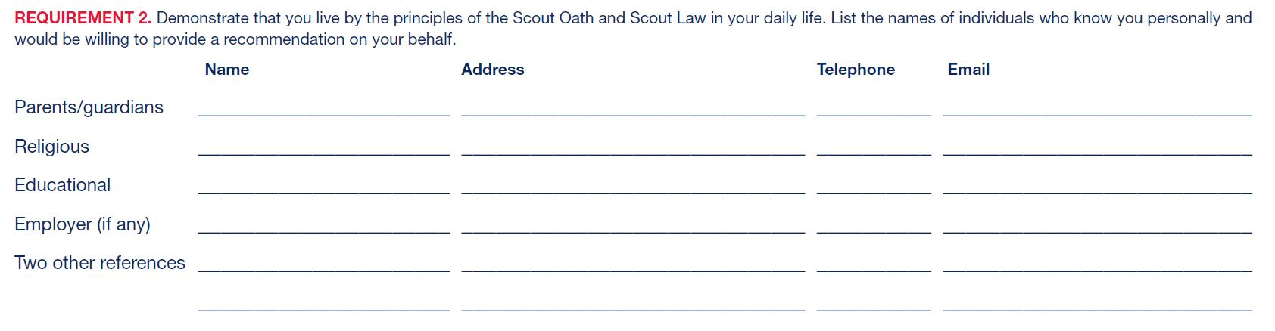
These people will be asked by the scout to write a “Letter of Recommendation”.

Slide 32
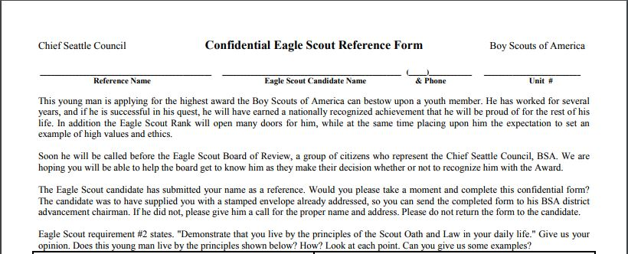
Chief Seattle Council uses this form for recommendations.
Download from SeattleBSA.org

Slide 33
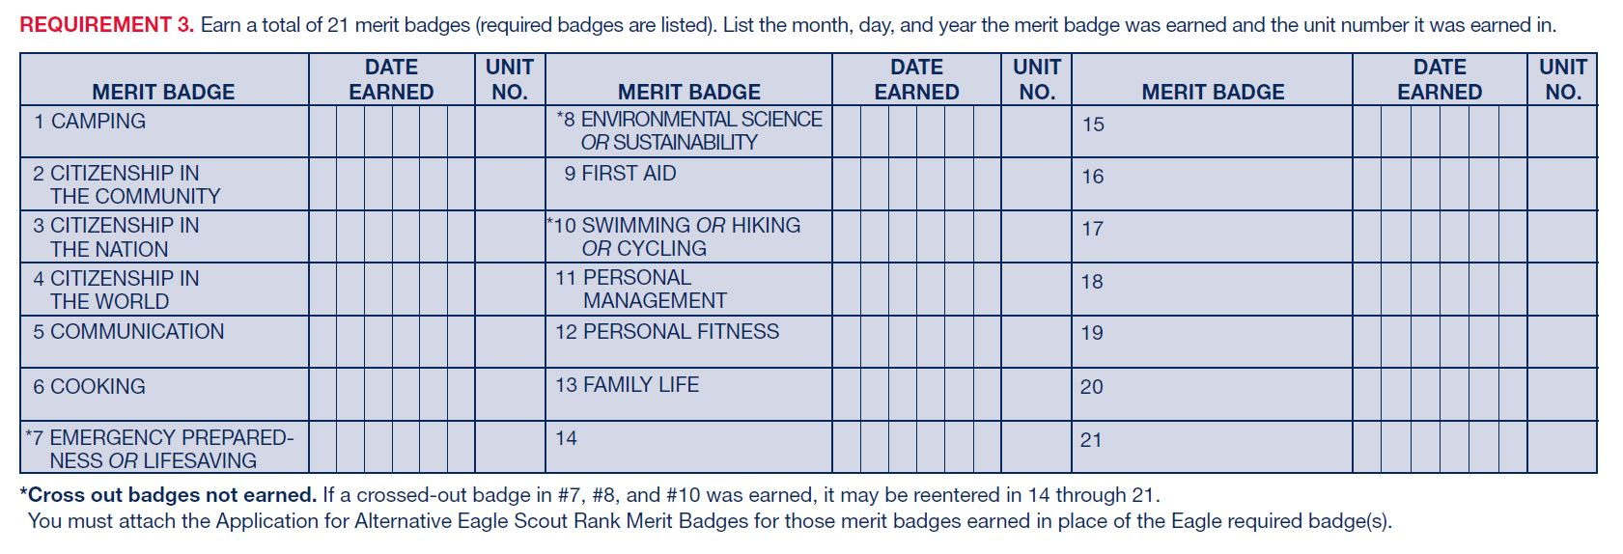
Enter dates merit badges completed.

Slide 34
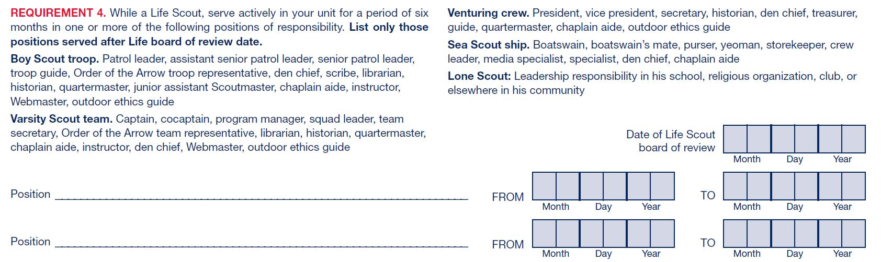
The “Position of Responsibility” dates are entered here. Six months minimum.

Slide 35
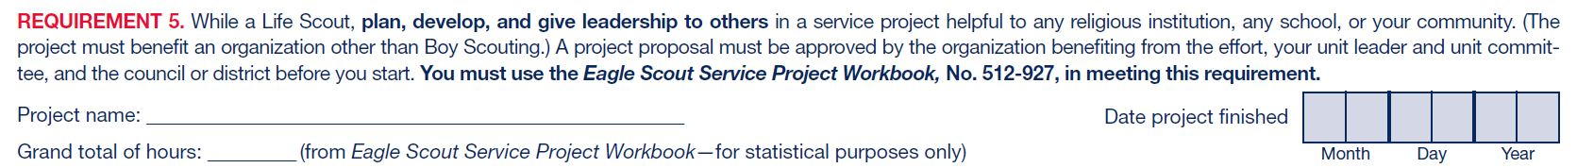
Details of the Eagle Project are entered here.

Slide 36
This is the date of the “Scoutmaster Conference”
This form is really easy to fill out!

Slide 37
The “Personal Statement”
In preparation for your board of review, prepare and attach to your Eagle Scout Rank Application a statement of your ambitions and life purpose and a listing of positions held in your religious institution, school, camp, community, or other organizations, during which you demonstrated leadership skills. Include honors and awards received during this service.

Slide 38
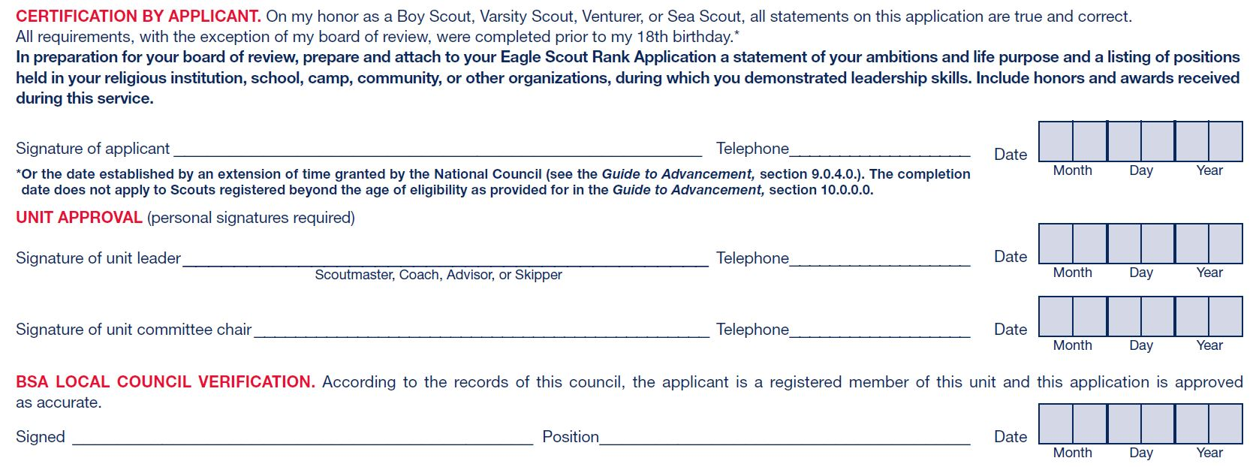
After the Scout, Scoutmaster, and Committee Chair signs the application, email it to the Council office.

Slide 39
The Eagle Rank application should be submitted to the Council office within 2 weeks after the 18th birthday at the latest.

Slide 40
After the Council verification, the Eagle Rank Application is forwarded to the appropriate District representative.

Slide 41
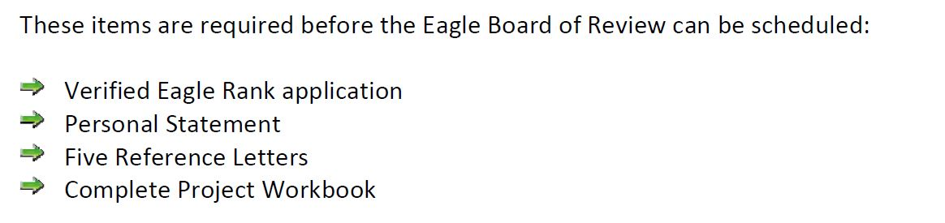

Slide 42
Successfully complete an Eagle Scout board of review!
This must be completed within 3 months after the scout’s 18th birthday.
Council approval required for boards of review held within 3 – 6 months after the 18th birthday.
National approval required for boards of review held beyond 6 months after the 18th birthday.
[This is a big deal]

Slide 43
There are 9 Districts in the Chief Seattle Council. Each District has specific methods to process the paperwork and schedule the Board of Review.
Contact your District Advancement Chair for their “Trail to Eagle” process.
District contacts are located here:
www.seattlebsa.org/eagle-scout-advancement
(this web page needs updated)

Slide 44
Current District Advancement Chairs:
Alpine District
Contact: David Clemens davidpclemens@comcast.net
Aquila District
Contact: Shelly Johnston csjohnston@comcast.net
Aurora District
Contact: Rod Gowdy rodgowdy@msn.com
Kitsap District (formerly Orca & Sinclair)
Contact: Sherry Bougan sherry.bougan@gmail.com
Mt. Olympus District
Contact: Jim Sherwood sherwohj@gmail.com
Mt. Tahoma District (formerly Green River & Foothills)
Contact: Perry Faulk ptfaulk@comcast.net
Northern Trails (formerly North Lakes & Sammamish Trails)
Contact: Mike Ocheltree mocheltree49@gmail.com
South District (formerly Cascade & Sammamish Trails)
Contact: Jacqui Orgovan jacquiorgovan@comcast.net
Thunderbird District
Contact: Gregory Bellinger gregory.john@outlook.com

Slide 45
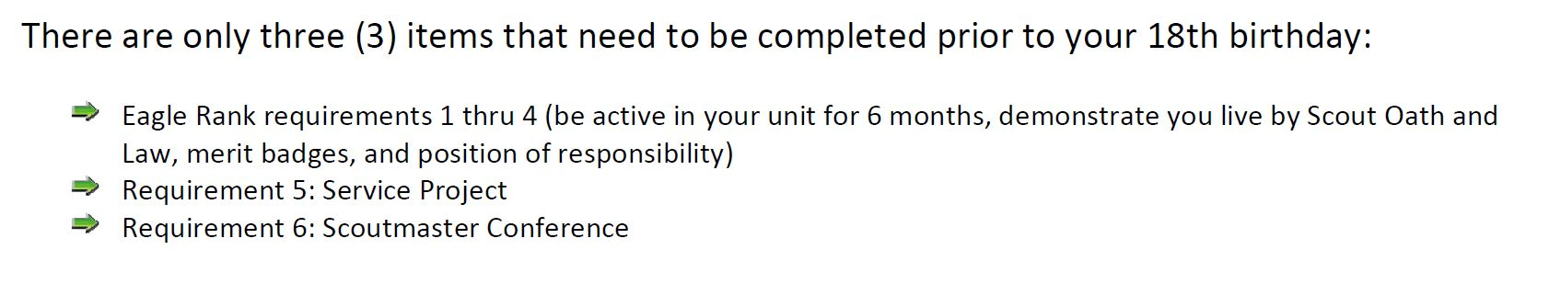
This is the “Freaked Out Parent Clause” used by the Aurora District.
(The workbook, rank application, personal statement, reference letters can all be completed and submitted after the 18th birthday).

Slide 46
Eagle Scout Extensions (special offer just for 2019)
Girls and first-time-joining boys (16 or older) joining after February 1, 2019 can file for a 2 year extension to complete their Eagle Rank requirements.
The deadline to file for this extension is December 31, 2019
/blog.scoutingmagazine.org/2019/05/13/heres-how-new-scouts-bsa-members-can-request-an-eagle-scout-extension/

Slide 47
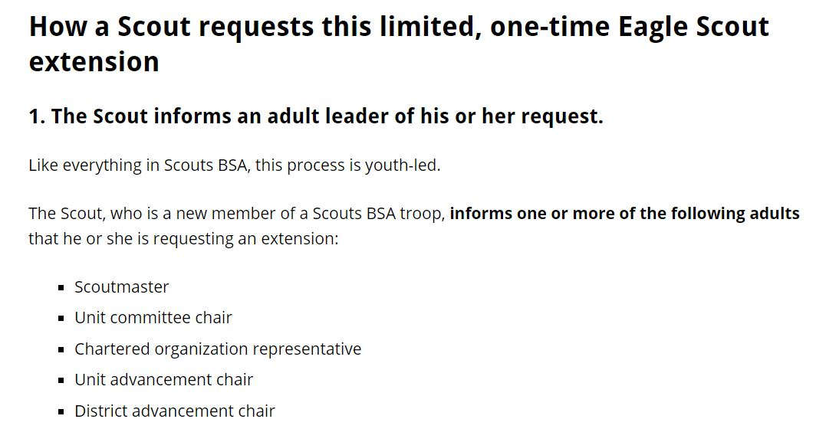

Slide 48
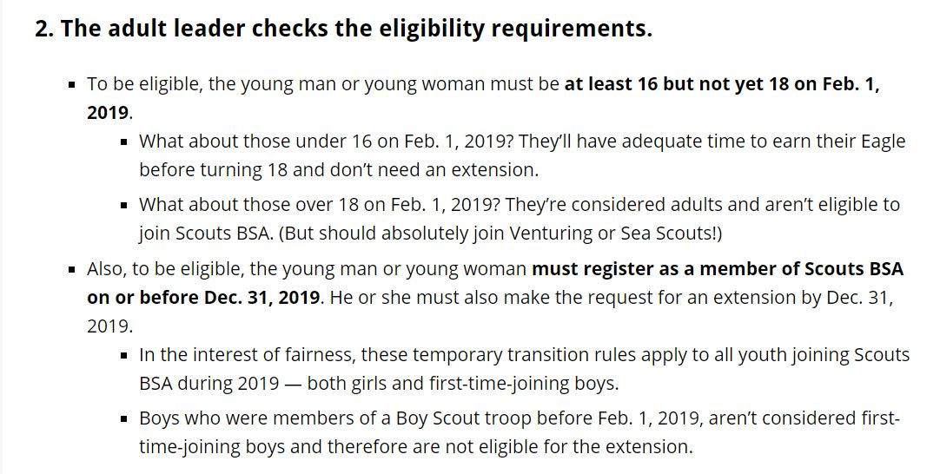

Slide 49
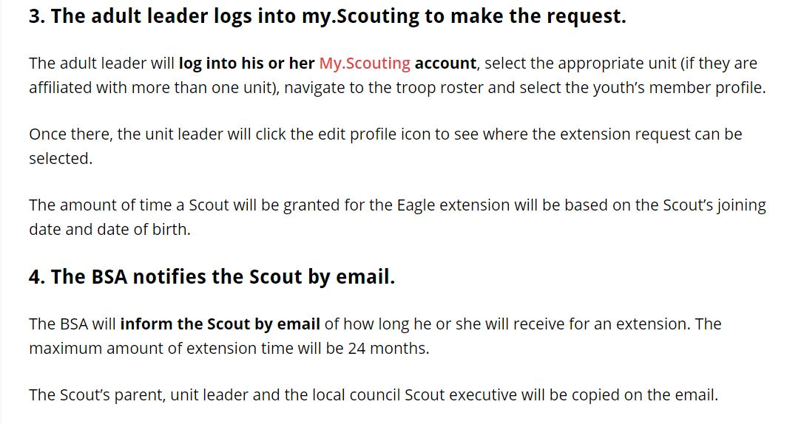

Slide 50
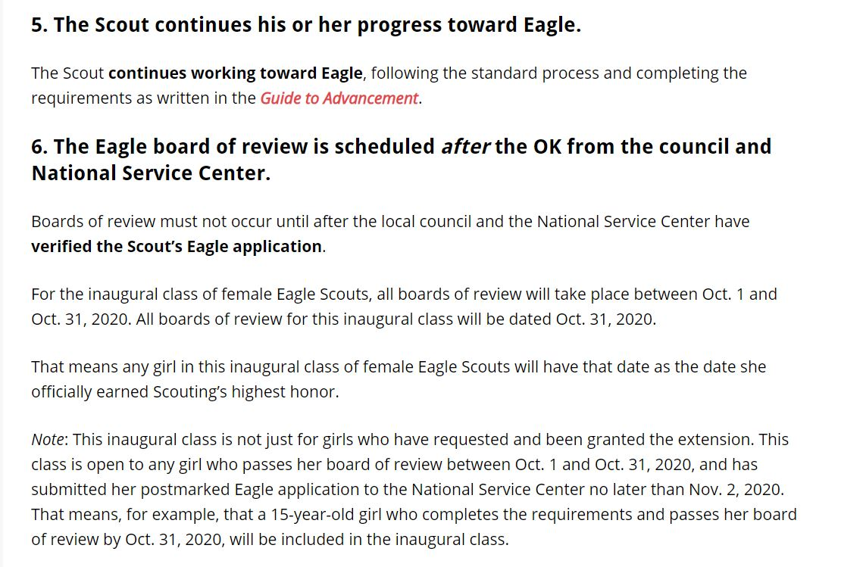

Slide 51
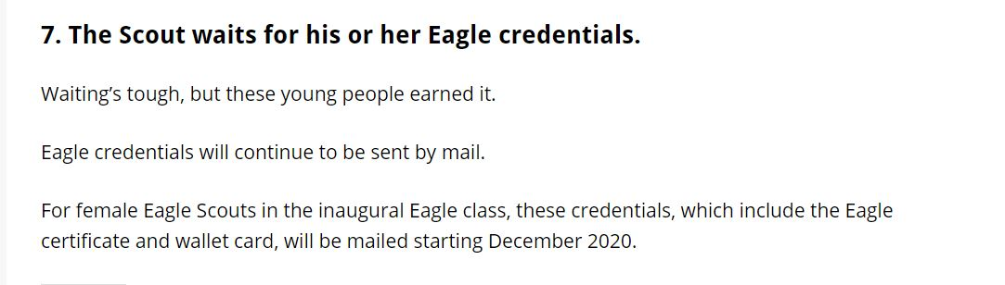

Slide 52
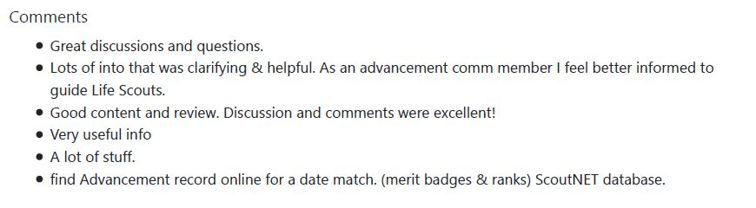
These are the comments received from last year’s presentation, what have I left out? Please ask questions!

Slide 53
Chief Seattle Council has a ton of great information on the Eagle Scout process on their website:
www.seattlebsa.org/eagle-scout-advancement
Some District websites have District specific information for their Trail to Eagle process.

Slide 54
You can download a copy of this presentation (and all PTC presentations) from
www.seattlebsa.org/ptc

Slide 55
This concludes Session 2.
To record your evaluation and attendance from a mobile device, go to https://seaptc.org and click "Class Evaluation.“
The evaluation code for this session is 6035.

