Slide 1

Trail to Eagle
Chief Seattle Council
Program & Training Conference
October 20, 2018
Rod Gowdy, Aurora District Advancement Chair
rodgowdy@msn.com

Slide 2
You can download a copy of this presentation (and all PTC presentations) from www.seattlebsa.org/ptc
No need to write copious notes!
Except this web address ;)

Slide 3
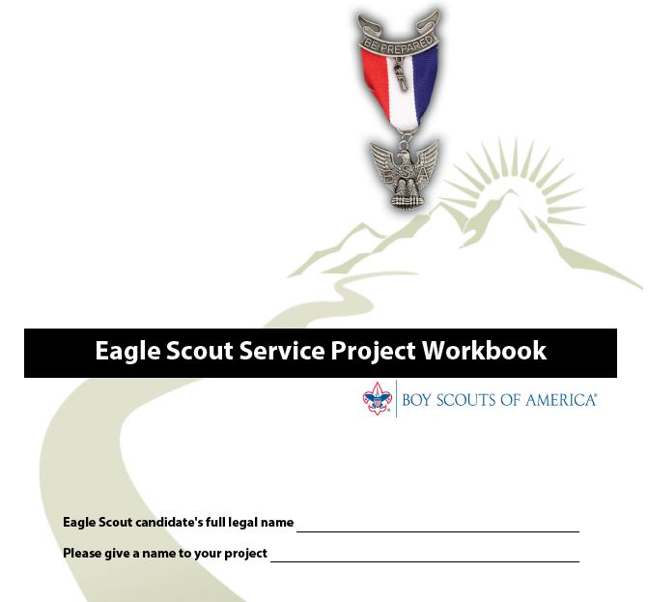
Current Edition: October, 2015
Download from Scouting.org!

Slide 4
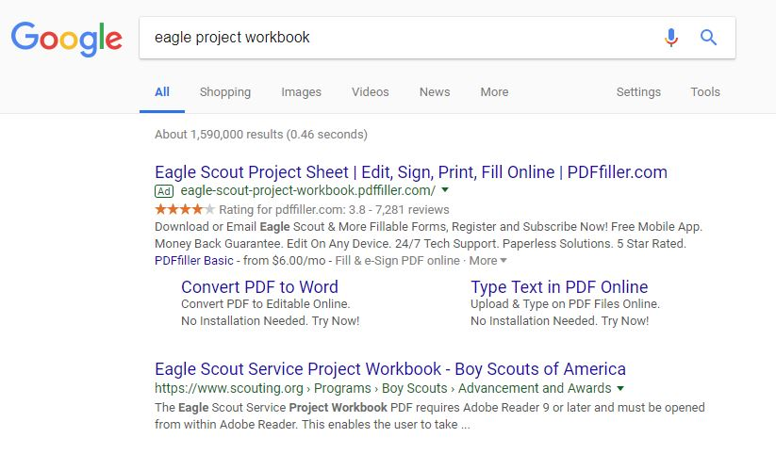
Use of third party services to fill out the PDF is not required. May lead to unnecessary frustration and money spent!
No!
Yes!

Slide 5
Eagle Scout Requirement No. 5
While a Life Scout, plan, develop, and give leadership to others in a service project helpful to any religious institution, any school, or your community.

Slide 6
What types of projects are acceptable for Eagle Scout Service Projects?
Permanent improvements (construction, painting, etc)
Drives (food drives, clothing drives, hygiene drives)
Park services (removing invasive species, new plants, etc)
Anything that benefits the community!

Slide 7
The project must benefit an organization other than Boy Scouting
Your project must be for any religious institution, any school, or your community. It is important to note, however, that the BSA has defined “your community” to include the “community of the world.”

Slide 8
• Routine labor is not normally appropriate for a project. This might be defined as a job or service you may provide as part of your daily life, or a routine maintenance job normally done by the beneficiary (for example, pulling weeds on the football field at your school).
• While projects may not be of a commercial nature or for a business, this is not meant to disallow work for community institutions, such as museums and service agencies (like homes for the elderly, for example), that would otherwise be acceptable. Some aspect of a business operation provided as a community service may also be considered; for example, a park open to the public that happens to be owned by a business, but primarily benefits the community.
• A project may not be a fundraiser. In other words, it may not be an effort that primarily collects money, even for a worthy charity. Fundraising is permitted only for securing materials and facilitating a project, and it may need to be approved by your council. See “Eagle Scout Service Project Fundraising Application” later in this workbook.

Slide 9
There are three parts to the Eagle Project Workbook:
Proposal
Plan
Report

Slide 10
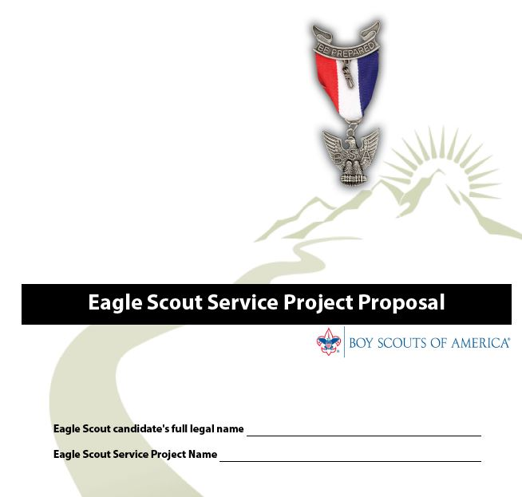

Slide 11
“Proposal Must Be Approved …Before You Start”
The Five Tests of an Acceptable Eagle Scout Service Project. The proposal is an overview, but also the beginnings of planning. It shows the unit leader and any representatives of a unit committee, council, or district, that the following tests can be met.
1.The project provides sufficient opportunity to meet the requirement.
2. The project appears to be feasible.
3. Safety issues will be addressed.
4. Action steps for further detailed planning are included.
5. The young man is on the right track with a reasonable chance for a positive experience.

Slide 12
“Give Leadership to Others …”
“Others” means at least two people besides the Scout.

Slide 13
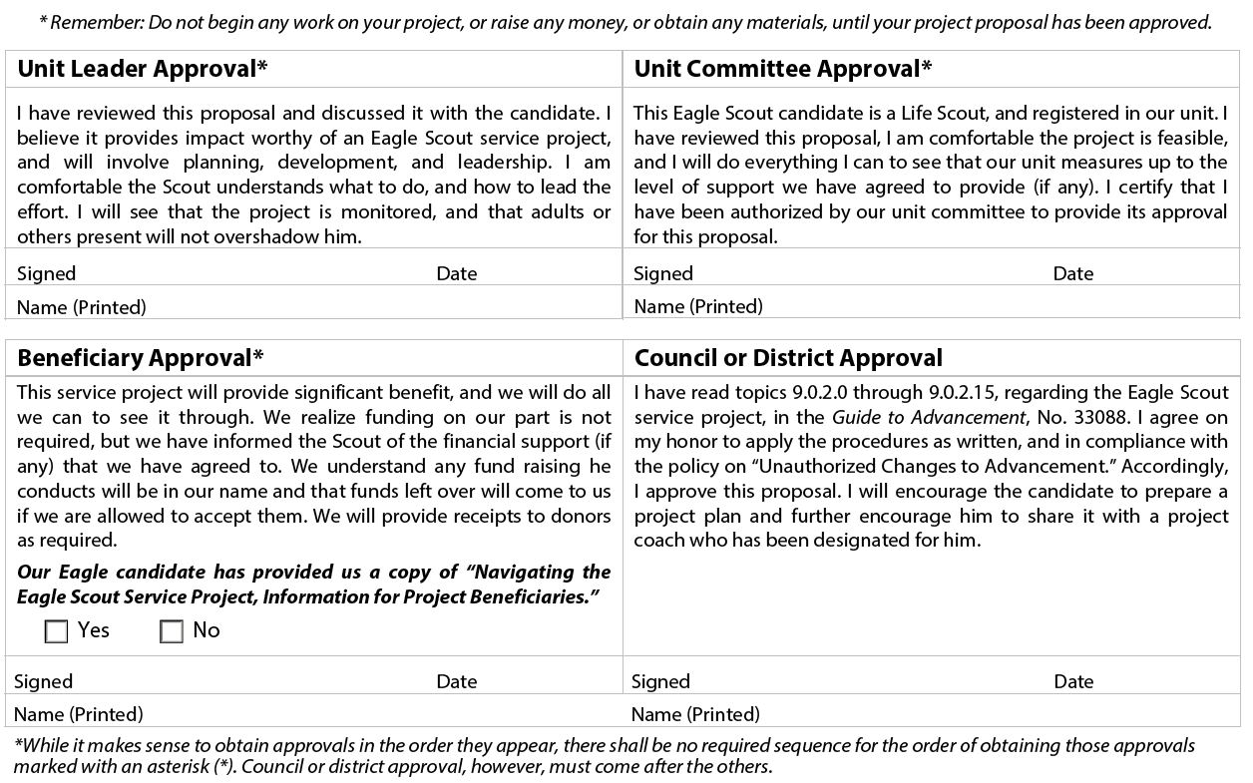

Slide 14
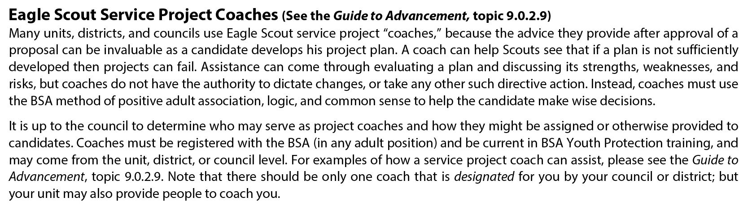
Not a requirement to use an “Eagle Project Coach” after the Proposal completed.

Slide 15
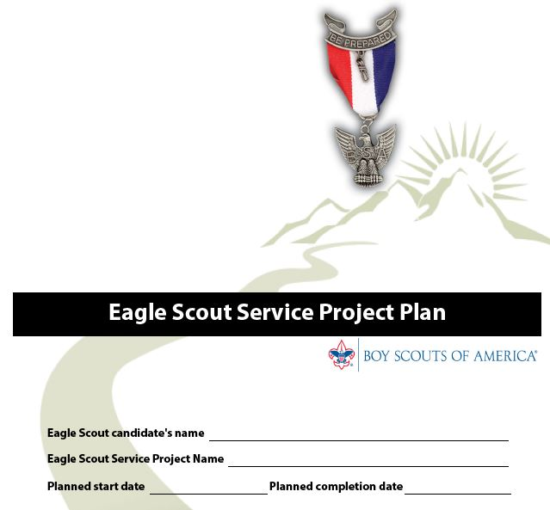

Slide 16
The “Plan” is completed and shared with the Beneficiary before work on the Project begins.
There are no approval signatures required.

Slide 17
Eagle Scout Service Project Fundraising Application
(completed as part of the “Plan”
Eagle Scout Service Project Fundraising Application must be used in obtaining approval for service project fundraising of monies and for in-kind donations of materials, supplies, tools, or other needs.*
*No application needed for donations from the Unit, Chartered Organization, or friends and relatives.
*No application required to solicit up to $500 in material from local stores (lumber, food, toiletries, etc.)

Slide 18
9.0.2.14 Risk Management and Eagle Scout
Service Projects
(Who didn’t just fall asleep when you read “Risk Management”….)
All Eagle Scout service projects constitute official Scouting
activity and thus are subject to Boy Scouts of America
policies and procedures. Projects are considered part
of a unit’s program and are treated as such with regard
to policies, procedures, and requirements regarding
Youth Protection, two-deep leadership, etc.

Slide 19
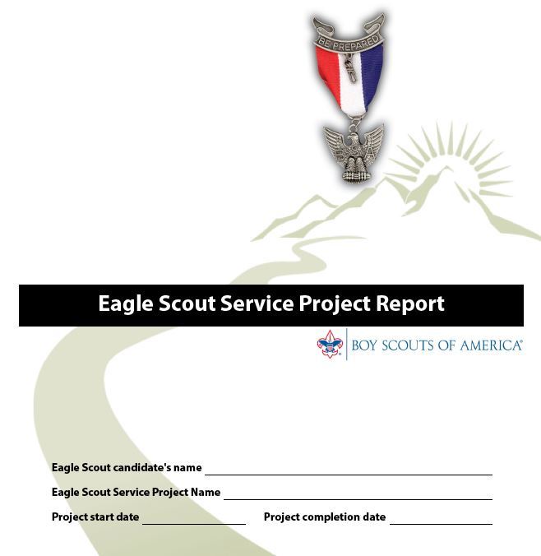

Slide 20
The “Report” is filled out after the project is completed.
Approval from Scoutmaster and Beneficiary required.

Slide 21
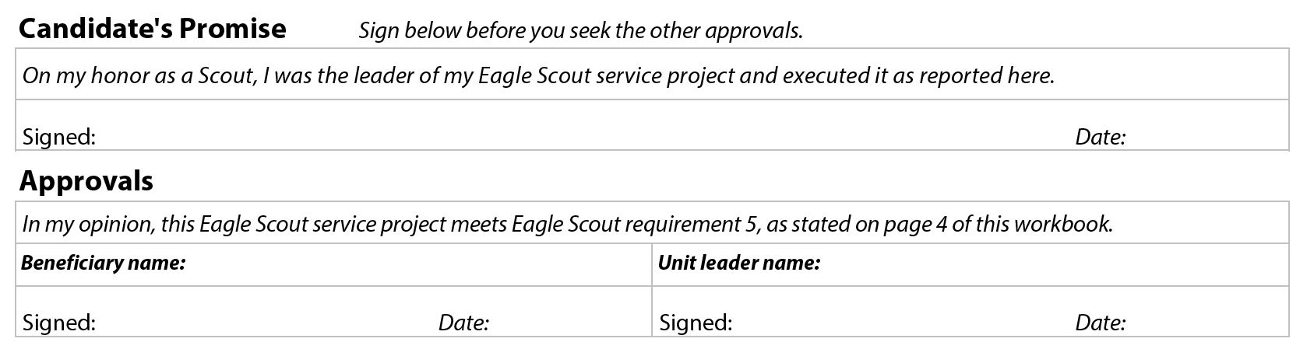

Slide 22
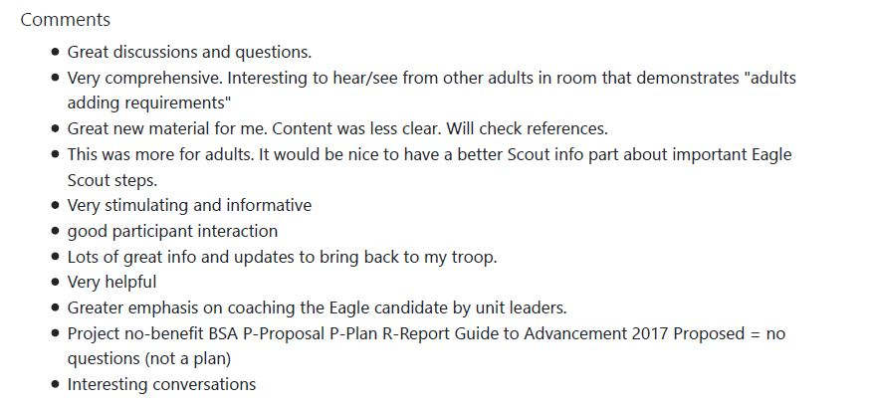
These are the comments received from last year’s presentation, what have I left out? Please ask questions!

Slide 23

Part 1 of 2, Session 1
To record your evaluation and attendance from a mobile device, go to https://seaptc.org and click "Class Evaluation.“
The evaluation code for this session is 8370.

Slide 24

Current Edition: April, 2017
Download from Scouting.org!

Slide 25
Special Request from Mary Compton
Lead Registrar, Chief Seattle Council:
Please make sure your printing is legible!
Type written applications are preferred!

Slide 26
These must be completed before the scout’s 18th birthday.
Be active in your troop, team, crew, or ship for a period of at least six months after you have achieved the rank of Life Scout.
Demonstrate that you live by the principles of the Scout Oath and Scout Law in your daily life.
Earn a total of 21 merit badges
While a Life Scout, serve actively in your unit for a period of six months in one or more positions of responsibility.
While a Life Scout, plan, develop, and give leadership to others in a service project helpful to any religious institution, any school, or your community.
While a Life Scout, participate in a unit leader conference.

Slide 27
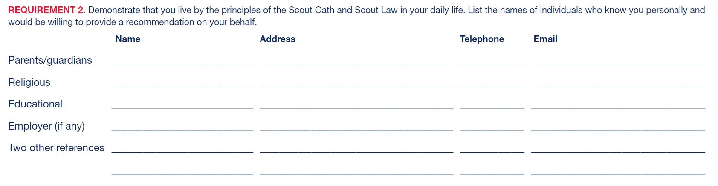
These people will be asked by the scout to write a “Letter of Recommendation”.

Slide 28
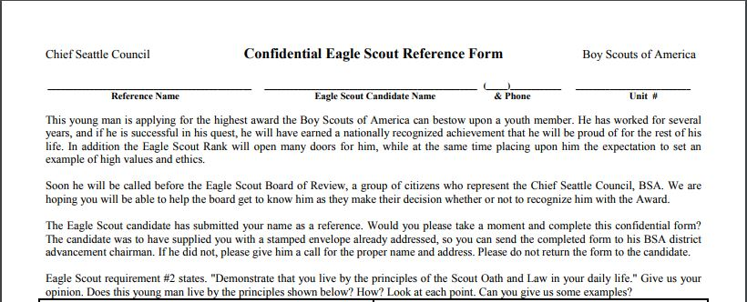
Chief Seattle Council uses this form for recommendations.
Download from SeattleBSA.org

Slide 29
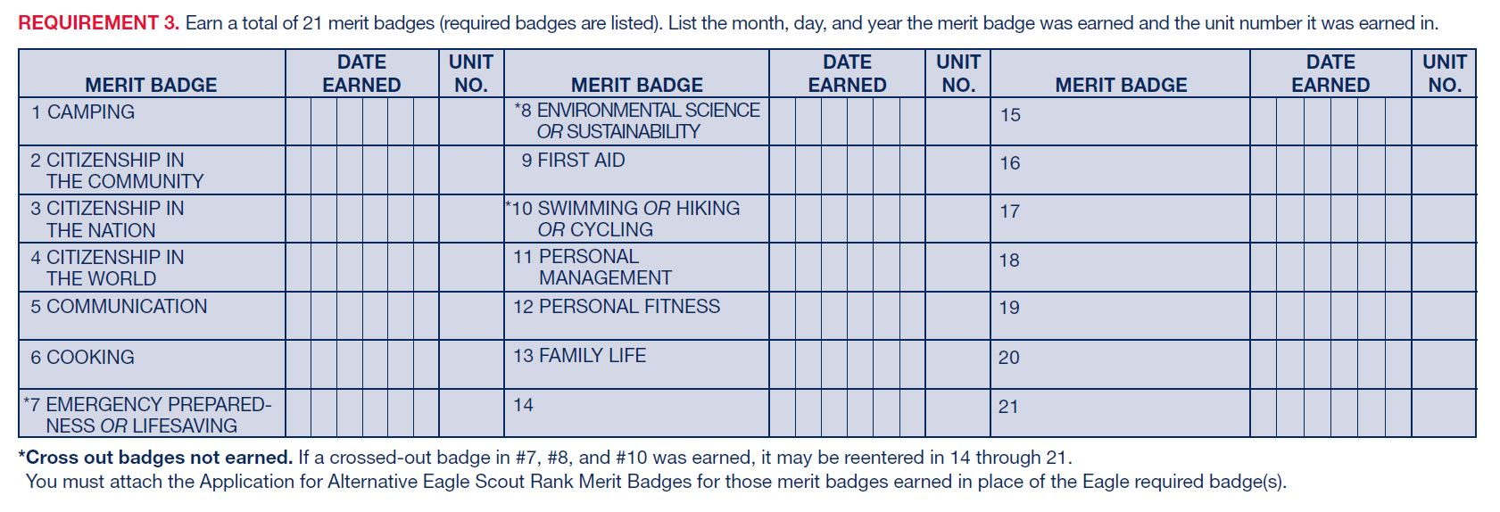
Enter dates merit badges completed.

Slide 30
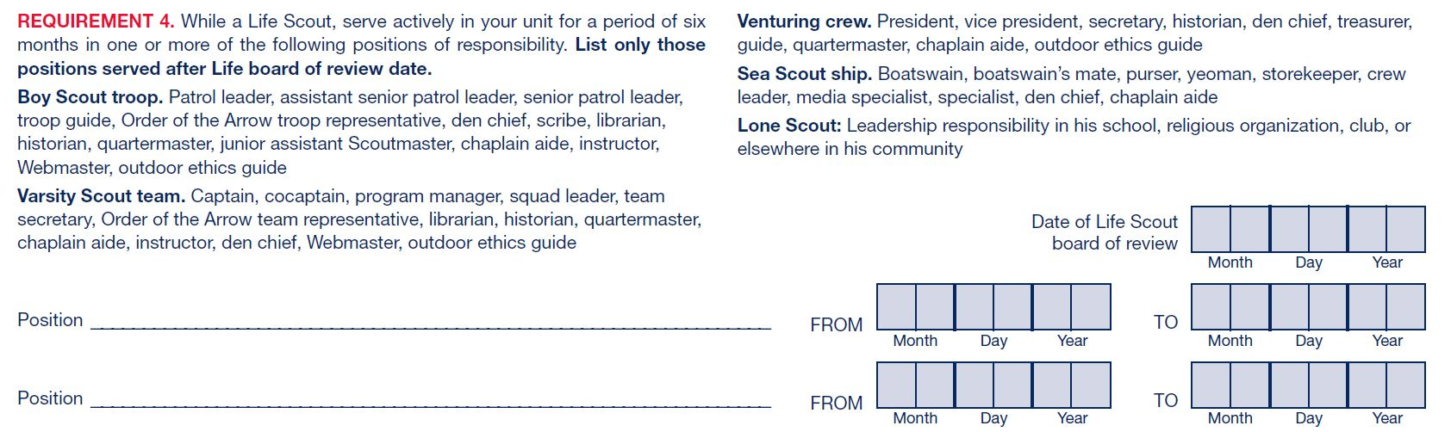
The “Position of Responsibility” dates are entered here. Six months minimum.

Slide 31
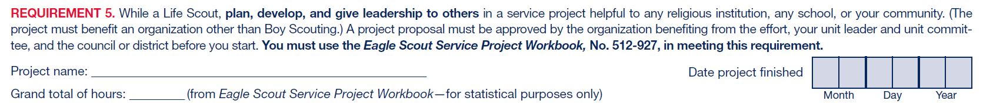
Details of the Eagle Project are entered here.

Slide 32
This is the date of the “Scoutmaster Conference”
This form is really easy to fill out!

Slide 33
The “Personal Statement”
In preparation for your board of review, prepare and attach to your Eagle Scout Rank Application a statement of your ambitions and life purpose and a listing of positions held in your religious institution, school, camp, community, or other organizations, during which you demonstrated leadership skills. Include honors and awards received during this service.

Slide 34
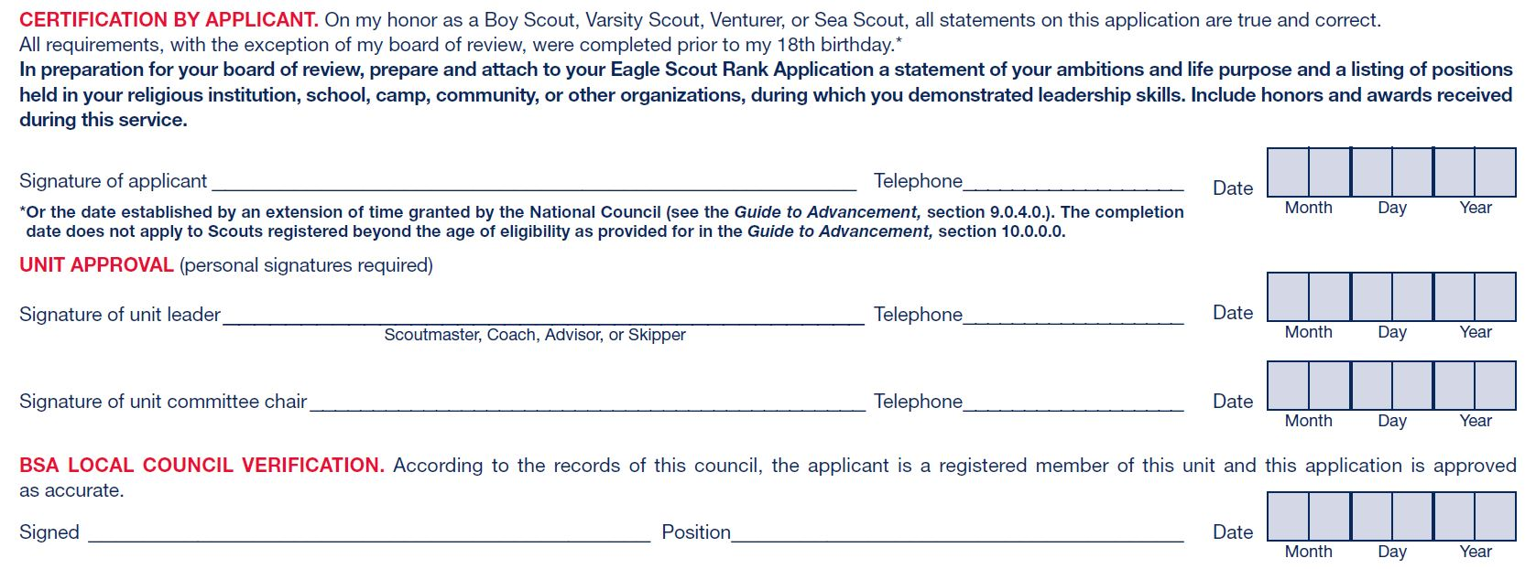
After the Scout, Scoutmaster, and Committee Chair signs the application, submit it to the Council office.

Slide 35
The Eagle Rank application should be submitted to the Council office within 2 weeks after his 18th birthday at the latest.

Slide 36
After the Council verification, the Eagle Rank Application is forwarded to the appropriate District representative.

Slide 37
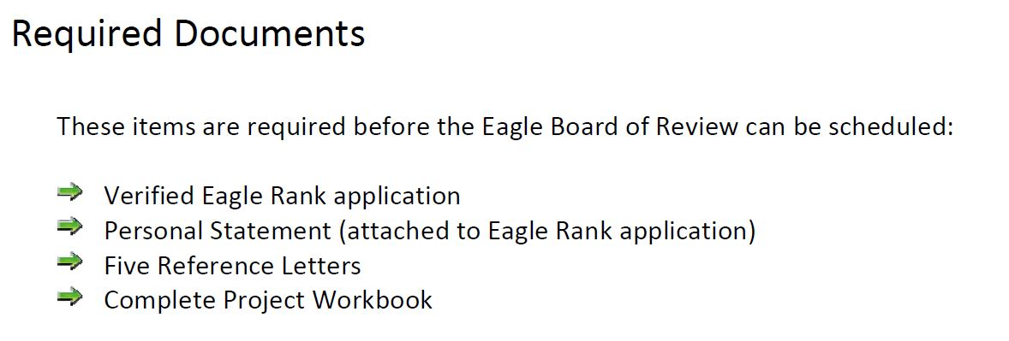

Slide 38
Successfully complete an Eagle Scout board of review!
This must be completed within 3 months after the scout’s 18th birthday.
Council approval required for boards of review held within 3 – 6 months after the 18th birthday.
National approval required for boards of review held beyond 6 months after the 18th birthday.

Slide 39
There are 12 Districts in the Chief Seattle Council. Each District has specific methods to process the paperwork and schedule the Board of Review.
Contact your District Advancement Chair for their “Trail to Eagle” process.
District contacts are located here:
www.seattlebsa.org/eagle-scout-advancement

Slide 40
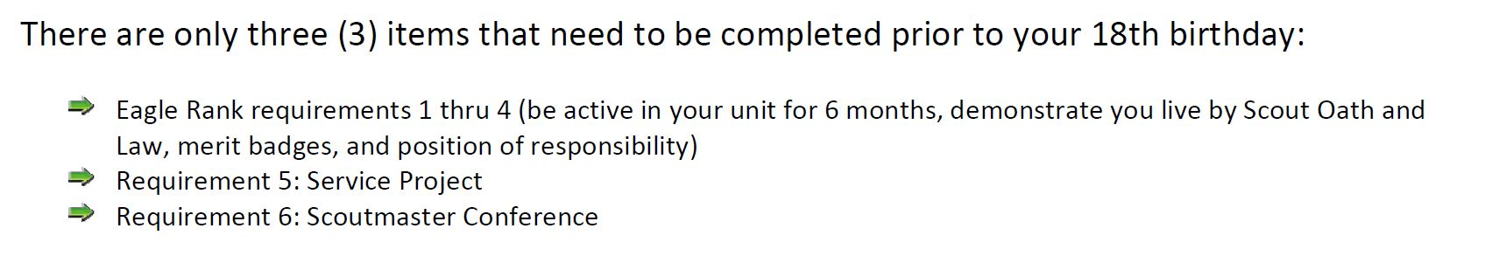
This is the “Freaked Out Parent Clause” used by the Aurora District.
(The workbook, rank application, personal statement, reference letters can all be completed and submitted after the 18th birthday).

Slide 41

The big news! As of August 1st, 2017:
All earned Palms may be awarded instantly to new Eagle Scouts! The “Board of Review” for Eagle Palms has been eliminated!

Slide 42
You can download a copy of this presentation (and all PTC presentations) from
www.seattlebsa.org/ptc

Slide 43
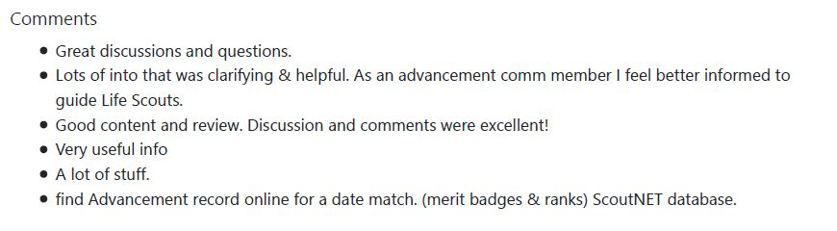
These are the comments received from last year’s presentation, what have I left out? Please ask questions!

Slide 44
Part 2 of 2, Session 2
To record your evaluation and attendance from a mobile device, go to https://seaptc.org and click "Class Evaluation.“
The evaluation code for this session is 9502.

