Slide 1

Teaching Internet Safety for Scouts
(What, Why, Who and How)
The BSA’s “Cyber Chip” for all ages
Instructor: Craig Pearce (craig.w.pearce@gmail.com)
Notes:
Welcome, is everybody in the right room?
OK, as it is somewhat topical to Cyber Chip and near enough to essential for your packs (troops especially), in the Den Chief training session this morning for Boy Scouts, Dr Randall Ogata was upfront with the audience about his electronics policy:
ELECTRONICS
If you bring a Phone...
You may use it to reference questions or solve problems asked of class
Take pictures of what you are doing & post to Facebook/Instagram or share with others
Call or Text during the BREAKS
Note that the Breaks may not occur at exactly the same time each hour...
If you use your phone for Games or call/text during Class
Will ask 1x (and only once) for it to be put away
Will ask you to turn it over to me for safe keeping - if asked a 2nd time
With Phone or Device returned - at end of class
1

Slide 2
Who am I and why am I standing up here?
- Relatively new to scouting (2 years for me,
4 years for my children across UK, AU, US)
- Undertook wood badge (still working on my ticket)
- Help lead Webelos and Bears
- IT Security engineer and consultant for 15 years
- Have delivered Cyber Chip to my dens and troop and want to share my learnings
2
Notes:
Any wood badgers here? Bead ceremony?
Any Jamboree Over the Air / Jamboree Over the Internet (JOTA-JOTI) participants here?
The slides are wordy and I will often talk to them (that is because I want the slides to hold up on their own for offline consumption) but you can all read so I will gloss over some stuff along the way
INTERACTION – I want this to largely be a group discussion … not a one-way street …

Slide 3
Science Fiction ROCKS
What Sci-Fi Got RIGHT
  SPACE TRAVEL
  TELEVISION
  CREDIT CARDS
  CELL PHONES
  SKYPE
What Sci-Fi MOSTLY Got Right
  COMPUTERS
  INTERNET
  WORLD WIDE WEB
3
Notes:
For Cyber Chip I am going to cover the WHAT, WHY, HOW and WHO … the WHEN is easy … do it at the start of a meeting when you can maintain focus and attention spans are stronger
Lets start with the WHAT
Mention jetsons and Maxwell Smart

Slide 4
Science Fiction MISSED STUFF
What Sci-Fi Mostly MISSED
  SPAM
  SCAMS
  EBAY
  TWITTER
  YOUTUBE
  FACEBOOK
  BAD APPS (malware, viruses)
  CYBERBULLYING
  TROLLS
  … and some more recent terms: CATFISH, CLICKBAIT, FAKE NEWS
4
Notes:
If its too good to be true then it probably is …
Phishing, whaling
Bullying … fortnight … and the 42year old catfish
Tell us how you got scammed …
OK I’ll go first … USA visa waiver program cost $14 https://esta.cbp.dhs.gov/ … others accidentally paid $88 and they were lucky that the service onforwarded the application and didn’t sell the details
My 10 year old downloaded a Minecraft mod which was a virus or trojan. Luckily he runs in a non-admin account when using Windows

Slide 5
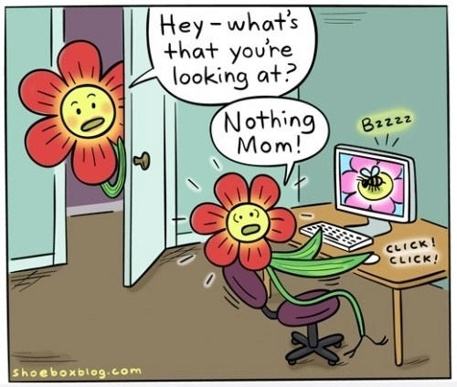
Science Fiction MISSED STUFF
5
Notes:
Cyber Chip is an extension of youth protection.
Two-deep communication applies to online comms as well !

Slide 6
What can possibly go wrong?
Children have near-instant access to
  Every Picture
  Every Movie
  Every Song
  Every Book
  Every Game
  Every Store
  Billions of People
  Billions of People!
6
Notes:
In the heat of the moment, children (adults even) forget that the Internet can remember everything for all time

Slide 7
Kids Face New Risks
Lots of online fear mongering
BUT:
1 in 7 kids will receive an unwanted intimate solicitation online
Kids who engage in risky online behaviors are at higher risk of solicitations:
  posting personal information
  interacting with strangers online
  accepting “friend” invitations from strangers
65% of online offenders use social networking sites to gather personal information i.e. school and home information
7
Notes:
Now for the WHY
Stats gathered from: National Sex Offender Public Website, Facts and Statistics
https://www.nsopw.gov/en/Education/FactsStatistics#technology

Slide 8
Scouting Needs to Teach Kids
New Skills
How to Navigate Online
find information
recognize unreliable content
recognize inappropriate content
seek “trusted adult” help
How to Protect Themselves Online
protect personal information
avoid/report predators
How to Behave Online
show good “netiquette”
discourage/report inappropriate behavior
discourage/report abuse or bullying
8
Notes:
UYN (use your netsmartz)
Sherriff Clicky (click click click)
Pottymouth Pete
Google safesearch versus bing
OpenDNS family protection
iOS 12 parental controls
Avoid chat, beware of ASL information

Slide 9
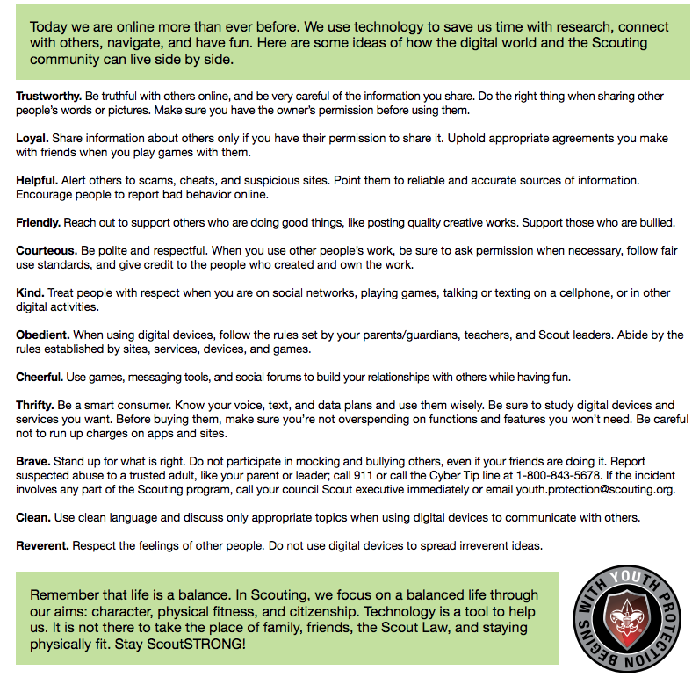
The Online Scout Law
9
Notes:
Group interaction … each person reads one

Slide 10
The BSA’s Cyber Chip
      Developed in Partnership with Netsmartz (Center
      for Missing & Exploited Children)
      Teaches Appropriate Online Behavior and Safety From Tiger Cub to Eagle Scout:
Grades 1-3
Grades 4-5
Grades 6-8
Grades 9-12
Increasing Level of Depth/Complexity
Annual Refreshers
10
Notes:
And now for the WHO - The BSA Cyber Chip covers scouts of all ages
Topics include:
Cyber bullying
Internet etiquette
Gaming
Cell phone usage
Note that the content is split up into 3-year blocks? My 10yo is a boy scout but in Grade 5. As a parent I let him watch the Grade 6-8 content and he found it more interesting than the Grade 4-5 content.

Slide 11
The BSA’s Cyber Chip
Tigers, Wolves and Bears:
Level I Internet Safety Pledge
Netiquette Video Online
Online Game/Quiz
Re-tell What They’ve Learned
11

Slide 12
Cub Scouts: Tigers, Wolves and Bears
Internet Safety Pledge:
I will tell my trusted adult if anything makes me feel sad, scared, or confused.
I will ask my trusted adult before sharing information like my name, address, and phone number.
I won't meet face-to-face with anyone from the Internet.
I will always use good netiquette and not be rude or mean online.
12
Notes:
Example: somebody online asks for your ASL information (age / sex / location)

Slide 13
Cub Scouts: Tigers, Wolves and Bears
Online “Netiquette” Video
Bad Netiquette Stinks
7 minutes
13

Slide 14
Cub Scouts: Tigers, Wolves and Bears
Online Game / Quiz / Certificate
Router's Birthday Surprise
Cubs Must Complete the Game/Quiz
Print the Certificate
Adults can log in as “teacher” and navigate the map/game as they wish.
“Educator’s Guide” tab also has helpful information
14
Notes:
Ideas for Unit Leaders
Tailor the requirements to your own unit rules. Complete the requirements for the Cyber Chip as a unit at a regular meeting, then hand out the cards and patches on the spot.
Review the resources available on the website, including teaching materials, an implementation guide, and more.
Create a fun challenge for youth to stump the unit leaders.
Play a “Jeopardy!”-style game in a meeting to use what’s been learned.
Use the Cyber Chip as a foundational step in preparation for leadership positions such as Webmaster.
Describe what worked for me:
- 5min intro discussion for children and parents (set the expectation), watch the “Bad Netiquette Stinks” 7min video, do a “show and tell” group discussion on what was learned … then remind parents a few days later to finish step 3 and watch the 26min video “Router’s Birthday Surprise” interactive adventure
1. (PARTLY DONE, we will get the Bears to sign these once 3. is complete) Read, commit to, and sign the Level I Internet Safety Pledge. (BSA Cyber Chip blue card)
2. (DONE) Watch the video “Bad Netiquette Stinks .” (NetSmartz.org/scouting )
3. (TO BE DONE BY PARENTS) Play the Router’s Birthday Surprise Interactive Adventure, and print the completion certificate to give to your den leader. (NetSmartz.org/scouting )
4. (DONE) Show and tell your family, den leader, den, or pack what you have learned.
Once you have completed item 3 with your child and printed the completion certificate, please bring it in and we will then get the scout to sign the BSA Cyber Chip blue card.

Slide 15
Cub Scouts: Tigers, Wolves and Bears
Retell What They’ve Learned
“Show and tell your family, den leader, den, or pack what you have learned.”
15
Notes:
Group discussion:
What has worked for you?

Slide 16
Cub Scouts: Webelos
Same Internet Safety Pledge
Online Video: Good Password Practices
and one “elective” (video of their choice)
Demonstrate Internet Safety Principles to their Den Leader, Den or Pack using a “Teachable Recipe” (can be done solo or as a Den)
Discuss w/Unit Leader: Appropriate Use of Devices
16
Notes:
Group discussion: have you set a “Appropriate Use of Devices” policy or “electronics policy”?
For example, in the Den Chief training session this morning for Boy Scouts, Dr Randall Ogata was upfront with the audience:
ELECTRONICS
If you bring a Phone...
You may use it to reference questions or solve problems asked of class
Take pictures of what you are doing & post to Facebook/Instagram or share with others
Call or Text during the BREAKS
Note that the Breaks may not occur at exactly the same time each hour...
If you use your phone for Games or call/text during Class
Will ask 1x (and only once) for it to be put away
Will ask you to turn it over to me for safe keeping - if asked a 2nd time
With Phone or Device returned - at end of class

Slide 17
The BSA’s Cyber Chip
Boy Scouts Grades 6-8:
Level II Internet Safety Pledge
Appropriate Use Agreement w/Parents
Online Friend Video and Two Others
Teach What They’ve Learned (EDGE)
Discuss w/Unit Leader: Appropriate Use of Devices
17

Slide 18
The BSA’s Cyber Chip
Boy Scouts Grades 9-12:
Level II Internet Safety Pledge
Appropriate Use Agreement w/Parents
Discuss w/Parents Benefits & Risks of Social Media
Three Online Videos: Impact of Social Media Sites
Teach What They’ve Learned (EDGE)
Discuss w/Unit Leader: Appropriate Use of Devices
18

Slide 19
The BSA’s Cyber Chip
EDGE: Four Step Method for Teaching a Skill:
Explain
Demonstrate
Guide
Enable
19

Slide 20
What is your Electronics Policy?
https://blog.scoutingmagazine.org/2012/03/14/electronics-policy/
No Electronics. Period.
Only allowed while driving to/from events.
OK, but with certain restrictions.
Not just allowed – encouraged!
20

Slide 21
In a Nutshell
Kids Face New Challenges
We Need to Adapt Our Programs to Give Them the Skills They Need
The New Cyber Chip Programs Cover a Lot of Ground
21
Notes:
Cyber Chip is an extension of youth protection.
Remember, Two-deep communication applies to online comms as well ! A merit badge councilor friend lives 2 hours away and is working with my son for his welding merit badge. For the verbal discussion of requirements he ensured that the mobile was on speakerphone at our end so that I could listen in.

Slide 22
My Own Opinion
What Cyber Chip Misses:
Fluffy: More Candid Options Are Out There
Question All Information (snopes.com)
Great General Media Ratings at commonsensemedia.org
Incomplete: Lots more information at netsmartz.org
22
Notes:
Practical ways to stay safer online:
- Google SafeSearch
“OpenDNS FamilyShield” for DNS lookups and does URL / website categorization to block domains that are categorized in our system as: Tasteless, Proxy/Anonymizer, Sexuality and Pornography.
Parental controls for Microsoft Family, iOS 12,

Slide 23
QUESTIONS?

Slide 24
Links
  BSA Cyber Chip
  http://www.scouting.org/cyberchip.aspx
  NetSmartz Scouting
  http://www.netsmartz.org/scouting
  Common Sense Media
  https://www.commonsensemedia.org/
  Boys Life articles
  https://filestore.scouting.org/filestore/youthprotection/pdf/Cybersafety_LO.pdf (younger readers)
  https://filestore.scouting.org/filestore/youthprotection/pdf/Cybersafety_HI.pdf (older readers)
24
Notes:
… and if pushed:
Jo Langford / Be Heroes
http://www.beheroes.net/

Slide 25
Class Evaluation
  To record your evaluation and attendance from a mobile device, go to:
  https://seaptc.org and click "Class Evaluation."
  The evaluation code for this session is 2390
25

