Slide 1
How Troops Successfully Grow: Nine Ideas
PTC 525
Wayne Perry
wayne@shotguncreek.com

Slide 2
#1 Scouts Have Fun

Slide 3
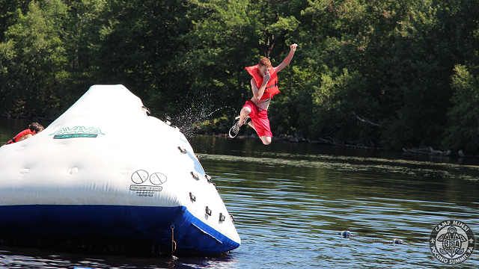
"A boy is not a sitting-down animal."

Slide 4
“A fisherman does not bait his hook with food he likes. He uses food the fish likes. So with boys.” BP

Slide 5
#2 Scouts Lead: Chaos Tolerated

Slide 6
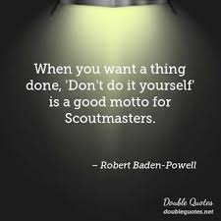

Slide 7
#3 Camping Happens

Slide 8
#4 Advancement is Tracked

Slide 9
#5 Parents Are Involved

Slide 10
#6 Signature Events Occur

Slide 11
Examples of Signature Events
50 Milers
National Jamborees
World Jamborees
NYLT/NAYLE

Slide 12
#7 Scout/Leaders Are Trained

Slide 13
#8 Leadership Succession
Youth & Adult Planned

Slide 14
#9 Meaningful Service Project

