Slide 1
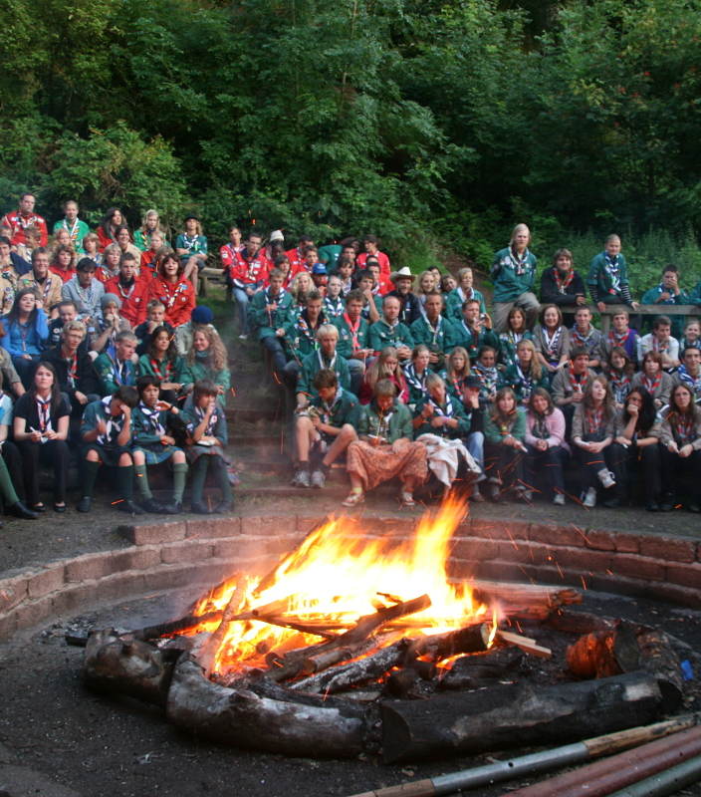
Campfire
Skits & Songs
Notes:
Great campfires create memories that last a lifetime.
I still fondly remember specific skits, songs, and openings from campfires when I was a scout 30 years ago.
In this class you’ll learn how to create exciting and memorable campfires that your unit will love!
Class roster -- https://dashboard.seaptc.org/classes/616?t=695285

Slide 2
Why are you here?
Notes:
If you came here with specific questions or goals, I want to make sure those are addressed.
Make a list on the whiteboard -> vote if necessary

Slide 3
Key elements
Two P’s
  Planning
  Presentation
Four S’s
  Showmanship
  Songs
  Stunts (skits, cheers, etc)
  Stories (ghost, funny, adventure, etc)
Notes:
http://www.boyscouttrail.com/stories.asp
https://boyscouttrail.com/content/story/horrible_pirate-2203.asp

Slide 4
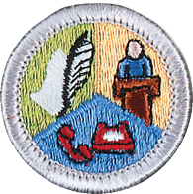
Planning
Have an MC
  Communication Merit Badge requirement 8
  Announce who’s next and who’s on deck
Don’t wing it
  Get songs, skits, etc from the participants
  Organize them into a program
  BSA’s Campfire Program Planner can help – https://tinyurl.com/bsacampfire
Safety first!
Variety
Flow
  Build excitement -> high point -> transition to closing

Slide 5
Wow, that’s inappropriate!
Topics to avoid
Religion / Race / Nationalities
Politics
Underwear / Toilet Paper
Use of alcohol, drugs or tobacco
Cross-gender impersonation
Water
Inside Jokes
Follow the Scout Law…
Friendly
Courteous
Kind
Notes:
Planning can also help you avoid some potential land mines
I saw a campfire once where a boy did a comedy routine based on jokes about immigrants.
He figured it was ok because he was an immigrant, but it came across as incredibly insensitive.
It spoiled the mood and embarrassed the boy.

Slide 6
Opening ideas
Procession
  Silence
  Singing a song
Some other way to get everyone’s attention
  Dramatic entrance of MC
  Scout sign
  Fire lighting
Other ideas?
Notes:
Procession– One way to do this is to process around camp picking up patrols/troops as you go.
If everyone isn’t arriving at the same time, you’ll need some other way to signal that it’s time to start the show.

Slide 7
Lighting the Fire!
Torch walked in ceremoniously
Magic
  Battery + long wires connected to…
    steel wool
    a spring wedged with match heads
  Backup plan!
Flaming arrow
  Rides on fishing line directly to the kindling.
  See https://www.programresources.org/campfires/
Other ideas?
Notes:
Torch -- When I was a scout, summer camp fires were always lit by OA members in full regalia who arrived by canoe with a torch.
Magic – really electricity. When it works, scouts get a big kick out of it. If it doesn’t, have a backup plan!

Slide 8
Skits
Have fun!
Enthusiasm
Speak loudly & clearly
Variation
Simple costumes
Consider lighting
Length
Rehearse, rehearse, rehearse!
Be prepared
What else?
Favorites?
Notes:
Fun – if you’re having fun, the audience is more likely to enjoy
Variation – the classics get old unless you can somehow make them great again. For example, “Raisin Bran Skit” (spoon!), Oneski Twoski (Who sneezed?)
Length -- 2 minutes is good, 4+ minutes generally too long
Lighting – If the audience can’t see you, they may not “get” the skit.
Be prepared – get on stage and get started quickly; have your props ready
What else? – What makes a good performance in your opinion? Any examples good or bad?
Favorites? – What are your favorite skits? Mine are the bandana/banana skit and the two-person sloppy shaving/toothbrushing skit, gravity check

Slide 9
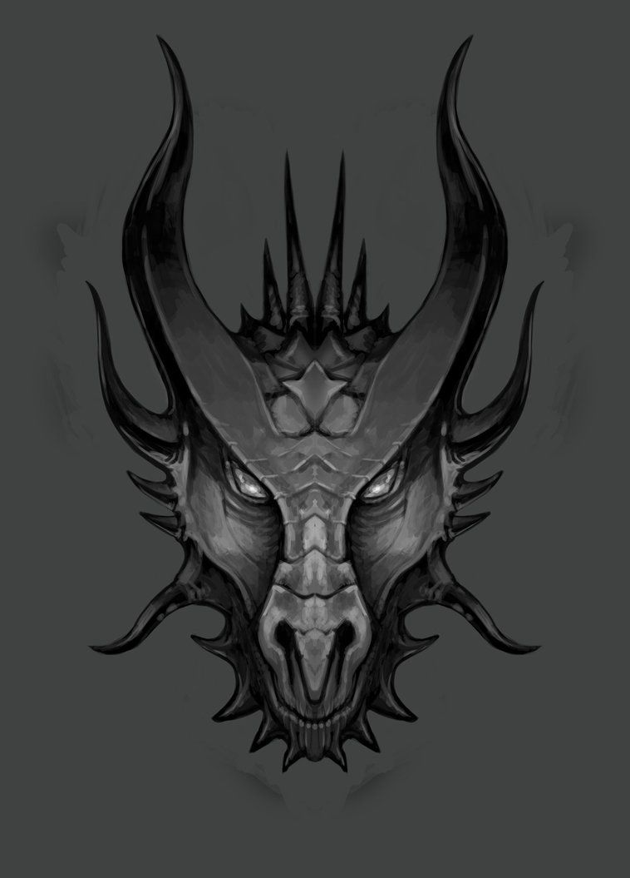
A Tale of Two Jabberwockies
One got huge applause…
Read with passion
Actors
Simple costumes
One was boring…
Read seriously
No actors
Notes:
At summer camp I saw two performances of Lewis Carroll’s poem “Jabberwocky.”

Slide 10
Look for inspiration at home
Television
  Monty Python – Dead Parrot
  The Sketch Show – California Dreaming
  Commercials – Berlitz ad “On the Fritz”
Web archives
  http://www.scoutorama.com/skit/
  http://www.boyscouttrail.com/skits.asp
  www.boyscouttrail.com/boy-scouts/boy-scout-skits.asp
Notes:
As a kid, a friend and I did a great rendition of Monty Python’s “Dead Parrot” skit at summer camp.
A well executed version of The Sketch Show’s “Phobias Workshop” skit could be amazing!

Slide 11
Songs
Have fun!
Enthusiasm
Loud voices
Variation
Are the words right?
Musicians?
Rehearse
What else?
Notes:
Are the words right? – Sometimes the exact words for songs will vary by region. I grew up in Boston and the words we used for The Bear Song for example are slightly different. Your audience will enjoy the song more if they’re not annoyed that you’re getting the words wrong. ☺ When in doubt, ask a friend if your words sound right to them.
Musicians – can really add to the impact of the song

Slide 12
A Tale of Two Meadows
Notes:
Who knows the song “Mow the Meadow”.
On its own it’s pretty boring.
In the Camp Parsons dining hall they make it awesome with one change…

Slide 13
But…
I don’t like to sing!
I can’t remember the words!
Stage fright
Notes:
Don’t like to sing -- Older scouts frequently claim that they don’t like to sing. But start singing Johnny Verbeck or Over the Irish Sea and they’ll all start singing.
Can’t remember words -- Consider giving a pocket size song book to everyone in your unit. When you want to sing, at a campfire, hike, or whatever, you can just pull it out and everyone has the same songs.
Stage fright – Team up with other scouts, maybe older scouts. Scout audiences are super friendly especially if they can tell you’re trying.

Slide 14
Recurring themes
Short jokes
Guy in dinosaur costume
Second MC
Notes:
Recurring themes can add an extra dose of fun when sprinkled throughout the program

Slide 15
Ceremonies
Ashes
Flag retirement
Notes:
Ashes – There’s a tradition I learned about in Wood Badge, to save ashes from each campfire and sprinkle them in the next fire.
The ashes we were given have gone through more than 1000 campfires, going all the way back to the first Scout camp at Brownsea Island in 1907.
You can get a sample from someone, or just start your own.
Flag retirement – When a US flag is badly worn, torn, faded, or soiled it’s time to replace it with a new flag.
The old flag should be retired with all the dignity and respect befitting our nation’s flag.
Ideally you should know when and where the flag was used and mention that during the ceremony. And anything else remarkable about the flag.
You can find retirement ceremony scripts online

Slide 16
Closing ideas
Scout Vespers
Taps – either on a trumpet or sung
Troop circle – right hand Scout sign, left hand holds neighbors right
  Scout Oath
  Scout Benediction – “May the Great Scoutmaster of all Scouts be with us until we meet again.”
Scoutmaster Minute
Thorns and Roses
What else?

Slide 17
Homework
Notes:
Before your unit’s next campfire, I challenge you to find and practice one song and one skit that are new to you. Prepare them and knock them out of the park.
It’ll be worth the effort because, great campfires make memories that last a lifetime.

Slide 18
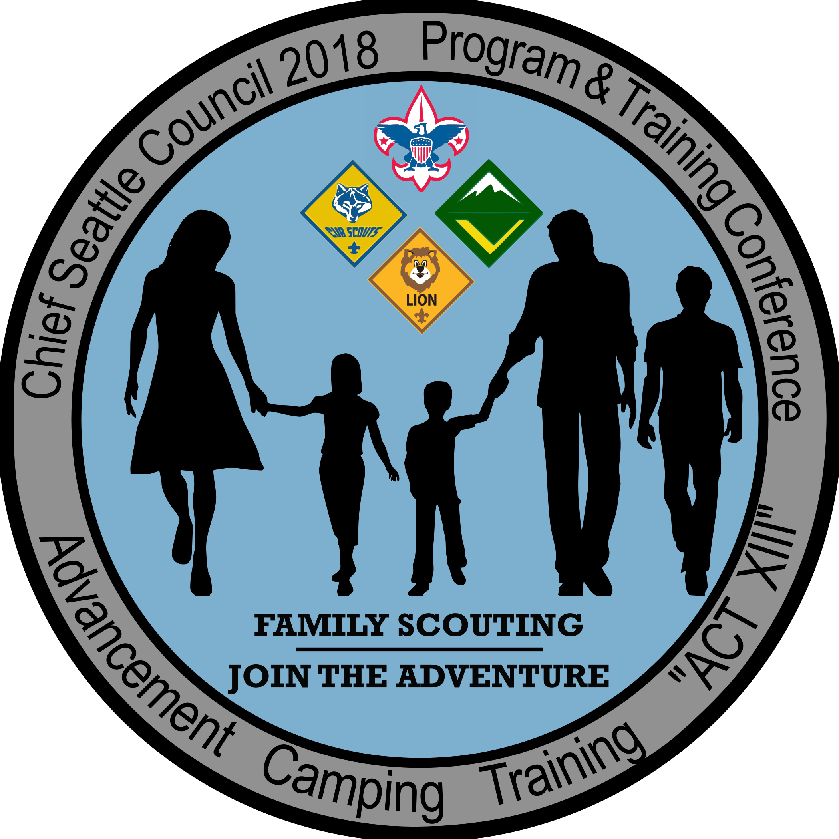
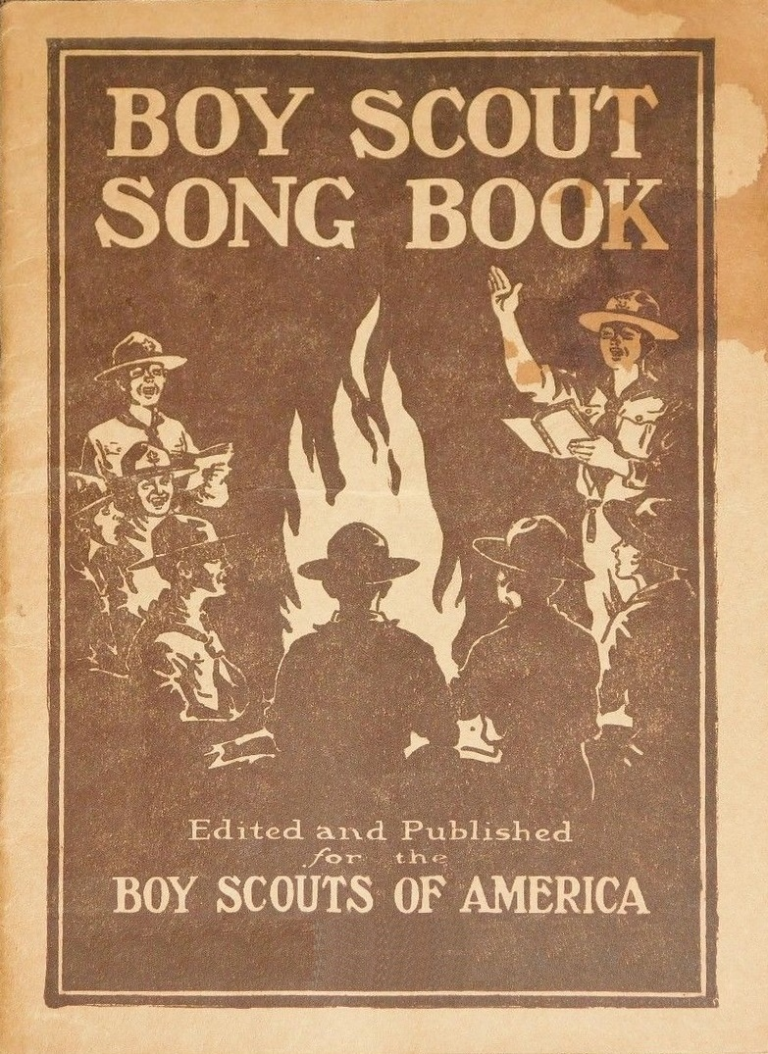
Feedback is a gift
erikd@microsoft.com
Go to https://seaptc.org and click "Class Evaluation"
The evaluation code for this session is 3302.
Show me the confirmation page to receive your parting gifts…
Notes:
I hope you enjoyed this class and your day here at PTC.
I have some parting gifts for you. Once you’ve filled out your class evaluation, show me the confirmation page and you’ll receive your PTC patch and a copy of a song book that I recently created.
If you’d like an electronic version of the song book, email me!

