Slide 1

611 Pack Ceremonies
Rick Quinn
Rick@rvquinn.com
Troop570 Sammamish Trails District

Slide 2
Lets Start with Us
Who we are
Scouting experience
Why we are here for this class
Can I fall asleep after the 32nd Slide?

Slide 3
Reasons for Ceremonies
To recognize Scouts for their accomplishments
To inspire them on to greater achievement
To motivate other Scouts
To excite scouts, leaders and parents
Scouting is a Recognition based organization

Slide 4
My Ceremony Philosophy
Don’t repeat ceremonies
Ceremonies should be fun, exciting or surprising!
There should be meaning or significance in ceremonies
Ceremonies should reflect the amount of work the Scout did
Make each kid feel special – inspire them to keep going

Slide 5
Types of Ceremonies
Flag - Pledge of Allegiance
Awards – All the achievements Pins – Belt Loops
Advancement - Tiger, Wolf, Bear and Webelos
Arrow of Light
Cross Over - Webelo to Boy Scout
Adults

Slide 6
Lets’ start with the Flag
Unless thought is given to it, the Pledge of Allegiance can become rote and boring
  Intros
  The greatest Public Document of the American People in the Constitution of the United States. Our Flag represents our Constitution in Action. Let us now Pledge our Allegiance to that Flag.
  13 Stripes and 50 Stars ...This phrase can only refer to our American Flag. Let us remember the history behind those stars and stripes as we say the Pledge of Allegiance
  The Red in our Flag stands for Courage and Bravery. Today as we Salute our Flag, let 's remember our men and women in the Armed Forces who are serving us and our country.

Slide 7
Awards
Be creative
Do Not become a “baggie and a handshake” pack,
Each scout gets their moment –
  Challenge with larger packs
  Try Frisbees – robots – Zip lines
  What Ideas from you ?

Slide 8
Advancements
Lion to Tiger – Tiger to Wolf – wolf to Bear – Bear to Webelo
  Once a year main event ?
  Note the moment – what is this about?
Arrow of Light
Crossover to Scouts

Slide 9
How To Handle Problems
Practice makes perfect
Not all ceremonies go as planned
Some problems are small
Some problems are big
Have a Plan B

Slide 10
Search Results
http://www.macscouter.com/Ceremony/CubScoutCeremonies.asp
http://www.boyscouttrail.com/ceremony_search.asp
http://www.stgerald.org/uploads/DanBourne/ceremonies-for-dens-and-packs.pdf
https://cubscoutideas.com/5801/my-7-favorite-cub-scout-crossover-ceremonies/
https://www.ncpack713.org/assets/ceremonies-resource.pdf
http://www.scoutorama.com/ceremony/
https://insanescouter.org/c/45/Cub_Scout.html#.W8lcAvZFy70
http://www.stgerald.org/uploads/DanBourne/ceremonies-for-dens-and-packs.pdf The Ceremony Table

Slide 11
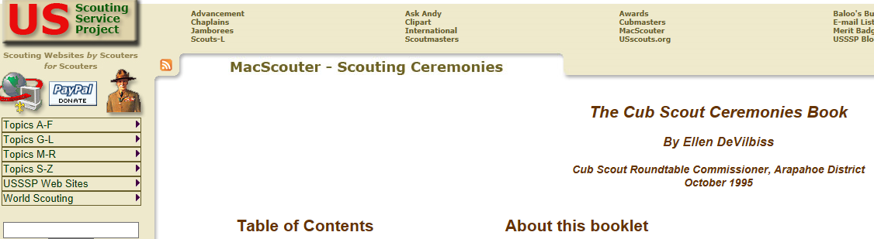

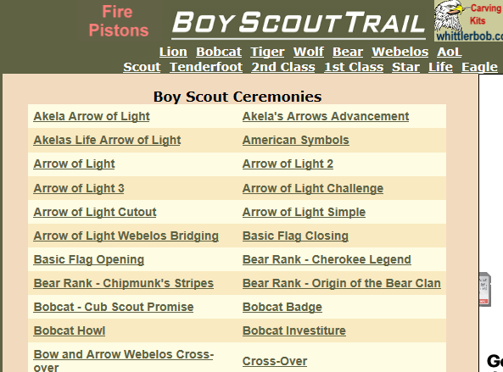
Some Search results

Slide 12
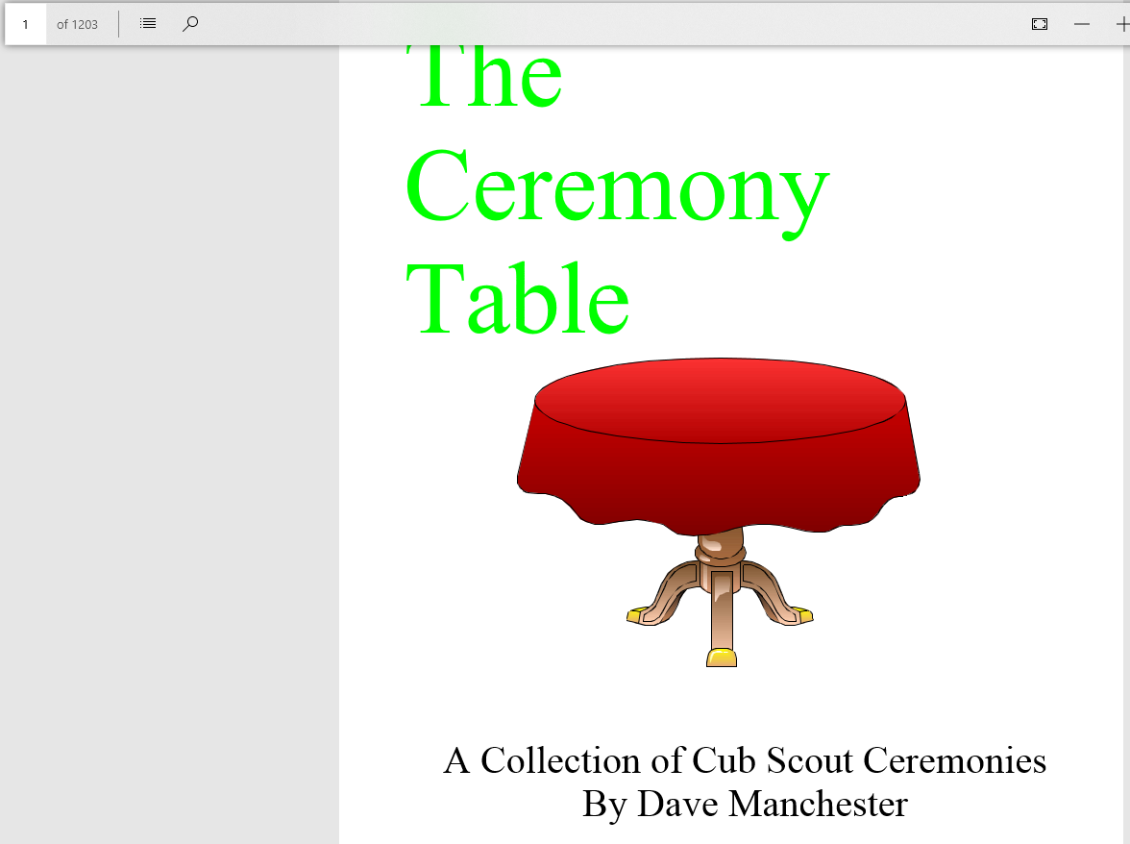
The Ceremony Table

Slide 13
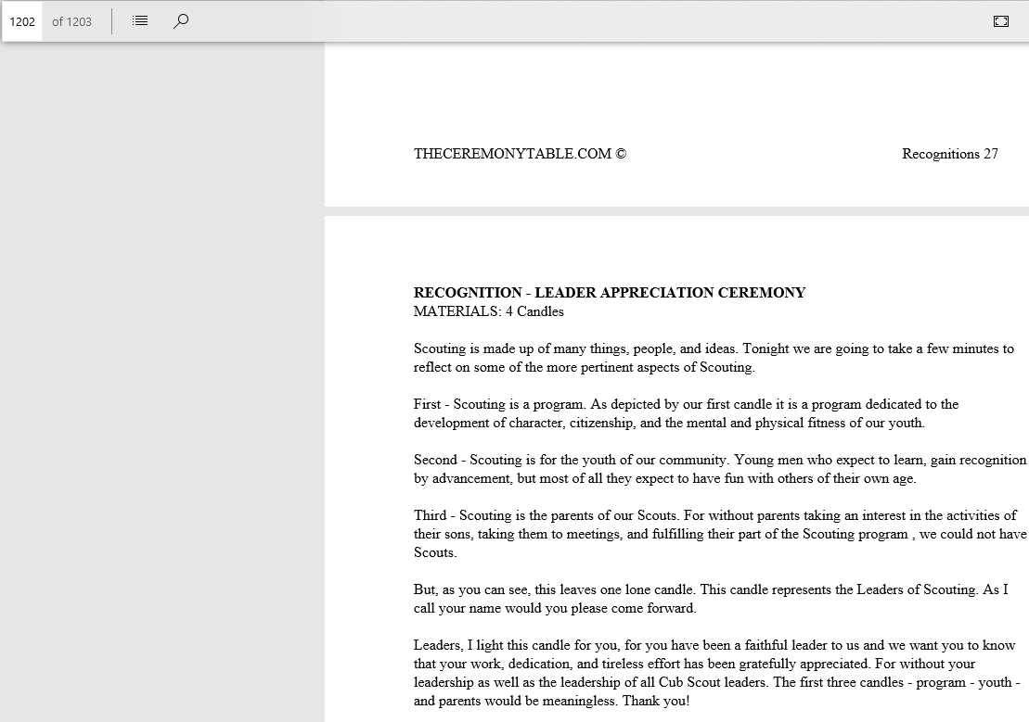
The Ceremony Table

Slide 14
Questions ?

Slide 15
Thank you

