Slide 1
Backyard Adventures!
(for Cub Scouts)
Session # 212 – Javier Ortiz
Program & Training Conference, October 20th, 2018
North Seattle Community College, Seattle WA

Slide 2
Welcome!
Introductions – A Small Survey
  Name
  Previous + Current Involvement in Scouting
    Where you a Boy/Girl Scout?
    Favorite memory
  What do you hope to get out of this course?
About Me
Method for the Course

Slide 3
Agenda
About Scouting
Getting with the Program ☺
Ideas for Adventures
Planning and Logistics
Q&A
Closing

Slide 4

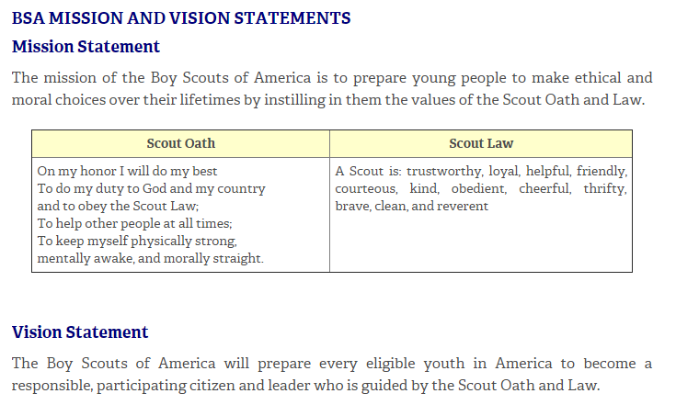
Why Scouting?
We want what Scouting can deliver – for our kids and our families!!

Slide 5
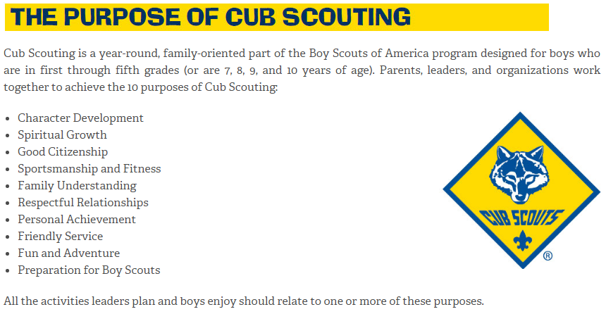
How Does Scouting Work?
Through a solid program delivered by trained leaders that looks to accomplish the Purposes of Cub Scouting…

Slide 6
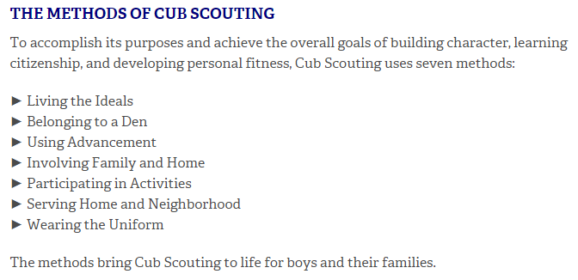
How Does Scouting Work?
… by using the Methods of Scouting.
ENGAGEMENT!

Slide 7

Cub Scout Programs
Each Cub Scout rank has the beginnings of a program laid out in their respective Cub Scout Handbook…
However, there is a lot of flexibility on how leaders and Cub Scouts can fulfill specific requirements!

Slide 8

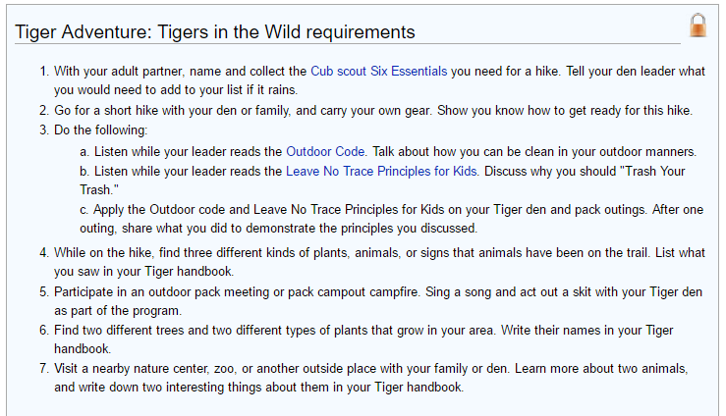
Cub Scout Programs: Tigers

Slide 9
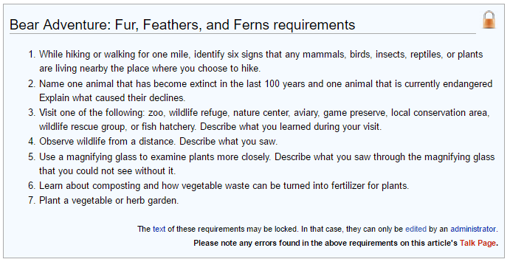
Cub Scout Programs: Bears

Slide 10

Our Goal in Programming
A Good Program (Ideas + Planning + Execution) is Key!
Our goal when planning the Program…
  Accomplish Aims of Scouting, …
  Using Methods of Scouting, while…
  Keeping the Cubs and their families fully engaged!
  “A Game with a Purpose”
The challenge…
  LIFE gets in the way!
The answer…

Slide 11
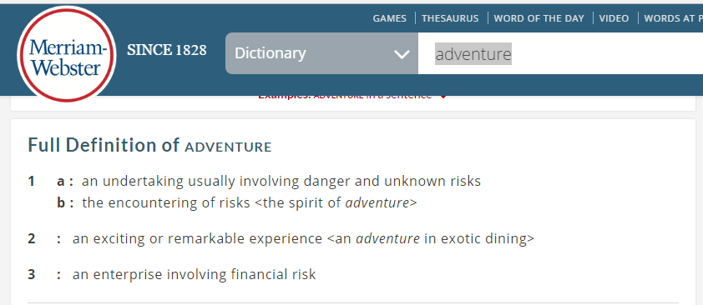
A Backyard Adventure!
What comes to mind when you think ADVENTURE?
With Cub Scouts, we focus on “exciting or remarkable”; also, unusual and memorable – AND safe! ☺

Slide 12
Principles for Backyard Adventures
1) Must be high-engagement – active, interesting, memorable
2) Must be accessible
  Close to home - walking, driving, busing, etc. (TIME)
  Mostly free or low-cost; an occasional splurge is good! ($)
  For all kinds of kids AND families! (ABILITY)
3) Must be safe
High Engagement + Accessibility + Safety = FUN!

Slide 13
Exploring the Playground
Brainstorming* ideas is the first step in programming!
Sky
On you own, or better in a group, consider…
Summer
Seasons
Settings
Rural
Spring
Urban
Land
Winter
Suburban
Wilderness
Fall
Elements
* Along w/ reading the handbook!
Water

Slide 14
Typical Cub Scouting Activities
Lots of options – indoors and outdoors!
Outdoors
Indoors
Swimming
Conservation Projects
Canoeing
Service Projects
Fishing
Campfires
Fire Stations
Museums
Cub Camping
Cooking
Zoo
Storytelling
Plays
Aviation
Horseback Riding
Day Hikes
Movies
Bowling

Slide 15
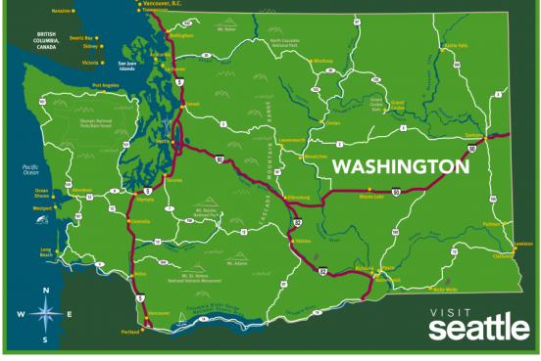
Where to Go?
WA is particularly blessed - your imagination is the limit!
An outstanding place to experience nature and the outdoors!
  Urban, suburban, rural or wilderness landscapes
  Land-based or aquatic environment
  Guided/formal or unguided/informal
  Short outings or multiday
A million option to explore the great indoors too!
Here are some ideas…

Slide 16
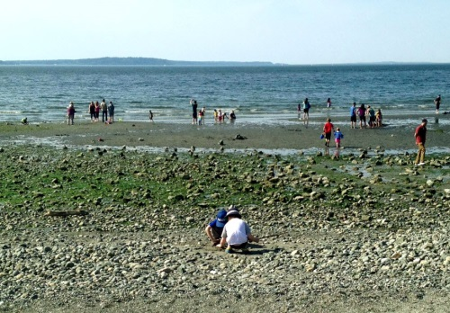
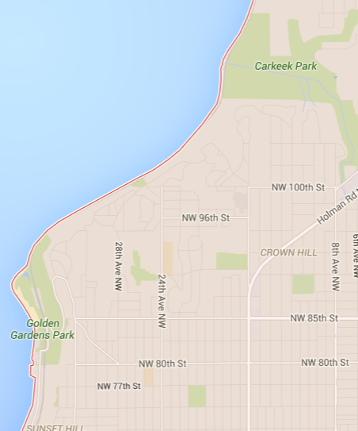
Idea #1: Carkeek to Golden Gardens
Urban: Low Tide Hike, Seattle
  Free
  Easy walking, can go N-S or S-N
  New, interesting side of the city many people do not see
  Nature docents at each end on low tide days
  Parks at each end – perfect for some free form play after the hike

Slide 17
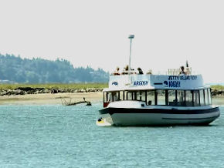
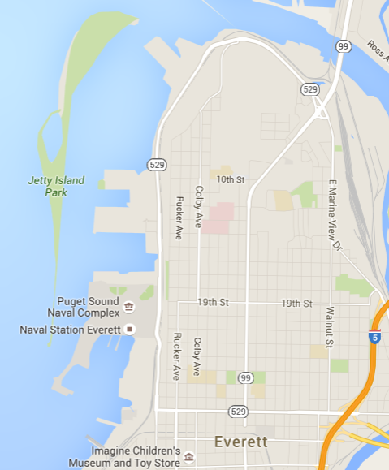
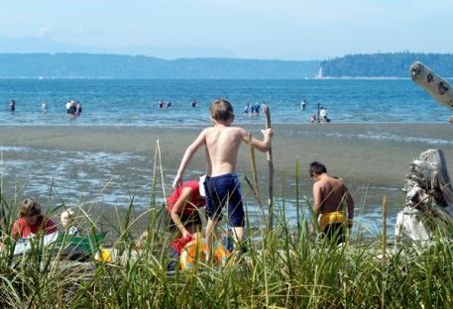
Idea #2: Jetty Island
Urban: Ferry and nature hike, Everett
  Low cost, reservations available
  Fun and short boat ride to and from the island
  Easy walking, perfect for family picnic
  Docent programs on the weekends
  Fun times in the mud flats digging cost shrimp with your hands, or building sandcastles on the beach

Slide 18
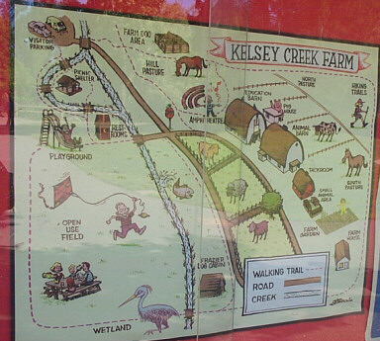
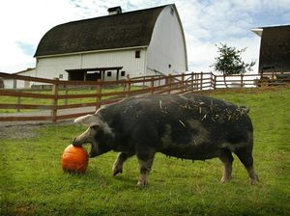
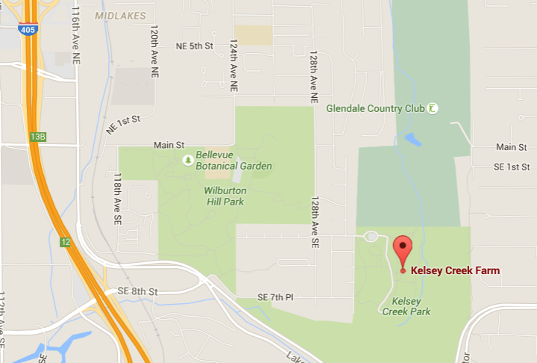
Idea #3: Kelsey Creek Farm
Suburban/Rural: Farm, Bellevue
  Low cost, reservations for groups recommended
  Short ride from metro areas
  Beautiful setting, working farm
  Seasonal events
  Petting zoo with docents

Slide 19
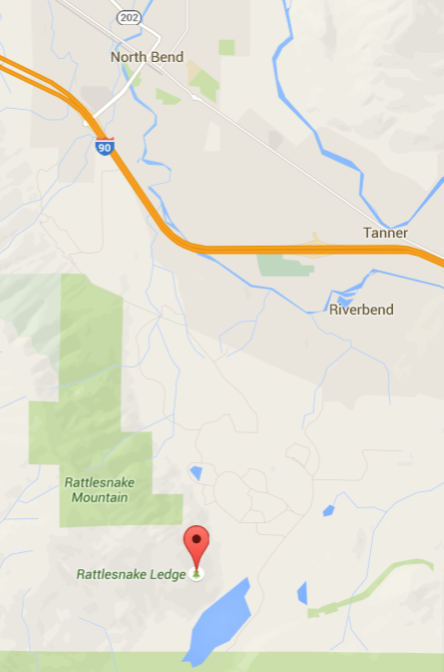
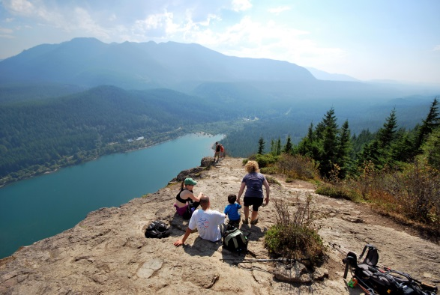
Idea #4: Rattlesnake Ledge & Lake
Wilderness: Hike and swim, I-90 Corridor
  Low cost
  Easy access from I-90 corridor (west of the pass), not far from North Bend, WA
  4 mi. round trip hike with moderate elevation gain to amazing views of the Cedar River watershed, Mt Si and others
  Cool down at the lake!

Slide 20
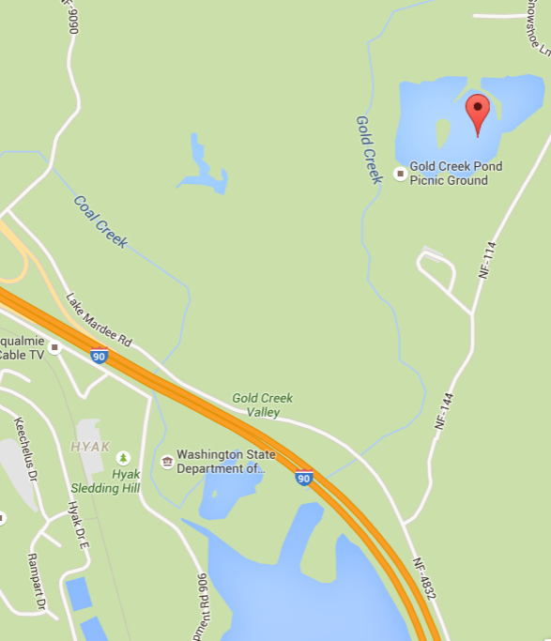
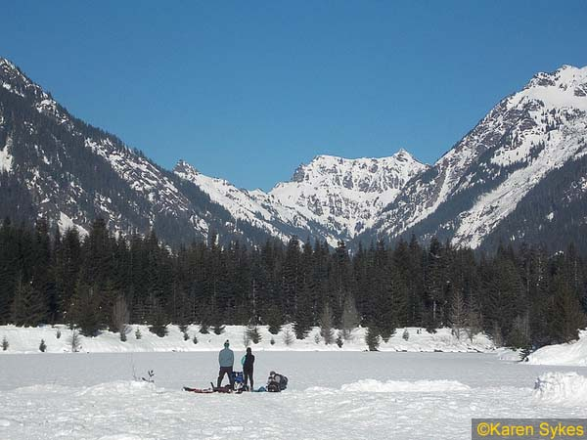
Idea #5: Gold Creek Basin
Wilderness: Snowshoeing and , Snoqualmie Pass
  Low-moderate cost
  Perfect winter snowshoe hike, under 2 mi through mostly flat, avalanche-free zones to frozen lake
  Docents and gear available with reservation from the ranger station at The Summit ski area; or rent your own gear at REI and guide you own trip!
  Unlimited snow for forts and snowball fights!

Slide 21
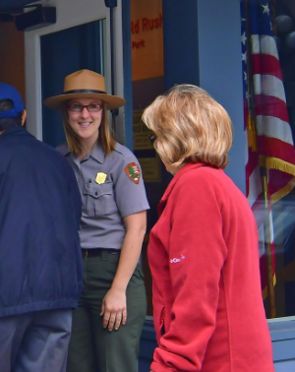
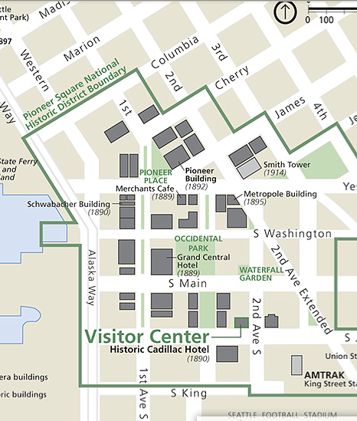
Idea #6: Klondike Gold Rush NP
Wilderness: National park and museum, Downtown Seattle
  A national park… IN SEATTLE!!!!
  Docent tours, scavenger hunt, gold panning demo
  Do the Trail to Treasure urban hike around Pioneer Square OR plan your own hike to Pike Place Market for lunch!

Slide 22

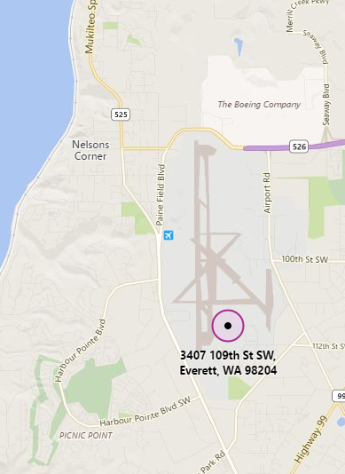

Idea #7: Flying Heritage Collection
Wilderness: Aviation Museum, Everett
  Low-moderate cost (Free-$14/person) – some special days are free for all
  Awesome collection of vintage airplanes
  Simulators
  Occasional fly-bys
  Docents available for Scouting groups (call ahead)
  Seasonal events

Slide 23
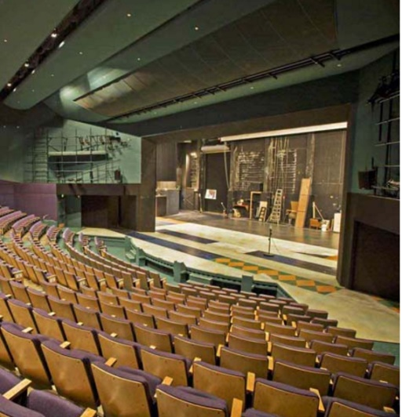
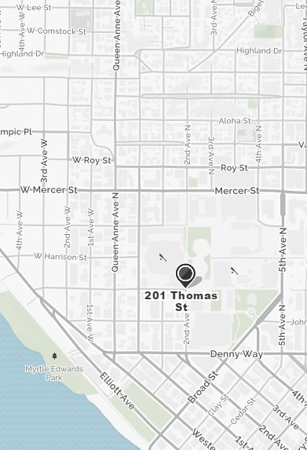
Idea #8: Seattle Children’s Theater
Wilderness: Theater, Seattle
  Moderate cost (group 10+ rates for groups 10+; also preview days are lower cost)
  High production values
  Q&A after shows
  In Seattle Center – lots of open spaces to play, including fountain!

Slide 24
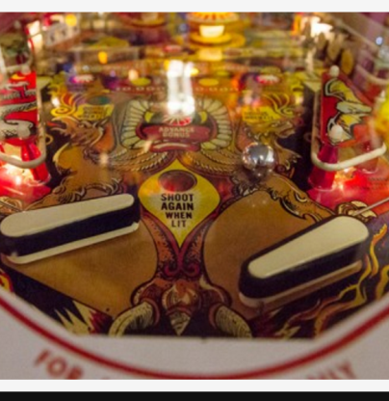
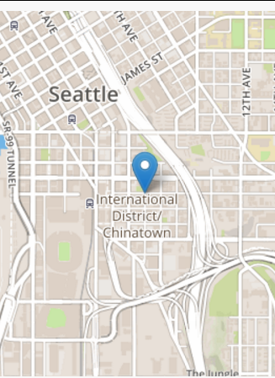
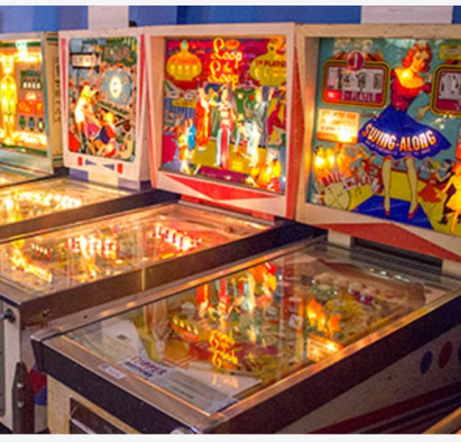
Idea #9: Seattle Pinball Museum
Wilderness: Fun times, ID, Seattle
  Moderate cost ($12-15; bring a little extra for snacks)
  All the old-school pinball you can eat… play
  Fun for kids AND adults
  Lots of cheap eats right outside the door!

Slide 25
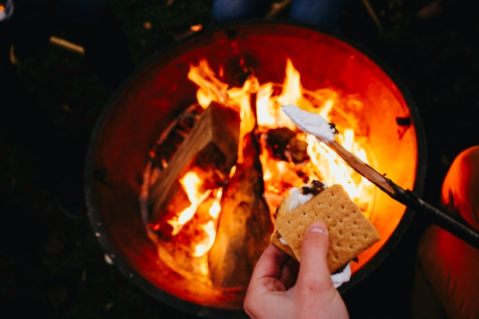
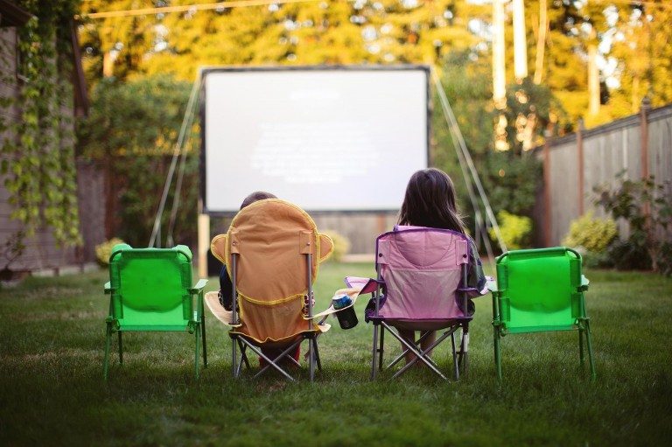
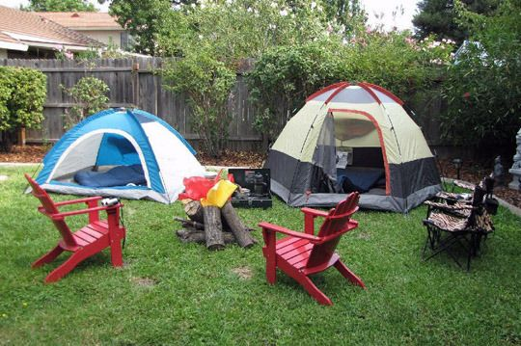
Idea #10: Backyard Camping!
Wilderness: Camping, Backyard
  Free to low cost
  Low-risk opportunity to learn and practice camping, while having a blast!
  Combine with campfire, foil cooking, storytelling (Scary/funny stories! Jokes! Skits!) and maybe even an outdoor movie (white sheet and borrowed projector) – a magical time for all!

Slide 26
Other Cool Ideas!
Night hikes hosted by in-city parks (e.g. Discovery in Seattle)
Sports events – many hold tours/events for kids before games
Council camps – special day and overnight camping events for Cub-age boys and families (e.g. Mom and Me, etc.)
Community center events – seasonal & special events, movies
Bowling/mini-golf/ice skating/roller skating – group rates!
Local art studios and workshops – smaller is sometime better

Slide 27
Other Cool Ideas! (cont.)
Learn to cook/knit/sew/etc. event – put on by parents or friends!
Shooting Sports Program (Chief Seattle Council)
Bicycle trips on bike trails (e.g. Burke Gilman)
Fishing derbies like Renton ‘s Kid Fishing Derby
Low cost canoeing/rowing – UW Canoe Rentals or city parks
Backyard gardening or P-Patch visit

Slide 28
Additional Resources
Seattle Area: http://seattleanne.com/seattle-with-kids
Tacoma/South Sound: http://www.soundsfunmom.com/100-places-to-take-kids-in-the-south-puget-sound/
Everett/North Sound: http://www.tripbuzz.com/things-to-do-with-kids/everett-wa

Slide 29
Planning & Logistics for Adventures
Four guiding principles in Scouting planning…
  Is it FUN? – we maximize enjoyment and preserve relationships
  Is it ACCESSIBLE? – everyone can participate
  Is it SAFE? – we all come me healthy and unharmed
  Is it SANE? – we have realistic goals and expectations, we ask for help, we spread the load
Keeping it Fun/Accessible
  We covered the first two - let’s look at the others..

Slide 30
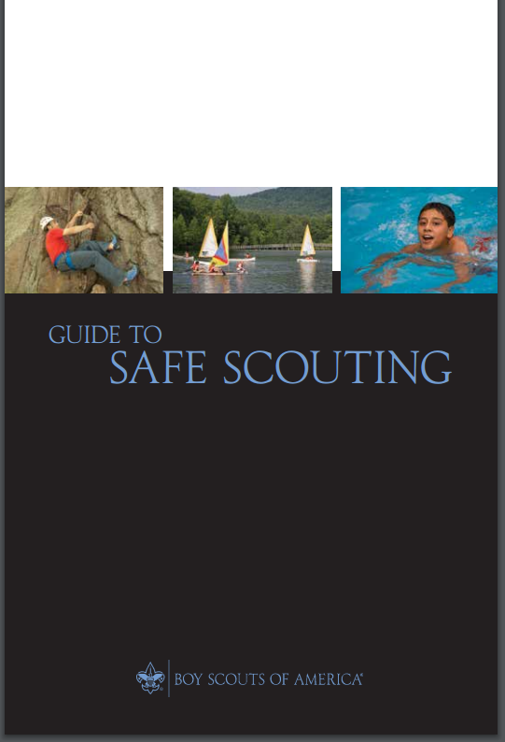
Planning & Logistics for Adventures
Keeping it Safe
  Safety is paramount – read and follow the “Guide to Safe Scouting”
Online version: http://www.scouting.org/filestore/pdf/34416.pdf

Slide 31
Planning & Logistics for Adventures
Keeping it Safe (cont.)
    Two Deep-Leadership - no 1:1 contact, at least 2 at all time, 1 registered over 21
    Appropriate Activities – see insert in Guide to Safe Scouting
    Proper Adult Training – basic and specialized training
    Medical Considerations – forms required?
    Proper Transportation – insurance requirements, drivers info
    Special Requirements – e.g., Safe Swim Defense for swimming activities

Slide 32
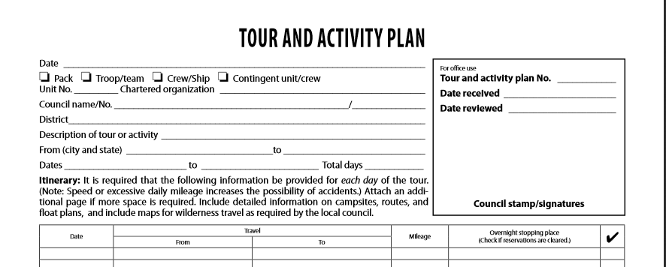
Planning & Logistics for Adventures
Keeping it Safe (cont.)
  That’s a lot to remember, you say? Enter the Tour & Activity Plan
    Even if not required, an excellent checklist! (see handout)

Slide 33
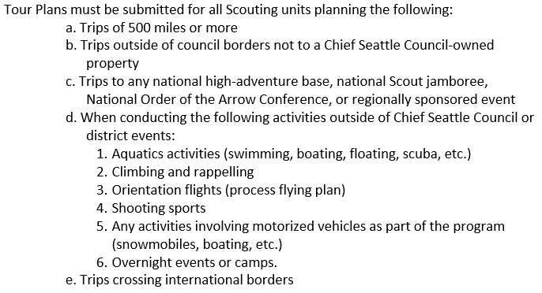
Planning & Logistics for Adventures
Keeping it Safe (cont.)
  When is a Tour and Activity Plan required?
  Super easy to do online – go to https://myscouting.scouting.org/

Slide 34
Planning & Logistics for Adventures
Keeping it Sane
  Plan Ahead – hold an Annual Planning Meeting with your adults; lay out events and activities in advance, make adjustments as you go; create an online calendar to share
  Spread the Load – enroll your parents into the event and activity planning and follow up; each parent or group of parents takes responsibility for the planning and coordination for each event – “many hands make light work” and all that; as den leader, focus on one or two events and on managing the other planners (e.g. follow up in advance of event, collect updates, etc.)

Slide 35
Planning & Logistics for Adventures
Keeping it Sane (cont.)
  Reach Out for Help – if you are not familiar with a subject (e.g. tree identification, backpacking, etc.), reach out to friends, parents, other den leaders, cubmasters, district and council friends; also lots of resource online
    TIP: Roundtable and training events are great for networking!!!
  Be Gentle with Each Other – if an event doesn’t happen due to weather, unforeseen circumstances, that’s OK; forgive yourselves, reschedule and try again; don’t give up!

Slide 36
Questions?

Slide 37
Closing Items
My Contact Info
  Javier Ortiz, boealper@yahoo.com, 206-673-1401
Evaluations
  Manual (stickers upfront)
  Electronic:
    To record your evaluation and attendance from a mobile device, go to http://seaptc.org and click "My Evaluation & Attendance"
    The code for this session is 9109

