Slide 1

Cubs 102: Growing Your Pack with a Successful Cub Scout Recruiting Program
Rick Cordray
Unit Commissioner, Pack 427
(Thanks to Kat Ressler for some of this material!)

Slide 2

Introductions
Introduce ourselves – name, primary position, and something you hope to learn here.

Slide 3
Successful Recruiting Rules
#1 - Never Stop Recruiting
(Actually, just the one rule)
Every activity and event is a recruiting event
  Cubs, leaders, and parents should be encouraged and shown by example to be open to more members
Cub recruiting is also parent/volunteer recruiting
  You need them too!

Slide 4

The Key 3 4
Program
Visibility
Events
NFAs – Normal Friend Activities
These are not distinct things – they blend together

Slide 5
Program Creates Membership
This is a time tested, proven principle
When Cubs are having fun…
  They come back for more
  They bring their friends
  They attract attention and people find the pack
How good is your Pack’s program? Can it be improved?

Slide 6
Program: Keeping Cub Scouts Engaged
Set expectations early
Enable the Patrol method as often as possible
Play games (Scouting is a Game with a Purpose!)
Be prompt with recognition
Be genuine
Allow for creativity and energy
Train your leaders

Slide 7
Make Sure People Can Find You!
Keep Your Unit Pin Updated
Keep your unit meeting information and websites current
Be sure to post if you are not meeting/have a way to cancel

Slide 8
How did your pack recruit this year?
Special events?
Flyers?
Open meetings?
Special outings?
What else?

Slide 9
Static vs. Dynamic Recruiting
Static: Make your self available and welcoming, then hope/expect people will come
  Events are like this
Dynamic: Proactively seek new families by using a deliberate process

Slide 10

Steps for a Successful Event
EVENT
  Venue and date are confirmed
  Event is publicized on unit website/social media
  Family/Scout participation is confirmed
  Families are encouraged to bring friends
  Friend participation is confirmed

Slide 11
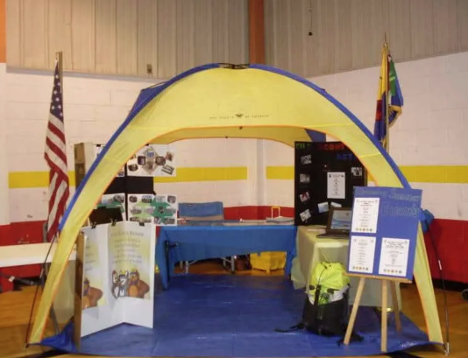
What to Showcase?
How Scouting Works
Pack Events; Pack Calendar
Dues & Fees; Fundraising
Registration
Payment
Advancement
Paper Packets; Online Information
Craft/Activity – make sure kids are engaged while you talk to parents
Leave Time for Q & A

Slide 12

Advertising
Be where families are. Be visible
Pizza box flyers with QR code
Flyers/posters at take-out restaurants, grocery stores
Yard signs (council will provide!)
Peachjar or other flyer system
Family Fun Fest
Guerilla Marketing:
Door flyers; twirly sign on street corner; geofencing; school supplies.
Use social media: Facebook; Next Door

Slide 13
Dynamic Recruitment
Overview
  Pack volunteers recognize that the future of the pack and of Scouting depends on recruiting
  Pack sees limitations in their past recruiting efforts – limited success, or declining membership
  Pack volunteers are determined to do better
  Dynamic recruitment is a process that includes commitment and motivation, but produces results

Slide 14
Dynamic Recruiting 3 Steps
1. Know It!
  Know and live the Scouting Values
  Set your goals and recruit until you meet (or exceed) them
2. Do It!
  Every family invite a new family
  Hold a Normal Friend Activity – weekend activities such as game days, cookouts, day hikes
  Sign them up!
3. Study It!
  Review and revise the plan
  Make plans to do it again next year!

Slide 15
Onboarding Families
Keep the kids you recruit and get their siblings
Make sure that, and make it possible for, the parents to have fun, too.
Parent orientation meeting: for all parents – not just new ones
Orientation Booklet
Pack Calendar
Communication: email, text, phone call, Facebook page, Scoutbook, pack website
On-going support: someone to answer questions, explain program, make families feel welcome
Dedicated Phone Tree or contacts - call current families and see what needs they may have

Slide 16
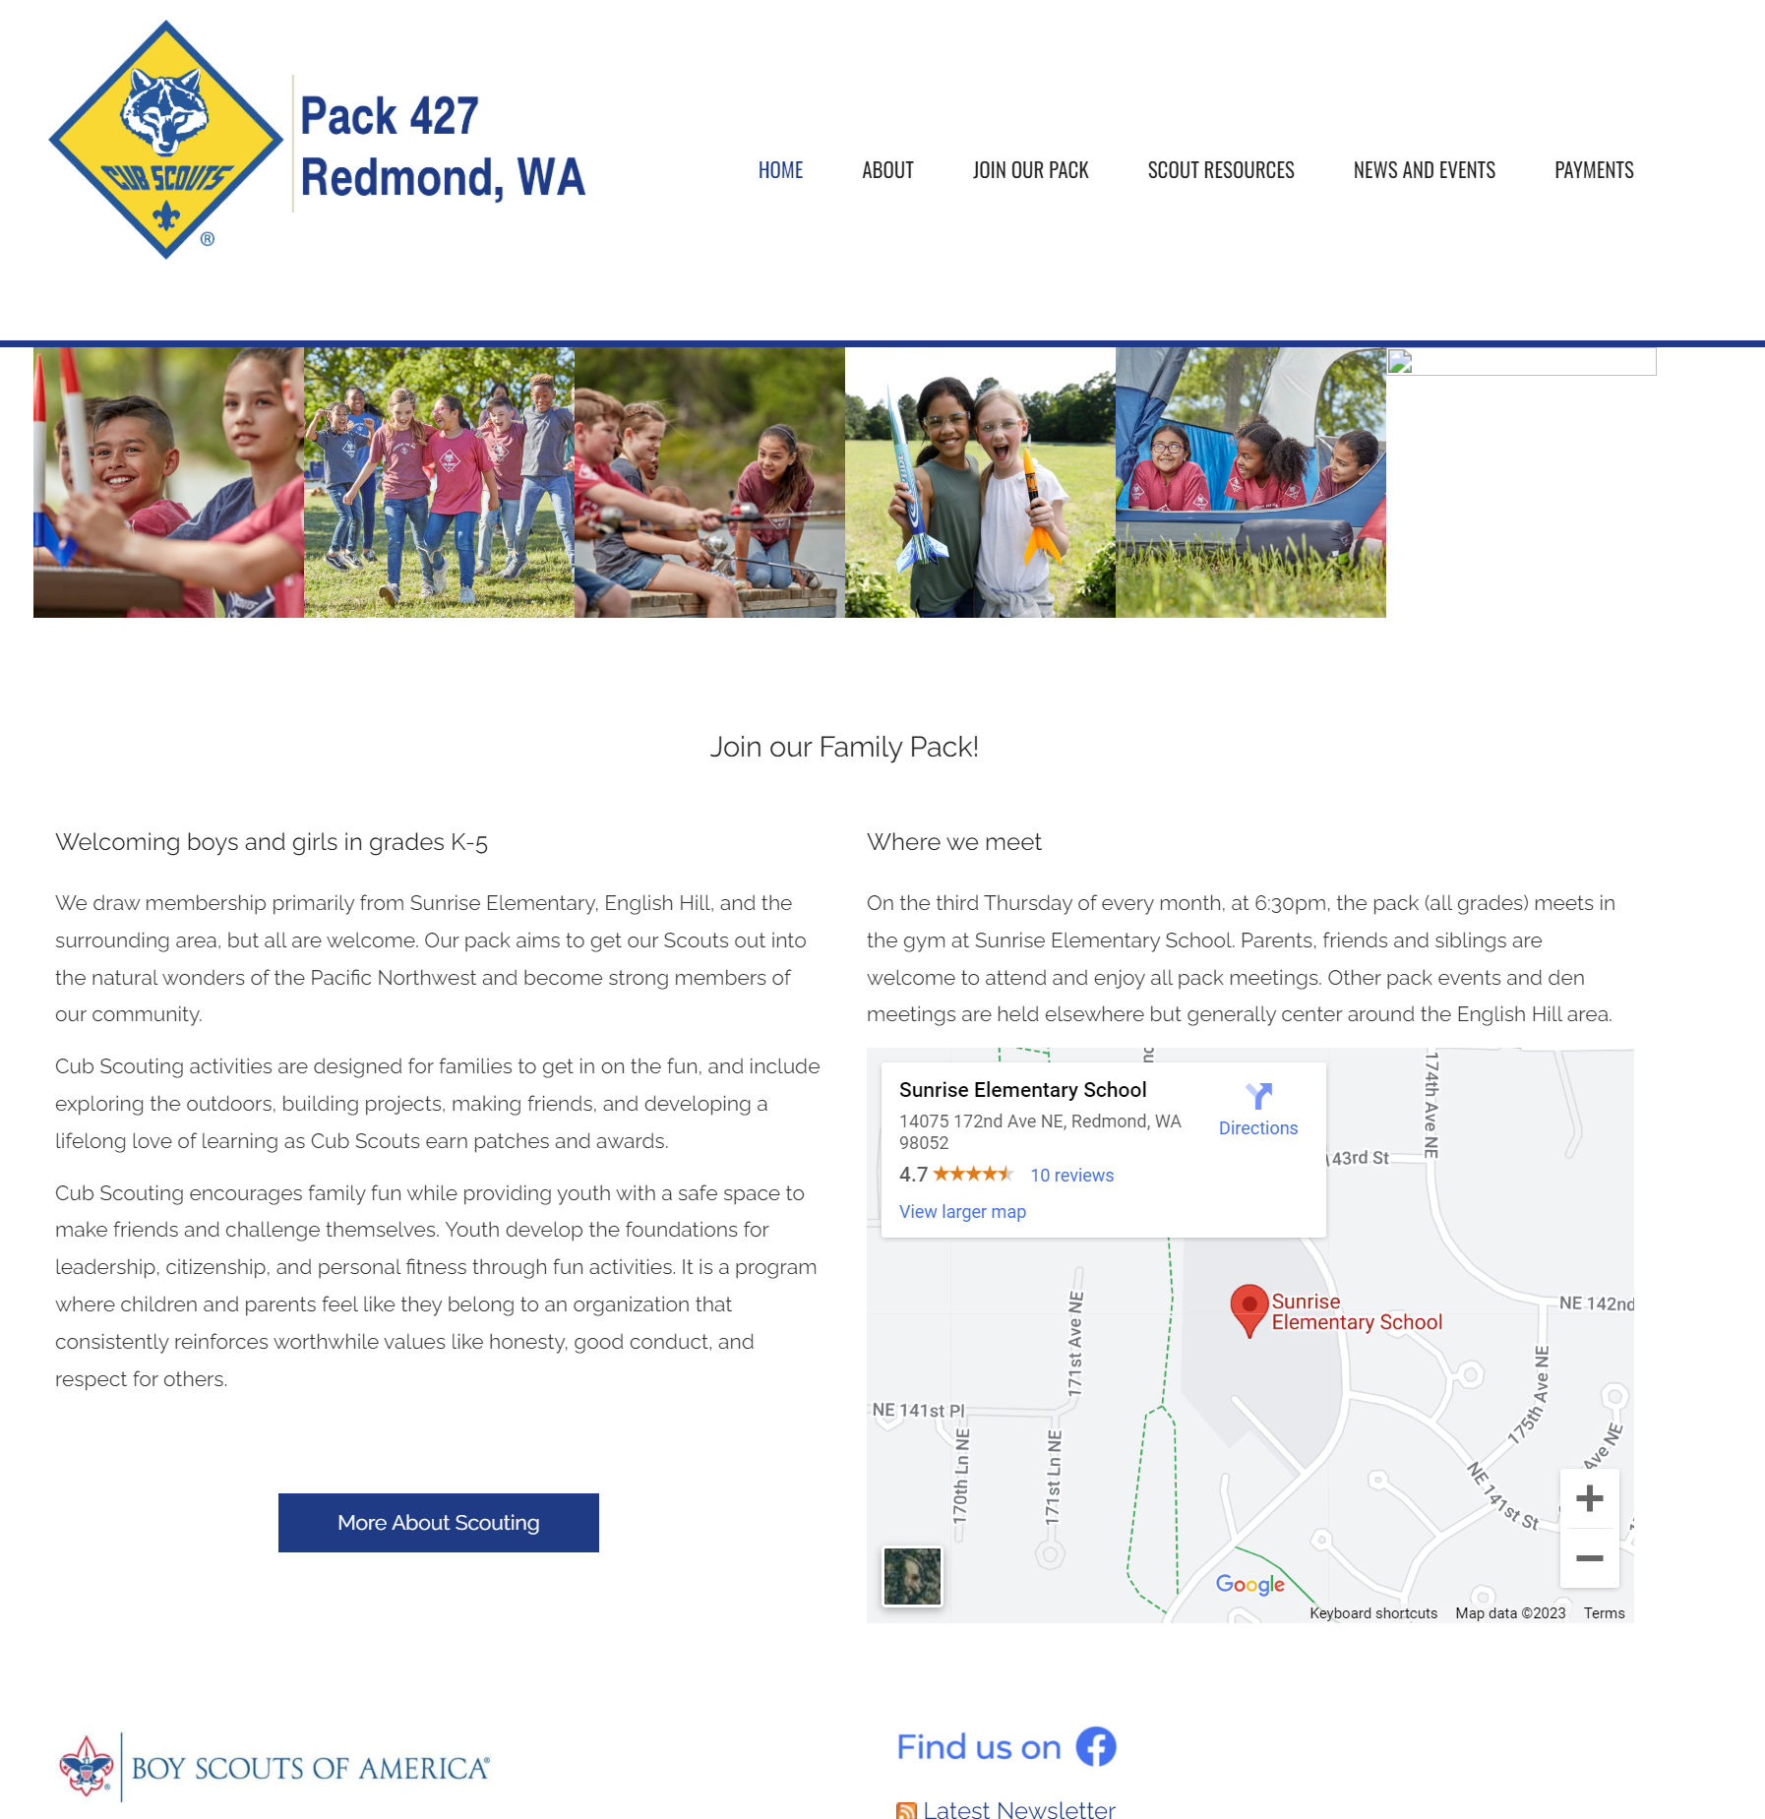
Example

Slide 17
Thoughts on…. Welcoming Committee
Must to be familiar with pack families so they recognize new faces
Help new families know where to go, what to do
  Also have signs directing people to gathering activities, seats, etc.
More than a Big Chain greeter: be more personal, take more time.
  Get to know new families, how they’re doing, answer questions, clear up confusion
  Help connect them to other families (same rank, interests, neighborhood, etc.)
  Foster integration and friendships
Stand near the room entrance, but do NOT block the door
  You want to be able to have short conversations with parents and not keep other families from entering.
Need a committee so there are enough Scouters to interact with all the new families
  One or more scouters may get into extended conversations with new parents, so you need a team to cover everyone.

Slide 18
Fun Ideas to Welcome Families
Get families involved as soon as their child joins – the more of a connection you make, the more they will want to invest back
Highlight and Welcome families via your newsletter – make them feel special – they are!
Ideas
Candy exchange (have separate baggies filled with candy and collect asap), hand out for the holiday
Welcome Gift
  Free flashlights, pencils, a mini care package (for existing and new families), yard signs welcoming the Scout, etc.

Slide 19
When Do We Onboard Families?
Needs to be an ongoing, year long effort – not just once

Slide 20

Discussion
&
Questions ?

Slide 21
Web Resources
Membership and Recruiting Resources: https://seattlebsa.org/membership/
Blog: https://blog.scoutingmagazine.org/category/cub-scouting/
BSA Virtual Recruiting Playbook for Fall Recruiting: https://scoutingwire.org/wp-content/uploads/2022/12/Cub-Scouting-Dynamic-Recruitment-Playbook.pdf
BSA Recruiting webinars: https://scoutingwire.org/marketing-and-membership-hub/marketing-webinars/
Geofencing, Social Media.
Outdoor Recruiting Event video (10 min.): https://vimeo.com/450279270
BSA Marketing Materials: https://scoutingwire.org/marketing-and-membership-hub/ Includes recruiting videos.
Logos, photos, etc. you can use: https://scouting.webdamdb.com/bp/#/assets

