Slide 1
BCS 104
Contacting Units
Discussion Leader: Rick Cordray
Revision date 4/1/2021
Notes:
This is a participant discussion format course.
Course leader(s) should guide a discussion. The experience level of your participants will guide you in how much you will have to dig for them to come up with the responses.
Watch your time. With group discussions, time can get away from you.

Slide 2
Course Objectives
Describe how the concept of unit service is demonstrated in frequent unit contacts
Identify ways to demonstrate good unit service as we serve as a coach/mentor and representative of the BSA
Explain the importance of using Commissioner Tools to record and manage unit contacts
Notes:
At the heart of unit service are the contacts commissioners make with their units.
The objectives for this course are:
Describe how the concept of unit service is demonstrated in frequent unit contacts
Identify ways to demonstrate good unit service as as a coach/mentor and representative of the BSA
Explain the importance of using Commissioner Tools to record and manage unit contacts

Slide 3
Commissioner Objectives
Supporting unit growth and retention
Contacting units
Linking unit needs
Supporting timely charter renewals
Supporting unit leaders
Notes:
Unit commissioners need to focus on five primary areas as displayed here on the screen:
Quickly review the topic which is covered in Commissioner Basic and BCS 101.
Supporting unit growth and retention through the journey to excellence.
Contacting units and capturing in Commissioner Tools their strengths, needs, and a Unit Service Plan that enables continuing improvement.
Linking unit needs to district operating committee and other resources.
Supporting timely unit, district, and council charter renewals.
Supporting unit leaders by collecting and distributing information, enabling program training, and providing networking opportunities.
Make the point that this session is going to focus on objective 2.

Slide 4
Focus of this Course
  Contacting units and capturing in Commissioner Tools their strengths, needs, and a Unit Service Plan that enables continuing improvement.
Notes:
Our core task remains making contacts with units over the course of a year. This is probably the most important objective we have as commissioners because nothing else happens in unit service until we contact a unit and establish a relationship with their unit leaders.
We’ll talk more about Commissioner Tools and establishing relationships later.
A unit’s strengths and needs, assessed through unit contacts and captured in Commissioner Tools enables commissioners to develop a customized Unit Service Plan to address those identified needs, but the Unit Service Plan is the subject of another course.

Slide 5

What is a Unit Contact?
BSA has defined a unit contact as “a meaningful exchange between a commissioner and 1 or more members of the unit.”
Notes:
Why is it important to clearly define what constitutes a unit contact and why do you think BSA uses this definition?
Ensure that the following points come out:
In order to count contacts as a measure of successful unit service, we must agree on what contact is significant.
To count as a unit contact it must satisfy the three criteria
“meaningful” – does it contribute to unit service
“exchange” – implying two way communication
“between a commissioner and 1 or more members of the unit”
Why these criteria?

Slide 6
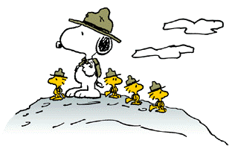
Supporting Our Mission
To prepare youth to make ethical and moral choices over their lifetimes by instilling in them the values of the Scout Oath and Law.
Notes:
Unit contacts are critical to commissioners achieving success in our mission.
As commissioners, we share the BSA’s mission: To prepare youth to make ethical and moral choices over their lifetimes by instilling in them the values of the Scout Oath and Law.

Slide 7

Who makes unit contacts?
Who Makes Unit Contacts?
Any commissioner
Professional
Notes:
Who makes unit contacts? Ensure that the following points come out:
Any commissioner may make a unit contact
the assigned unit commissioner
a non-assigned unit commissioner
an administrative commissioner
a Roundtable commissioner
Which commissioner would be preferred? The assigned unit commissioner. Why? Because he/she has history with the unit.
Can a professional scouter make unit contacts? Yes, commissioners and professionals both wear the wreath of service and are there to support units.
What would be the advantage of professionals logging information from unit contacts? It ads to the picture of a unit’s strengths and needs. All entries - as well as professional unit contacts - count towards district/council JTE objectives.

Slide 8


Where and How are Unit Contacts Made?
  Visit to a unit meeting
  Visit to a committee meeting
  Visit to a unit activity
  Individual contact
  A meaningful phone conversation
  Email exchange
  Text messages
Notes:
Discussion: Where and How are unit contacts made?
Reveal the following on the slide following the discussion:
Visit to a unit meeting
Visit to a committee meeting
Visit to a unit activity (e.g., district/council event)
Individual contact (e.g., at roundtable, private meeting or a chance encounter)
A meaningful phone conversation or
Two-way email exchange (e.g, discussing a unit problem)
Text messages (as a follow-up)
Discuss the appropriate use of each and the advantages of a mixture of types of contact.

Slide 9

When to Make / Frequency of Contacts?
  Make as many contacts as needed
  Recommend at least monthly
  Prioritize contacts based on need
Notes:
Discussion: When to make/frequency of contacts?
Reveal the following on the slide following the discussion:
Make as many contacts as needed to fulfill your unit service mission
Recommend at least monthly
When districts have insufficient resources, prioritize contacts based on need

Slide 10
Some Basic Ground Rules for Unit Visits
Call in advance
Visit the entire meeting
Should not participate in the meeting
Full and proper uniforms are to be worn
Notes:
Some basic ground rules for unit visits
Call in advance to be sure that the visit is convenient.
The visit should extend through the entire meeting.
The commissioner should not make an effort to participate in the meeting, except to be introduced.
Uniforms are to be worn and should conform to the appropriate uniform inspection sheet
Now let’s identify some commissioner dos and don’ts for unit visits and other types of contacts

Slide 11

Who makes unit contacts?
Contact Do’s and Don’ts
Notes:
Discussion: Contact do’s and don’ts
Buzz Groups Form two buzz groups, one to make a list of good practices for commissioner contacts with units and the other bad practices.
Allow up to 4 minutes for discussion. Then have the buzz groups report back to the class.
Some example do’s and don’ts follow:
DO’s
Visit often - Visit different types of meetings/activities
Smile – Be Positive
Bring something (e.g., a flyer for an upcoming event or news of some coming program change)
Talk to several leaders and some youth
Be cognizant of your body language
Listen – actively and empathetically
Ask if there’s anything you can do to help
Check your ego at the door
Follow up on questions you couldn’t answer
Follow up on promises
Follow up with a Thank You
Respond promptly to messages
DON’TS
Act as the uniform police
Enter your visit while you’re there
Be late
Overstep your bounds
Take sides
Over post in electronic communications
Lie – You will be found out
Take too much of the unit leader’s time – He/She has a meeting to run
Start sentences with “You” if you’re saying something negative
Give advice directly if not asked for (Avoid “Should”)

Slide 12
Building Relationships with our Units
Our success supporting a unit depends on a healthy and trusting relationship with the unit’s leadership.
What are some things people value in a relationship?
Notes:
Our success supporting a unit depends on a healthy and trusting relationship with the unit’s leadership.
Let the class suggest some of the qualities people want in a relationship. After a brief discussion, show the next slide, listing the values people want most

Slide 13
Top 10 Relationship Values
The top 10 values people want in a relationship?
Appreciate people’s worth
Positive
Empathetic
Reliable
Communicate openly
Understanding
Listen
Trustworthy
Willing to find common ground
People person
Notes:
Top 10 things that people want from a relationship
1.Appreciate people’s worth - Genuine
2.Empathetic - Unselfish - Giving
3.Communicate openly – Knowledgeable
4.Listen - Demonstrate interest - Inquisitive - Quiet
5.“People person” - Upbeat - Optimistic
6.Positive
7.Reliable - Do what you say - Be honest
8.Trustworthy
9.Understanding-Objective-Unbiased-Respect other’s point of view
10. Willing to find common ground-Persistent, but not Aggressive
Ask: Which do you value? Which do you demonstrate in your relationships?
How could you improve?

Slide 14
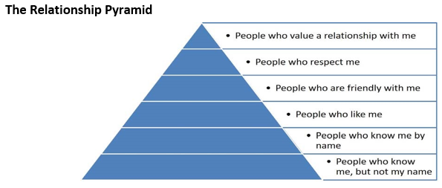
The Relationship Pyramid
Notes:
Handout: Relationship Pyramid – 1 per participant
Questions (Either rhetorical or for discussion, depending on time still available):
Where are you and your unit’s Key 3 on the relationship pyramid?
Where would you like to be and what actions can facilitate getting there?
Note that there is an entire course on Building Meaningful Relationships (DCS 514) in the Doctoral Program.

Slide 15

Commissioner Tools and
Journey to Excellence
Notes:
Unit Contacts - Assessments
Building trust in the relationship helps provide a basis for assessments and collaboration between the commissioner and the unit.
Support implementation of the Unit Service Plan through detailed assessments and an increased number of significant unit contacts to packs, troops, crews, ships, clubs, and posts.
A Unit Assessment is a first step in supporting unit growth on the Journey to Excellence. Scouting’s Journey to Excellence (JTE) is the BSA aspirational planning, performance and recognition program designed to encourage and reward success of our units, districts, and councils. It is meant to encourage excellence and continuous improvement in providing a quality program at all levels of the BSA.
The JTE standards are based on achievements the previous year or previous few years, both individually and for the creation of national standards. Due to the extraordinary circumstances occurring in 2020, benchmarking 2019 to 2020 at the district and council level is not constructive and similarly basing 2021 standards on 2020 for districts and councils is equally inappropriate. Many units, however, have largely adapted their programs to the challenges of 2020 so their members have continued to enjoy Scouting.
For these reasons, the Journey to Excellence recognition program for districts and councils was discontinued in 2020. The Unit level recognition program continues, and recognition patches will be available for units.
Every unit is required to have a detailed health assessment annually, and it must be recorded in Commissioner Tools in order to be counted. Any commissioners detailed assessment fulfills this requirement. Simple Assessment function in Commissioner Tools provides a quick and easy was to document plan progress. Simple assessments document regular, monthly contacts by a unit commissioner.
Whenever possible, it is preferred that a Detailed Assessment be done in collaboration with the unit Key 3. However, this is not always possible so the assessment can be done unilaterally by the commissioner or professional. The assessment is meant to engage commissioners and unit leaders in implementing a continuous improvement process for the unit. It provides the greatest insight into unit health.
Unit contacts recorded in Commissioner Tools should involve substantive interaction with unit leaders that ensure Unit Service Plan progress or address some other significant unit need.

Slide 16
Commissioner Tools
After making contact with your units, what do you do with the information you have acquired?
You enter a contact report in Commissioner Tools – the software developed by commissioners, for commissioners, to enable fast and efficient unit service.
Notes:
After making contact with your units, what do you do with the information you have acquired?
You enter a contact report in Commissioner Tools – the software developed by commissioners, for commissioners, to enable fast and efficient unit service.

Slide 17
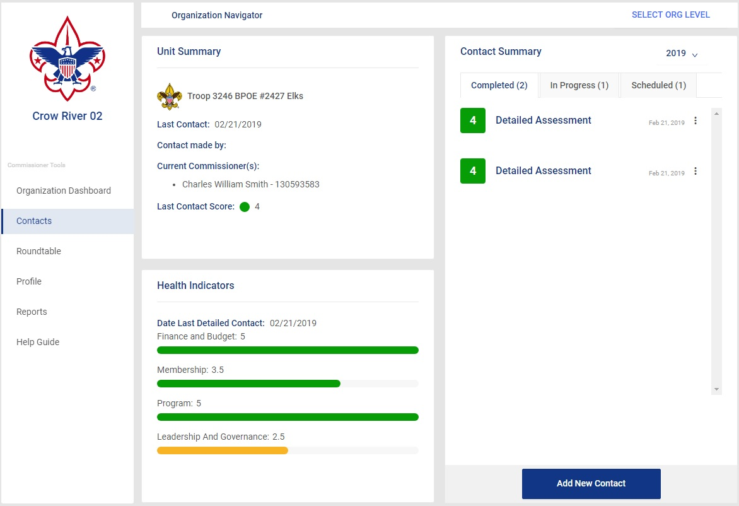
Commissioner Tools
An example of a unit’s Commissioner Tools page in My.Scouting
Notes:
There are several important pieces of information displayed here. The summary page provides; the unit type, number, the name of the Chartered Partner, the date of the last contact, and the name of the commissioner or professional who made the contact. You can also see the name of the commissioner assigned to the unit. Finally, you see the last contact score.
In the Contact Summary box, users can see three tabs labeled Completed, In Progress, and Scheduled, each with the number of contacts in that category shown parenthetically. In the upper right-hand corner, using the pulldown arrow the user can change the year for which the information is displayed. As required, from here commissioners have 48 hours from submission to edit or delete a completed contact. Click on the 3 dots after the contact date to edit or delete the contact. After 48 hours you will only be allowed to view or print the assessment.
The final box displays the unit health indicators for the unit based on the latest detailed assessment. These indicators only appear when a detailed assessment has been completed.

Slide 18
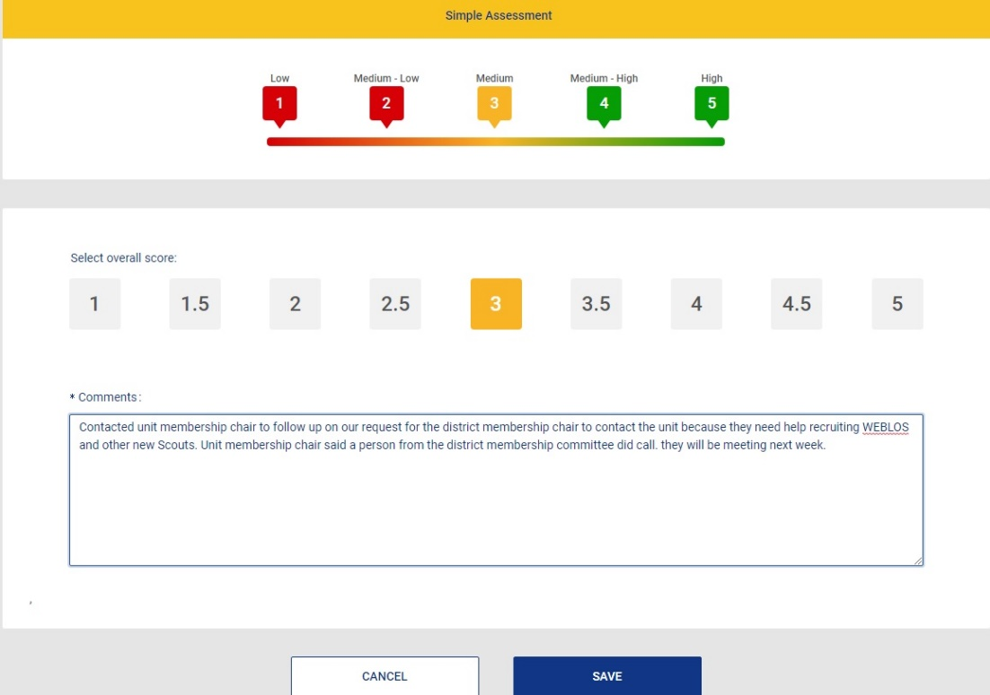
Commissioner Tools
An example of a Simple Assessment unit contact entered by the unit’s assigned commissioner
Notes:
Here we chose a Simple Assessment. At the top of the screen is the unit health scoring matrix. Hover your mouse over each number to get a brief definition of what that score means. Then, choose the score you feel most accurately reflects the present health of the unit as determined from your latest contact with the unit.
The comments box must be completed. Remember, your comments should be Actionable Information about the unit so that the appropriate assistance can be provided. When you are satisfied with your comments and score, click on the SAVE button. Your simple assessment is now complete.

Slide 19
Reports
  Assigned and Unassigned Units
  Commissioner Contacts
  Commissioner Contacts without Sub Totals
  Commissioner Recruitment
  Commissioners without Contacts
  Contacts In Progress
  Detailed Assessments with Comments
  District Contact Stats
  Newly Registered Commissioners
  Priority Needs Units
  Roundtable Attendance
  Simple Assessments with Comments
  Units with Service Plan
Notes:
Unit commissioners input valuable and actionable information into Commissioner Tools when they record their unit contacts. This is important for them as unit commissioners so that they have a record of the assistance they are providing to their units. It is also important for unit commissioner succession planning because newly assigned unit commissioners can view the history of the unit. Administrative commissioners at all levels of the organization can see the health of the units in their jurisdiction to provide help and guidance when needed. Reports give commissioners actionable information to ensure that units remain healthy and able to deliver the promise of Scouting to the youth they serve.
The reports available in Commissioner Tools provides the information you need as an administrative commissioner to lead your commissioners in achieving the objectives of Unit Service.
Important reports For district and council commissioners are shown in RED:
Assigned and Unassigned Units
Commissioner Contacts
Commissioner Contacts without Sub Totals
Commissioner Recruitment
Commissioners without Contacts
Contacts In Progress
Detailed Assessments with Comments
District Contact Stats
Newly Registered Commissioners
Priority Needs Units
Roundtable Attendance
Simple Assessments with Comments
Units with Service Plan

Slide 20

Commissioner Tools
Commissioner Tools Training is available in 5 videos in the BSA Learn Center.
Notes:
Commissioner Tools training is available in 5 videos in the BSA Learn Center.
These videos are part of the online Commissioner Basic training. PowerPoints are also available on the Technology for Commissioners page.

Slide 21

Course Summary
A commissioner’s core task remains making contacts with units over the course of a year
Unit contacts provide opportunities to coach/mentor unit leaders and to develop a healthy relationship between the unit and the commissioner
Unit strengths and needs captured in these contacts are recorded in Commissioner Tools to provide actionable information
Notes:
Summarize with these points:
A commissioner’s core task remains making contacts with units over the course of a year
Unit contacts provide opportunities to coach/mentor unit leaders and to develop a healthy relationship between the unit and the commissioner
Unit strengths and needs captured in these contacts are recorded in Commissioner Tools to provide actionable information

Slide 22

Questions?
Comments!

