Slide 1
MCS 309
Good Commissioners
Need Both Head and
Heart
Revision date 8/1/2021

Slide 2
Discussion Leaders
Kevin Baker
  NST1 Program Lead
  Past Chief Seattle Council Commissioner
Rick Cordray
  Pack 427 and Troop 422/8422 Unit Commissioner
  Past Chief Seattle Council Commissioner

Slide 3
Course Objectives
Define the role of a commissioner relative to the unit’s leadership
Learn how to engage units to identify unit needs
Understand unit culture
Notes:
Course objectives:
Define the role of a commissioner relative to the unit’s leadership
Learn how to engage units to identify unit needs
Understand unit culture
In BCS 109 - The Essential Element (A Servant’s Heart), you learned about the concept of servant leadership as explained by Robert Greenleaf in his essay titled “The Servant as Leader” that was later expanded into a book. That course gave you the basic concepts for Servant Leadership.
In this course, we will discuss how the servant leadership concept is carried out in service to units using your head and heart.

Slide 4
“You can’t LEAD the people, if you don’t LOVE the people. You can’t SAVE the people, if you won’t SERVE the people.” Dr. Cornel West, philosopher and author
“Titles mean nothing. The one with the servant’s heart is the leader.” Joe Everett, former sports editor, The Observer - Notre Dame
“The X-Factor of great leadership is not personality, it’s humility.” Jim Collins, Business management consultant
“The only things we keep permanently are those we give away.” Waite Phillips, donated Philmont Scout Ranch to BSA
Notes:
Think about these quotes – in the slide show click and read one by one for emphasis.
How do each of these individuals feel about leadership and in particular servant leadership?

Slide 5

Notes:
As commissioners we should use a healthy combination of the head and the heart when working with the units we serve.
The heart is compassion and lending a shoulder, and importantly, understanding why a unit would be facing a particular challenge. The head comes in learning the why of a challenge. Both heart and head, but maybe more heart, apply when the UC supports the unit by participating in the recruitment events.
We need to be flexible and aware of the fact that different approaches work better in different situations.
Leading with your head is about competence, skills, and knowledge in Scouting.
Heart leaders are great at making people feel special, giving them a sense of purpose and making them feel appreciated.
Do you usually lead with your head or your heart? (pause for a few seconds)
Commissioners who are able to blend the two styles are far and away the most effective. They can help units with goal setting and building teams while cultivating an environment where youth can thrive.

Slide 6

Commissioner Role with Unit
Commissioners work with the unit’s leadership. Who is that?
Notes:
Commissioners work with the unit’s leadership. What unit leadership are we talking about?
6

Slide 7
Commissioner Role with Unit
All of the unit’s leadership:
Chartered organization representative
Committee chair
Unit leader
New Member Coordinator
Other leaders
Notes:
All of the unit’s leadership but in particular commissioners work with the unit Key 3:
Chartered organization representative
Committee chair
Unit leader (Cubmaster, Scoutmaster, Advisor, Skipper)
The commissioner may also work with
The institutional head
New Member Coordinator
Other leaders – assistants, committee members, etc.
Commissioners are there to work with ALL of the unit leadership. While we will likely work most closely with the unit Key 3 (chair, unit leader, chartered organization representative), our role as commissioners is to support all of them.
We need to create an environment where our assistance and mentorship is not only accepted and welcome, but desired and sought.
7

Slide 8

Notes:
Commissioner vs. Unit Leader Roles
Commissioners serve a role in supporting the unit as they develop their program. Commissioners need to let unit leaders run their units as they see fit, but within policies and procedures of the Boy Scouts of America.
As commissioners we serve as consultants and coach/counselors along with linking the unit with district resources. Knowledge is power, and it should be freely shared – it should not be a commodity. Share resources, such as available training or leadership development events, district or council events, and individuals that can help improve the unit’s program.
Our goal is to help make the unit leadership successful, and as a result, the unit succeed.
8

Slide 9
Engaging Unit Leadership
Sometimes we are asked for help.
Sometimes we observe problems or concerns.
Notes:
Engaging Unit Leadership
Commissioners are sometimes asked for assistance, and sometimes commissioners are in a position to observe leaders who need help, but don’t know it.
How do we “help” when we identify a problem?
When we spot a problem or issue, we can tell them they are doing it wrong, but that doesn’t help. The better way is to ask: “How can I help?” We need to understand why units do what they do. Is it based on unit tradition, lack of knowledge, or a bad experience?
Example: A unit you serve, which has been around for ten years, and regularly attended summer camp, has not attended summer camp for the last two summers. Why? There could be a number of reasons behind this situation:
Scouts were not aware of the summer camp opportunity
Leaders or parents were unable to take time to participate
The unit does not have an active outdoor program
The unit elected to do their own summer camp experience.
The unit chose to utilize an out-of-council camp experience.
9

Slide 10

Effective Unit Service
Understand
Discover
Investigate
Communicate
Notes:
Prior service as a unit leader is not necessary but will help you as a commissioner. This gives you knowledge about the Scouting program, and how units operate. But, remember if you have served as a unit leader, that this was in the past, and these unit leaders are the ones directly delivering the Scouting program to today’s youth.
To provide effective unit service we need to:
Understand the challenges your unit leaders face.
Help leaders discover and understand the challenges they face, rather than telling them what they are.
Investigate to understand the reasons units are not succeeding. Sometimes, the issue you observe is the result of a different problem.
Communicate with leaders in ways that leaders want.
Are you there to help?
Do you visit your unit unannounced, just to note a simple contact in Commissioner Tools?
Or do you build a relationship and really get to know your unit, their chartered partner, their program, and their leadership?
Is your “help” really “helpful” to the unit?
Whose purpose are you serving?
Do you visit only when the district or council needs something from the unit, such as product sales, Friends of Scouting presentations, or camp promotion date?
What direction is the flow of energy between you and your unit?
Are you on the giving end or the receiving end?
And, more importantly, what would your units think if they were asked this question?
Ask participants for 2-3 examples where a commissioner’s interactions with unit leaders set the right tone.
10

Slide 11
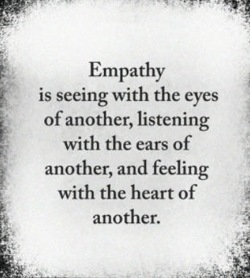
Notes:
We need to approach every situation with empathy. Here is a great quote by Arthur Adler to define empathy:
Empathy is seeing with the eyes of another,
listening with the ears of another, and
feeling with the heart of another.

Slide 12

Unit Culture
Notes:
Unit Culture – Not Wrong…Different
Every unit is different – whether it be different chartered partners (religious vs. civic), geography (rural vs. suburban vs. urban), demographics (young scouts vs. older scouts, diverse memberships), unit traditions, leadership experiences, or unit resources (money, equipment, knowledge).
Scouting functions because we charter community partners to provide the Scouting program to their youth. Each chartered partner has the opportunity to implement Scouting as they desire, within the guidelines of the Boy Scouts of America.
As an example, some units will have more religious elements in their program, while others may have less. Some will be more focused on their chartered partner for service opportunities, while others may focus on the larger community.
Commissioners need to recognize the difference between doing something wrong, versus doing something different, and not doing something as others do, or as well as could be accomplished. Not every unit will function exactly like other units, do the same things, or do them in the same way.
Different leaders have different approaches on achieving goals and accomplishing tasks. We need to recognize and support those approaches as long as they are within BSA’s policies and guidelines.
12

Slide 13
Where is the unit located?
Who is the chartered organization of the unit?
What are the socio-economic conditions?
How knowledgeable and experienced is their leadership?
What resources are available?
What are the ages and experience levels of the Scouts?
What Scouting experiences has that unit had?
Notes:
To be able to help we need to understand the unit we are serving.
Where is the unit located? Rural, urban?
Who is the chartered organization of the unit?
What are the socio-economic conditions affecting that unit?
How knowledgeable and experienced is their leadership? Are they trained for their roles?
What resources are available to that unit?
What are the ages and experience levels of the Scouts within the unit?
What Scouting experiences has that unit had?
Note to instructor: These questions set up and are used in the activity on Slide 13.

Slide 14
Discussion Group Activity
How can
I
help You?
A Cubmaster calls the district executive stating that she is leaving the unit and has not been able to recruit a new Cubmaster. She is leaving when her son crosses over to Scouts BSA in February.
The district executive gives the information to the district commissioner who in turn contacts you.
Describe how you would go about finding out how this situation arose and what has gone on. In addition, describe what can be done to remedy the situation and what recourses are available. Include what you would enter into Commissioner Tools.
Notes:
Activity: 15 minutes – 10 minutes for discussion time, 5 minutes to debrief
Instructor: Following MCS 309 – Group Discussion Activity Instructions divide the class into 2 or 3 small discussion groups, giving each MCS 309 – Group Discussion Handout. In Slide Show click on “How can I help You” button for group discussion. Click again to recover button.
Using the questions from previous slide (also listed on handout), have each group discuss how to provide unit service by identifying resources best suited for their needs.
Instructor: About midway in their group discussion time ask: “What things that might not be obvious could be causing difficulties?".
Ask the AWE Question (introduced in BCS 106) - And What Else? This question creates more - more wisdom, more insights, more self-awareness, more possibilities—out of thin air.
You do want to remember that the first answer someone gives you is almost never the only answer, and it’s rarely the best answer. You may think that’s obvious, but it’s less so than you realize.
When you use “And what else?” you’ll get more options and often better options. Better options lead to better decisions. Better decisions lead to greater success.
If you get three to five answers, then you’ve made great progress. And what else?” is such a useful question that you can add it into almost every exchange.
Depending on available time, have each group quickly debrief their discussions.

Slide 15
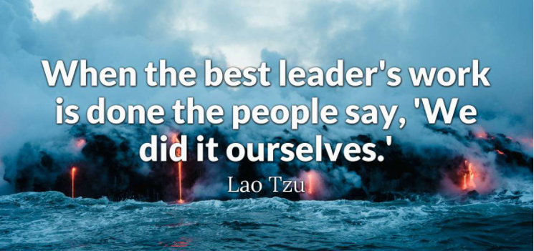
Notes:
As you can tell in this activity, we remain engaged to assist the unit in receiving help, and assisting the unit to implement the help. An effective commissioner should empower the unit leadership. Our role is to observe, guide, and assist, not to run the unit program. We observe, and note areas for improvement.
Remember the best unit service a commissioner can give is showing that we care and we want their unit to be successful. This takes using both our heads and our hearts. If the unit is successful with a great program, the youth will be successful in Scouting.
When the best leader’s work is done, the people say, “We did it ourselves.” --Lao Tzu

Slide 16

Course Summary
You should now:
Understand the role of a commissioner relative to the unit’s leadership
Understand the need to engage units in a guided discovery process to identify unit needs
Develop communication skills to work effectively with units
Notes:
Course Summary
You should now:
Be able to define the role of a commissioner relative to the unit’s leadership
Know how to engage units to identify unit needs
Understand unit culture
Sometimes knowing how to link a unit to resources does the trick. The heart to care about the success of the unit, its leaders, its parents, and it’s Scouts makes the job easier to do and the unit commissioner more successful in serving their units.

Slide 17

Questions?
Comments!

