Slide 1

my.scouting.org
General Instructions for Units
What tools will I have access to?
The tools a volunteer has access to will vary by position. The unit key-3 will have access to all tools by default. Unit leaders can use the “security manager” to grant access to restricted tools to up to five volunteers.
Everyone will be able to access basic tools such as training courses, located on “my dashboard.”
PTC Class 205
Unit Tools at My.Scouting
Guides
Keith Potter
&
Lynn Harvey
What tools are available?
Print roster, & membership cards
View, print, and edit training records
View chartering organization information
Give additional registered leaders access to online tools
Access to Internet Advancement
  Built and track unit Calendar
  Service hours reporting
Leader position-specific training
Help for common error messages.
If you have forgotten your myscouting.org log in credentials, use the “forgot” tool. If you are unable to recover your log in information, contact the Chief Seattle Council at 206.902.2324. We can assist you with recovering your log in credentials.
https://www.scouting.org/resources/online-registration/

Slide 2
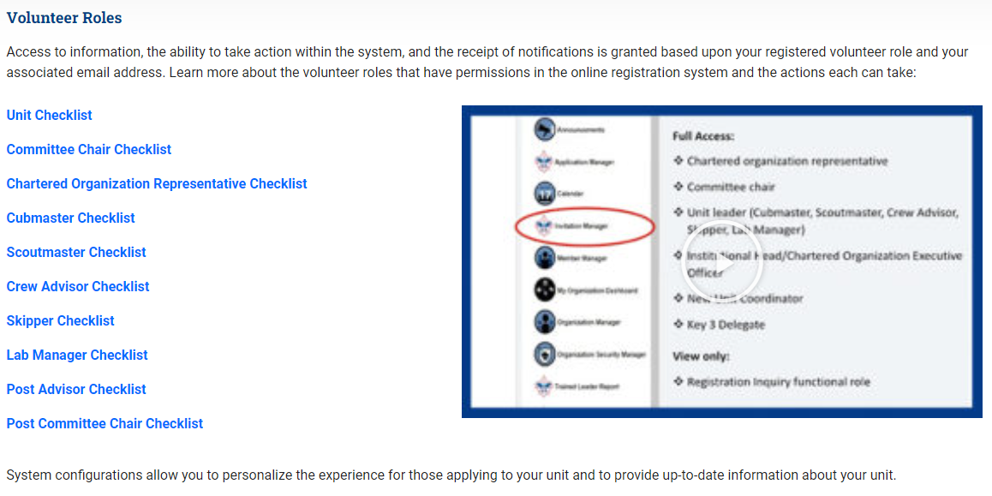
Unit Guidebook 2021

Slide 3
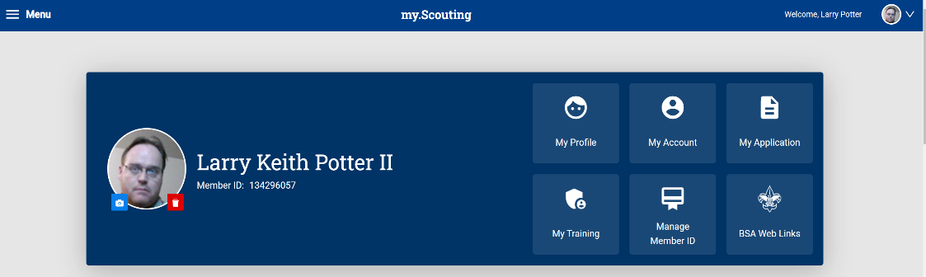
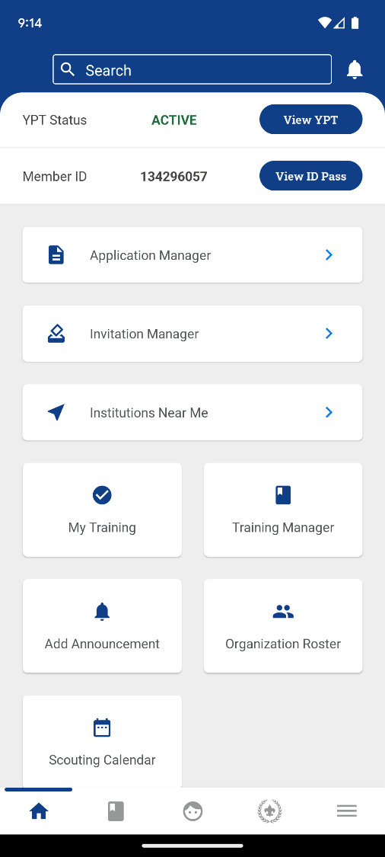
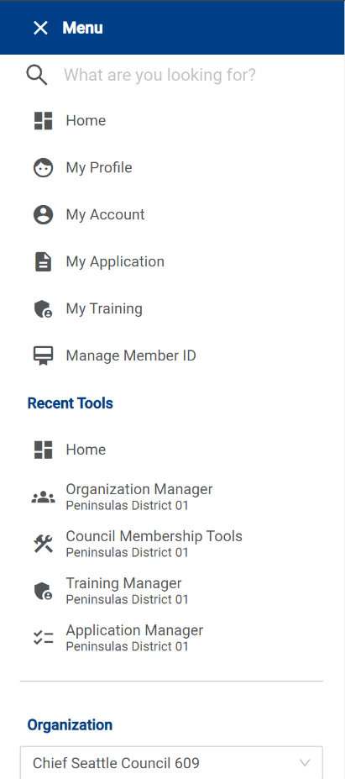
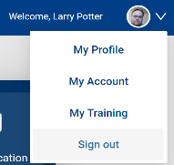
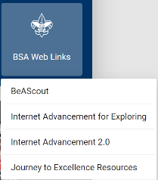


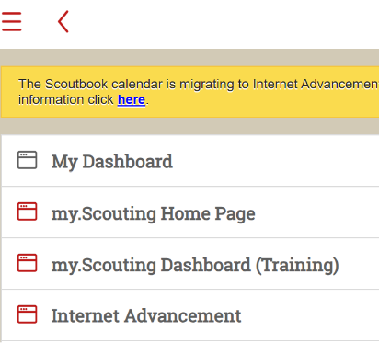

On Smartphone
On Computer
There are multiple ways to access features this portal
On Scoutbook

Slide 4
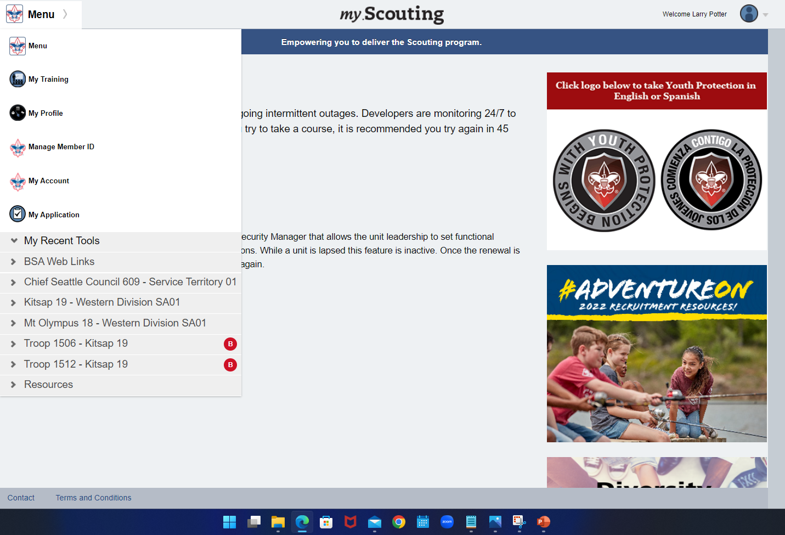

Slide 5
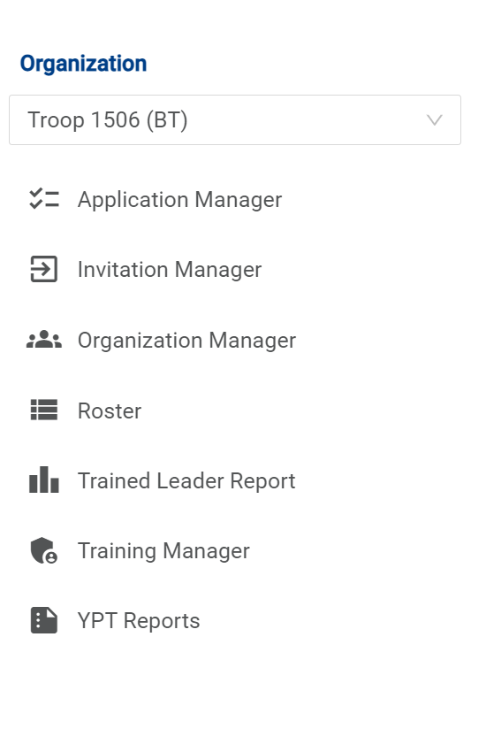
Most everything is accessible from static links. Make a shortcut if you find yourself coming back to the same things time after time.
https://my.scouting.org/e5ecf654-3e82-4625-a29d-b67c54c2d654/membership-manager/application
https://my.scouting.org/e5ecf654-3e82-4625-a29d-b67c54c2d654/membership-manager/invitation
https://my.scouting.org/e5ecf654-3e82-4625-a29d-b67c54c2d654/organization-manager/settings
https://my.scouting.org/e5ecf654-3e82-4625-a29d-b67c54c2d654/organization-manager/roster
https://my.scouting.org/e5ecf654-3e82-4625-a29d-b67c54c2d654/training-manager/dashboard
“Reports” have “timed life sentence” so they don’t work for creating desktop static links

Slide 6
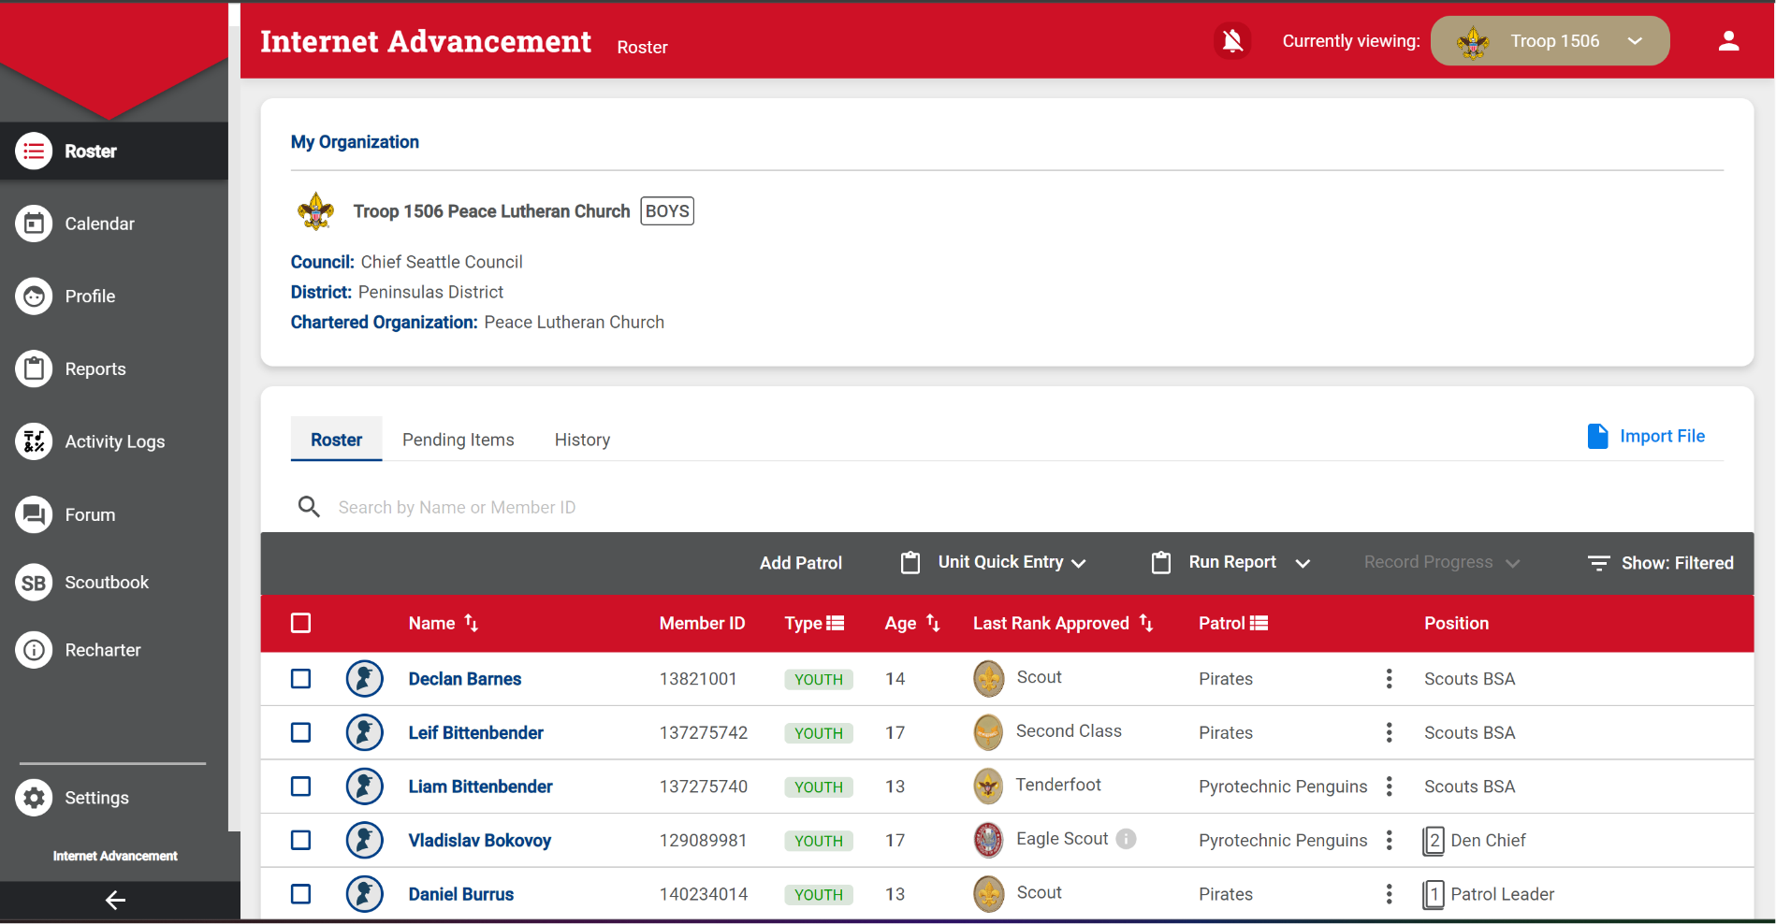
This is Internet Advancement 2.0

Slide 7

Settings Tab
As we go through this training, in the Top Right, I’ll be showing which tab I am on as we move through the portal

Slide 8
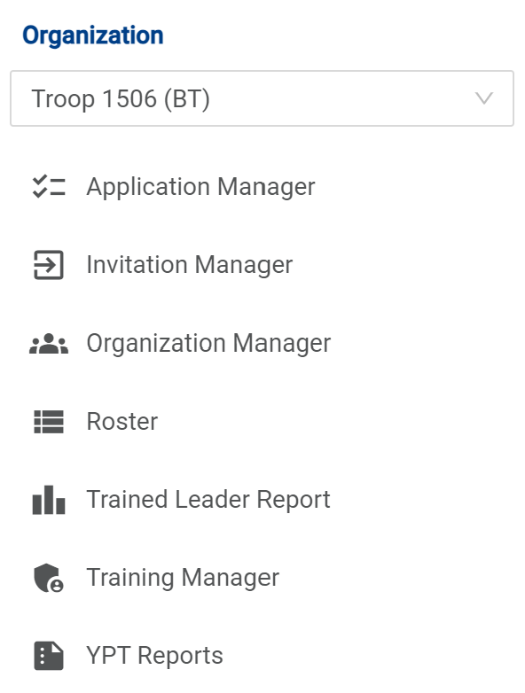
*Note
BSA IT is slowly phasing in a consolidation to the Organization Manager for Application monitoring, Invitation monitoring, and Roster adjustments

Slide 9
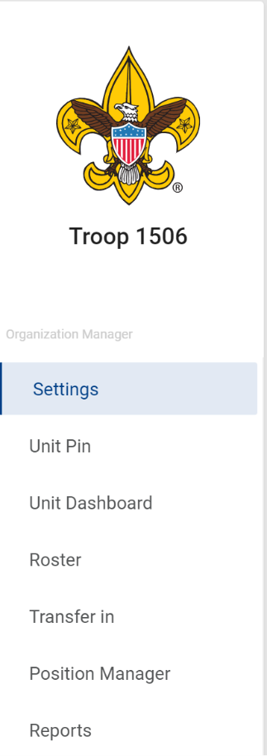
Organization Manager
Download of the Current Charter Certificate
Whom are the Key 3 (Informational)
Membership Application Permissions
Automated Email

Slide 10

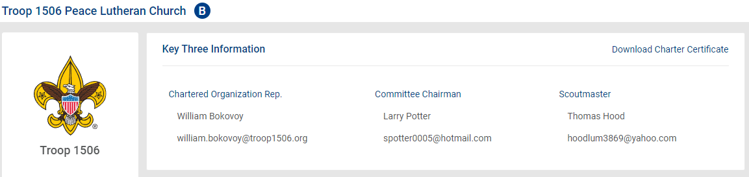
Settings Tab
Download your current certificate
Key 3

Slide 11
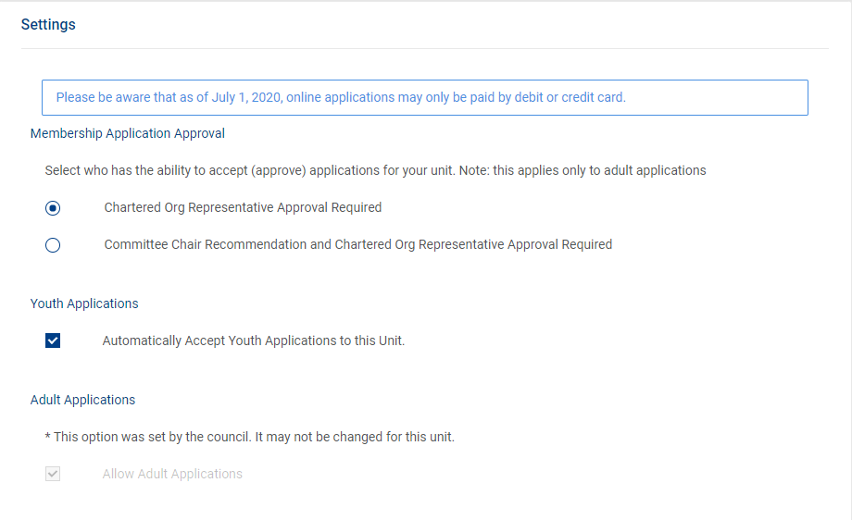
Settings Tab

Slide 12
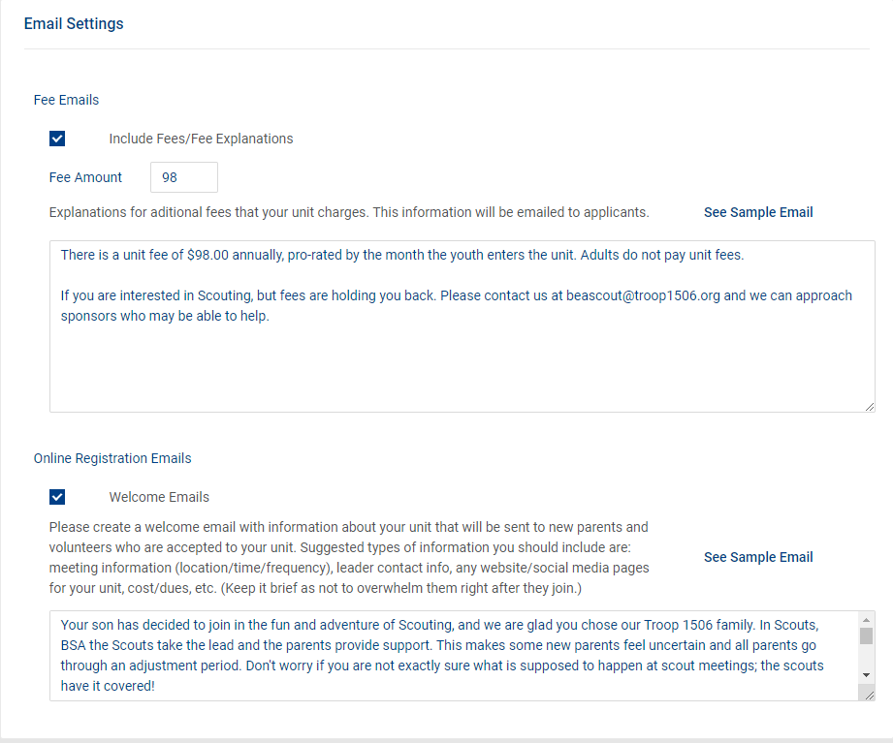
Settings Tab

Slide 13
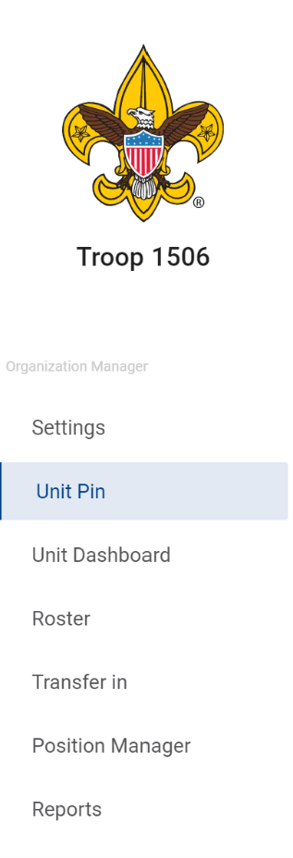
Unit Pin Tab
Permissions for the Unit Pin
What does the Unit Pin Say
Ways to contact the unit
Where the unit is located

Slide 14
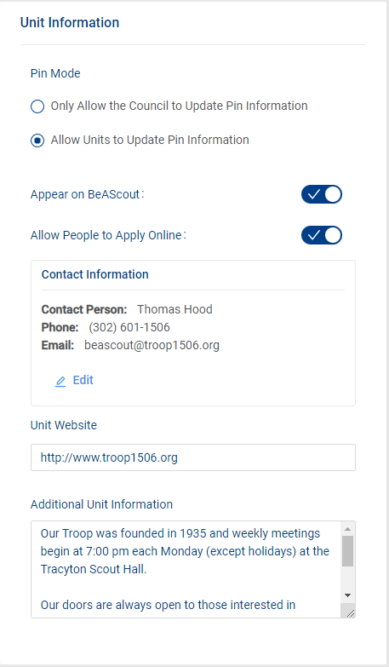
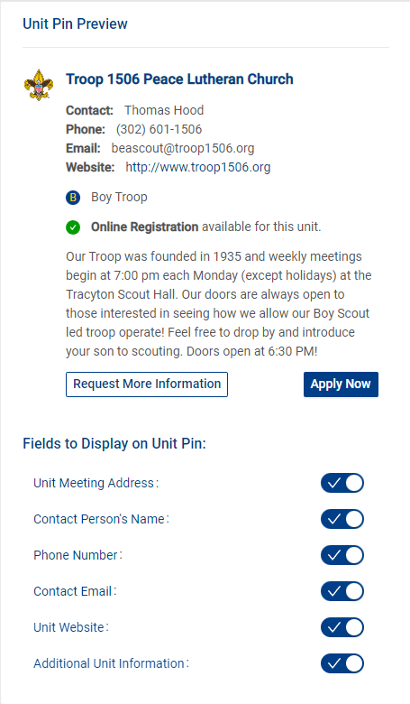
Unit Pin Tab
https://my.scouting.org/SOMELONGNUMBER/organization-manager/unit-pin

Slide 15
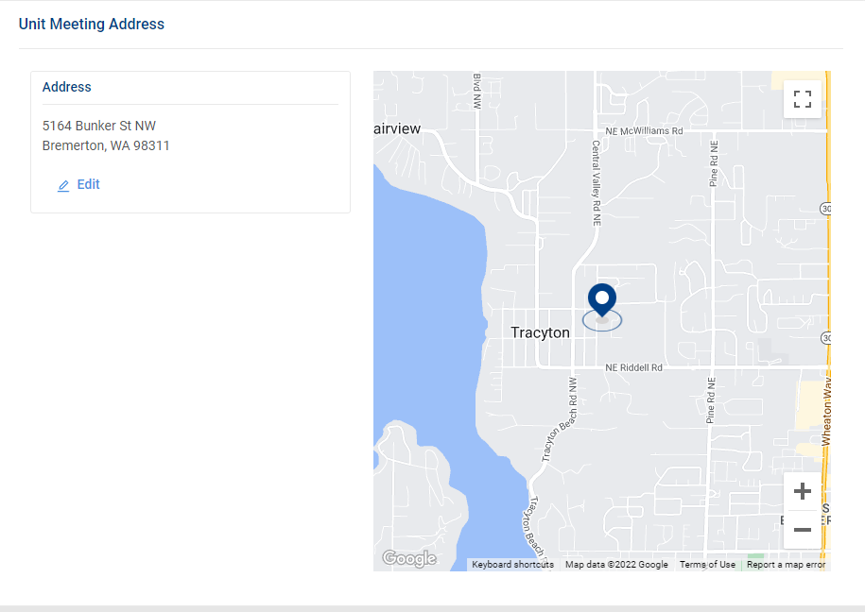
Unit Pin Tab

Slide 16
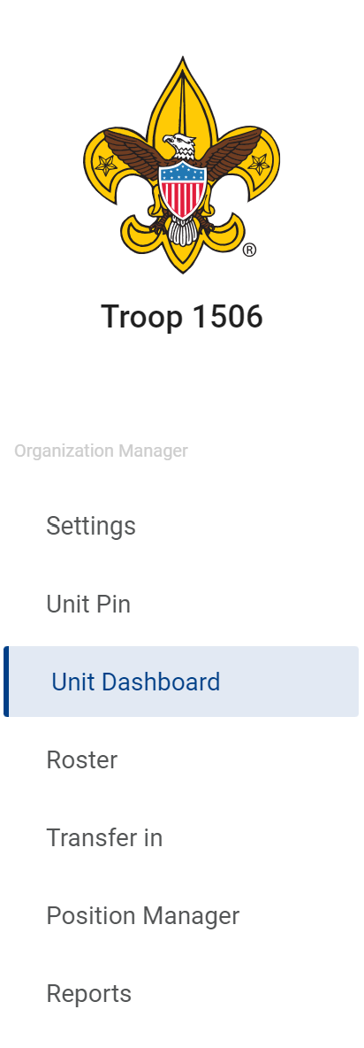
Unit Dashboard
Whom is in the unit
Unit overall training stats
If the unit Attended Roundtable and when the next one is
Youth Membership stats
(Gains and losses)
Advancement Status
Camping Stats
Hiking Stats
Service Projects Stats

Slide 17
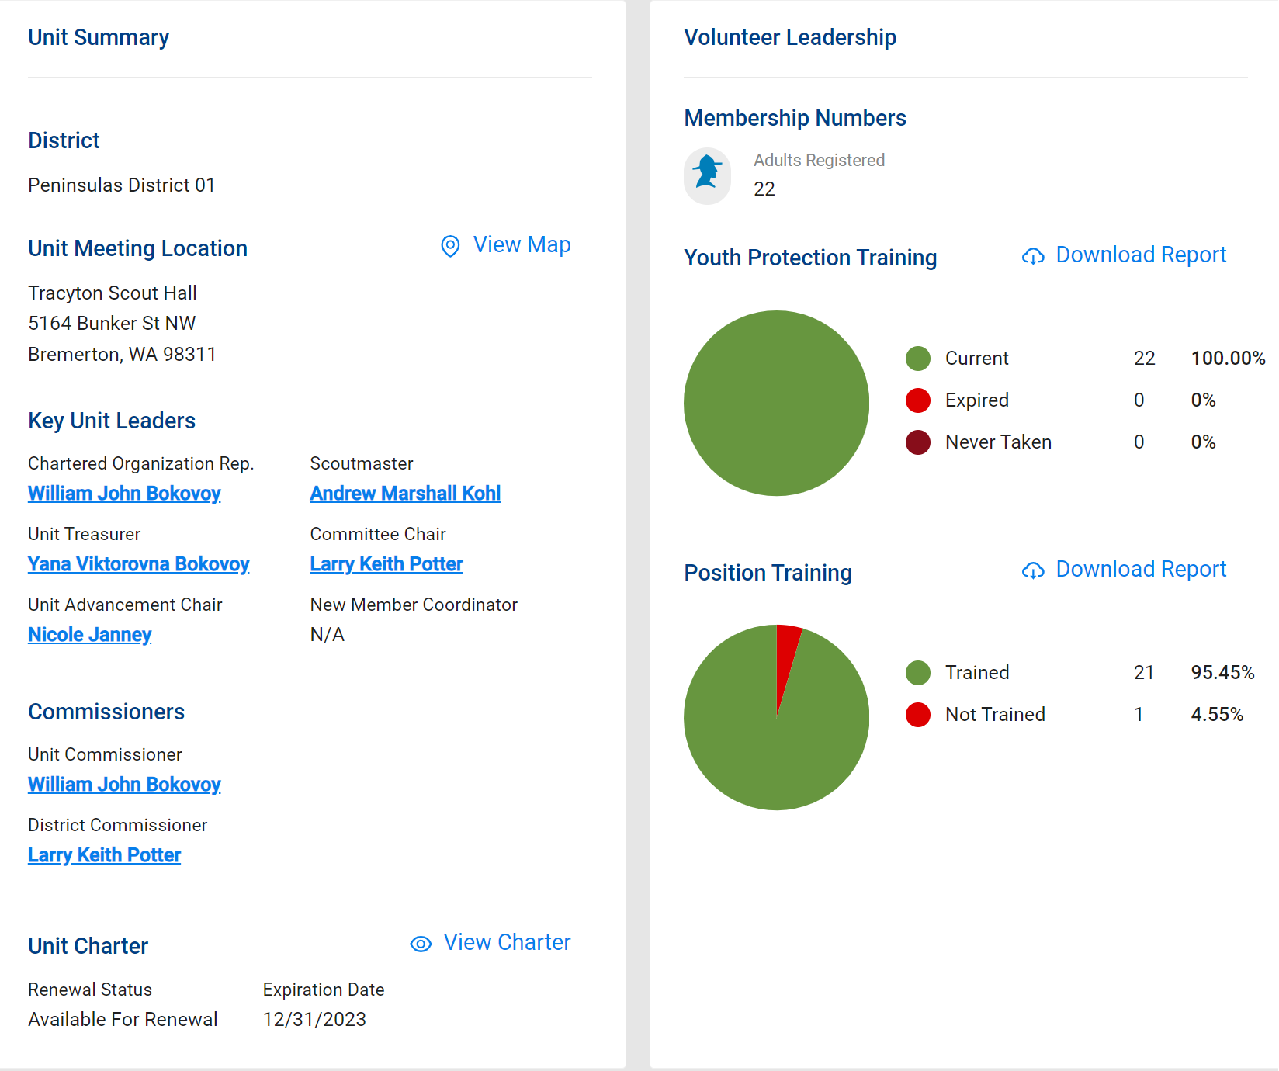
Unit Dashboard

Slide 18
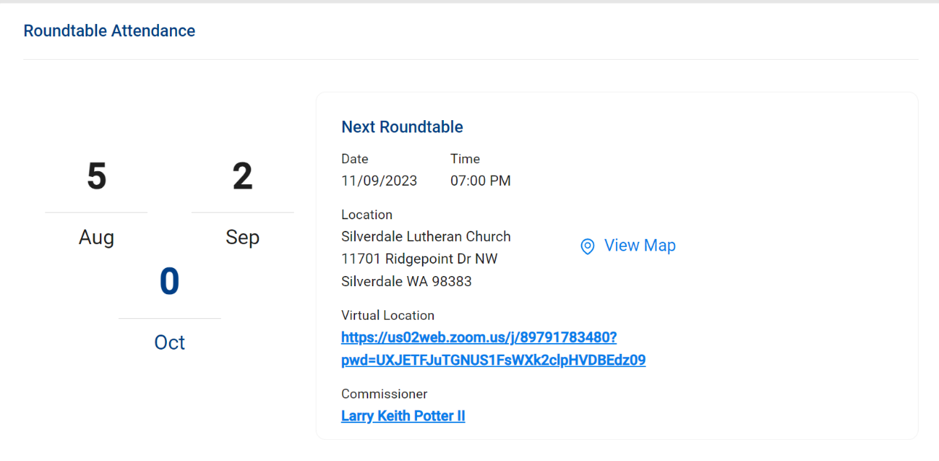
Unit Dashboard
This information comes from taking attendance by your Roundtable Commissioner team at the completion of Roundtable.
The Roundtable Planning calendar is current calendar year only so 2024 events won’t post until Jan 2024
*Note there is not a report to reflect “Whom by name” attended only that someone from the unit did attend. This makes Adult leadership position training awards more difficult to manage.

Slide 19
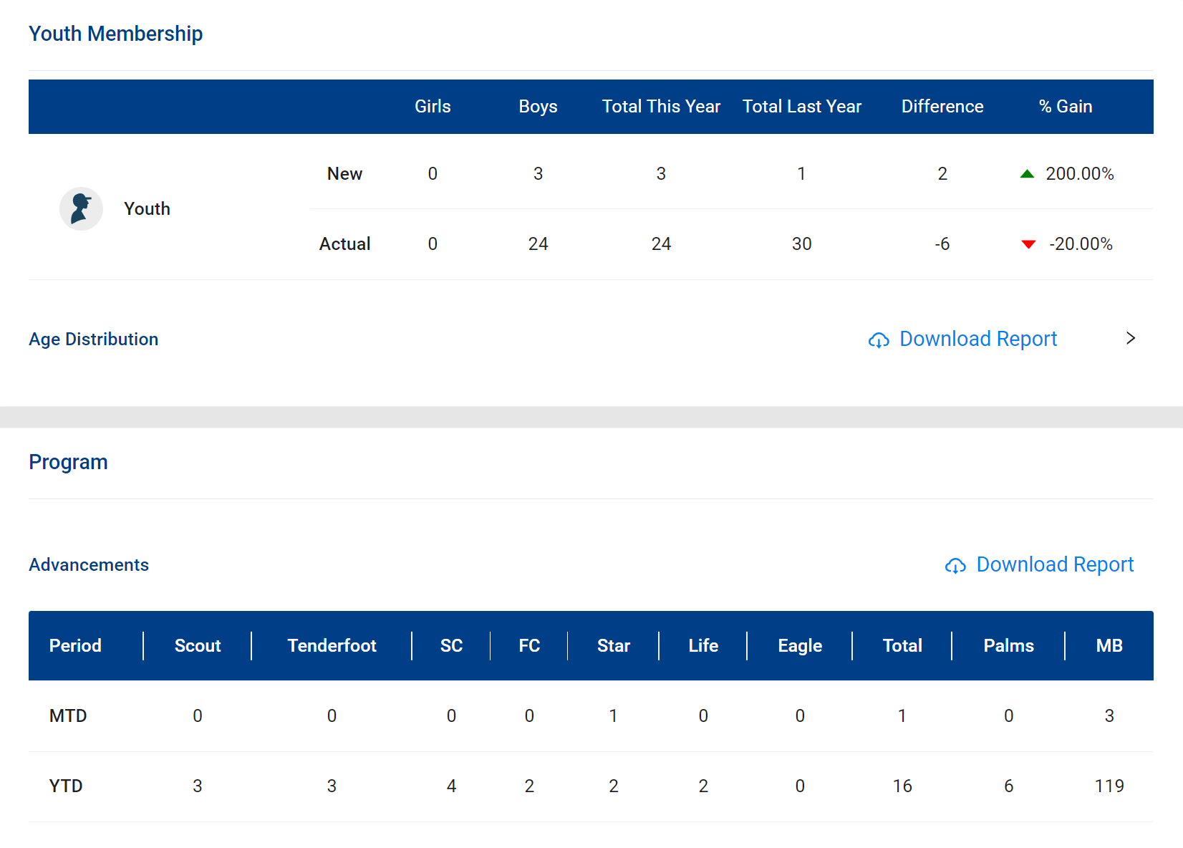
Unit Dashboard
This information comes from the Registrar report at the council level. As youth and adult applications are accepted this will change.
Program updates come from what is recorded in Scoutbook after replication to Internet Advancement.

Slide 20
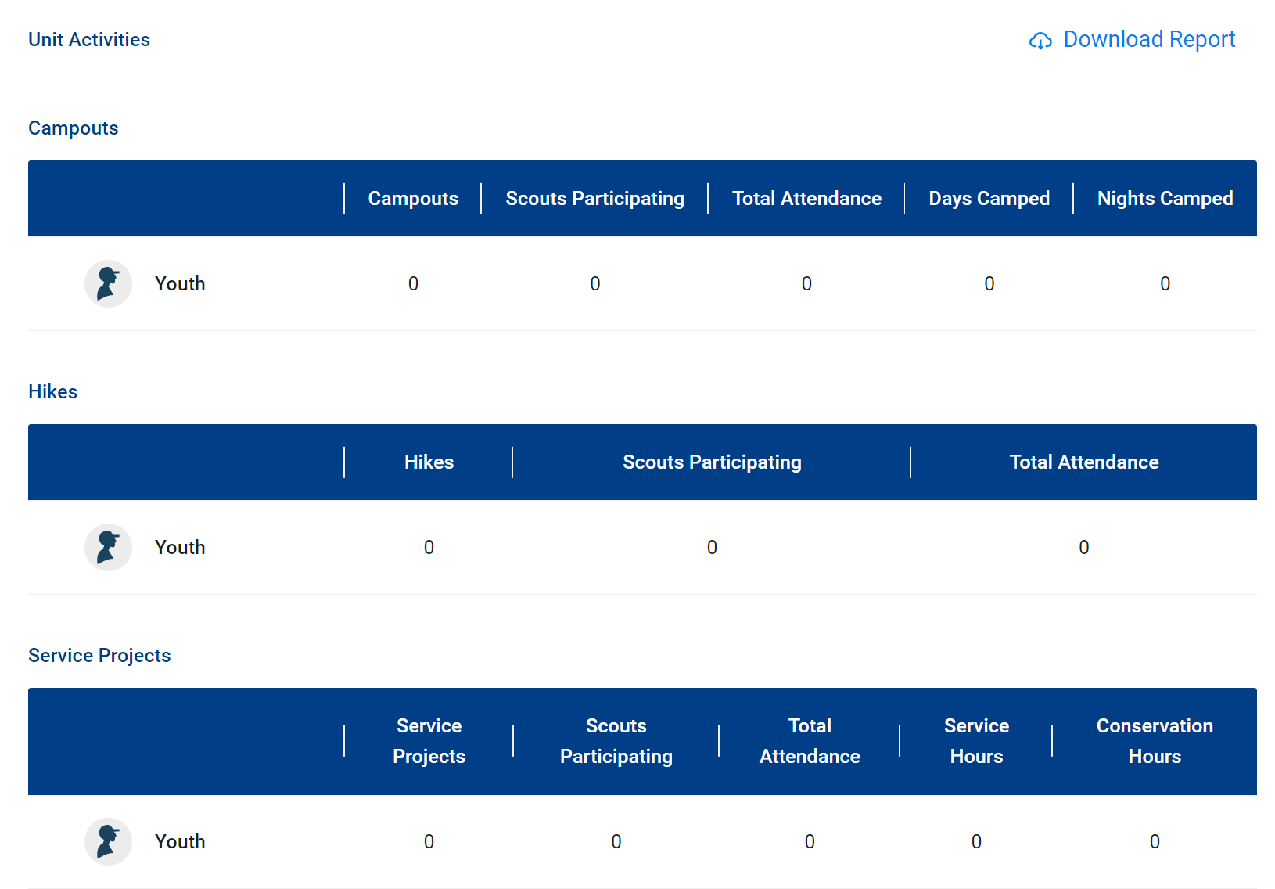
Unit Dashboard
This information comes from taking attendance in of an event within the new calendar within internet advancement.
As of 1 Nov the Scoutbook Calendar will be read from the Internet Advancement Calendar

Slide 21
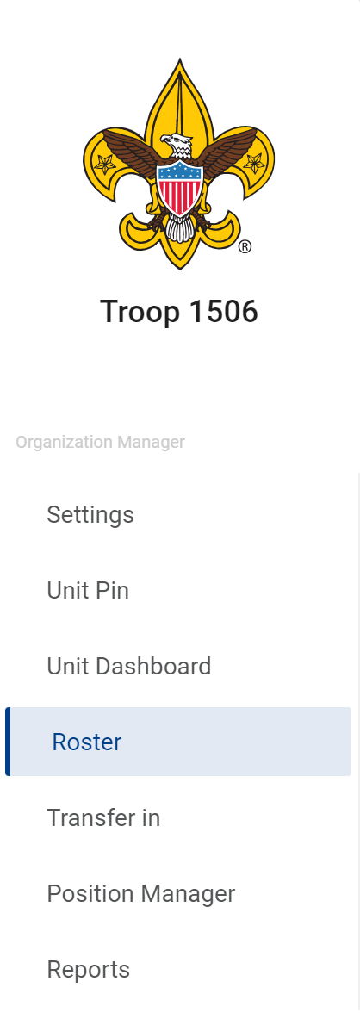
Roster Tab
Search Members
Transfer Youth
Send an email
Print
Membership Cards
Eagle Extension Reports
Youth Age Report
Unit Advancement Details Report
Edit Profile
Export Members

Slide 22
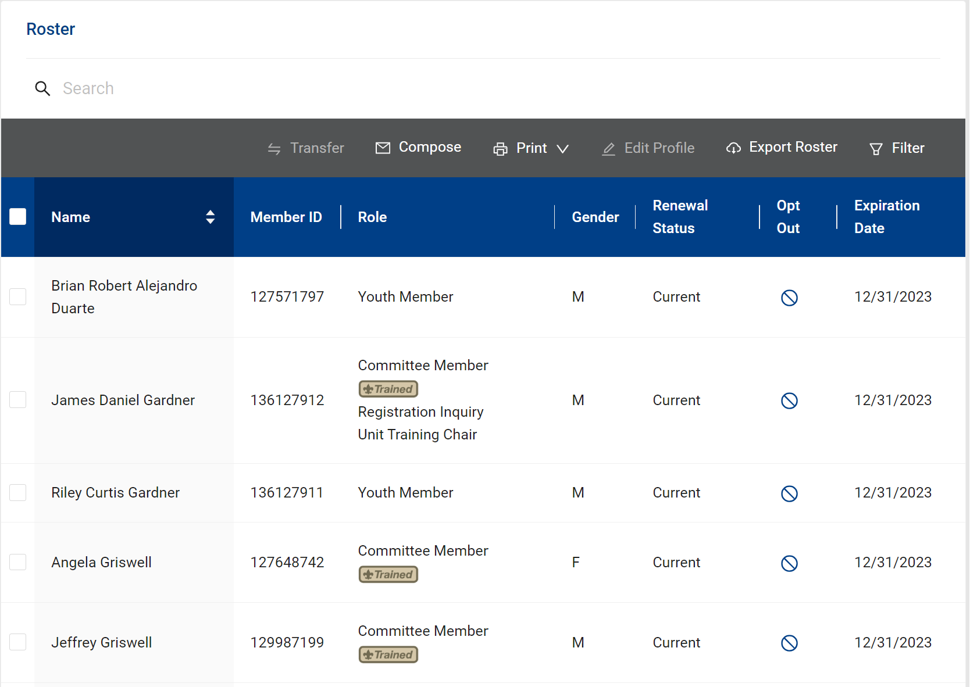
Roster Tab

Slide 23
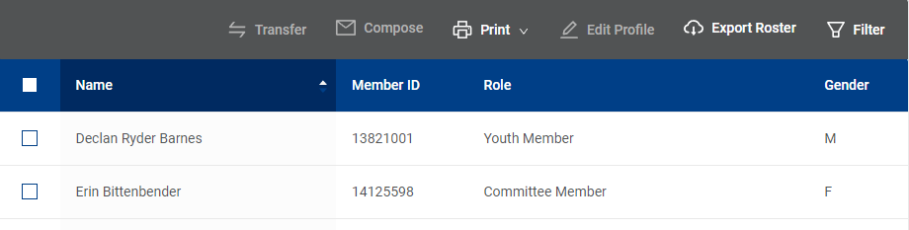
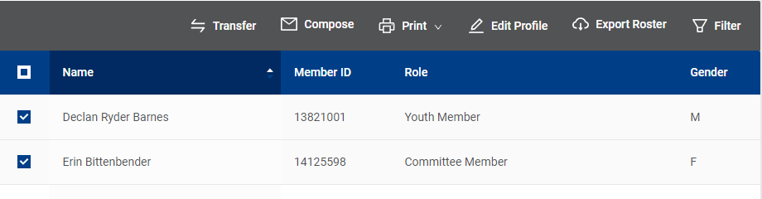
Roster Tab

Slide 24
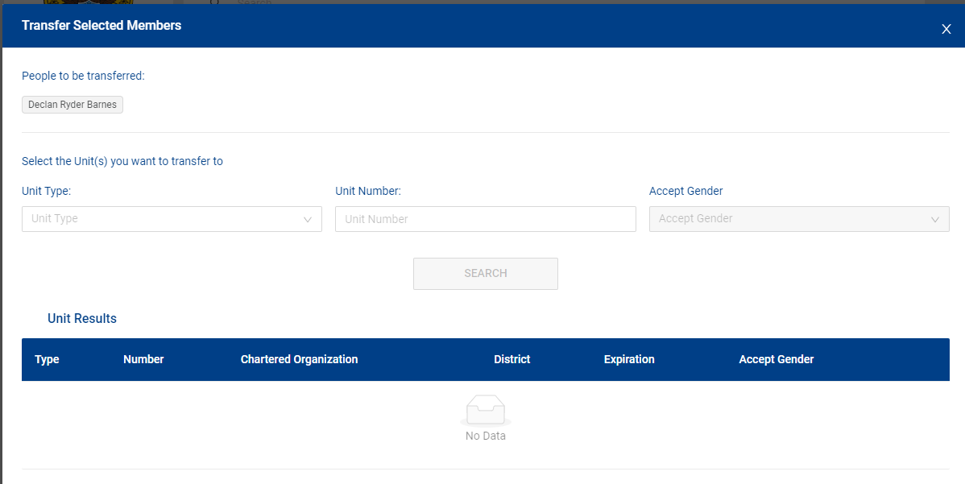
Roster Tab

Slide 25
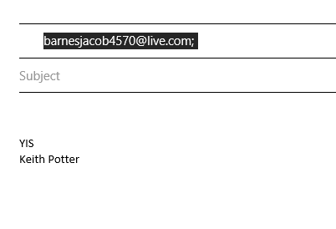
Roster Tab

Slide 26
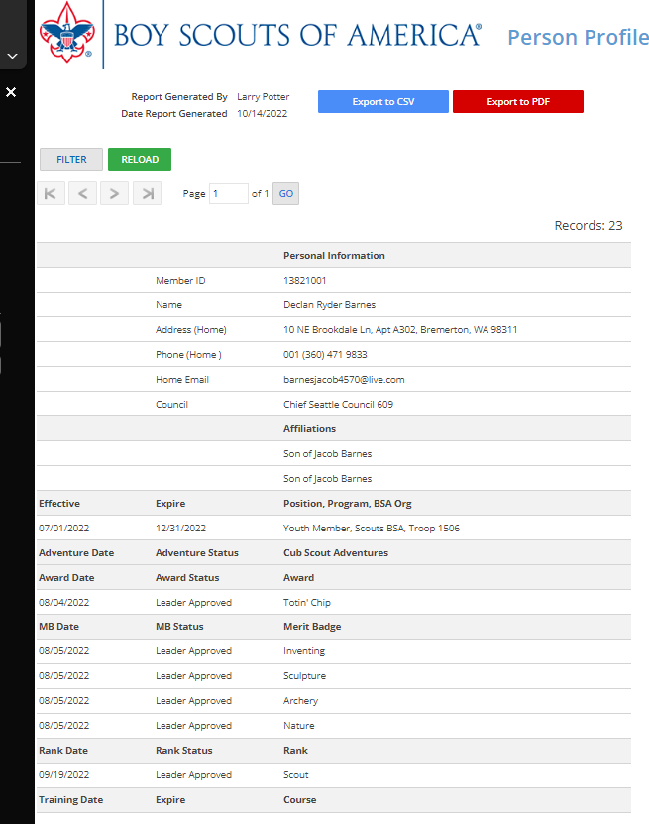
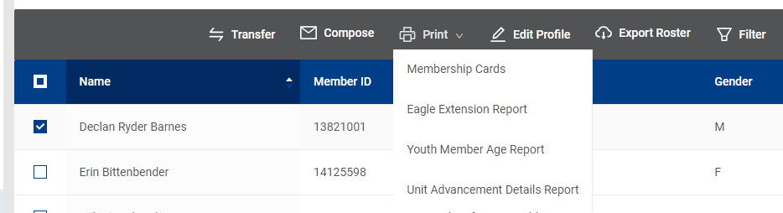
Roster Tab
Creates what’s called a Person Report
This is a Youth

Slide 27
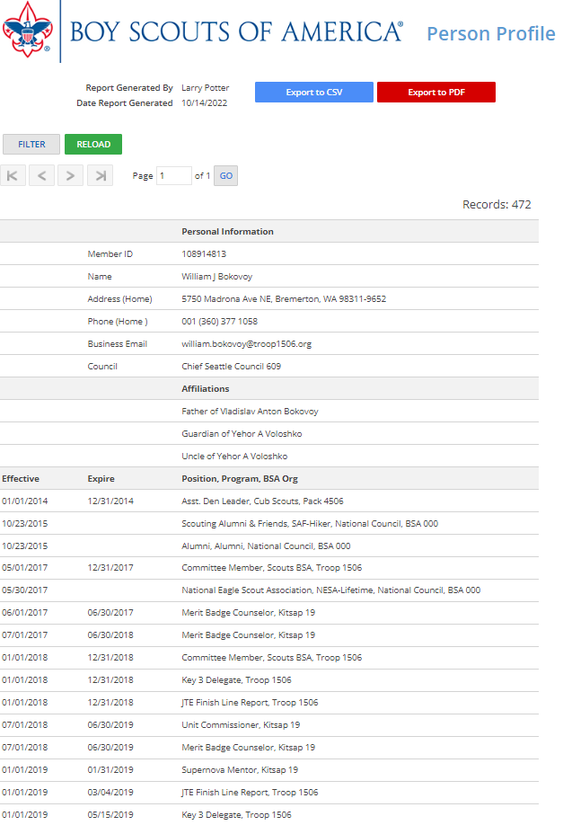
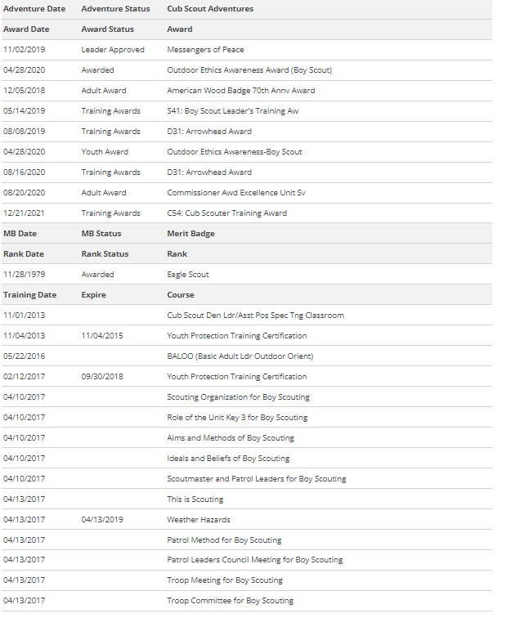
Roster Tab
Leadership
Awards
This is an adult page

Slide 28
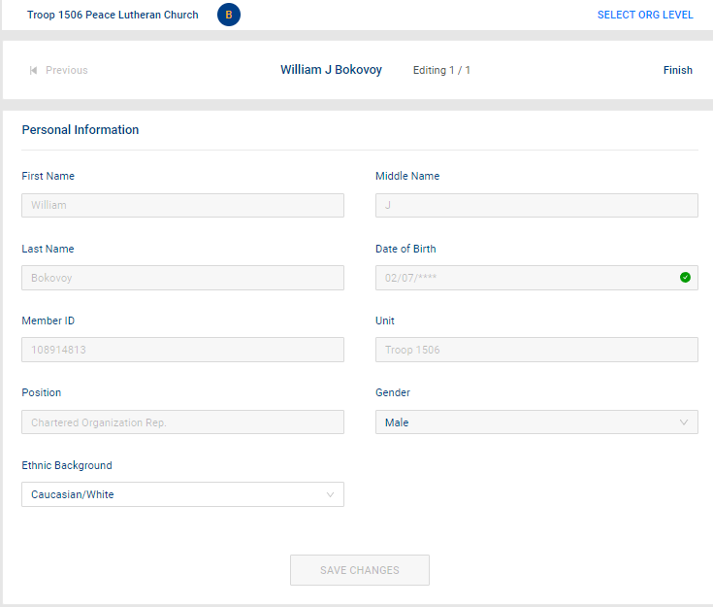
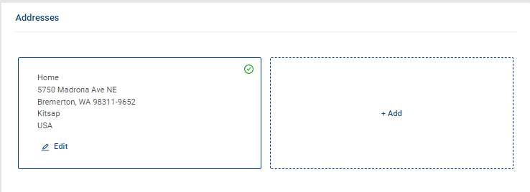
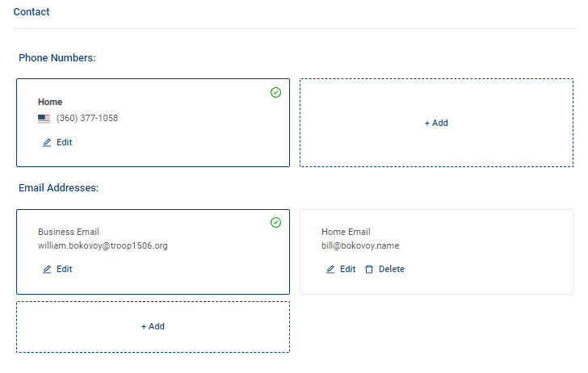
Roster Tab

Slide 29
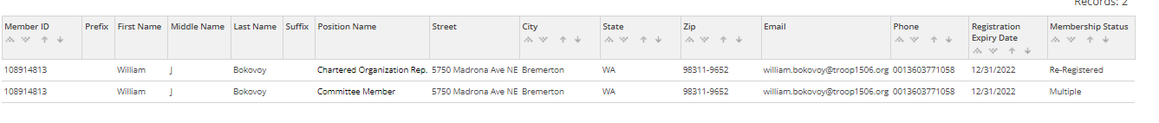
Roster Tab

Slide 30
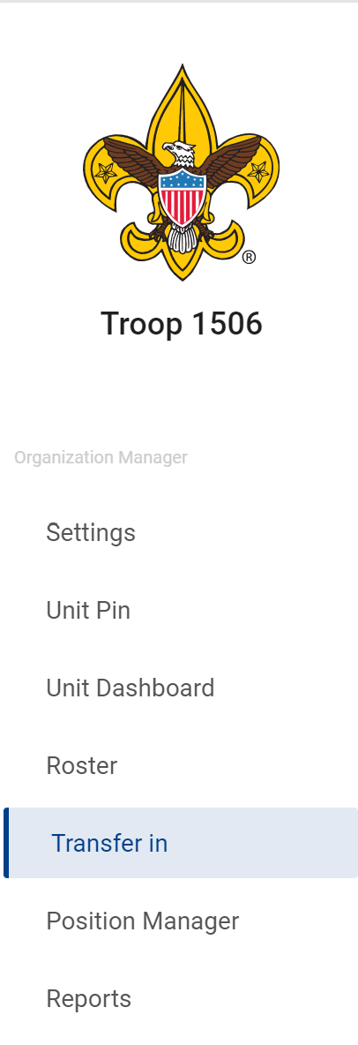
Transfer in Tab

Slide 31
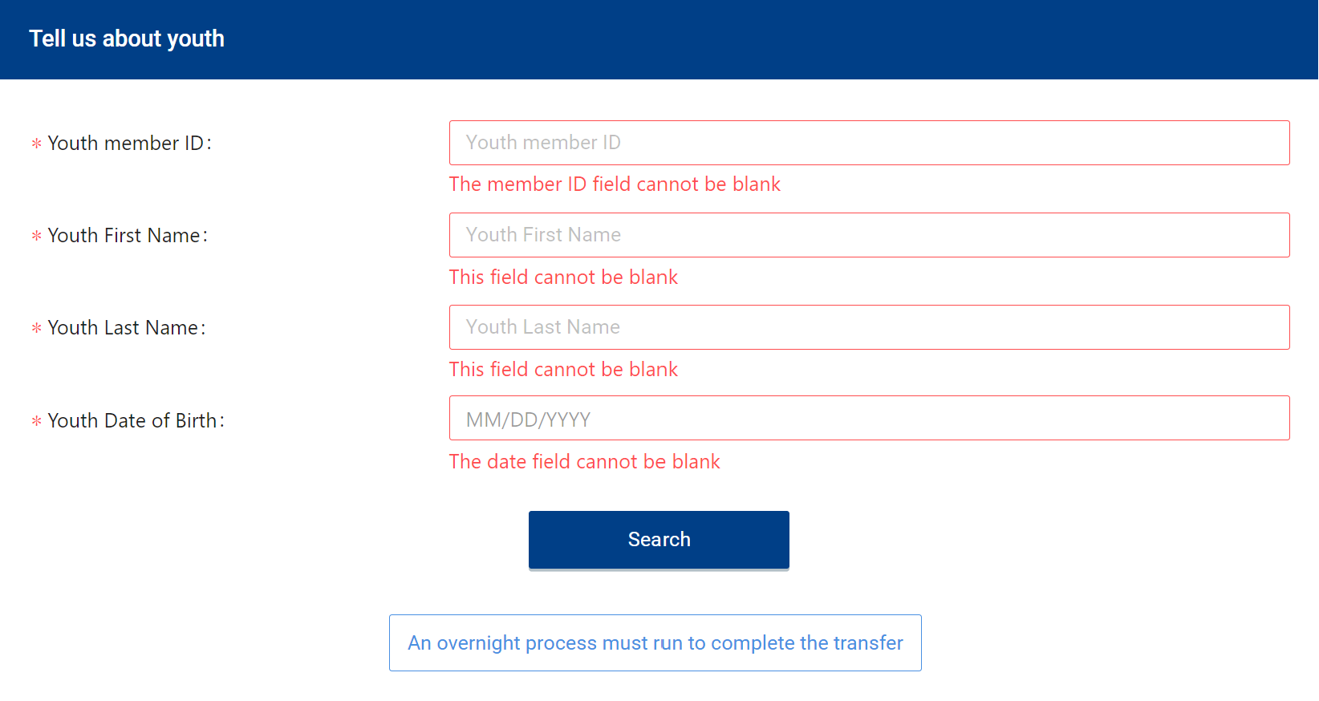
Transfer in Tab
Between 2 – 4 AM EST

Slide 32
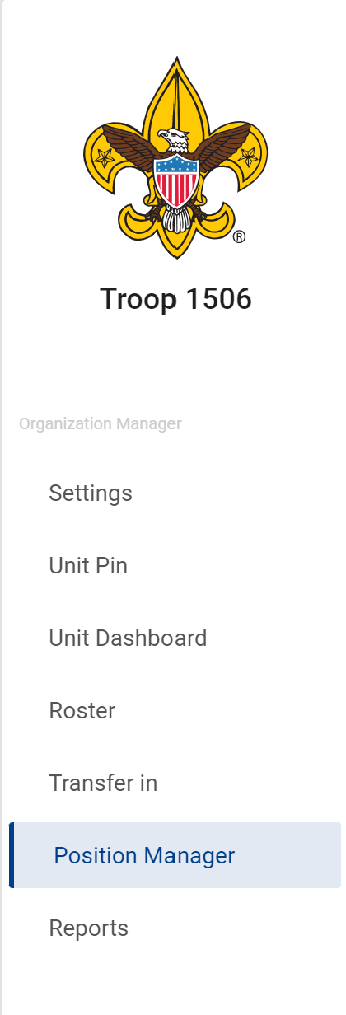

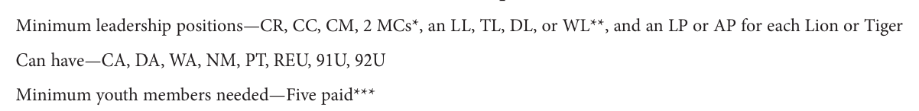
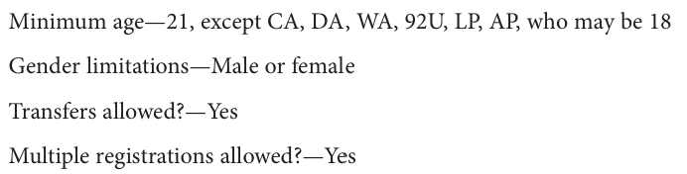
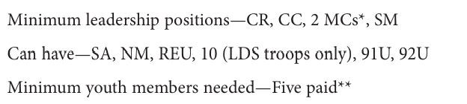
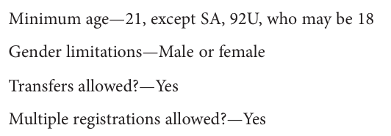


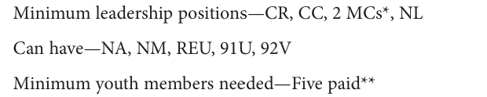
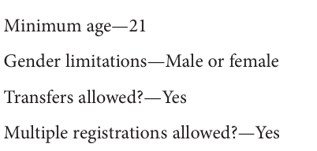

Position Manager Tab
Understanding the difference between a Registered Position vs a Functional Position as a Registrar sees it.
https://www.scouting.org/wp-content/uploads/2019/06/Registration-Guidebook.pdf

Slide 33
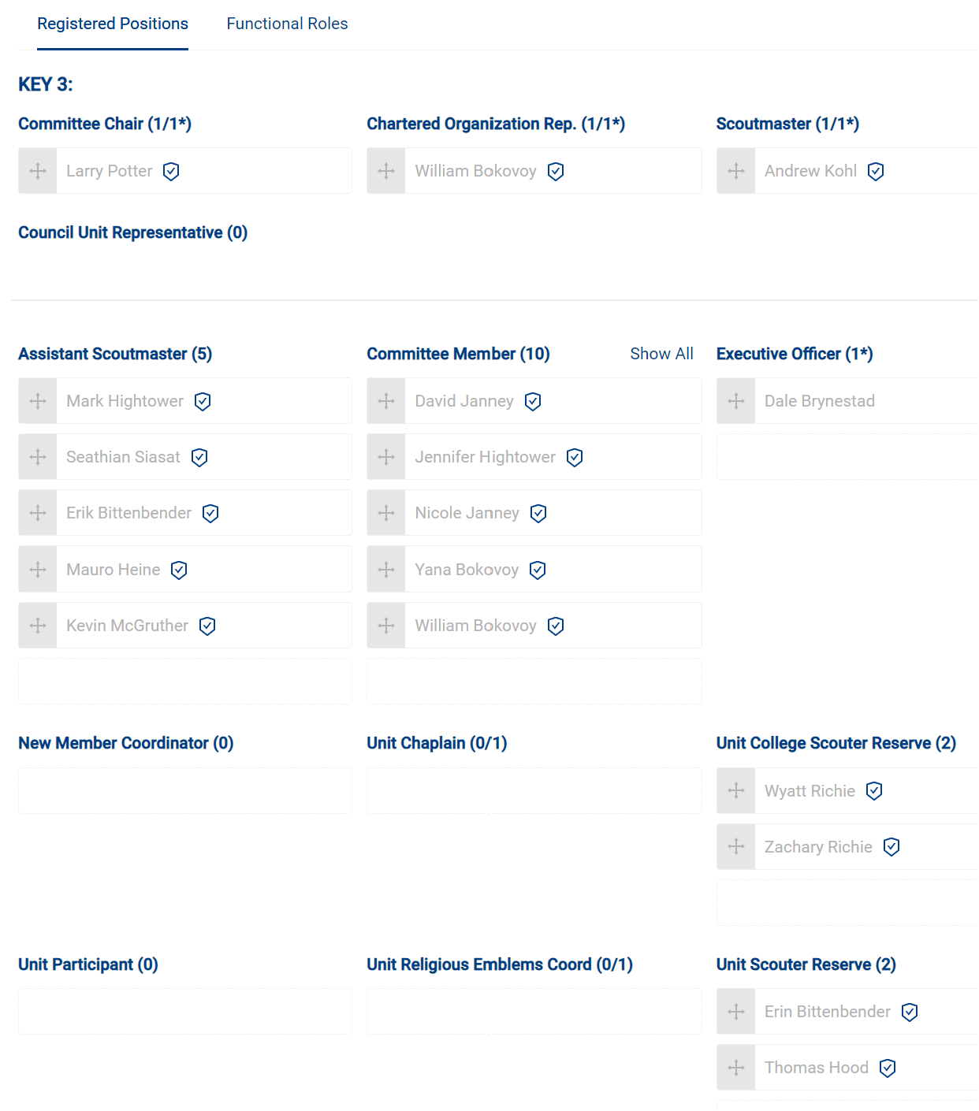
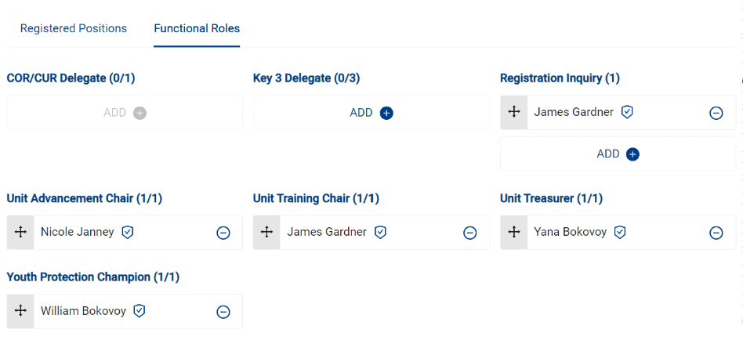
Positions controlled by registered applications
Position Manager Tab
Positions controlled by Unit Key 3

Slide 34
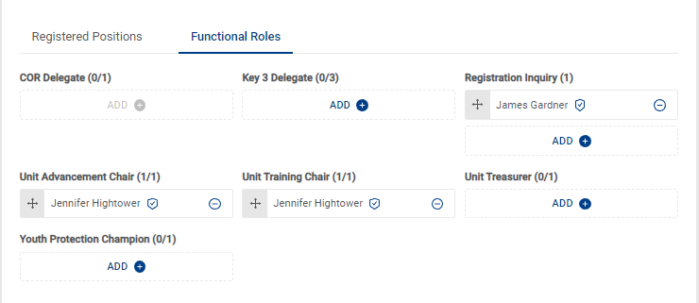
Position Manager Tab
Positions that should receive the email notifications for invites and applications that come Online from beascout

Slide 35


Application Manager
Invitation Manager
The Emails

Slide 36




Reports Tab
The only reports from the Committee Chair perspective I run for Special purposes
Quarterly – to update my unit on whom is doing which MB
After Recharter posts (Feb) and After District renewal posts (July) to ensure my expected leaders are where they should be.
After Recharter posts (Feb) and After District renewal posts (July) to ensure my expected communication and controls are where I expect them to be.

Slide 37







At the Unit Level I don’t think these are value added
Reports Tab

Slide 38

Scouting Wisdom I don’t get but the title of this section is Membership manager
Even though you will click Application Manager or Invitation manager
Our older training had you select membership manager then you selected either applications or invitations.
The grouping it this way separates out the two specific functions most used.
Save you a click I guess mentality

Slide 39

Application Tab

Slide 40



Invitation Tab

Slide 41

Invitation Tab
This is a view from the Commissioner view for the table to demonstrate more units with status

Slide 42

Invitation Tab

Slide 43
APPLICATION SUMMARY
The Applications Summary report is a recap of in-progress applications summarized by status and days in progress.
Reports Tab
APPLICATIONS IN PROGRESS
The Applications In-Progress report displays the list of membership applications that have not been accepted and posted. These applications are progressing through the workflow and may require a unit leader or council personnel to take an action - review, accept, acknowledge, comment, re-assign, etc.
CLOSED APPLICATIONS
The Closed Applications report lists membership applications that were not completed registrations and are now closed. No further action is expected regarding closed applications.
CLOSED LEADS REPORT
This report group lists applications that were not completed and are now closed. No further action is expected regarding closed applications.
COMPLETED APPLICATIONS
The Completed Applications report is a list of membership applications that have been completely processed and resulted in a BSA membership for the designated term.
FAMILY SCOUTING
The Family Scouting Report lists all units that are eligible for Family Scouting and displays which are boys only, girls only, boys and girls.
INITIATED APPLICATIONS REPORT
The Initiated Applications report displays applications that have been created, but not yet submitted and are in an Initiated status.

Slide 44
LEADS IN PROGRESS
The Leads Report displays information about all leads submitted.
Reports Tab
MEMBERSHIP TOTALS REPORT
The Membership Totals Report returns a detail list of each active unit within the structure of the district or council. By unit, the reports give you demographic data such as the number of youth and adults, male and female along with the chartered organization and charter expiration date.
PAYMENT METHOD
This report lists completed membership applications from Online Registration by all payment methods.
RECORD OF CHANGE
The Record of Change report will give you a detailed list, for the date range selected, of all registration changes such as, new enrollment, transfers, drops, multiples, transfers etc. This report will report the members name, unit and status code.
REFUND DETAILS
The Refund Details Report lists details about membership applications that had their fees refunded. These applications are in “closed” status after the fees are refunded. Only applications paid with a credit card will appear on this refund list.
TIMED OUT APPLICATIONS
This report lists summary counts of membership applications that have timed out. The rows of the report are units. The columns are the total of timed out applications by month.
TIMED OUT APPLICATIONS SUMMARY
This report lists membership applications from Online Registration that were not processed within 60 days. Applications that reach 60 days of age without completion are considered timed-out. The applicant is automatically refunded fees collected if the transaction was processed with a credit card payment.
UNPAID APPLICATION
This report lists all incomplete membership applications from Online Registration that have not been paid.

Slide 46


This report will list out all of the adult members of the unit
Name, BSA ID, Position(s),
Home and Email address
Position(s) for which they are trained or working to be trained in
If they are completed with training in a particular position
What courses they have remaining to complete. The courses are listed by Course number not it’s common name

Slide 48


https://my.scouting.org/e5ecf654-3e82-4625-a29d-b67c54c2d654/training-manager/dashboard

Slide 49


Specific Report of just the Trained leaders needing training
Specific Report of just the YPT members never taken or have expired

Slide 50
Everyone Report of Training status
Everyone Report of just the YPT Status

Slide 51




Enter the date then more options arise

Slide 52


Slide 53


Slide 54

This Search will enable you to run a report on a specific course or member or position for your unit

Slide 55

Once you select the box next to the members name the functions become useable

Slide 56



If you mouse over “Viewing Completions” you can filter

Slide 57

Thank you for your time!
This was Class
Unit Tools at My.Scouting
Lead by Keith Potter and Lynn Harvey
Class assessment form

Slide 58


I do not see a Scoutbook how to class this year.
This year I will cover the general overview of the 1 November change in the Calendar section of Internet advancement that will port over to Scoutbook.
Specific roll of the Advancement chair or Recharting using this portal are in these classes later today
The Advancement chair training is class
310 Unit Advancement From 11 – 11:50
The Recharter Process (BCS 102) From 2 - 2:50

Slide 59




Slide 60




There are four views to choose from all have the same capabilities.

Slide 61


Slide 62


Slide 63


Slide 64


Click on a Day and an Event Box will appear.

Slide 65


Note: Events associated with multiple units must enter their activity logs (if applicable) through the Activity logs page to ensure proper approval.

Slide 66

As I have several Units I am associated with Make sure you are selecting the right unit for you’re event

Slide 67

Alternatively, I can select individual members vs selecting the Patrol or Unit.

Slide 68

This is a Dynamic Drops Down based on Unit Type.
Pack, Troop, Crew, Ship all have different defaults.

Slide 69


Slide 70


If this is a reoccurring event (troop meeting, Committee Meetings) then select the box. The options will then become available

Slide 71

Will there be a safety tail required?
Do you need to know who will be there; Food, Travel, Tickets, Assignments, Etc…

Slide 72


To enable email reminders uncheck this box.
You will then be presented with five options but you can only choose a total of 3 per event.

Slide 73


At the top right your Status bar now reflects a few things.
The event is not yet saved.
Name and email address of your guest. This can be another scout not in your attendance list or a particular member you want to to know about the event.
Does not have to be a registered scouter.
That I chose a Patrol for this event and not the whole unit
RSVP is On, and how many have said anything
External Guest is now turned on.

Slide 74

At the Bottom of the page there are download options for your calendar. This are ICS files. Meaning you can add them to your personal phone / calendar tool of choice
This would be the whole troop 1512
This would be the whole troop 1506
This view differs for everyone. It reflects the unit’s which you are associated as part of within the Units of Scoutbook.
This is My view for my family
This would be the whole Pack 4537
This would be the whole troop 1523
There is no “patrols” for these units so there are no further breakdowns.
This would be the whole Ship 1661

Slide 75

My Complaint. (being prepared ☹.
I know that there is Community Service, Webelos to Scout transition and Camping involved with this event.
I cannot add those expected details until after the time and date of the event has completed.

Slide 76

So the event has passed. Both Date and Time. So if you mark it to end at midnight you get to do this the next day.

Slide 77



Fill in the blanks from the “Actual”

Slide 78


If everyone did the same things and arrived/departed as a group use the GROUPS option
If you had stragglers or odd one out or drop(s) or add(s) use the INDIVIDUALS option

Slide 79


Fill in the blanks from the “Actual”

Slide 80


If everyone did the same things and explored as a group use the GROUPS option
If you had stragglers or odd one out or drop(s) or add(s) use the INDIVIDUALS option

Slide 81



Fill in the blanks from the “Actual”
This box turns off start and stop time boxes
Select Yes if an Eagle Project then enter the phrase in the black box
Qualified words

Slide 82


If everyone did the same things and arrived/departed as a group use the GROUPS option
If you had stragglers or odd one out or drop(s) or add(s) use the INDIVIDUALS option

Slide 83

Back to the Calendar. You will see the event created. And the options chosen. From here you can go back to editing the event.

Slide 84


What we don’t have at this point is a means to import by bulk to the calendar. Aka bulk upload.
On Thursday, November 2, The SUAC will be making an assessment on any outstanding reported issues that may adversely affect the user experience of the Internet Advancement calendar. Based on that assessment, SUAC will review the planned migration date of the Scoutbook calendar user interface to the IA Calendar user interface scheduled for Thursday, November 9 and determine if more time is warranted to more fully address reported calendar issues. An updated announcement will be made no later than Friday, November 3.
As such the “Bulk Calendar update” is not included in this years class as its’ methodology has not been implemented. As of Nov 1 the prior work around to bulk upload via Scoutbook is expected to have been turned off.

Slide 85
Thank you for your time!
This was Class
Unit Tools at My.Scouting
Lead by Keith Potter and Lynn Harvey
Class assessment form

