Slide 1

College
of CommissionerScience
.,.,_
MCS
315
Effective
Unit
Service
In
Rural
Communities
Revision date 10/29/2023

Slide 2

Course /
Learning Objectives
.,.,_
At the end of this training a commissioner
will
be able to:
•
Understand the opportunities and challenges of working with rural units.
Learn methods for recruiting leaders and Scouts in rural and distant communities.
Receive and share methods to reduce the cost of Scouting.
Capture methods for providing Scouting in small units.
•
•
•

Slide 3
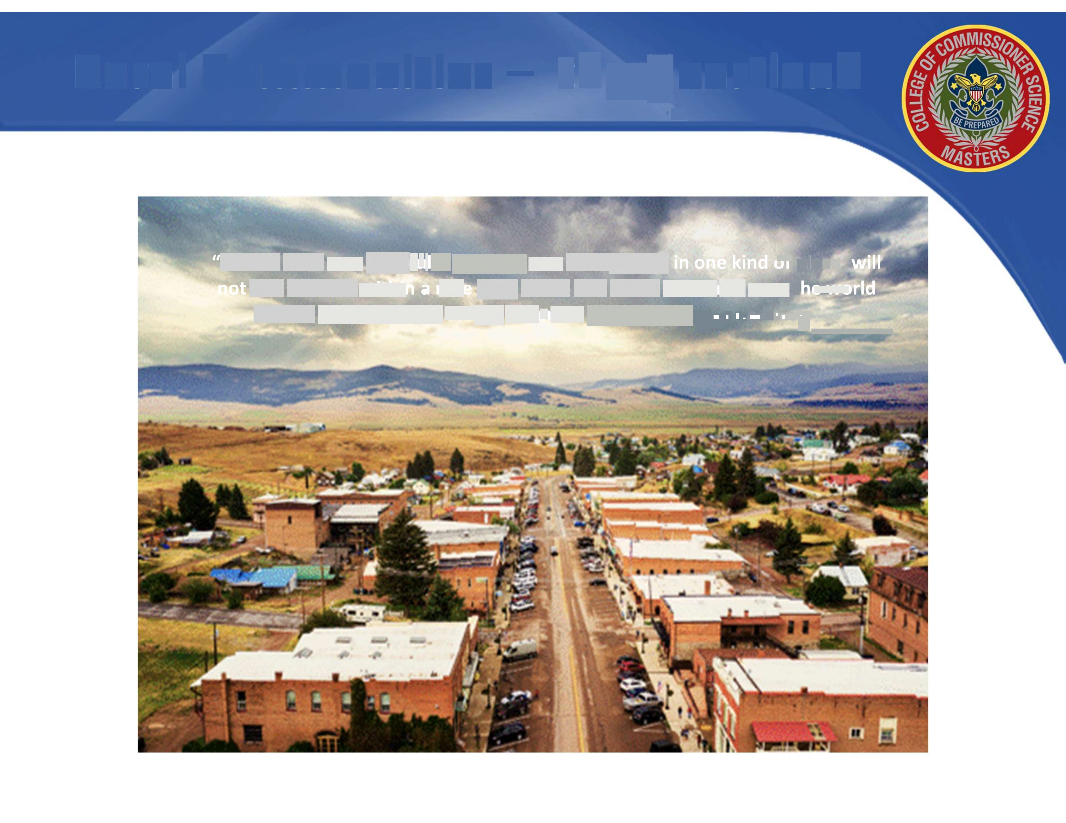
Rural
Communities - theHeartland
.,.,_
"...what suits one particular troop or one kind of boy, in one kind of place, will not suite another within a mile of it, much less those scattered over the world and existing under totally different conditions." - Lord Baden-Powell
e,
a.a-
l
p

Slide 4

A
Different
Approach
Time and commitment to earn trust.
People who live in rural areas are self-sufficient and generous in their community.
These folks are busy, often holding multiple jobs and volunteer positions.

Slide 5

People
Considerations
•
•
Be aware of Scouter's life events
Respect cultures and
lifestyles

Slide 6

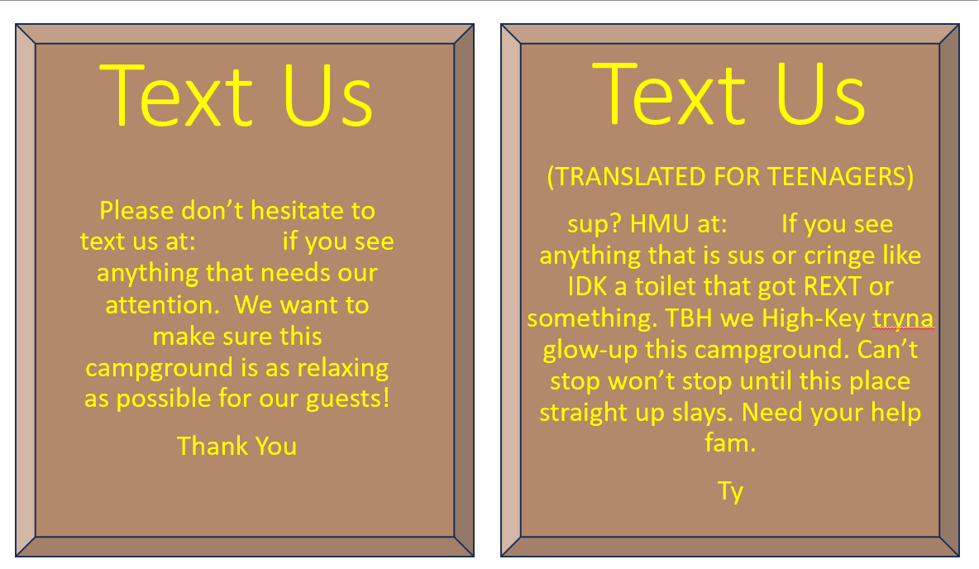
Recruiting
in
Rural Communities
.,.,_
•
•
•
•
•
Focus on serving youth
Locate previous Scouters
Talk face to face
Learn community history and culture
Get to know community members

Slide 7

Communication
•
•
•
•
•
•
Be a
People Person
Listen to leaders and
Empathize
parents
Be responsive and timely
Encourage
Provide immediate recognition

Slide 8

Resolving
Issues
•
•
•
•
Stay Neutral and
Be available
Be adaptable
impartial
Alternative approaches

Slide 9


Slide 10
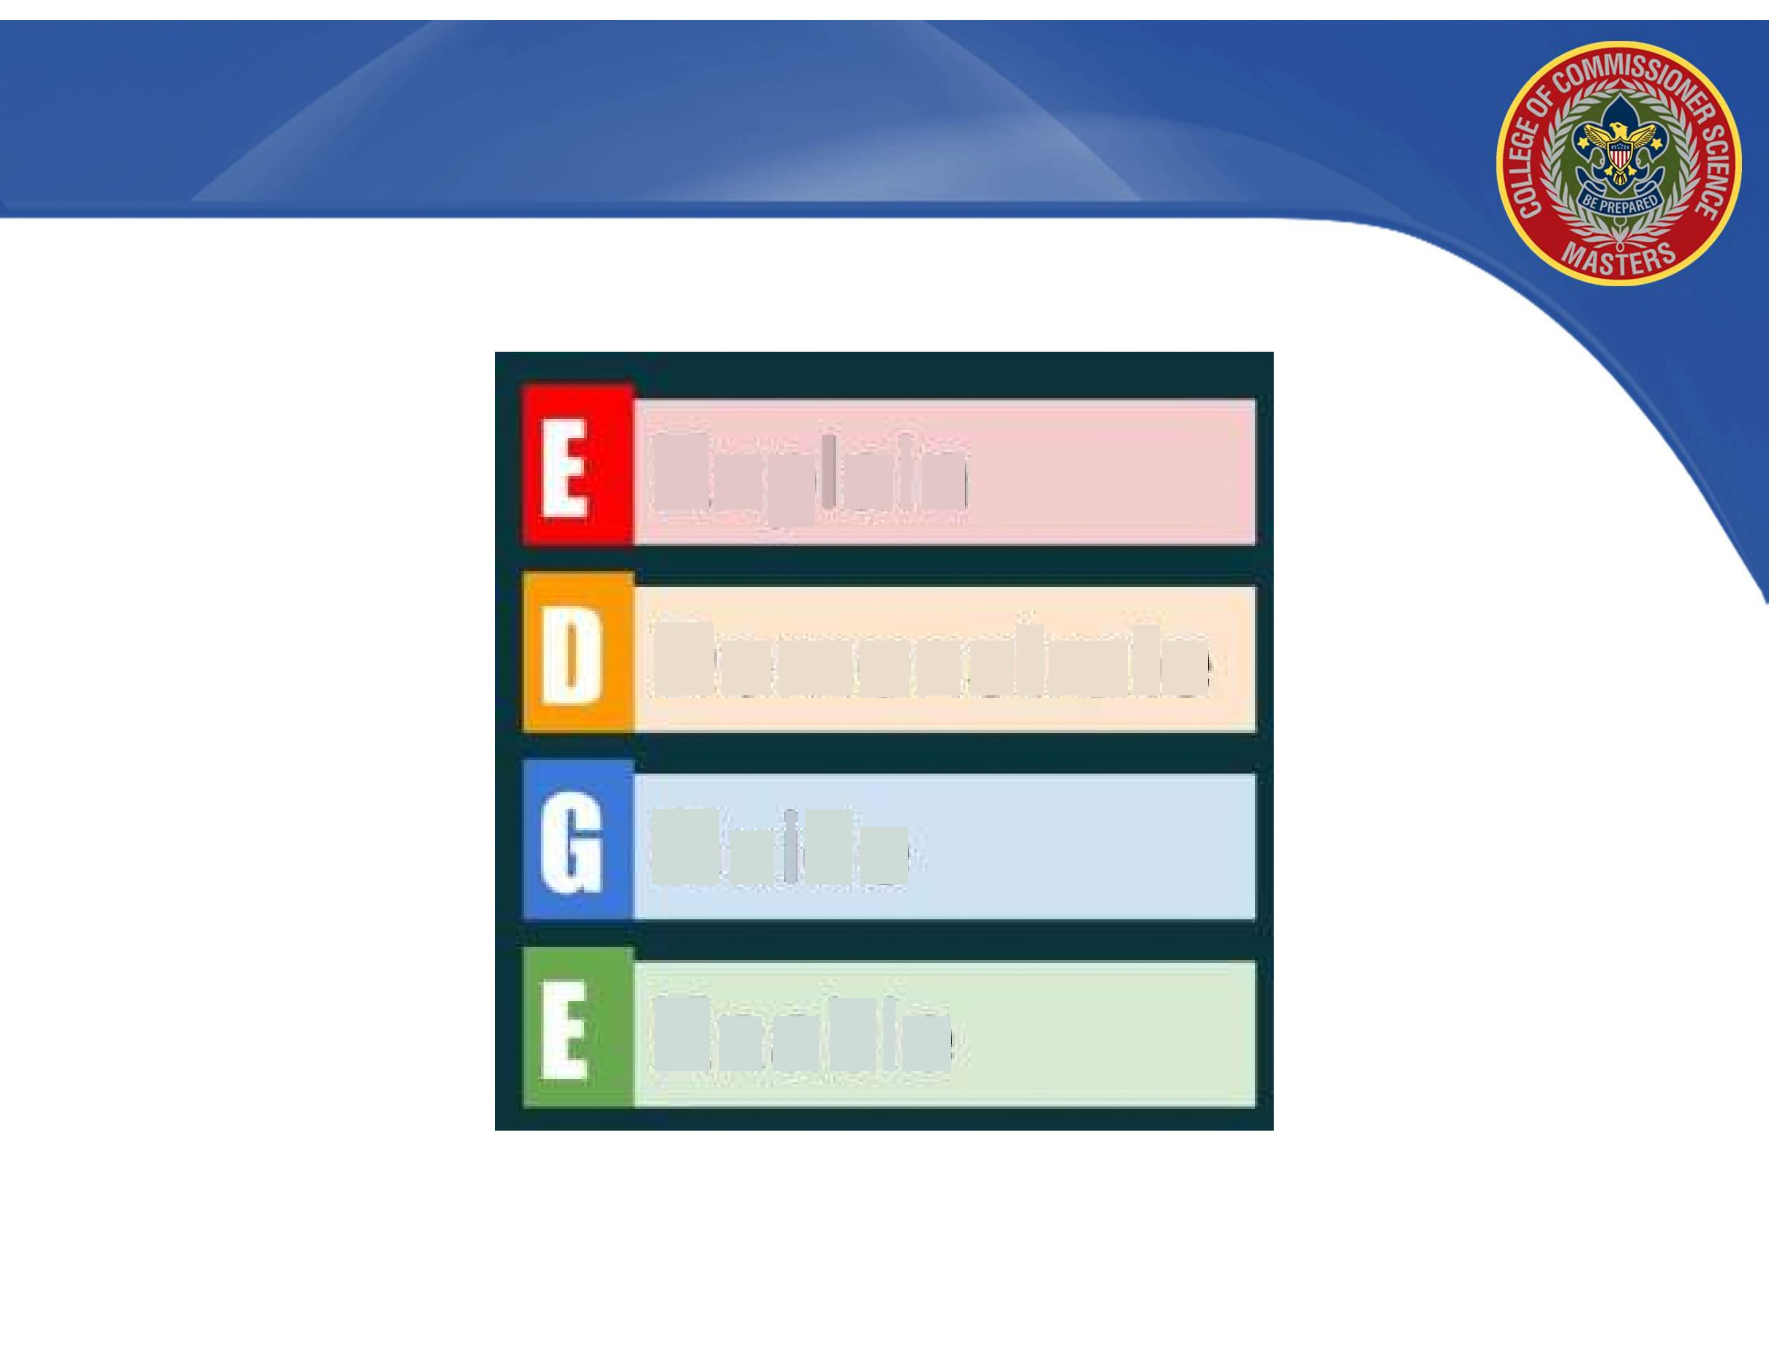
Explain
Demonstrate
Guide
Enable

Slide 11

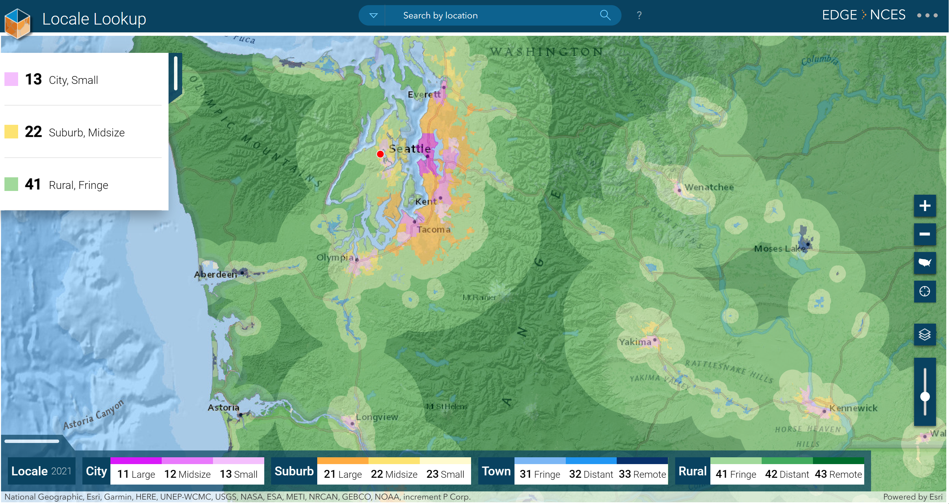
Locale Lookup (ed.gov)
https://nces.ed.gov/programs/maped/LocaleLookup/

Slide 12
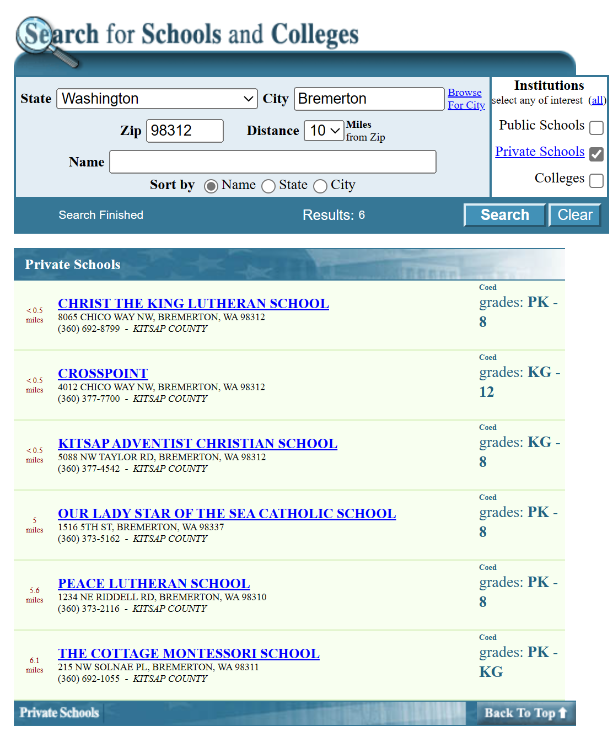
Search For Schools and Colleges (ed.gov)
https://nces.ed.gov/globallocator/

Slide 13
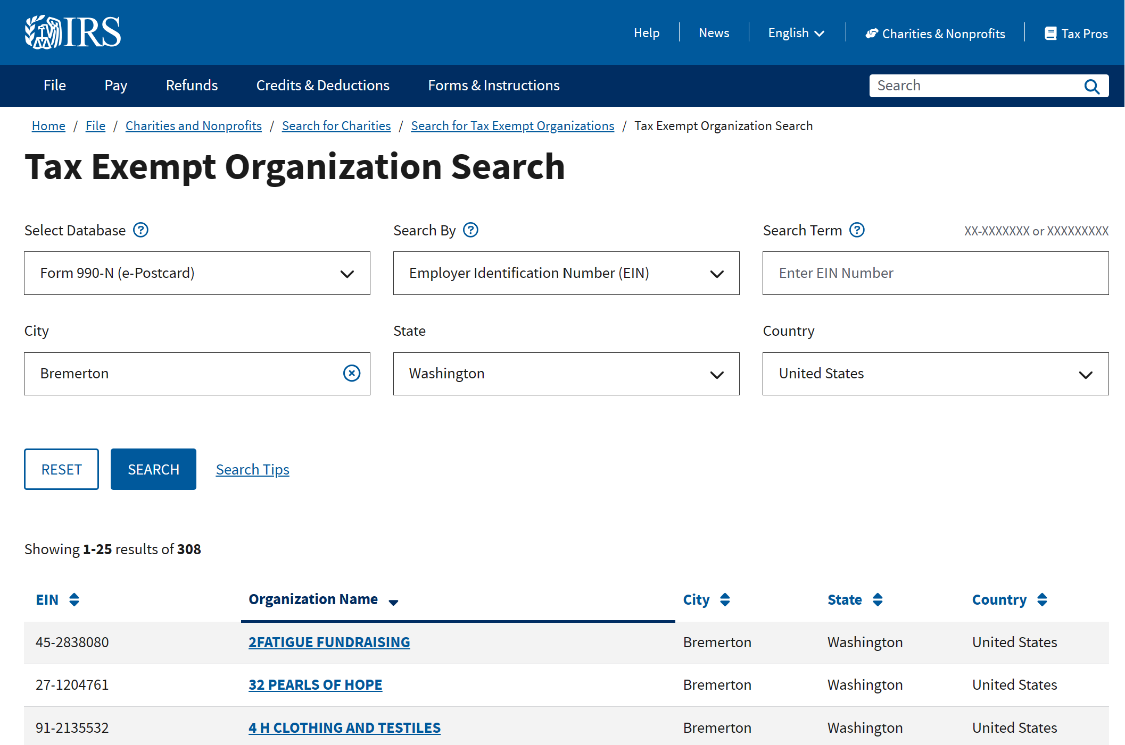
Tax Exempt Organization Search Bulk Data Downloads | Internal Revenue Service (irs.gov)
https://www.irs.gov/charities-non-profits/tax-exempt-organization-search-bulk-data-downloads

Slide 14
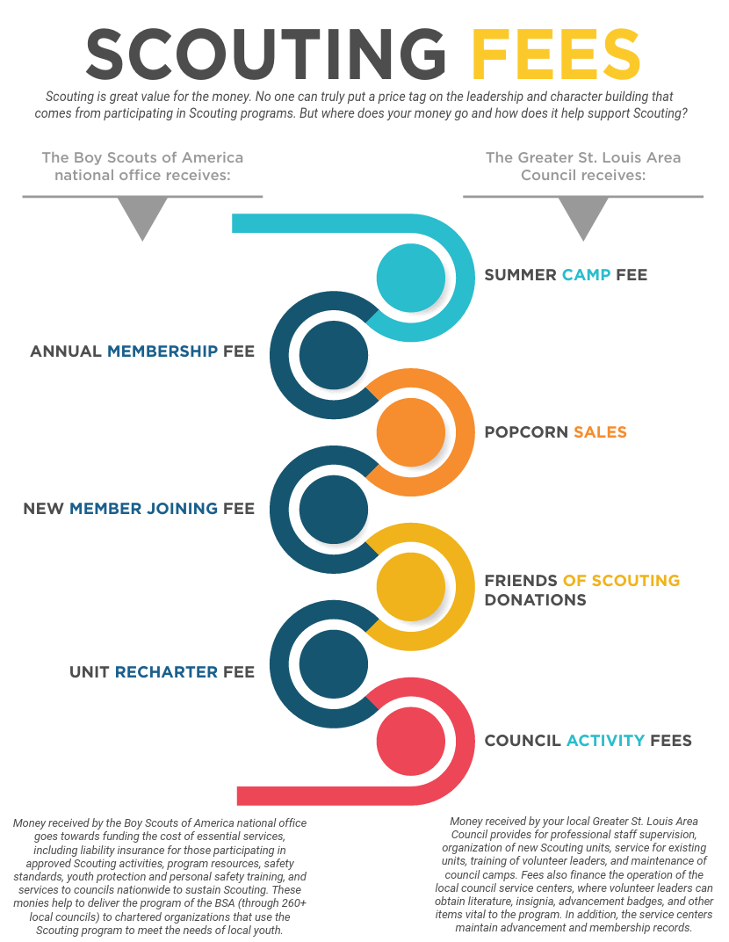

Slide 15

Reducing Costs of Scouting
^{p} .,.,_
•
•
•
•
•
Sharing resources
T shirts/ Neckerchiefs
Multiple units combining activities
Camperships / Scholarships
Remote meetings/ Virtual/ Hybrid

Slide 16

Small Rural
Unit ScoutingOptions
.,.,_
Den aide or Denner instead of den chiefs
Multi-aged dens
Lone Cub Scouts, Scouts BSA
Wagon-wheel troops, weekly patrol meetings, monthly troop meetings
Technology options: virtual meetings, social media, shared drives
Multi-Unit activities

Slide 17

Learning Check
Review this scenario and discuss as a class
Janet is the new Unit Commissioner for Firestart Council covering Faye county. None of the other Commissioners are in Faye county where 3 units are chartered. Janet has 3 years experience as a unit commissioner, and recently relocated with her family to start a new job at Acme. Janet has 2 older children; both have had the Scouting experience.
Faye county is sparsely populated but has 3 key employers that many residents work for:
Acme auto parts, a manufacturing facility; The Refugee and Immigrant Center, temporary
home to 500 families and Holy Divinity Bible College, a renowned theological school with
2000 students enrolled, though half are online. There is also a large retirement community in the county.
Janet has some key contacts at Acme, but needs a way to connect to the other big
employers and community.
What are some strategies Janet can take to engage existing units and potentially expand
Scouting in Faye County?

Slide 18

Summary &
Review
•
•
•
•
•
•
Get to know the community and residents
Build relationships and find leaders
Spend time, build community trust
Recognize
Economize
Be flexible

Slide 19

College
of CommissionerScience
.,.,_
Questions?
Comments!
THANK
'YOU!!
®

