Slide 1

Serving Scouts with Special Abilities
Nancy Peterson, Instructor

Slide 2
Why not?
To encourage positive, inclusive experiences for all youth in Scouting, especially those with different abilities or challenges.
Scout ranks can be earned for a scout with special abilities, it just may take somewhat longer
Lessons and merit badges can be taught creatively (out of the box)
Inclusion into packs/troops
Flexibility is key
"The key is finding the right troop."

Slide 3

A Program of Opportunities
As the population of children with special abilities continues to grow, more and more scout leaders, are finding themselves working with these children for the first time.
Many of these scout adults are volunteers who generously give their time and expertise; others are highly trained in their chosen field, but have little or no knowledge of disabilities and how to work with scouts that might have them.

Slide 4
Strategies as a guide to working with Scouts with special abilities
Mobility impairments
People who use adaptive equipment see their wheelchair or crutches as an extension of their body, so never move those out of reach.
Before booking a campout or field trip, check to make sure the destination has accessible facilities and aids like ramps and handrails.
Offer assistance, but only give help, if it’s wanted.

Slide 5
Strategies continued:
Autism
Remember that it’s called the autism spectrum for a reason: There’s no one-size-fits-all approach, i.e. "cookie cutter”. Learn the person’s coping methods and what triggers negative reactions. Expected-Unexpected Behaviors.
Be patient and allow extra time for activities. If possible-supply a visual schedule of the day’s events — something all Scouts will appreciate. Avoid using specific times on the schedule, though, because you might be expected to follow them to the minute.
Talk with the Scout’s parents before planning noisy activities that could cause difficulty for the Scout. Perhaps these activities could take place outside, where noise dissipates. Or have headphones available, if necessary.

Slide 6
Strategies continued:
ADD/ADHD
Plan short sessions. Intersperse seated activities with more active, hands-on ones.
Don’t give long lists of instructions. Give two or three step directions, then add more steps when those are completed.
Be sensitive to Scouts when talking about taking medication. Never use public proclamations like, “Trevor, go take your pill.”
Learning disabilities
Don’t ask a Scout with a learning disability to read aloud unless they want to and have practiced.
Use praise and encouragement to build self-esteem, and ask the Scout’s buddies to support them.
Be patient and give the Scout extra time if needed.

Slide 7
Strategies continued:
Hearing loss
Face the person directly and enunciate clearly. Speak in a normal volume.
Remember the person might be trying to read your lips, so never stand with your back to them.
If you don’t understand what the person with the hearing loss said, simply ask them to repeat it.
Vision impairments
If the person needs or wants help with guidance, let them hold on to your arm. Don’t grab onto them or try to lead.
Let them use their hands to touch and feel the world around them; this is how they see.
If you meet someone who uses a guide dog, never pet or feed the animal.

Slide 8
Strategies continued:
Speech and language disorders
Don’t shout. People with speech disorders often have perfect hearing.
Avoid noisy situations. Background noise makes communication hard for everyone.
Don’t interrupt by finishing sentences or supplying words. Model slow speech with short phrases and yes-or-no questions when appropriate.

Slide 9
Eight Tips For Working with Special Abilities Scouts
1. Interact
The same rules of polite conversation apply to adults and children, introduce yourself. Then, explain the activity that you will be doing with the scout. Explain the different steps of the activity, including the beginning and the end – while making as much eye contact as possible (if the scout can tolerate eye contact).
2. Observe
Some children with special needs perceive sensory input in different ways and may be unable to verbalize discomfort. Remember that all behavior is communication. Always keep a lookout for these differences and think about what the child’s behavior is communicating to you. If you’re unsure, ask the child’s parents or other adults for advice.

Slide 10
Tips continued:
3. Use Common Sense
Put safety first and arrange the environment for physical/emotional comfort and positive support.
4. Be Flexible
Some adults may think they will not change the way they do things to accommodate one person in a group. But the whole point of teaching is to use a variety of methods to help another person understand and master new skills.
5. Be Consistent
If a set of rules is presented to the group, apply those rules consistently to everyone. Be firm, but fair.

Slide 11
Tips continued:
6. Use visual, auditory or tactile cues
Having the right cues in an environment can mean the difference between participation and non-participation for many children with special needs.
7. Have a plan. And a back-up plan.
You know what they say about the best-laid plans. In the world of special needs, there is always a Plan B, and usually a Plan C. Make sure that there is space to calm down and move freely if things go badly. Think about what each participant can do instead of focusing on what they can’t contribute.
8. Be Positive
A positive attitude is the single most important quality for anyone who works with children with special needs. I’ve seen highly trained specialists unable to interact with children because of their negative attitude and assumptions. But some people with no experience or knowledge of the disability have jumped right in. It is important not to "dumb down" how we talk to scouts with disabilities. We should always presume competence.

Slide 12
First Steps:
Meet with the new scout’s parents. Talk openly and frankly about the behaviors, needs and how to manage them. Be especially alert for suggestions that the scout could have tantrums, need breaks,...etc.
Meet with someone who knows about working with children with disabilities. Often the parents can recommend someone who might even know their child. Get tips, suggestions.
Have someone medically savvy in your unit review the boy's meds and brief the scouters. Some meds are pretty strong, and can have withdrawal symptoms if a scout misses a dose or two; others might "knock a kid out" and some should always be taken shortly before bed, etc.
Meet with your PLC and all of the scouts in the new scout's patrol. Have fellow scouts who include them and look out for them The key to that is making sure the scouts understand the new scout’s disability. If they know that a scout can't process "social cues" like body language and tone of voice, they won't get upset when they seems to "act like a jerk." They'll consider it a sort of challenge to work with them instead. If they know the scout is likely to get fixated on some things, they'll be alert for it and will help redirect them. Make your scouts full partners in the effort!
Don't hesitate to say "no" to a particular trip when you don't think you can manage a scout safely, or ask the parents ahead of time to assist on the outing and then work with the scout to make the next trip on their own, great.
Most scouts won't need rank requirement or merit badge substitutions.
I believe every unit has to be honest with itself and with the families about what the troop’s real capability is to serve any given child. Don’t be afraid to ask for help!

Slide 13
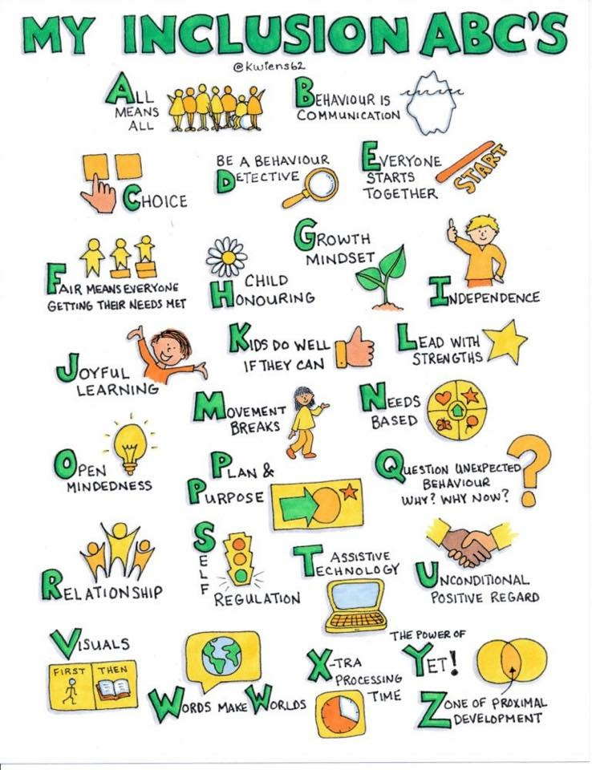

Slide 14
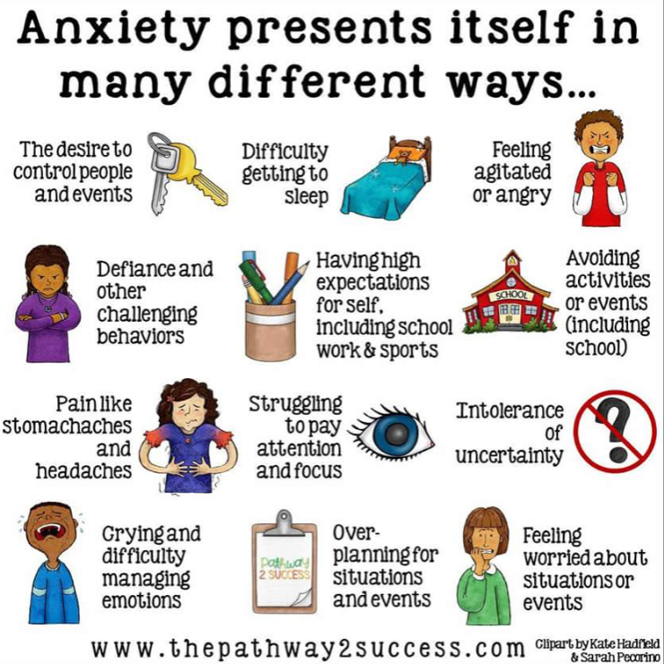

Slide 15
Additional Information & Resources
https://scoutingmagazine.org/2017/02/language-important-leading-scouts-special-needs/
https://scoutingmagazine.org/2017/02/help-youth-special-needs-most-scouting/
https://blog.scoutingmagazine.org/2016/04/21/6-resources-working-scouts-autism/
https://filestore.scouting.org/filestore/pdf/33088.pdf
https://www.autismempowerment.org/autism-scouting-program/leadership-training-kit/
https://www.facebook.com/autismandscouting
https://www.socialthinking.com/

