Slide 1

2024 Program Training
Conference
Cubmaster and Assistant Cubmaster, Den Leader, Committee Member Position Specific Training
Course 101
David Bader – davidbader23@gmail.com

Slide 2
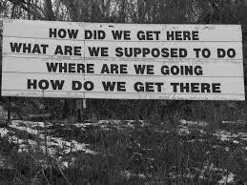
Welcome!!
Introductions

Slide 3
Welcome!!
What we are going to do today
  Session 1 – Cub Scouting – An introduction (All Classes)
  Session 2 – Cubmasters – Your Role
  Session 3 – Outdoors, Volunteers, Safety, Continuing the Journey
What we hope to accomplish - Goals
  Gain Knowledge and Ideas on how to better your Pack
  Be competent in knowing what to do and how to do it
  Knowing how to set the example for the Cubs and the Adults
  Finalize your training and next steps!

Slide 4
Session 1 Training
Goals of Session 1 – Cub Scouting – An Introduction
  The Basics – How we start
  Aims and Methods of Scouting
  Purpose of Scouting
  Pack Structure
  Childhood Development
  Cub Scout Uniforms
  Advancement
  Conclusions

Slide 5
Session 1 Training
The Basics – Four Things
  Cub Scout Sign
  Cub Scout Salute
  Opening Flag Ceremonies
  Scout Oath and Law

Slide 6
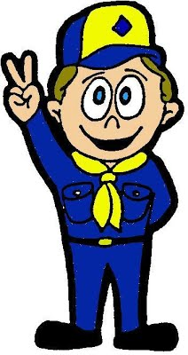
Scout Sign
The Cub Scout sign is made with the right arm held high and straight up above the shoulder, with the index and middle fingers forming a V. The other fingers are held down by the thumb. It's the sign of Cub Scouts all over the world.
What do the two raised fingers stand for?
Notes:
Scout Oath and Scout Law

Slide 7
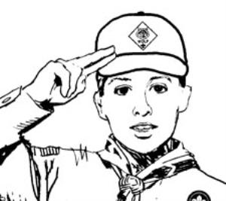
Scout Salute
  The Cub Scout salute is made by joining the index and middle fingers of the right hand (holding the other fingers with the thumb) and touching them to the cap visor or forehead above the right eyebrow. The hand is held the same as for the Cub Scout sign, except the index and middle fingers are together.
  The Cub Scout salute is used to salute the flag when in uniform and to show respect to den and pack leaders. It can be used when greeting other Cub Scouts.

Slide 8
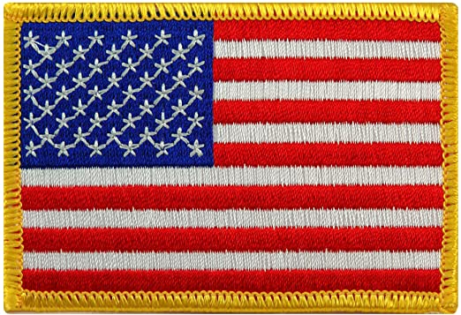
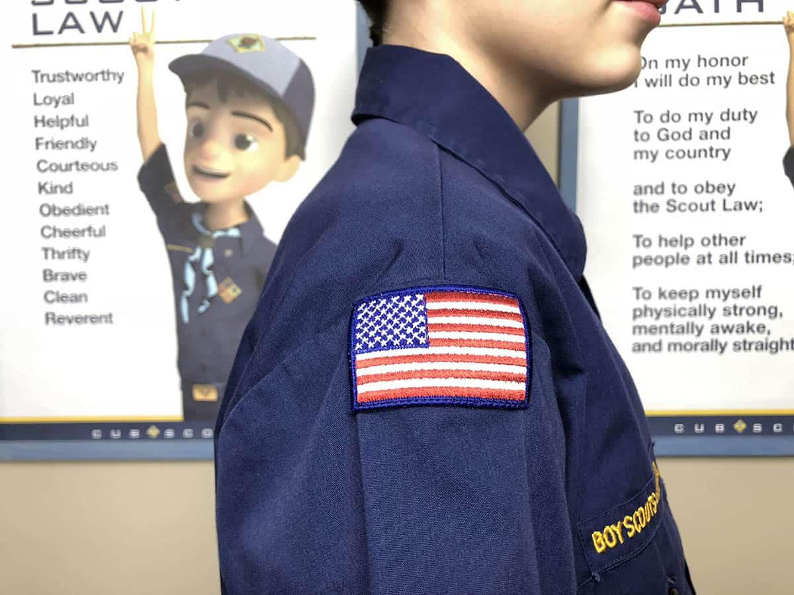
How To Start A Meeting
Volunteers:
  Pledge of Allegiance
Notes:
Make note that if you don’t have an actual flag with you, there is one on each uniform. On the right sleave. Have a younger scout come to the front and turn to the side to be the flag. They will get a kick out of being the flag.

Slide 9
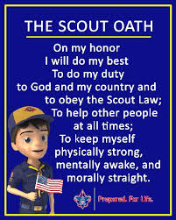
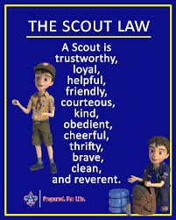
Scout Oath and Law

Slide 10
Aims and Methods of Scouting
Cub Scouting uses Time-tested Methods to achieve and reinforce the Aims of Cub Scouting.
While Scouting is known for the outdoor adventures, those program elements are not the purpose of Scouts BSA.
The purpose of Cub Scouting and all Scouting programs is found in the Mission Statement of Scouts BSA:
    “The mission of the Boy Scouts of America is to prepare young people to make ethical and moral choices over their lifetimes by instilling in them the values of the Scout Oath and Law.”

Slide 11
Aims of Scouting
Character Development
Citizenship Training
Personal Fitness
Leadership development
  “Through Scouting’s Aims and Methods and with the example of their Family, Adult and Youth Leaders, boys and girls learn to become men and women of sound character”

Slide 12
Methods of Scouting
Living the Ideals
Belonging to a Den
Using Advancement
Involving Family and Home
Participating in Activities
Serving Home and Neighborhood
Wearing the Uniform
  “These seven Methods and the four Aims, when used in Cub Scouting, helps accomplish the overall goals of building character, learning Citizenship, developing Personal Fitness and Leadership and brings Cub Scouting to life for Children and their Families.”
Notes:
The Scout Oath and Scout Law are the ideals the program instills in youth and are ideals adult leaders strive to live by.
The Cub Scout sign, salute, handshake, and slogan serve as physical reminders of the ideals.
The den—a group of six to eight boys or girls who are about the same age—is the place where Cub Scouting starts. In the den, Cub Scouts develop new skills and interests; they practice sportsmanship and good citizenship; and they learn to do their best, not just for themselves but for the den as well.
Recognition is important to everyone. The advancement plan provides fun, gives Cub Scouts a sense of personal achievement as they earn rank badges, and strengthens family understanding as adult family members and the den leader work with members on advancement projects.
Whether a Cub Scout lives with two parents or one, other relatives, or a foster family, his or her family is an important part of Cub Scouting. Parents and adult family members provide leadership and support to ensure that Cub Scouts have a good experience in the program.
Cub Scouts participate in a huge array of activities, including games, projects, skits, songs, outdoor activities, trips, and service projects. Besides being fun, these activities offer opportunities for growth, achievement, and family involvement.
Cub Scouting focuses on the home and neighborhood. It helps Cub Scouts strengthen connections to their local communities, which in turn support their growth and development.
Cub Scout uniforms serve a number of purposes. They demonstrate membership in the group by having everyone dress alike, and they identify individual achievement, with Scouts wearing the badges and pins they’ve earned. Wearing the uniform to meetings and activities also encourages a neat appearance, a sense of belonging, and good behavior.
o The uniform represents a democratic idea of equality, bringing people of different backgrounds together. When universally adopted, it covers up all differences of social or economic background.

Slide 13
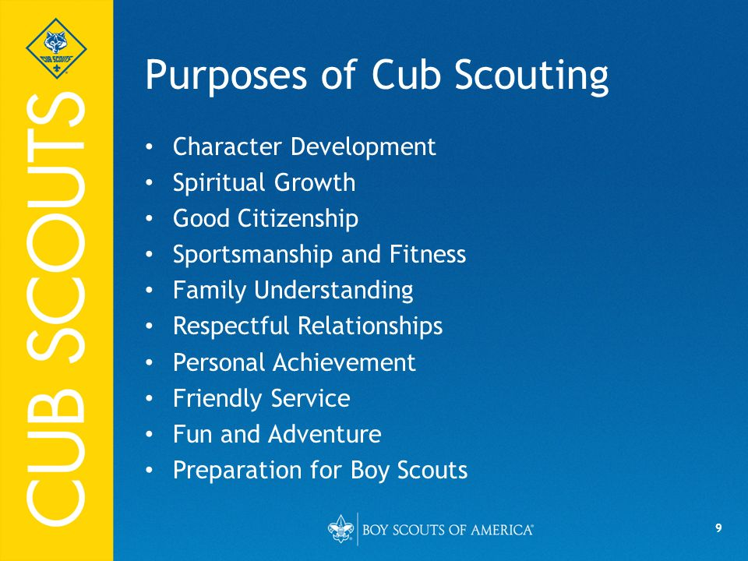

Slide 14
Pack Structure
Types of Packs
Notes:
In a Cub Scout pack, there are several volunteer leadership positions that are required and others that are optional. Let’s talk about these volunteer positions and the roles they play in the pack. Let’s also look at several common pack and den structures.
Cub Scout activities take place primarily within the den setting, although some take place with the pack. Requirements for completion of adventures, which lead to the badge of rank, are usually completed in the den meetings.
The pack consists of all of the dens in the pack, which come together as one for recognition and special activities. The pack exists to support these dens and it serves as the official entity, or unit, of Cub Scouting.
The Cub Scout pack requires a variety of leaders who work together to
Ask participants for them to tell you what they think

Slide 15
Session 1 Training
Types of Packs
  All Girl/All Boy
  Small/Large
  Mixed Grades

Slide 16
Pack Structure
Types of Packs
  All Girl/All Boy
  Small/Large
  Mixed Grades
Types of Chartered Organizations
Notes:
Ask participants if they can name a few of these
An organization that partners with the BSA to provide the Scouting program is called a chartered organization. Each Cub Scout pack, as well as all other BSA units, is required to have one.

Slide 17
Pack Structure
Types of Packs
  All Girl/All Boy
  Small/Large
  Mixed Grades
Types of Chartered Organizations
  Church
  Business
  School
  Organization
  Group of Individuals
Notes:
The chartered organization adopts the Scouting program and provides a meeting place or assists in securing one in addition to other resources. Examples of chartered organizations are churches or other religious institutions, civic groups, or community organizations. In all cases a qualified chartered organization must share the values of Scouting and may not use Scouting for political or special interest purposes.
This partnership is often mutually beneficial when it is the goal of the chartered organization to serve its own youth membership or the youth in the community. The chartered organization may choose to serve both its own youth members and youth in the community.

Slide 18
Pack Structure
Pack Key 3
  Chartered Organization Rep*
  Committee Chair*
  Cubmaster*
Pack Committee Members/Leaders
Notes:
The charter contains actions that the chartered organization agrees to perform and support that the BSA agrees to provide through the local council. The chartered organization helps to select and approve the volunteer adult leaders in its units.
A representative is selected by the head of the chartered organization to serve as the point of contact for the pack and provide direct support to the pack from the chartered organization. This person is known as the chartered organization representative. This is a required position in the pack.
The pack committee chair supports the activities of the pack, including recruitment of new members. It provides an administrative infrastructure to handle tasks such as managing BSA registration for youth and adults, purchasing program supplies and recognition items, and coordinating camp or other pack activity attendance.
The next required position for a pack is the Cubmaster. The Cubmaster’s main responsibility is to conduct pack meetings and serve as the master of ceremonies. Larger packs may have assistant Cubmasters who help organize pack meetings or who may be preparing to serve as the next Cubmaster.

Slide 19
Pack Structure
Pack Key 3
  Chartered Organization Rep*
  Committee Chair*
  Cubmaster*
Pack Committee Members/Leaders
  Treasurer*
  Secretary*
  Outdoor and Activities Chair(s)
  Den Leaders*
  Assistant Cubmaster(s)
  Recruitment and Re-Charter Chair(s)
  Advancement Chair * = Required
Notes:
Every pack is required to have a pack committee. At a minimum, a pack committee has a committee chair, treasurer, and secretary. Successful packs actively recruit as many parents as possible to serve on the pack committee.
The pack committee provides financial support for the den leaders to purchase program supplies and materials. Each pack will have its own

Slide 20
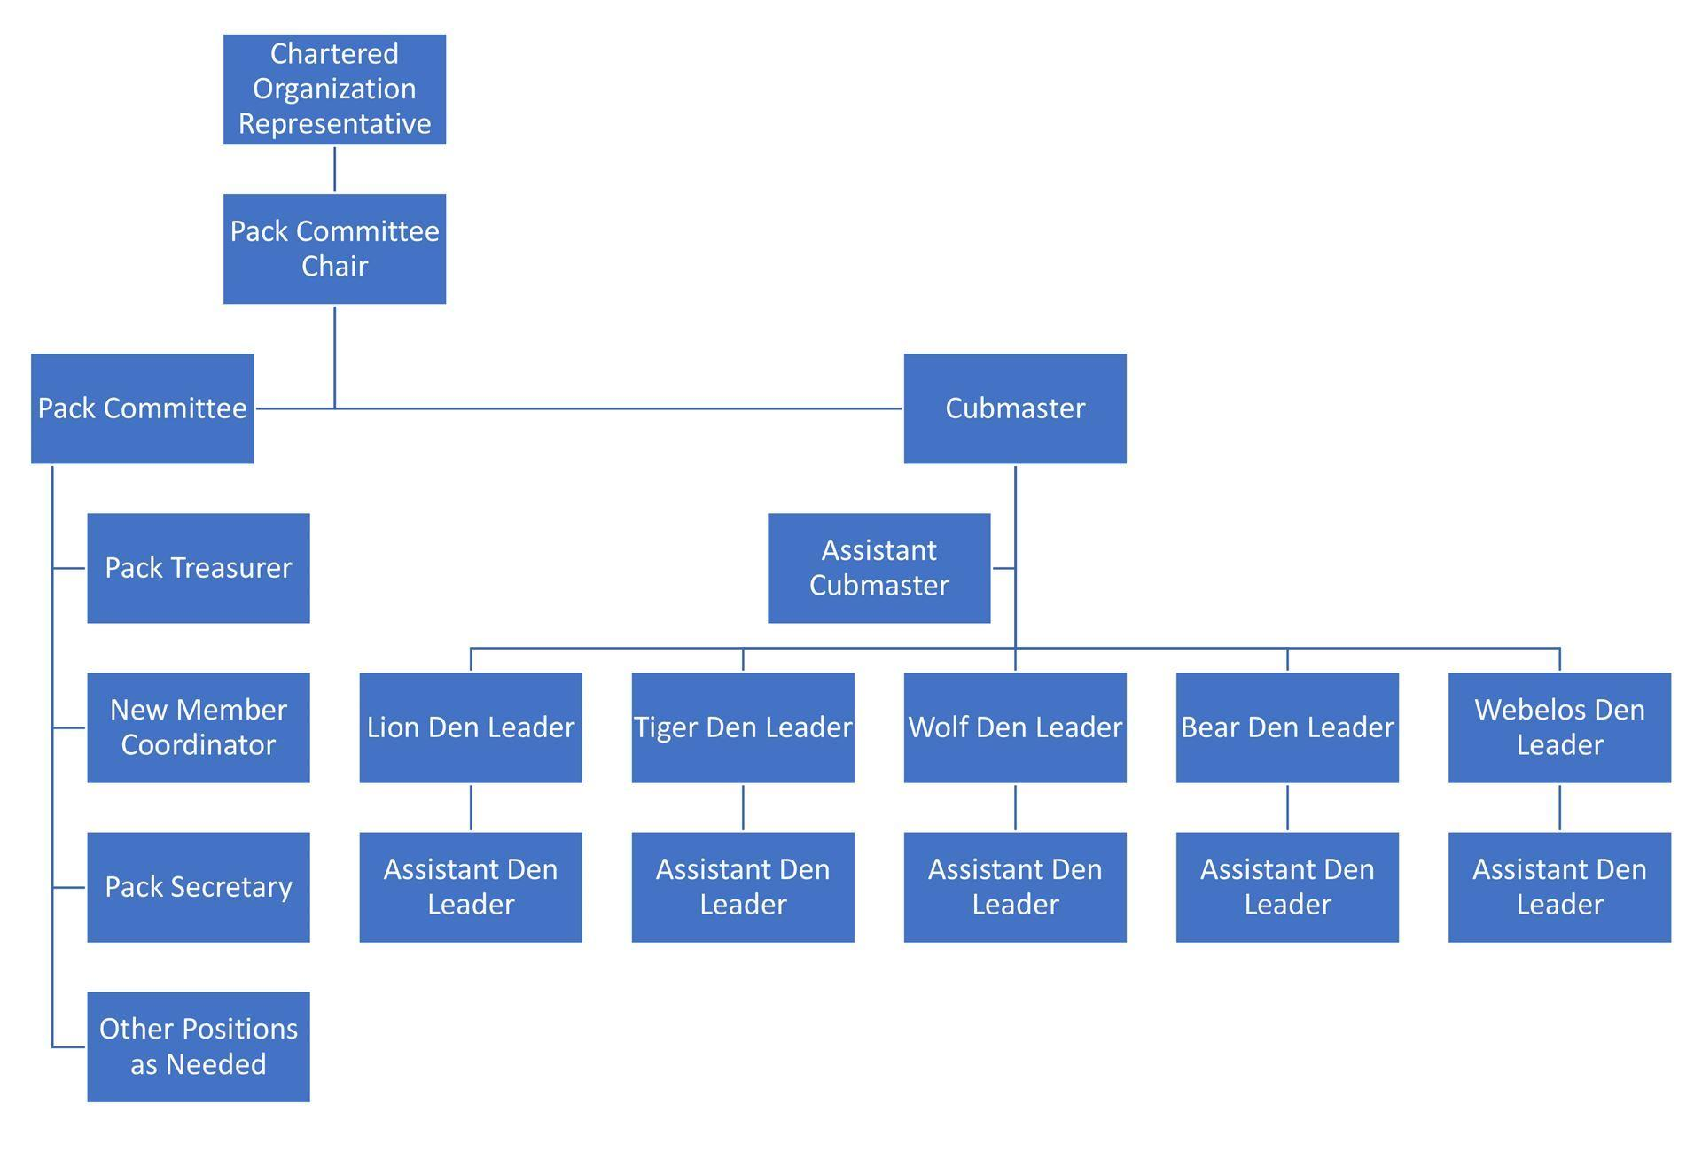
Example Pack Organization Chart
Notes:
As you can see, a Cub Scout pack may choose the structure that best meets its needs, always using two-deep leadership and adhering to Youth Protection standards and practices.
These varying pack structures allow for flexibility in delivering the Cub Scouting program to maximize the quality of the program and engage as many families as possible.
There are many different structures that a Cub Scout pack can adopt,

Slide 21
Pack Organization
How are your packs organized?

Slide 22
Child Development
Stages
  Kindergarten to First Graders
    Lions and Tigers
  Second and Third Graders
    Wolves and Bears
  Fourth and Fifth Graders
    Webelos and Arrow of Light
Behaviors
  Boy
  Girl
  “Children develop in different ways physically and emotionally, in social maturity and appearance, regardless of age.”
Notes:
Let’s start with kindergartners and first-graders, who are Lions and Tigers.
They are just starting to refine their large motor skills. They may be riding tricycles or bicycles with training wheels.
However, their attention spans are short, and they may become easily bored.
They tire easily but love to be active. At times they may appear clumsy and accident-prone and need good supervision.
Socially, they are developing friendships and learning to play cooperatively.
They look for comfort and reassurance from their primary caregivers and teachers, including their den leader.
They are eager to share and enjoy boasting about accomplishments and are quite enthusiastic about learning new skills.
They may cry easily when embarrassed or hurt. Sometimes children of
Second- and third-graders, who are Wolves and Bears, are growing in their physical strength and endurance.
They are curious about the way things work and have vivid imaginations.
At this age they can understand the difference between right and wrong.
They have a keen sense of rules and will protest if they think someone is cheating.
They may be highly critical of themselves and often need some encouragement from caring adults.
They are eager to please and demonstrate this by wanting to help.
Although Cub Scouts of this age can tell time, they have little understanding of what time means and cannot tell how much time has passed or how to manage their time on a project.
Having mastered the ability to play cooperatively, they enjoy having a close circle of same-gender friends.
However, they are more susceptible to peer pressure, which can be positive or negative.
Wanting to play on the same sports teams or wanting to play together outside of school signals the importance of having close friends.
Children of this age still need help managing and expressing their emotions, but they are also showing a greater sense of empathy for one another.
Fourth- and fifth-graders, who are Webelos, have well-developed eye-hand coordination and can better think through an action before performing it.
Their physical stamina is also growing. Their fine motor skills are becoming refined and they are more willing and able to take on more tedious tasks and crafts.
Their sense of time has improved, and they can better manage their time to complete a project, with the help of their den leaders and perhaps den chief.
They now like to be part of the planning process for projects, campouts, and pack meetings etc., as they are now more organized in their thinking skills.
They are growing in confidence and may be devoted to one or several sports or extracurricular activities.
Their attention spans are increasing, and they are able to sit and discuss issues of importance; they may bring up topics other than the topics presented in their adventures.
They understand rules better than younger Cub Scouts, and they now understand the difference between intentional and accidental rule-breaking.
They may ask many questions and appear more sensitive and curious about the feelings of others, including adults.
Webelos Scouts are very devoted to their friends and may have a best friend.
In all children of Cub Scout–age, you may see a great difference in physical size and appearance even among those who are the same age. These differences in size can sometimes lead an adult to mistake physical size for social maturity. Some children develop socially and emotionally earlier than they do physically. For other children, it is the opposite.

Slide 23
Poll Questions & Break
Answers to the poll will be discussed after the break
10 min break?

Slide 24
Eight Behavior Questions
Who do you think is more likely to express themselves more with their actions?

Slide 25
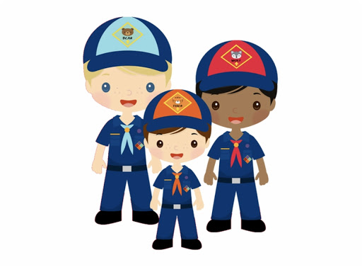
Eight Behavior Questions
Who do you think is more likely to express themselves more with their actions?
Notes:
On average, most young boys tend to be physically active.

Slide 26
Eight Behavior Questions
Who do you think is more likely to show more social aggression, such as name-calling or excluding others?

Slide 27
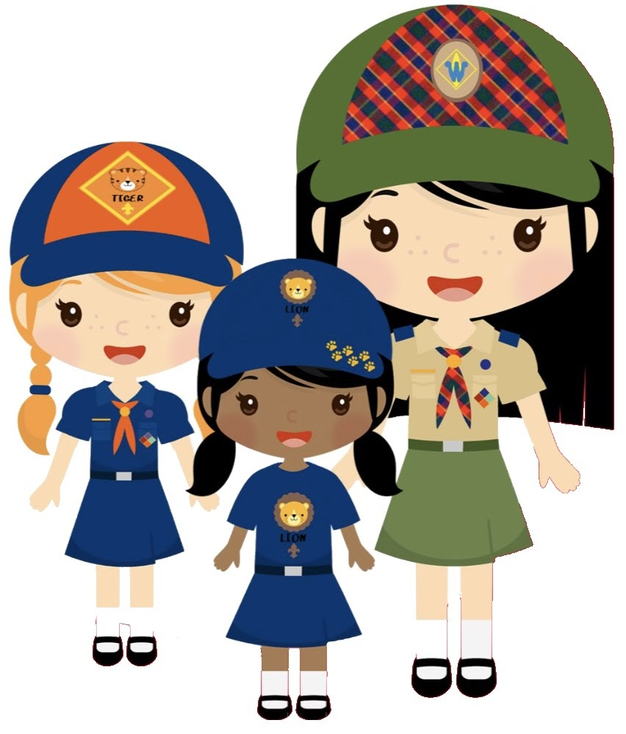
Eight Behavior Questions
Who do you think is more likely to show more social aggression, such as name-calling or excluding others?

Slide 28
Eight Behavior Questions
Who do you think is more likely to show more physical aggression, such as hitting and kicking?

Slide 29
Eight Behavior Questions
Who do you think is more likely to show more physical aggression, such as hitting and kicking?
Notes:
One of the reasons that adult partners are required to be with each Lion and Tiger is to aid in managing behaviors.

Slide 30
Eight Behavior Questions
Who do you think is more likely to be better at talking about their emotions?

Slide 31
Eight Behavior Questions
Who do you think is more likely to be better at talking about their emotions?
Notes:
Be alert for Cub Scouts who might have trouble joining in group activities or who seem to be isolating themselves.

Slide 32
Eight Behavior Questions
Who do you think is more likely to show signs of more physical and emotional maturity and may be entering puberty at 9 to 10 years of age?

Slide 33
Eight Behavior Questions
Who do you think is more likely to show signs of more physical and emotional maturity and may be entering puberty at 9 to 10 years of age?
Notes:
Girls might tend to be taller than boys of the same age and therefore look older.

Slide 34
Eight Behavior Questions
Who do you think is more likely to find it hard to talk about their emotions?

Slide 35
Eight Behavior Questions
Who do you think is more likely to find it hard to talk about their emotions?
Notes:
You can help them by asking simple questions such as “How do you feel about that?” or “How do you think someone else might feel if that happened to them?”
Be alert for Cub Scouts who might have trouble joining in group activities or who seem to be isolating themselves.

Slide 36
Eight Behavior Questions
Who do you think is less likely to show signs of physical and emotional maturity early?

Slide 37
Eight Behavior Questions
Who do you think is less likely to show signs of physical and emotional maturity early?
Notes:
Boys of this age may not be showing any signs of entering puberty.

Slide 38
Eight Behavior Questions
Who do you think is more likely to be comfortable using words to express themselves?

Slide 39
Eight Behavior Questions
Who do you think is more likely to be comfortable using words to express themselves?
Notes:
You may find that girls in a den can sit for longer periods of time and have lengthier attention spans.
Well done! As an adult leader in Cub Scouting, you are serving as a role model and mentor for the youth in your den and pack. Maintaining patience and a positive attitude as you work with children of any age can have a profound influence on those children.
Your actions will speak louder than words. Children may not remember your words, but they will remember how you treated them and how they felt being in your presence. Having a basic understanding of normal childhood development will give you a bit of insight into how to best work with the Cub Scouts in your den or pack. Being aware of these characteristics can help you plan for and work with each grade level in the best way possible.

Slide 40
Cub Scout Uniforms
Scouting Ideals that the Uniform supports
  Identification
  Achievement
  Personal Commitment
  Personal Equality
When to Wear
  Meetings & Outings
  Special Functions
  Camp
  “Set expectations early on everyone - Leaders and Families of youth - how the uniform is a Method that reinforces the four ideals of Scouting”
Notes:
Wearing uniforms has been a method of Scouting from the beginning, and decades of experience show uniforms to have many benefits. The Scout uniform is one of the seven methods of Cub Scouting used to support the values embodied in the Scout Oath and Scout Law. There are also four ideals associated with wearing the Scout uniform.
The uniform is a sign of identification. Youth and adult members who wear the uniform can be instantly identified as members of the BSA. The uniform is a visible reminder that Scouting is a positive force for good in the community and for the character development of all its members. When the uniform is properly worn and cared for by both youth and adult leaders, the uniform builds good den and pack spirit.
ASK: Think about when you wear your uniform.
Does the uniform help you identify other Scouters?
Answers could include:
• At meetings and outings
• Special functions
• Camp
• Helps identify other Scouters
Mention being out in public and people randomly coming up and talk about their scouting experiences.
The uniform is a sign of achievement. The uniform shows the wearer’s activity, responsibility, and achievement. The accomplishments of every youth and adult member can be recognized by the insignia worn on the uniform. The only thing you can tell about someone in uniform is where they are from and what they have accomplished as an individual.
The uniform is a constant reminder to all members of their commitment to the ideals and purpose of Scouting. It is a way of making visible members’ commitment to the Scout Oath and Scout Law.
The uniform is a sign of personal equality. The uniform represents a democratic idea of equality, bringing people of different backgrounds together. When universally adopted, it covers up all differences of social or economic background.

Slide 41
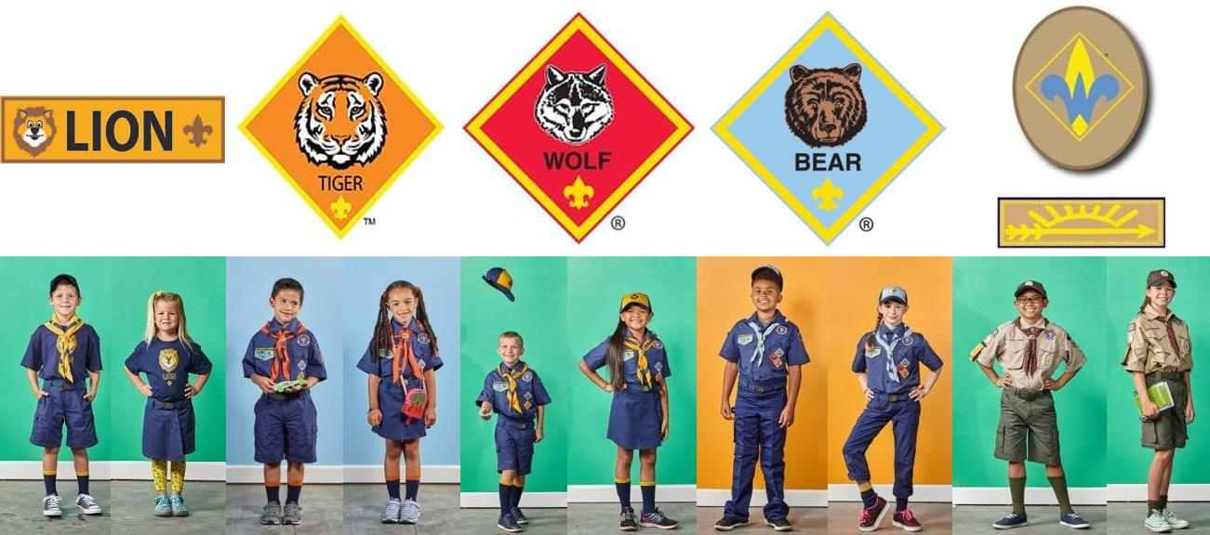
Cub Scout Uniforms
Show slides of uniforms

Slide 42
Advancement
Goals
  Grade Specific, Age Appropriate
  Instills the values of the Oath and Law
  Fulfills the Mission of Scouts BSA
    “Helps young People to make Moral and Ethical choices over their lifetimes”
How the Scouts advance
  Achieve goals through a series of developmentally appropriate and fun adventures
  Develop skills and favorable dispositions related to personal fitness, good character, participatory citizenship, outdoor skills and awareness, and leadership development
  Most importantly: HAVE FUN! (KISMIF)

Slide 43
Advancement
How tracked
  By Leader using Scout Book – Official Scouts BSA tool
    Allows leaders to record, approve and report advancement to Scout office and Scout Shop (www.scoutbook.org)
  By Leader using tally sheets or Charts
    Note – Will have to transfer to online version before awards can be picked up at Scout Shop
  Using Third Party Software
    Can be transferred for free into Scout Book
What is awarded
  Adventure loops for all Cub Scouts through third grade
  Adventure Pins for Fourth and Fifth Graders
  Cloth Rank Badges for all

Slide 44
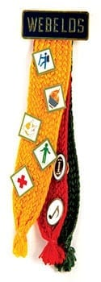
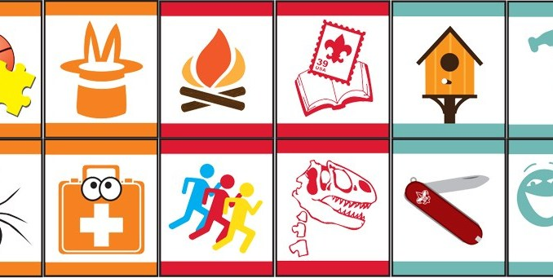
Advancement
Notes:
How Earned
Den Leaders guide all adventures with help from fellow parents and Den Chiefs
How to know what is required and what is an elective from looking at the belt loop?
The required is in full color. The elective is a single color.

Slide 45
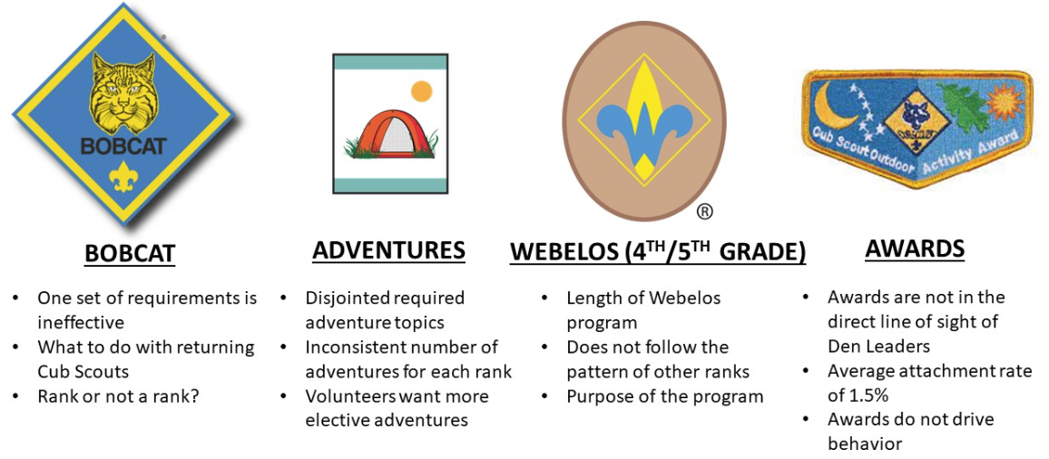
Advancement – Updated!

Slide 46
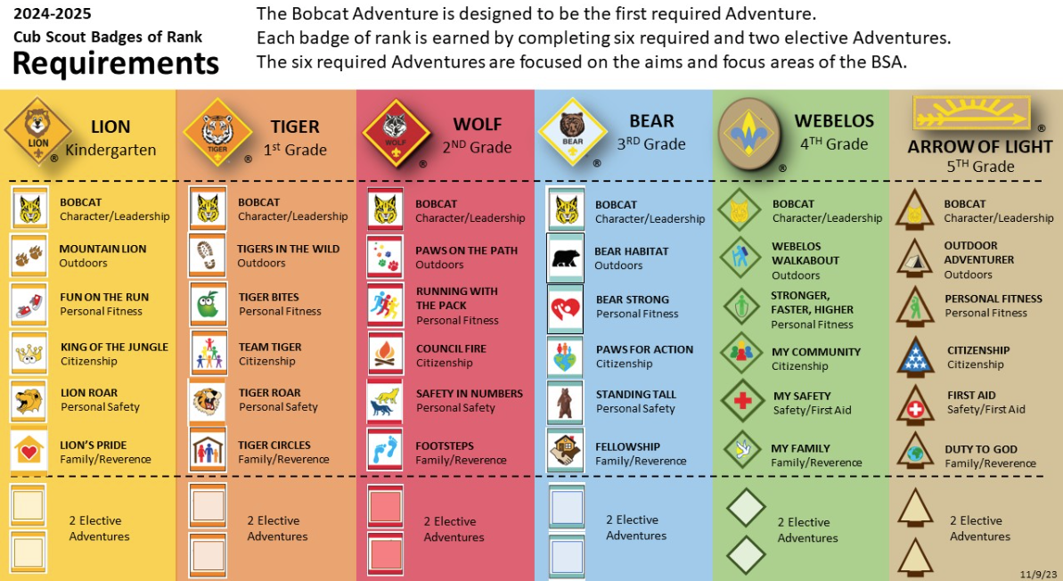
Advancement – Updated!
Advancement
  Ranks
Notes:
How Earned
Den Leaders guide all adventures with help from fellow parents and Den Chiefs
Ideally, All Ranks are to be earned by Blue and Gold in February, but can also be presented at a Cross Over Ceremony at end of year
Cub Scout Adventures have been improved to make it easier to deliver the program to multi-rank dens or as a Pack. To earn each rank in Cub Scouting will require a Cub Scout to earn the six required Adventures and two elective Adventures. Required Adventures reflect the aims and focus areas of the BSA. The number of elective Adventures increases.
Webelos and Arrow of Light will be separated. Webelos becomes the 4th-grade program in Cub Scouting. Arrow of Light becomes a stand-alone badge of rank for 5th graders and will no longer be associated with Webelos. Arrow of Light will be the program that prepares Cub Scouts to join Scouts BSA.
Cub Scouts Awards will be reimagined as Cub Scout Adventures. Topics like camping, STEM, and range and target sports will remain and are reimagined into elective Adventures that can be used towards earning a badge of rank.

Slide 47
Advancement
How/When Awarded
  At All Pack Meetings
  Adventure Loops and Pins Given to Scout By Den Leader
  Rank awarded in special Ceremony and present to Scout and Parents by Cubmaster
Ceremonies
  Make them special, make them meaningful
    Many resources online, in books, etc. – Make it your own
Conclusions/Questions?
Notes:
Ranks at Pack Meetings and adventures at den meetings; depending on the size of your Pack and the traditions currently held

Slide 48
Session 1 Training
This is the end of session 303, part 1 of 3
10 Minute Break – Move to your session rooms
Questions?

Slide 49
CM/ACM Training
Goals of Session 2 – Cubmasters – Your Role
  Training – The requirements
  The Basics – Your Responsibilities
  Den/Pack Management
  Fiscal Policies
  Conducting a Cub Scout Pack Meeting
  Denner and Den Chiefs
  Resources
  Conclusions

Slide 50



  Training – The requirements
To Be Trained
  Youth Protection – Renewed each year
  Cub Scout Leader Training
  Cub Scout Leader Specific Training
  Hazardous Weather
  BALOO - Basic Adult Leader Outdoor Orientation
Tools Available
  www.scouting.org or www.my.scouting.org
  Unit Commissioner
  Round Table
  Council – District Executive
Notes:
YPT – renewed each year in our Council
Basic Adult Leader Outdoor Orientation
Overnight activities require a minimum of 1 leader who is BALOO trained be in attendance
Registered Leaders and Parents may take BALOO
The Guide to Safe Scouting

Slide 51
CM/ACM Training
  - Work Directly with Den Leaders, Pack Trainer, Committee Chair and Committee members to ensure Dens are functioning well.
  - Ensure all direct contact Leaders have completed Youth Protection and Leader Specific Training.
  - Work as a team with Committee Chair, Den leaders, Pack Trainer to recruit, educate, guide, support, motivate and inspire the other adult leaders.
  - With the help of other leaders, plan quality, year-round Pack and Den programs filled with fun and activities.
  - Lead the monthly Pack Meetings with the help of others, involving all dens in some way.

Slide 52
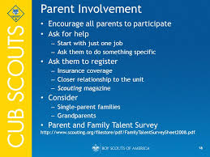
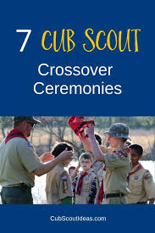


The Basics – Your Responsibilities
Notes:
- Conduct impressive advancement, recognition and graduation ceremonies. For Webelos Crossover ceremonies, involve Scoutmasters, the Order of the Arrow and other Scout BSA Leaders.
- Coordinate Pack membership, recruiting and transition.
- Maintain good relationships with all parents and guardians. Seek their support and include them in activities.
- Request Den Chiefs for all Pack Dens from Scout Troop(s). Upon selection, insure they are Trained and recognize them at all Pack Meetings.

Slide 53




The Basics – Your Responsibilities
Notes:
- Establish and maintain good relationships with Scouts BSA Troops that your Webelos Scouts may work with and/or join.
- Know about and use the appropriate and available literature to help improve your Pack and Dens programs and activities.
Attend Monthly Roundtable Meetings and associated Cub Scout Break out sessions for information on local activities and program updates that help continue providing a quality program for your Cub Scouts.

Slide 54
Den and Pack Management
Scout/Youth Behavior
  Child Development
    Stages and Behaviors
Methods of Control of Behavior
  Scout Sign
    Set expectations when sign is up
  Do your Best
  Be Prepared
  Code of Conduct
    Agreed upon by Scouts, Leaders, Families
    Use method of positive reinforcement for behavior you want to encourage
Notes:
Even though you are a Cub Scout leader, the Scout motto “Be Prepared” is the way to think. Being prepared is being proactive and thinking ahead.
Preventing behavioral problems is the first step but being prepared with a plan of action when behavioral problems arise will keep situations from escalating and disrupting the flow of the meeting.
Your first den meeting should include development of a den code of conduct. Children are more likely to behave when they have some ownership of the rules and consequences of their actions.
You can use a poster board or the official Den Code of Conduct poster available at your local Scout shop or online at www.scoutshop.org.
You should introduce the subject of a den code of conduct during Talk Time with a discussion of how friends should act toward one another.
Cub Scouts will often contribute rules that relate to safety, respect for property, and relationships with others. You can make suggestions along these lines if they do not bring them up.
In addition to rules, the Cub Scouts can decide on some of the caring values and behaviors that they would want to display within their den.

Slide 55
Den and Pack Management
Cub Scouting is fun, but sometimes the fun can get interrupted by behavioral problems in the den.
The first method, the Cub Scout sign, you have already learned is used as a way to get everyone’s attention without yelling or raising your voice or even using any words.
Preventing behavioral problems is the first step but being prepared with a plan of action when behavioral problems arise will keep situations from escalating and disrupting the flow of the meeting.
Notes:
Scouting has a long and successful history of developing simple and easy-to-use methods to provide a quality program while maintaining the necessary level of positive discipline and structure.
By making your Cub Scouts aware of how the sign works early on, you have set a standard that they will be able to meet.
Let’s talk about four more things you can use to manage your den.
Your first den meeting should include development of a den code of conduct. Children are more likely to behave when they have some ownership of the rules and consequences of their actions.

Slide 56
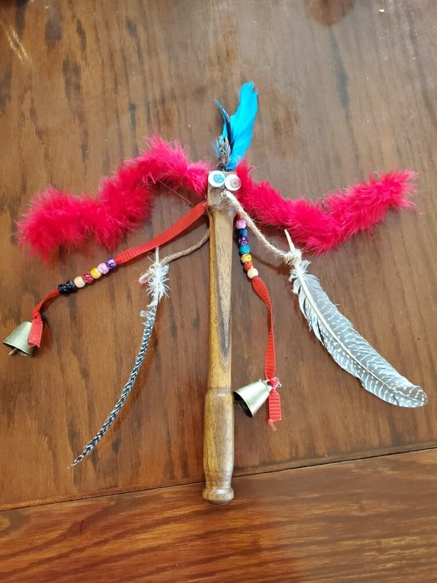
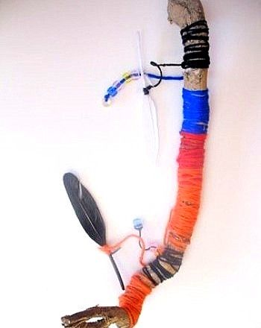
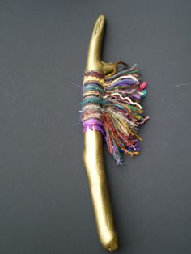
Den and Pack Management
Reinforcement Methods
  Talking Stick
Notes:
The talking stick is simply a stick or other object that gives the person holding it the opportunity to speak without others talking or interrupting. This is an excellent tool to use during Talk Time.
Naturally, the den leader or another adult controls who has the talking stick and for how long it is held by any Cub Scout.

Slide 57
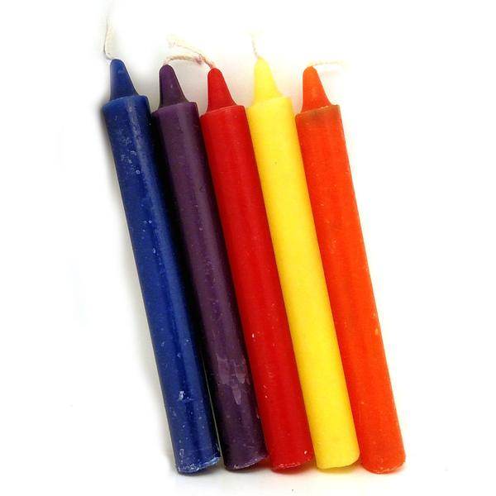
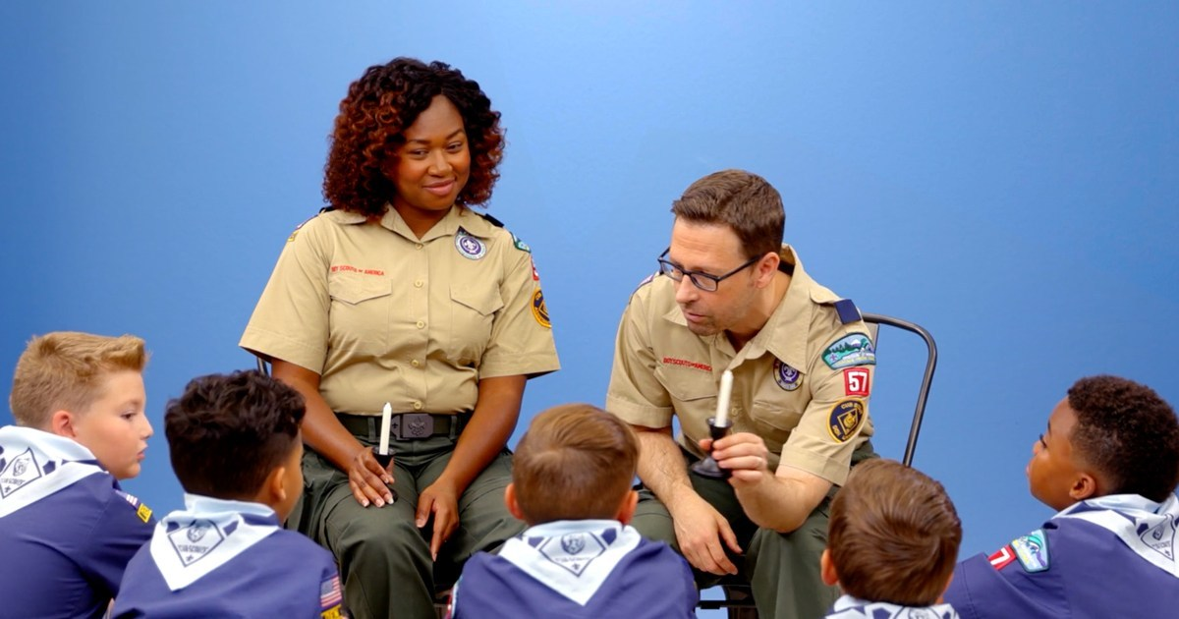
Den and Pack Management
Reinforcement Methods
  Talking Stick
  Conduct Candle
Notes:
A “conduct candle” should be a candle that will burn for about four hours. (6-7 inch tapered candle) If you use a candle that lasts longer than that, you run the risk of the Cub Scouts losing sight of its purpose.
At the beginning of the den meeting, light the candle. If someone misbehaves (violates the den code of conduct), the candle is blown out and is lit again at the next meeting.
Choose a reward such as a pizza or ice cream party that the den can earn when the candle burns all the way down.
In order for this method to work, the Cub Scouts need to see the candle burning down steadily. If the candle is too big, the reward will seem unattainable and they may give up. Ideally, they should be able to earn the reward within three to four meetings of good behavior.

Slide 58
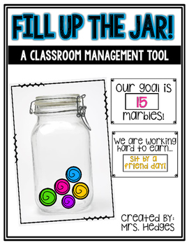

Den and Pack Management
Reinforcement Methods
  Talking Stick
  Conduct Candle
  Mason Jar and Marbles
Notes:
The marble jar method is similar to the conduct candle.
At the beginning of each meeting, each Cub Scout gets three marbles. You don’t have to physically give out the marbles but set them out so that they are visible during the meeting. If a Scout misbehaves, he or she has to give up a marble.
At the end of the meeting, everyone puts their marbles in a jar. When the jar is filled, the den receives a reward.
As with the candle, make sure that the reward can be earned within three to four meetings of good behavior, so choose a jar that can be filled in three to four meetings.
Note that the rewards are focused on positive reinforcement for the entire den; individuals are not singled out or punished.

Slide 59
Den and Pack Management
Reinforcement Methods
  Talking Stick
  Conduct Candle
  Mason Jar and Marbles
Consequences
  Refer to Code of Conduct
    Warnings
    Time Outs
    Parent Take away
    Extreme Conduct
    Pack Dismissal

Slide 60
Fiscal Policies
- All units need a Checking and Savings account to deposit yearly dues, registration fees and fundraising monies. All purchases, reimbursements and payments to be run through these accounts.
- Units could have a Tax ID number by completing IRS Form SS-4. See www.irs.gov or call 800-829-4933.
- Committee Chair is in charge of all accounts. Best practice would be to recruit and assign a Treasurer to handle all accounts. It is recommended that you have two signatories on the accounts.
- All unit fundraising requires approval of Scouts BSA’s Money Earning Application by Council and Chartered Organization.

Slide 61
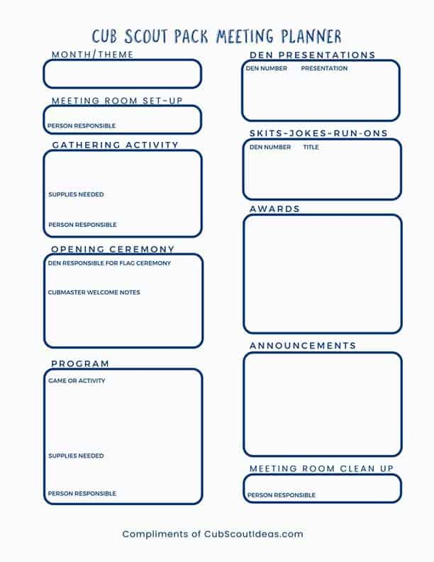
Monthly Meeting Plan
  Before Meeting Starts
  Gathering Time Activities
  Opening
  Program
  Recognition
  Boys/Girls
  Adults
  Closing
  After The Meeting
  Have Plan, To the Point, Variety, Motivational, KISMIF
Notes:
The pack meeting brings all of the dens in the pack together for the purposes of recognizing the achievements of the Cub Scouts, communicating information about upcoming events, and providing a program that enriches the Cub Scouting experience.
Attending pack meetings helps Cub Scouts realize their den is part of a larger organization.
A good pack meeting is well planned and well organized. Although there is not a required number of pack meetings, most packs meet several times during the year. Some packs meet monthly; others less often. As you determine how many meetings to schedule and when, please keep their purpose in mind.
Events such as the pinewood derby or blue and gold banquet can be considered pack meetings, especially if brief announcements and some achievements or rank advancements are included.
National has an outline for a theme for each month of the year
These should be determined during annual planning meeting
Closing - Allows people to leave on a positive note; National has one written for each theme of the month; To start bringing the meeting to a close, the Cubmaster shares an inspirational story;
It could be a personal experience, or the Cubmaster may highlight one of the Cub Scouts who demonstrated their commitment to live by the Scout Oath and Scout Law with an uncommon action. This is an opportunity for everyone to reflect on the values of Scouting.
KISMIF – Keep It Simple, Make It Fun

Slide 62
Denner and Den Chiefs
Why a Denner?
  Develop Leadership Skills
  Develop Confidence
  Experience working with Adults
  First Leadership Role
Why Den Chiefs?
  Scout Leadership Role
  Helps Den Leader Run Meeting
  Encourages Scouts to continue into Scouting
  Sets the example for Leadership and Service
  Acts as a recruiter for the Scouts Troop
Notes:
One of the key purposes of the Scouting program is to develop the leadership skills of youth who are in the program. These skills are often developed through hands-on experiences.
Youth serve in a variety of leadership positions during their time in Scouting and they are mentored and coached by caring adult leaders along the way.
Cub Scouts have the opportunity to begin developing their leadership skills, starting with Wolves in second grade and continuing through Webelos in the fifth grade. At this age, they do so by serving as a denner or assistant denner for their Cub Scout den.
The denner is a special person and helper at the den meeting. The denner may have the privilege of carrying the U.S. flag during the opening ceremony at the den meeting. If your den happens to be leading the opening flag ceremony at the pack meeting, the denner may carry the U.S. flag or call the commands.
It is best to give the denner the choice to carry the U.S. flag or to call the commands. Some Cub Scouts, especially Bear and Webelos Scouts, are very eager and willing to learn to call the commands.
If you are conducting an activity in a den meeting that allows someone to “go first,” it should be the denner.
ASK: Does anyone know what a den chief is?
Answers could include:
• A Scouts BSA member
• Older Scout
• Helps den leader
• Models behavior for Cub Scouts
• Encourages Cub Scouts to stay in Scouting

Slide 63
Denner and Den Chiefs
How to select a Denner?
Notes:
Ask: Does anyone have any ideas on how to choose the denner in a den?
Answers could include:
• Height
• Last name
• Age
• Birthday
SAY: A good practice is for the den leader to have each Cub Scout take a turn as denner, rotating the Scouts in some manner, either den meeting by den meeting or on a monthly basis.

Slide 64
Denner and Den Chiefs
How to select a Denner?
  Multiple ways
    Height, age, last name, birthday, etc.
  Rotate so all den members get a chance to be a Denner
Notes:
At this age, conducting an election for the position of denner can inadvertently create a popularity contest, with some Scouts feeling bad if they are not chosen. Since we want every Cub Scout to have an opportunity for this experience, the rotation system works best.
Children at this age have a keen sense of feeling they are being treated fairly or unfairly. Never favor one child over another, especially the den

Slide 65
Denner and Den Chiefs
How to select a Denner?
  Multiple ways
    Height, age, last name, birthday, etc.
  Rotate so all den members get a chance to be a Denner
Where do Den Chiefs come from?
  Troop, Crew, Ship
    Are to go through Den Chief Training
Den Chief Don’ts?
  Be left alone with Den
  Be part of any discipline
  Be in charge of the Den Meeting
Notes:
The den chief is never to be left alone with the Cub Scout den and never to be put in a position of providing discipline.
2 Year age gap rule to keep in mind

Slide 66
Resources
Local
  Roundtable – 2nd Thursday every Month
  Unit Commissioner
  District Commissioner
  District Executive
  Chartered Org Rep
  Scoutmaster of Local Troop
  Program Training Conference
  Scout Shop – Printed Leader Guides
  Pack Committee Members
  Pack Members

Slide 67
Resources
Other
  www.Scouting.org/CubScouts
  www.Scouting.org/scoutsource/Cubscouts
  www.Scouting.org/Training
  www.my.scouting.org
  Boys Life Magazine
  Scouting Magazine – blog.scoutingmagazine.org
  Bryan on Scouting - official blog for Scouting magazine
  Facebook, Pinterest, You Tube, etc.
  www.usscouter.com/bbuglar.asp
Numerous Websites – Type in ”Cub Scouts” = 1.2 million hits

Slide 68
Conclusions
- Remember, everything we do, we do for the kids
Encourage all leaders to be trained
Always start with the uniform
Communication with leaders and parents is key
Planning, planning, planning
Age-appropriate activities
You are not alone, use resources available to you
Remember – Scouting is Fun with a Purpose
KISMIF
Notes:
Keep It Simple Make It Fun

Slide 69
CM/ACM Training
This is the end of session 101, part 2 of 3
10 Minute Break
Questions?

Slide 70
CM/ACM Training
Goals of Session 3 – Outdoors, Safety, Volunteers, Continuing the Journey
  Pack Camping
  Keeping Cub Scouting Safe
  Journey to Excellence
  Volunteers
  Continuing the Journey

Slide 71
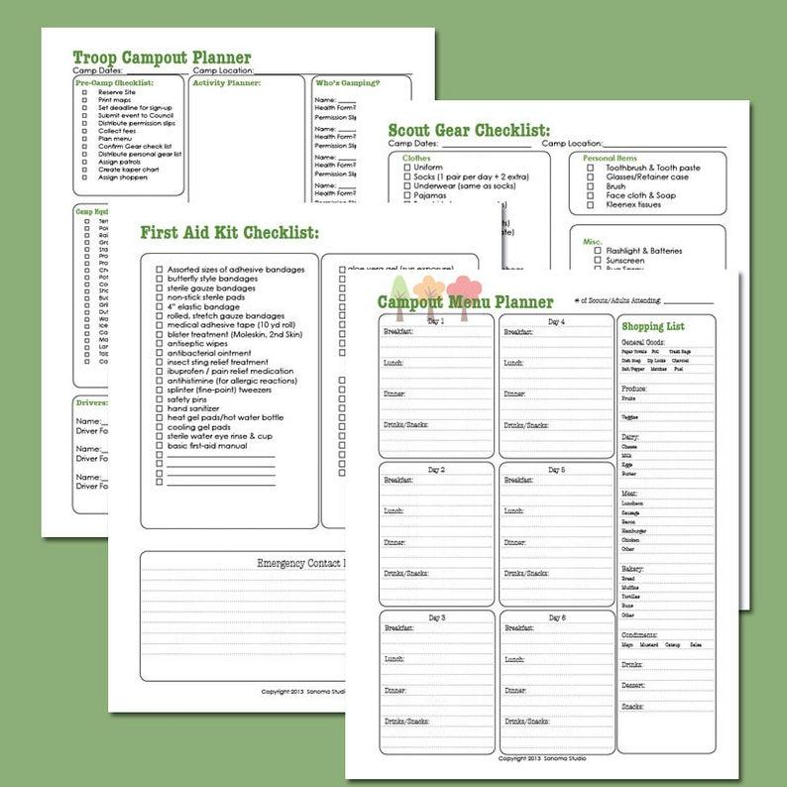
Pack Camping – Preparation!
Notes:
Create a template that is reusable that people can follow so items aren’t missed
These are sent to the leaders to solicit help
They are sent to the parents to show organization and what to expect

Slide 72
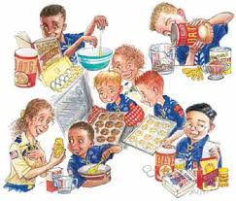

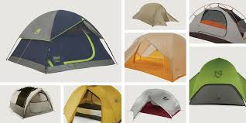
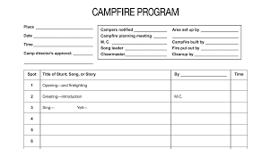
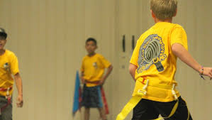
Pack Camping
Notes:
Location is everything. Fall campout, somewhere easy to get to and close if weather requires us to leave; Spring campout – go big!
(Tents) Garage sales, Facebook Buy Nothing sites to pickup extra gear. Can be loaned out to new families or ones that don’t have the financial means. Also talk to local Scout Troops to borrow equip
(Food/Cooking) Any food allergies? Are there enough stoves?
(Games) Capture the flag, Infection, Flashlight tag
(Camp Fire) This is one of the most under rated item but is one of the most important part of the weekend
Resources – Skills, Equipment, Knowledge, Experienced families, REI/Outdoor Stores, Troop, Scout Shop, Numerous websites and blogs

Slide 73
The Six Essentials
Can anyone name all of them???
Notes:
Who can name them??
A first-aid kit. This can be a lifesaver. ...
Water. ...
A flashlight. ...
Trail food. ...
Sun protection. ...
A whistle.

Slide 74




Keeping Cub Scouting Safe
  Health Forms – Youth and Adult
  Age-Appropriate Activities
  Buddy System
  Incident Reporting
Notes:
Cub Scout leaders are mandatory reporters

Slide 75
Incident Reporting
  All persons participating in Scouting programs are mandated reporters of child abuse. Reports must be made to local law enforcement and child protective services. State law may require additional reporting. This reporting duty cannot be delegated to any other person.
  Reporting to the Scout Executive or Scouts First Helpline ensures that follow-up can occur for the safety of our youth. Scout Executives and Scouts First coordinate follow-up actions.

Slide 76
Scouts First Helpline
  As part of its “Scouts First” approach to the protection and safety of youth, Scouts BSA has established a dedicated 24-hour helpline to receive reports of known or suspected abuse or behavior that might put a youth at risk.
  1-844-SCOUTS1 (1-844-726-8871)
  When to use it:
    Anytime you believe a youth has been harmed or their safety and wellbeing is at risk, and you cannot immediately reach your Scout executive or local council.
    If a youth is bullied because of race, color, national origin, religion, sexual orientation, or disability, and local help is unable to resolve the problem.
  If someone is at immediate risk of harm, always call 911.

Slide 77
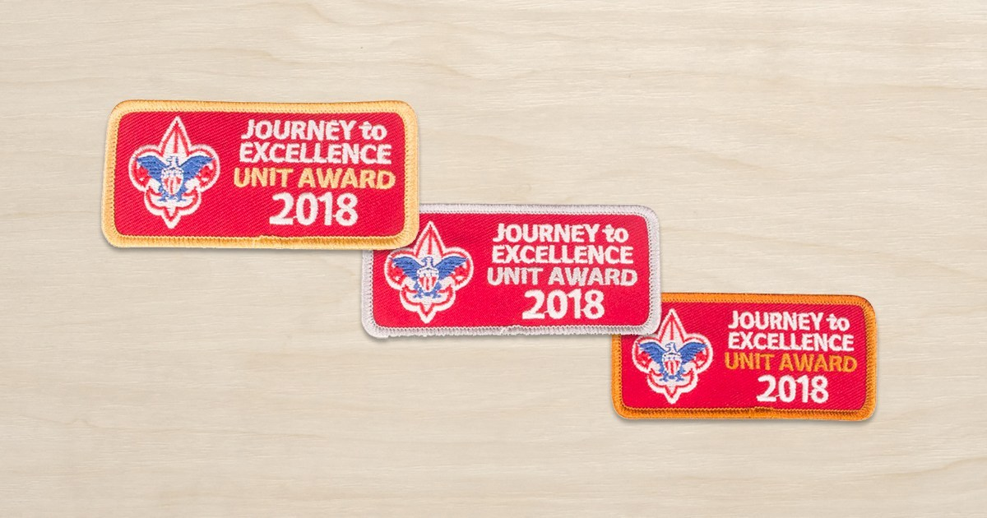
Journey to Excellence (JTE)
  Performance and Recognition Program
  Various Metrics that are used to help plan program year, also
  To review successes and challenges at the end of the year
  Helps determine what you are doing well and what you need to work on for a quality program

Slide 78
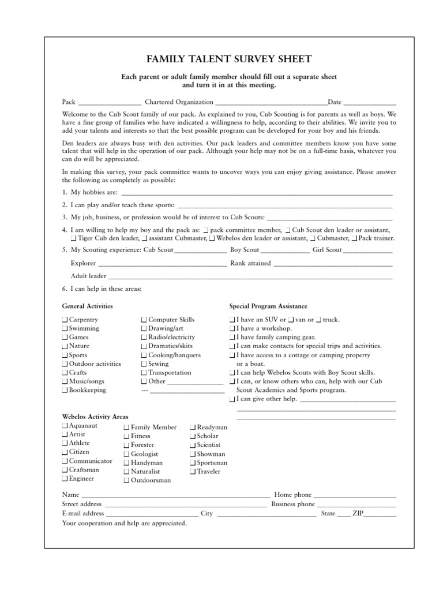
Volunteers
How you get adults involved?
  Talent Survey
  Present a “Friendly, Courteous and Kind” atmosphere

Slide 79
CM/ACM Training
Volunteers
  First Parent Meeting Agenda - Cont
    Pack Finances
      Budget, fees, Fund raising expectations, What monies are spent for
    Pack Communication
      Pack Manual, Email, Text, Social Media
    Expected Adult/Family Participation
      Application, YPT, Training
    Positions Needing to be filled
      Written Descriptions handed out for all positions
    Ask
      If “no” ask why?
  “Why did you volunteer to be a Scout Leader and Participate in the Pack with your Child?”
Notes:
Avoid overusing acronyms and Scouting terms

Slide 80
CM/ACM Training
Volunteers
  Resources
    Roundtable
    Unit Commissioner
    District Commissioner
    District Executive
    Chartered Org Rep
    Scoutmaster of Local Troop
    Program Training Conference
    Scout Shop – Printed Leader Guides
    Scouting Magazine
    Internet Blogs – Scout Websites – Voice of the Scout

Slide 81
CM/ACM Training
Continuing the Journey
  Advanced Training
    Wood Badge
  Acknowledge your Adults!
    Adult Recognitions
      Den Leader Training Award
      Cubmasters Key and Unit Leader of Merit Award
      Scouters Training Award
  District/Council Recognitions
    Leader Award of Merit
    District Award of Merit
    Silver Beaver

Slide 82
CM/ACM Training – Forms to Use
“So, You’re a New Cubmaster” Flier
Characteristics of Cub Scouts
Uniform Inspection Sheets - Youth & Adult
Family Talent Survey Sheet
Pack Meeting Planning Sheet
Flag Ceremony - Opening and Retiring
Pack & Scouter - Code of Conduct Forms
Parent Orientation/First Meeting Sample Agenda
Age-Appropriate Guidelines for Scouting Activities
Den Leader and Scouters Training Award forms
Cubmaster Key Progress Record Award Form
Den Advancement Forms
Journey to Excellence form
Pack Budget Work Sheet and Fund-Raising Application

Slide 83
CM/ACM Training
THANK YOU!!
Thank you for your commitment to becoming a trained Cub Scout Leader.
Still have questions, need help, looking for advice, please feel free to write:
David Bader – davidbader23@gmail.com

Slide 84
Appendix

Slide 85
Poll Questions
Which “ranks” have short attention spans and may become easily bored?
  Lions & Tigers
Which “ranks” have vivid imaginations and will protest if they think someone is cheating?
  Wolves & Bears
Which “ranks” are very devoted to their friends and may have a best friend?
  Webelos
Notes:
1. For these reasons, and others, having an adult partner with the Lion or Tiger at all Cub Scout den and pack meetings and activities is a requirement.
2.

