Slide 1

Camp Cooking and Menu Planning
Christy and Dave Freriks
Troop 8420 / 420
Bothell, WA

Slide 2
Introductions
Dave Freriks – Scoutmaster
  Troop 420 for 14 years (3 as SM)
  Two Eagle Scouts
  Wood Badge, Philmont 2024 Lead Crew Advisor
  117 Nights Camping, 266 miles hiking
Christy Freriks – Scoutmaster
  Founder Troop 8420
  Course Director, ASM, Troop Guide, Scribe - Wood Badge @ SBR
  ASM Troop 420
  104 Nights Camping, 166 miles hiking

Slide 3
Back and Front Country Defined
Front Country
Areas easily accessible by vehicle
Mostly day users
Developed campgrounds
Tend to be more crowded
Attract a wider range of visitors
Essentially car camping
Back Country
No vehicle access
No facilities
Nothing developed
Get out there on your own human power
Carry everything you need
Typically, is some distance from road
WE ARE GOING TO FOCUS ON FRONT COUNTRY

Slide 4
Rules to Live By
Diet at home…Fun fact: there are no calories when you camp cook!
You will burn more calories in the outdoors
Meals should be nutritious, delicious and fun!
Full bellies make for happy campers
Most of your favorite food dishes from home can be prepared in the field
  Almost anything can be made at camp with proper planning!

Slide 5
Planning
Factors to consider
Group size
Duration of trip
Purpose of trip
Exertion level
Weather
Altitude
Individual appetites
Food preferences
Special Considerations
Nutritional balance
Expense
Spoilage and ease of packaging
Weight
Dietary limitations of group members (Allergies, Religious, Vegetarian, etc.)

Slide 6
Planning: How much food?
1.5 pounds per person per day (ppppd)
  Good for hot days and warm nights
  Base camping or short trips (2 to 5 days)
  Roughly 2,500 to 3,000 calories per person
1.75 to 2.0 ppppd
  Warm or cool days and nights
  Hiking with full packs (7 days or longer)
  Moderate to active workdays
  Roughly 3,000 to 3,500 calories per person
2.0 to 2.25 ppppd
  Cool days and cold nights of early spring, late fall, or winter
  Hiking or skiing with full packs
  Ideal for heavy workdays and cold temperatures
  Roughly 3,500 to 4,500 calories per person
2.5 to 2.0 ppppd
  Cold days and extremely cold nights
  Midwinter skiing or snowshoeing with full packs or sleds
  Extremely strenuous workdays and very cold temperatures
  Roughly 4,000 to 5,000 calories per person

Slide 7
Planning: How much food?
Figure the amount needed for trip:
# of people X # of days X ppppd
For example, for four people on a 7-day trip at 1.75 ppppd, the total amount of food needed would be approximately 49 pounds. Divided by 4 is 12.25 pounds per person.
These are guidelines, not rules!
A 11 year old scout is not going to eat as much as a 17yr old scout
Know your scouts, rarely does any food cooked not get eaten…

Slide 8
Nutrition and Quantities
Should eat a wide variety of foods from these food groups each day to get the nutrients you need
Nutrients grouped in five classes
Protein (10 – 15 % of daily food intake should be proteins)
Carbohydrates (55 – 80 % of daily food intake should be carbohydrates)
Fats (Only 10% should be saturated fats)
Vitamins & Minerals (Iron, Vitamin C, Potassium)
And MOST IMPORTANTLY!!!!

Slide 9
Nutrition and Quantities
5. Water
  Makes up about 60% of your body weight
  Need for water increases with exercise due to losses from sweating and breathing
  In summer, drink a minimum of 2 – 3 quarts per day
  In winter, drink 3 - 4 quarts per day
  At altitude (above 7,000 ft) drink 3 - 5 quarts
  Dehydration causes headaches, muscle cramps, nausea
    Can increase your susceptibility to hypothermia, frostbite, altitude sickness

Slide 10
Pre-Cooking Preparation Tips
Precooking meat can prevent illness (story)
Precooking pasta saves time and water
Using Tupperware / Ziploc bags make for easy use and doubles to pack out unused / leftover food
Grab and go breakfast for last morning saves time packing out...

Slide 11
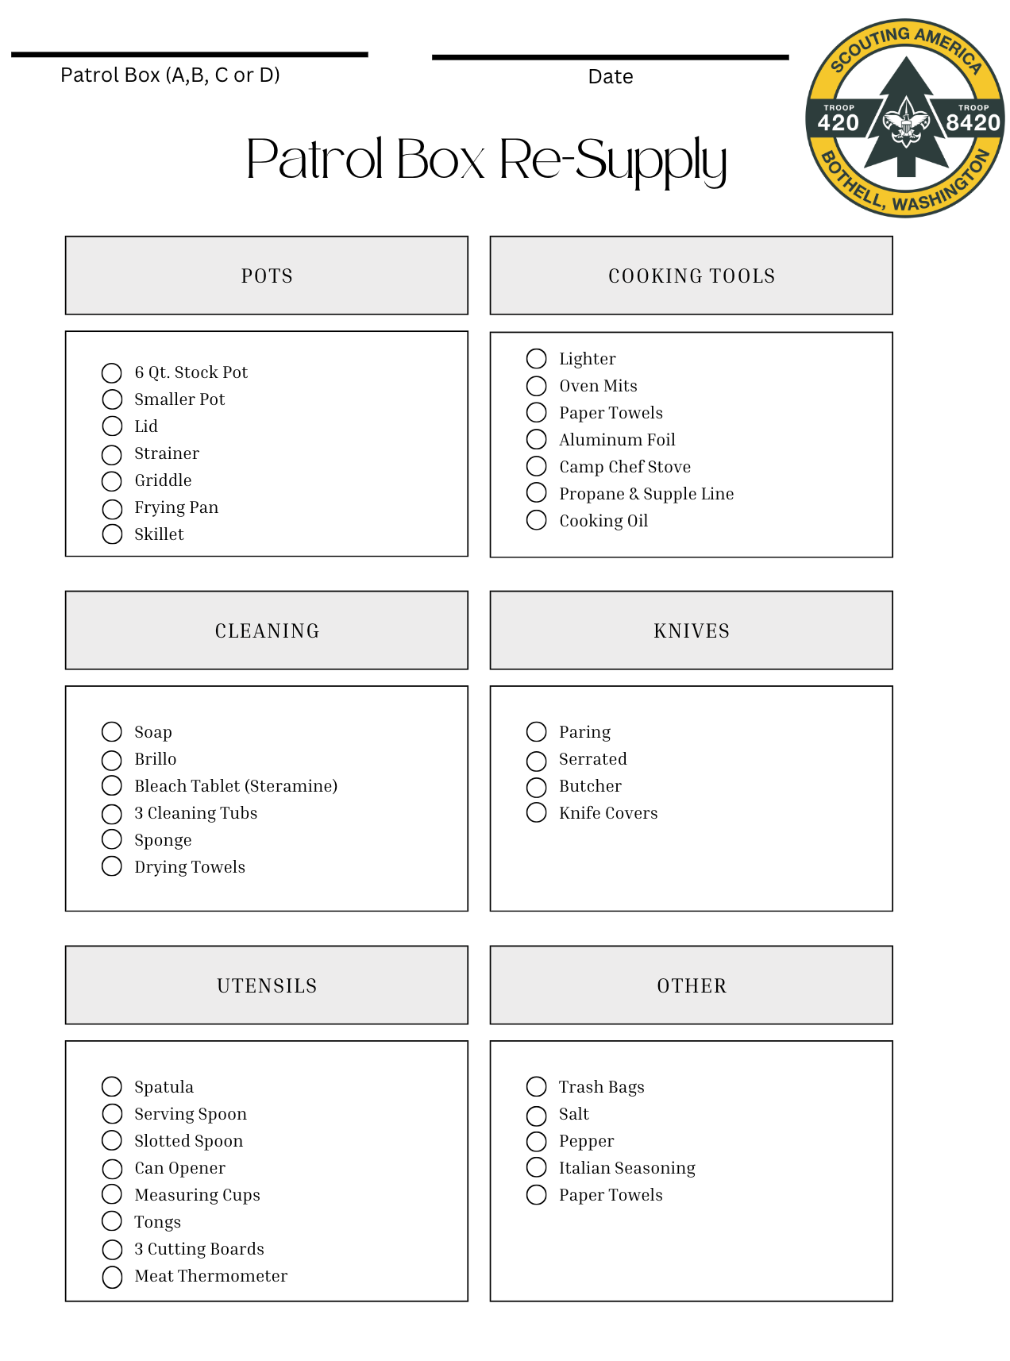
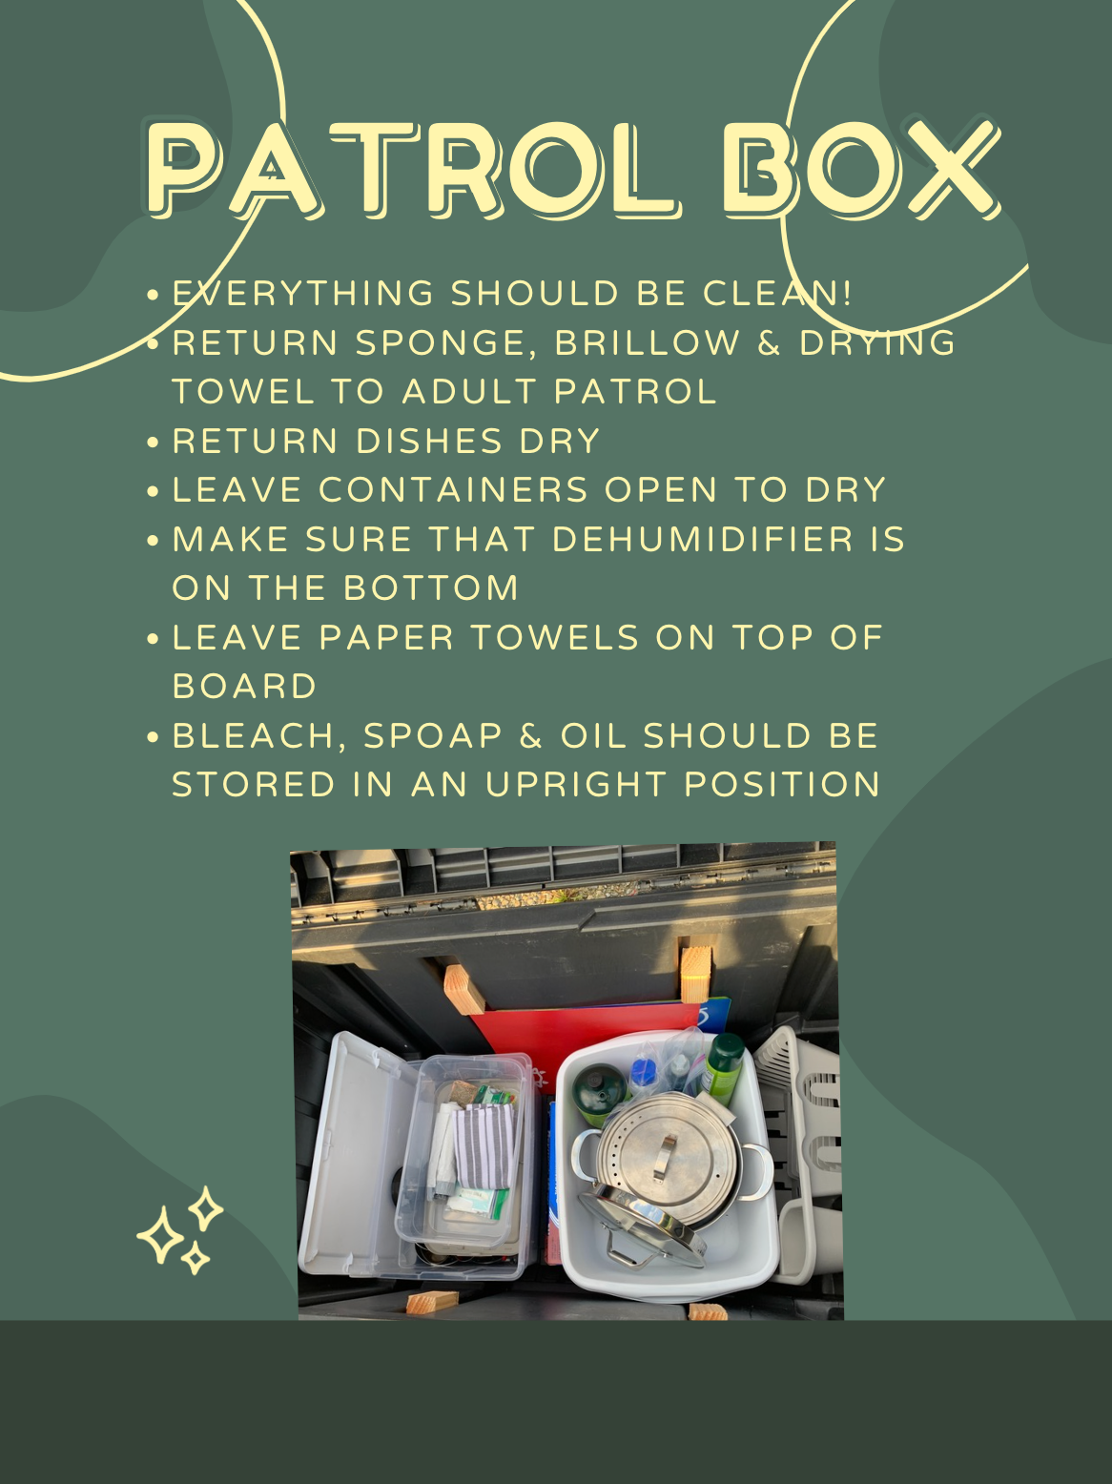
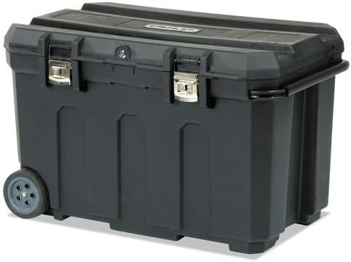
Patrol Boxes

Slide 12
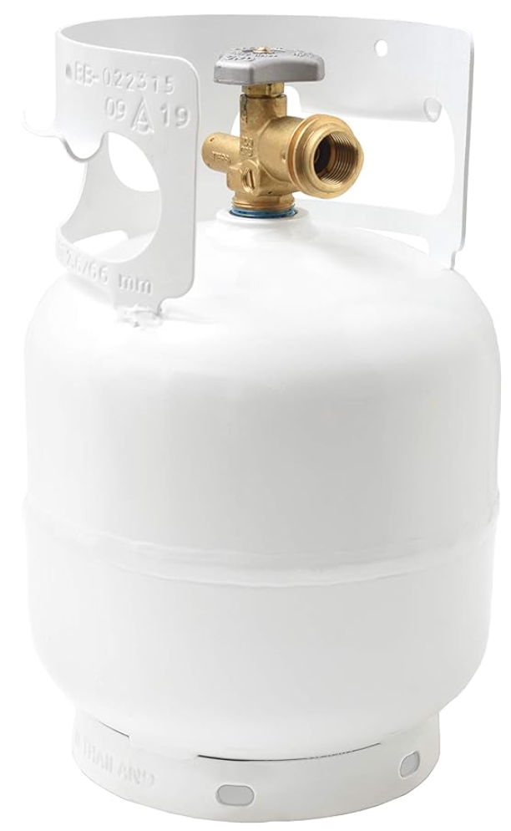
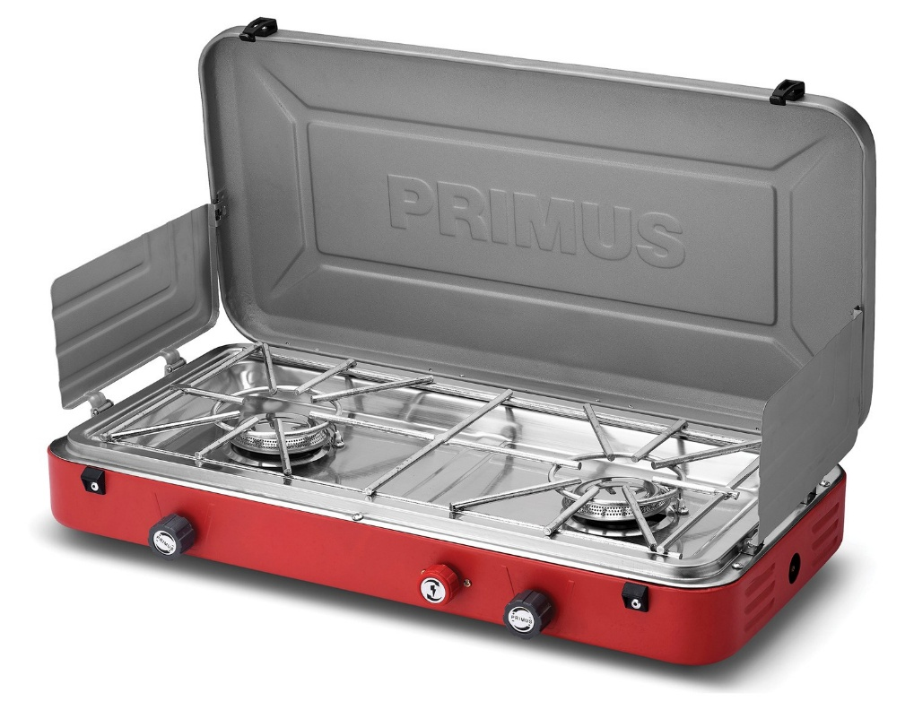
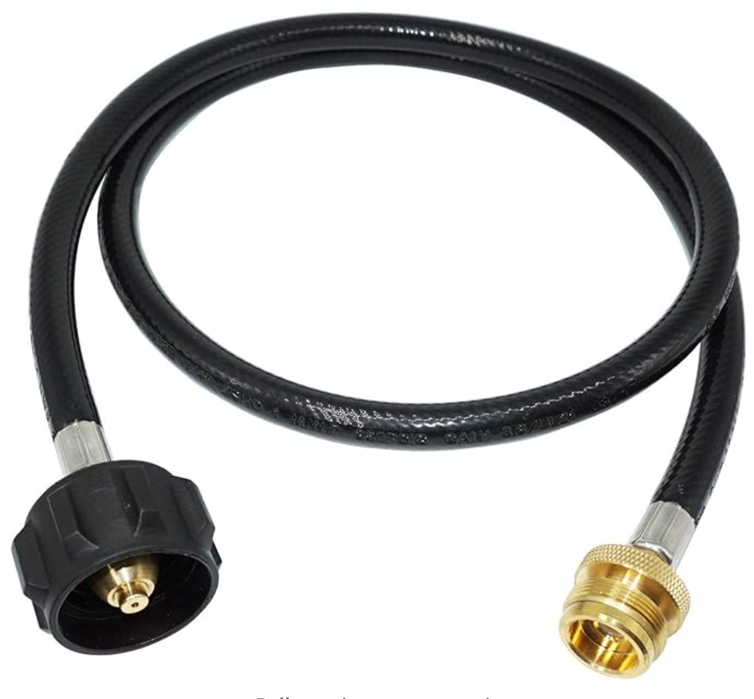
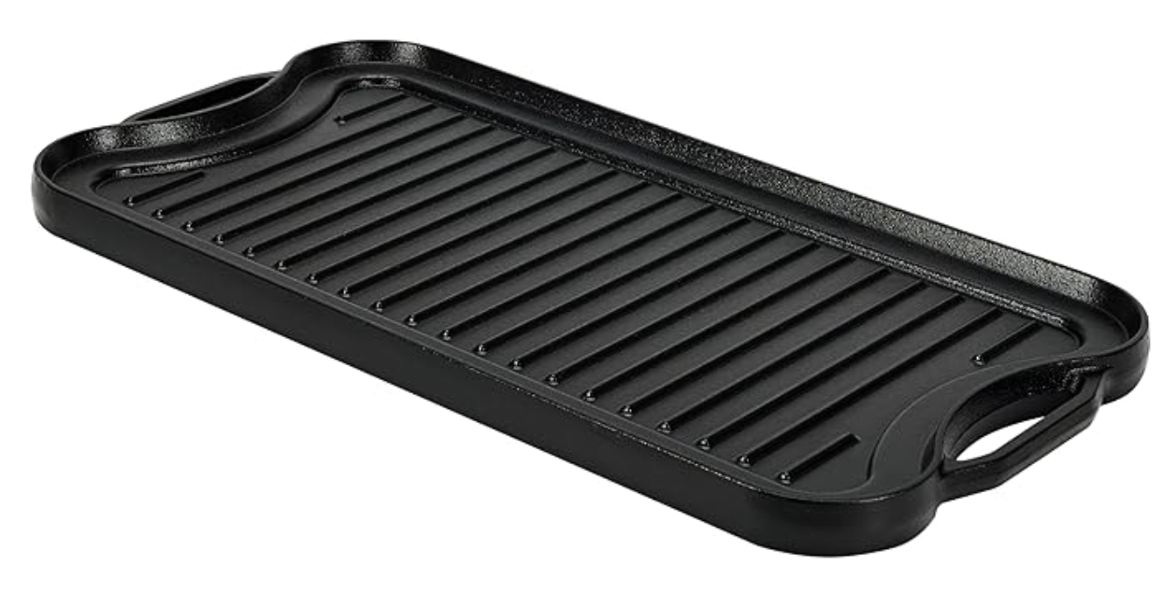
Patrol Boxes – Cooking Element
Cooking for 4-8 Scouts as a Patrol
Tanks last for multiple campouts vs Coleman canisters
Two burners speeds up meal preparation & cleaning
Griddles are great for grilling!

Slide 13
Fuel Amounts
Depending on how much you need to cook:
1 person in summer -> 1/6 liter of fuel -> Day
3 person in summer -> 1/2 liter of fuel -> Day
1 person in winter -> 1/2 liter of fuel -> Day
  If need to melt snow
3 person in winter -> 1 liter of fuel -> Day
  If need to melt snow

Slide 14
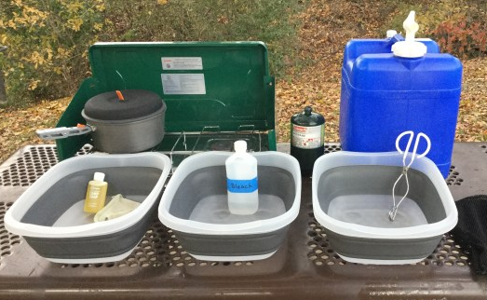
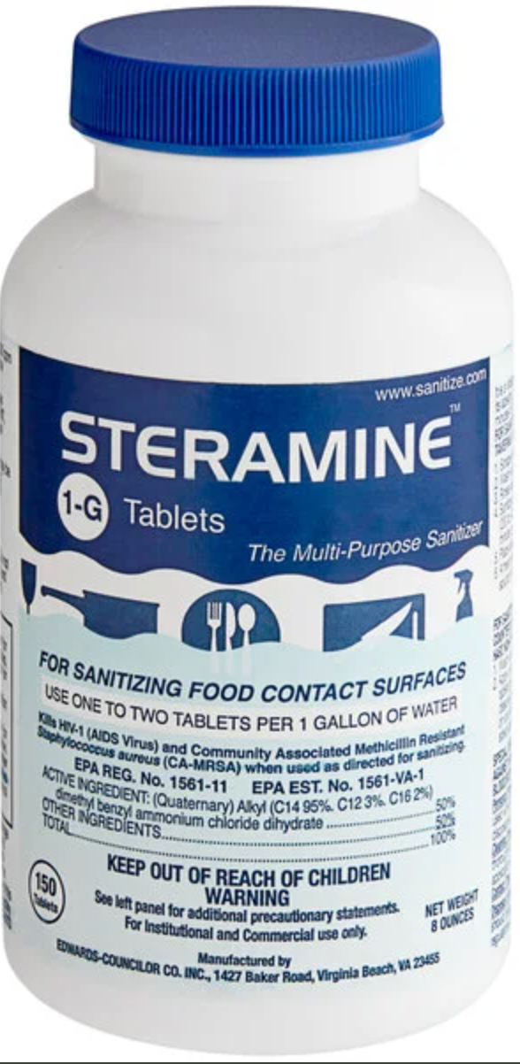
Cleanup
Three Bin Method
Boil Water first
Wash (Hot + Soap)
Rinse (Warm)
Sanitize (Cool & Sanitized)
Steramine works better than
Liquid bleach!!!

Slide 15
RECIPE TIME!!!

Slide 16
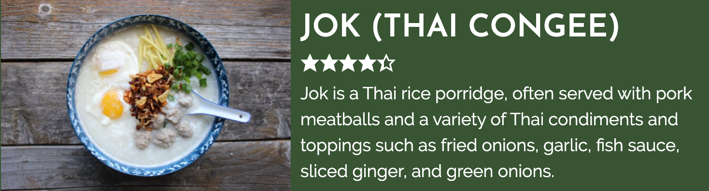
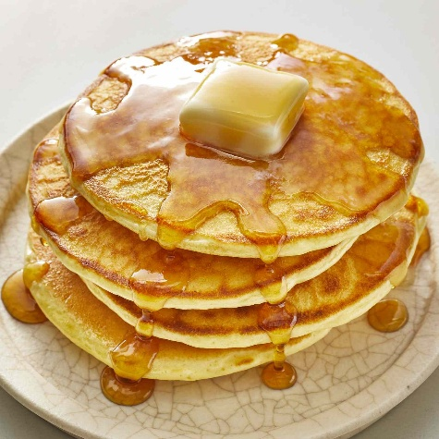
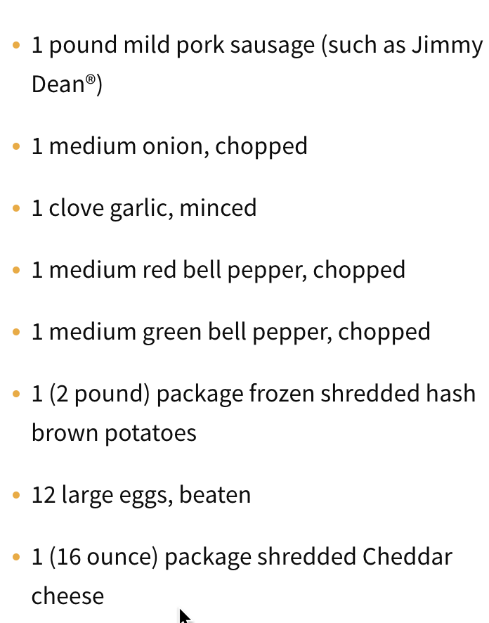
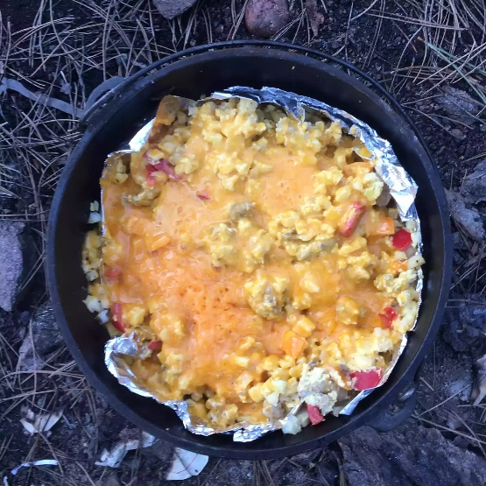
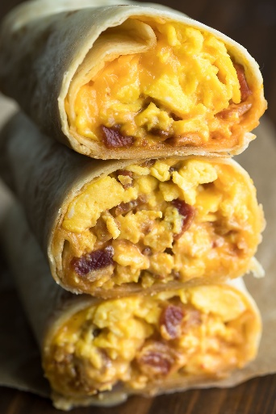
Breakfasts
https://fearlesseating.net/thai-congee-breakfast/
Pancakes
– Premake Batter!
Breakfast Burritos
https://www.allrecipes.com/recipe/216742/dutch-oven-mountain-man-breakfast/

Slide 17
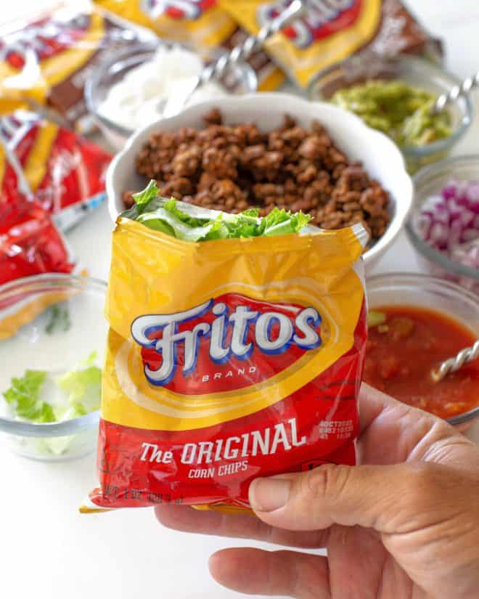
Lunches – Usually faster meals
(Camporees, Klondike, etc.)
Sandwiches are easy
Hot Dogs
Tortilla Wraps
Heat up pre-made soups
Walking tacos
https://www.the-girl-who-ate-everything.com/walking-tacos/

Slide 18
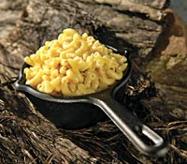
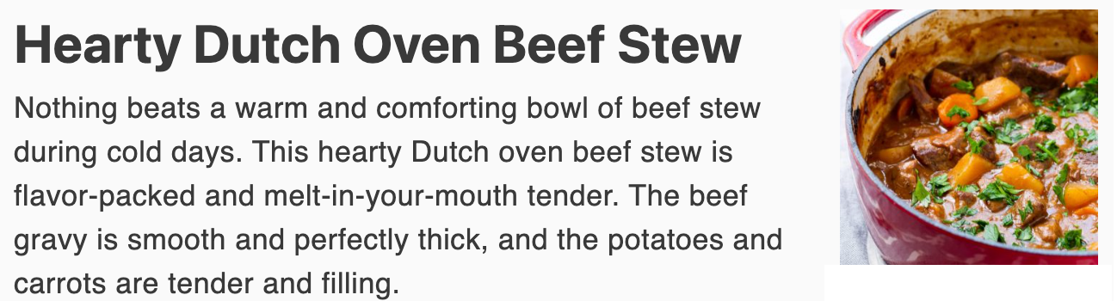
Dinners – Best Meal of the Day!
Thai Yellow Curry Chicken with rice
Chicken Fettuccine Alfredo
Spaghetti
Beef Stew
Chili
Jambalaya
Pulled Pork Sandwich
You generally have the most time for Dinner
– Make it fun!
Garlic Mac & Cheese
¼ pound cheddar or jack cheese, grated
¼ cup powdered milk
1 tablespoon dried parsley flakes
2 garlic cloves, minced (or ½ teaspoon garlic powder)
12 ounces macaroni noodles
salt and pepper to taste

Slide 19
What Are Special Dietary Needs?
Special dietary needs encompasses restrictions on certain foods due to:
Allergies
Health Reasons
Religious or Cultural Reasons
Personal Priorities
What do you do with picky eaters?

Slide 20
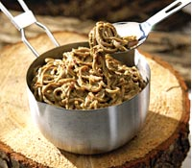
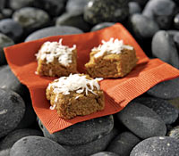
Sample Dinner Menu – Spot all the Potential Issues
Dinner: The Scout describes dinner and desert as Thai Noodles & Fudge…
½ cup peanut butter (creamy or chunky)
2 tablespoons tamari
4 teaspoons crushed garlic
3 tablespoons cider vinegar
2 teaspoons brown sugar
¾ teaspoon dried crushed red pepper
¼ cup chopped fresh cilantro or 1 tablespoon dried cilantro
salt and pepper to taste
12 ounces soba noodles or your favorite pasta
1lb hamburger
1 cup sesame seeds
½ cup almonds
½ cup cashew butter or peanut butter
¼ cup currants or chopped raisins
2 tablespoons honey
1 tablespoon water, or more as needed to hold mixture together
½ cup shredded coconut (optional)

Slide 21
Sample Dinner Menu – Spot all the Potential Issues..
Beef Noodles With Spicy Peanut Sauce
½ cup peanut butter (creamy or chunky)
2 tablespoons tamari
4 teaspoons crushed garlic
3 tablespoons cider vinegar
2 teaspoons brown sugar
¾ teaspoon dried crushed red pepper
¼ cup cilantro
salt and pepper to taste
12 ounces soba noodles or pasta
1lb hamburger
Sesame Almond Fudge
1 cup sesame seeds
½ cup almonds
½ cup cashew butter or peanut butter
¼ cup currants or chopped raisins
2 tablespoons honey
1 tablespoon water, or more as needed to hold mixture together
½ cup shredded coconut (optional)

Slide 22
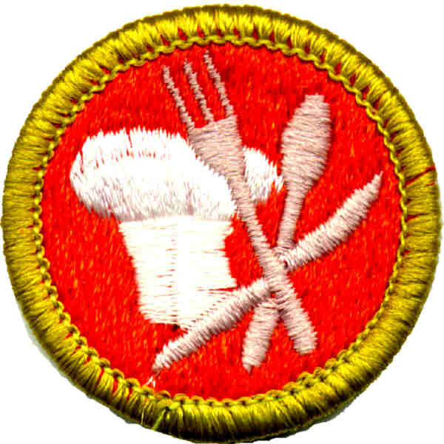

Common Dietary Restrictions and Special Diets:
Gluten Free
Halal
Kosher
Low-FODMAP
Whole Food Diets
Vegetarian
Vegan
Nut Free
Dairy Free
Diabetic

Slide 23
Safety Practices
Fill out the dietary forms completely. (We keep track on TroopWebHost so it’s automatically listed on the event roster)
If you oversee the camp kitchen, read through the dietary forms fully and ask questions as needed.
Usually in a Troop environment, there is an event “pre-meeting” to discuss meals, tenting etc., perfect time to discuss special needs with the patrol for good Grubmaster planning
Meeting should include cooking temps and safe food storage

Slide 24
There is no such thing as “just a little.”
For anyone with true anaphylactic allergies, even “just a little’ in the smallest traces can be deadly.
Ignoring someone’s religious or personal beliefs and allowing “just a little” in the meal is entirely disrespectful.

Slide 25
Hidden Allergens:
Consult with the scout and/or parent to identify safe ingredients.
Gluten can be hidden in products made from wheat, such as malt or soy sauce, or as fillers and emulsifiers in cheeses, processed meats, ice cream and many other processed foods.
Read ingredient lists, for example sesame oil / seeds are in a lot of things you don’t expect like hot dog / hamburger buns

Slide 26
Strategies for Planning a Meal
The goal is to help the Scouts with special dietary needs feel included with the rest of the scouts and to give the other scouts the opportunity to be kind, courteous and helpful to their fellow scouts.

Slide 27
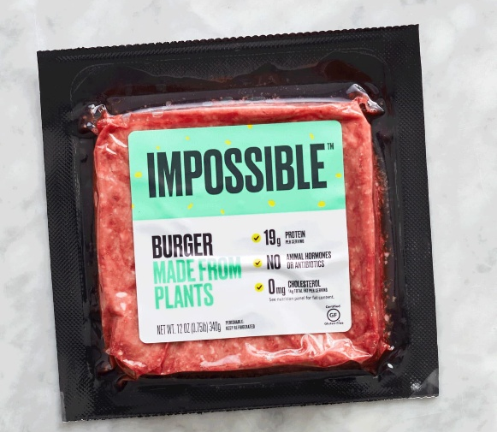
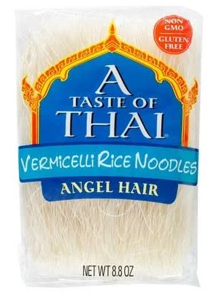

Simple Safe Swaps & Menu Items:
Butter (low risk)
Olive Oil / Avocado Oil
Cheese (low risk)
Chicken (except Veg.)
Eggs (low risk)
Rice Noodles
Impossible Beef
Great Resource for Substitutes
https://foodallergycanada.ca/wp-content/uploads/Food-allergen-substitution-chart_Linda-Kirste-RD.pdf

Slide 28
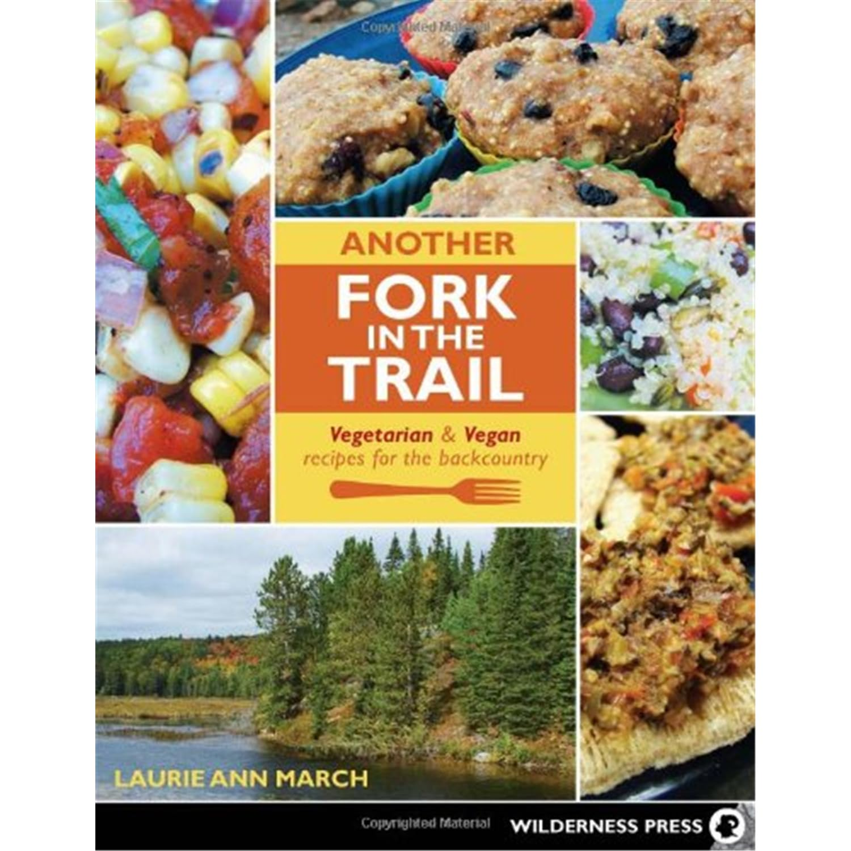
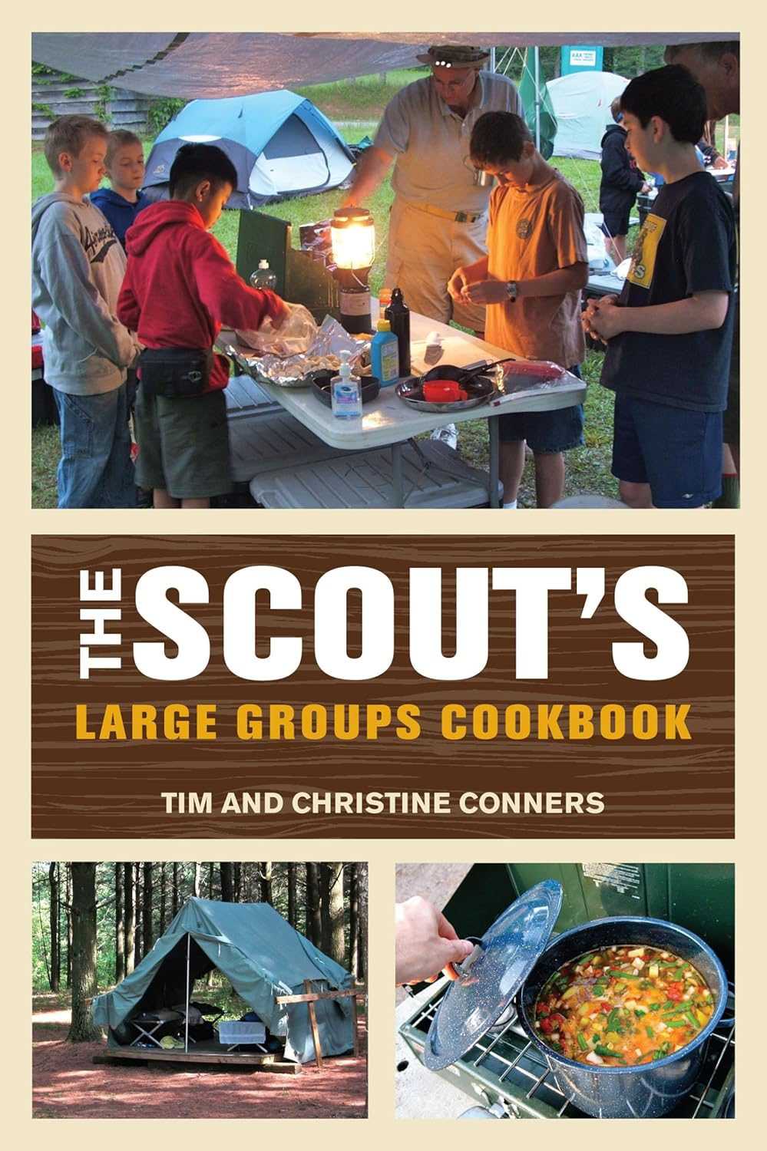
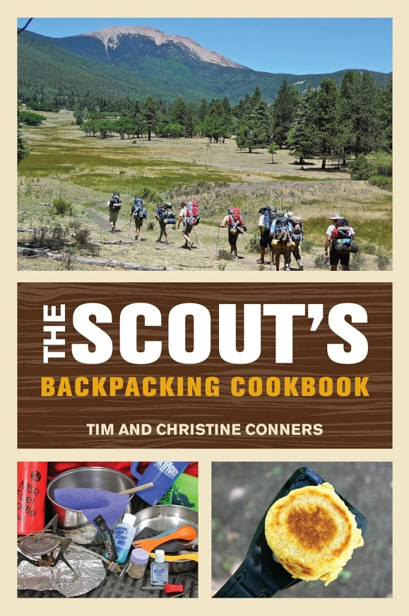
Resources
  Another Fork in the Trail, by Laurie Anne March
Vegetarian and vegan backpacking recipes.
The Scout’s Large Groups cookbook
The Scouts Backpacking cookbook
(both by Tim & Christine Conners)

