Slide 1

Developing Scouts Into Leaders
Christy and Dave Freriks
Troop 8420 / 420
Bothell, WA

Slide 2
Introductions
Dave Freriks – Scoutmaster
  Troop 420 for 14 years (3 as SM)
  Two Eagle Scouts
  Wood Badge, Philmont 2024 Lead Crew Advisor
  117 Nights Camping, 266 miles hiking
Christy Freriks – Scoutmaster
  Founder Troop 8420
  Course Director, ASM, Troop Guide, Scribe - Wood Badge @ SBR
  ASM Troop 420
  104 Nights Camping, 166 miles hiking

Slide 3
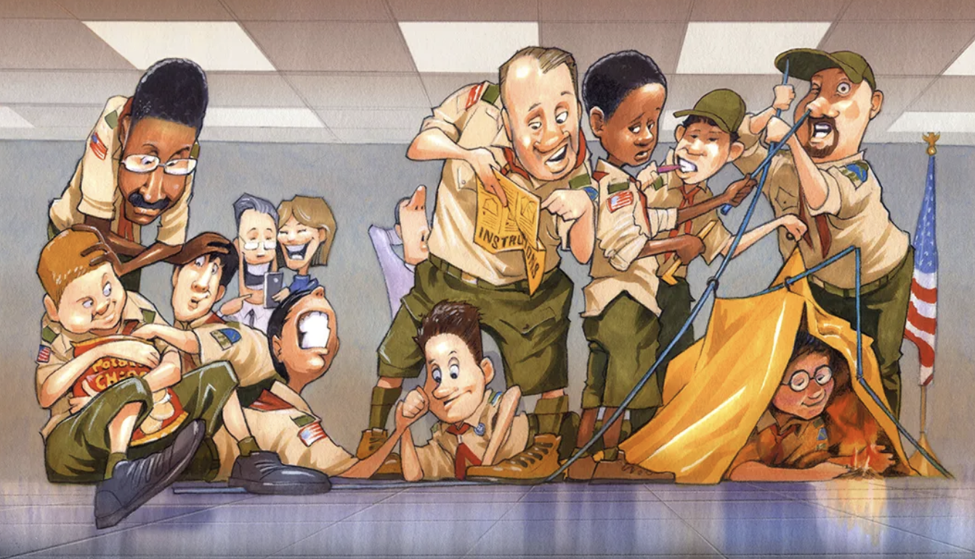
What does it mean to You for a unit to be Scout led?

Slide 4
What is the process that we use in Scouting to develop youth led programs?
Training
Training
Training

Slide 5
Building leaders is a process that starts at Cubs
…And continues through all the Scouting America programs!

Slide 6
What sort of leadership opportunities are available in Cub Scouts?
Denner – A member of your Cub Scout den who is either elected or appointed to be an official “helper” for the den. The position gives the Cub Scouts an opportunity to serve in a leadership role.
  Arrive early to help set up the meeting
  Welcome everyone when they arrive at the den meeting
  Lead the den in reciting the Scout Oath and the Scout Law
  Carry the United States flag during the opening
  Pick a game for the den to play
  Help hand out supplies for an activity
  Stay after the meeting to help clean up

Slide 7
What sort of leadership opportunities are available in Scouts BSA?
Scout in Charge
Patrol Leader, Assistant Patrol Leader
Quartermaster, Webmaster, Scribe, Etc.
Assistant Senior Patrol Leader
Senior Patrol Leader

Slide 8
What leadership position is great for creating youth-led leadership?
Den Chiefs - Scouts who assist a Cub Scout den leader or Webelos den leader. They are selected by the senior patrol leader and Scoutmaster and approved by the cubmaster and the pack committee for recommendation to the den leader.
Den chiefs help Cub Scouts advance through Cub Scout ranks and encourage Cub Scouts to join a troop upon graduation.

Slide 9
What is the patrol method?
A patrol is a small group of Scouts (8 or so) where Scouts learn together, take on leadership responsibilities, and develop friendships that last a lifetime.
What is the importance of the patrol method in Scouting

Slide 10
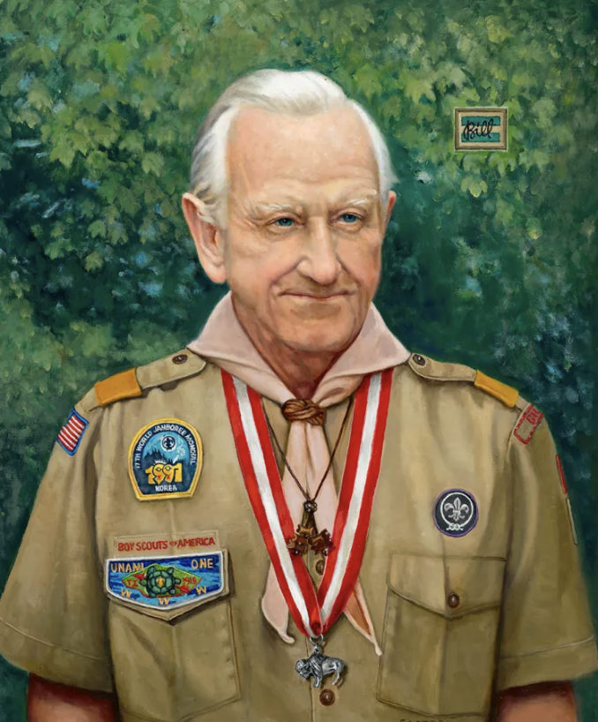
Train Them, Trust Them, Let Them Lead Game
Utilizing the Patrol Method in Scouting
To quote Baden-Powell:
“To get the best results, you must give the leader real, freehanded responsibility. If you only give partial responsibility, you will only get partial results.” Praise the junior leader when they succeed, encourage them when they fail.”
William ”Green Bar Bill” Harcourt

Slide 11
Three Strategies of Youth Lead Units
What does this training look like?
Train Scouts
Train Adults
Train Parents
National Youth Leadership Training
Introduction to Leadership Skills for Troops
Patrol Leaders Council
Youth Protection
Committee Meetings
Training
Assistant/Scoutmaster or other Unit Leader Training
Youth Protection
Committee Meetings
Explanation of youth lead regularly in committee time, parent meetings, etc.

Slide 12
What does it look like?
Do adults have a role in Scout-led units?
How involved should adults be in troop meetings and Patrol Leaders’ Council (PLC) meetings?
When should the Scoutmaster exercise veto power?
Should he or she even have veto power?
What happens when the PLC drops the ball?

Slide 13
Organization Across Scouting America Programs
Practical Application?
SCOUTS BSA
VENTURING
SEA SCOUTS
The unit runs under the direction of a Senior Patrol Leader and their Patrol Leaders Council. What is the role of adults? The role of adults is to ensure a safe program. Adults are available to coach and mentor.
Leadership is primarily provided by the individuals in the program with adults in the program referred to as advisors. Adults are there to coach and mentor.
Sea Scouts is youth - led and adult mentored. The shipmates lead the Sea Scout program. Elected youth leaders plan and conduct the program and adult leaders guide and support the efforts as you learn important leadership and life skills.

Slide 14
What are the challenges?
Sticky Notes
Use yellow sticky notes to write down challenges that face the youth is this system.
Use pink sticky notes to write down challenges that face adults in this system.
Use blue sticky notes to write down challenges that both adults and youth face in this system.

Slide 15
When teaching leadership, stress the importance of Servant Leadership
“A leader is best when people barely know he exists, when his work is done, his aim fulfilled, they will say: we did it ourselves.” Winston Churchill

Slide 16
Ellie Morrison – First Female National Commissioner
“Positive youth development occurs in an environment where there are multiple opportunities for success or failure that have no lasting consequences and there is a caring, connected adult of character.”

