Slide 1

Making First Aid Real
How to use moulage to enhance first aid training

Slide 2
Engage senses during a scenario
Level 1
  Verbal description of a wound
Level 2
  Picture of a wound
Level 3
  Fake wound to find - Moulage
Moulage
  A real thing to find
    “blood” on gloves
  Reminds the patients how to act
  Gets sight & touch involved

Slide 3
Potential Supplies
Special Effects Wheels
  e.g. Ben Nye
Stipple Sponge
Thick blood
Stage blood – powder or liquid
Liquid Latex
Wax
Prosthetics
Tubing
Squeakers or bulbs
Oatmeal
Food coloring
Alca Zeltzer
Baby wipes
Gloves
Disposable razors
Synthetic foam sponge
Scissors

Slide 4
Places to shop
Costume & Halloween
Drug stores
Grocery stores
A Masquerade Costume
  Redmond
Champion’s Party Store
  Seattle
Display & Costume Supply
  Issaquah
Hollywood Lights
  Kent

Slide 5
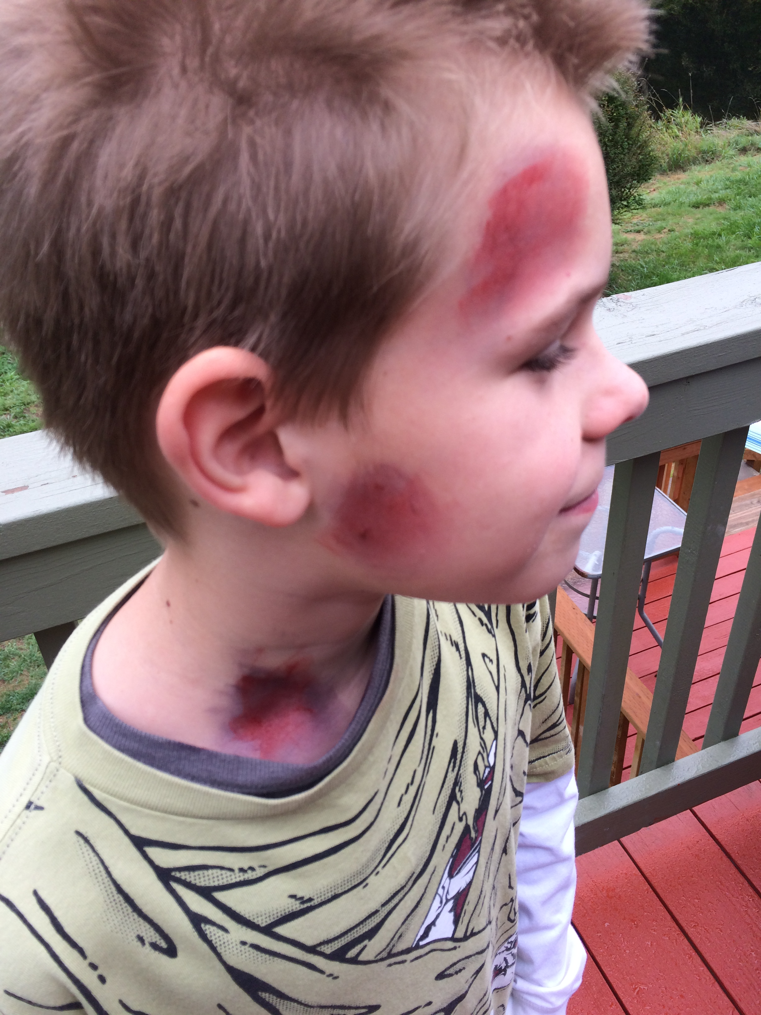
Making a bruise
Bruise wheel
Bruise lifecycle
  Fresh - Bright red
  A few days - Dark red & dark blue
  Healing – Green & yellow

Slide 6
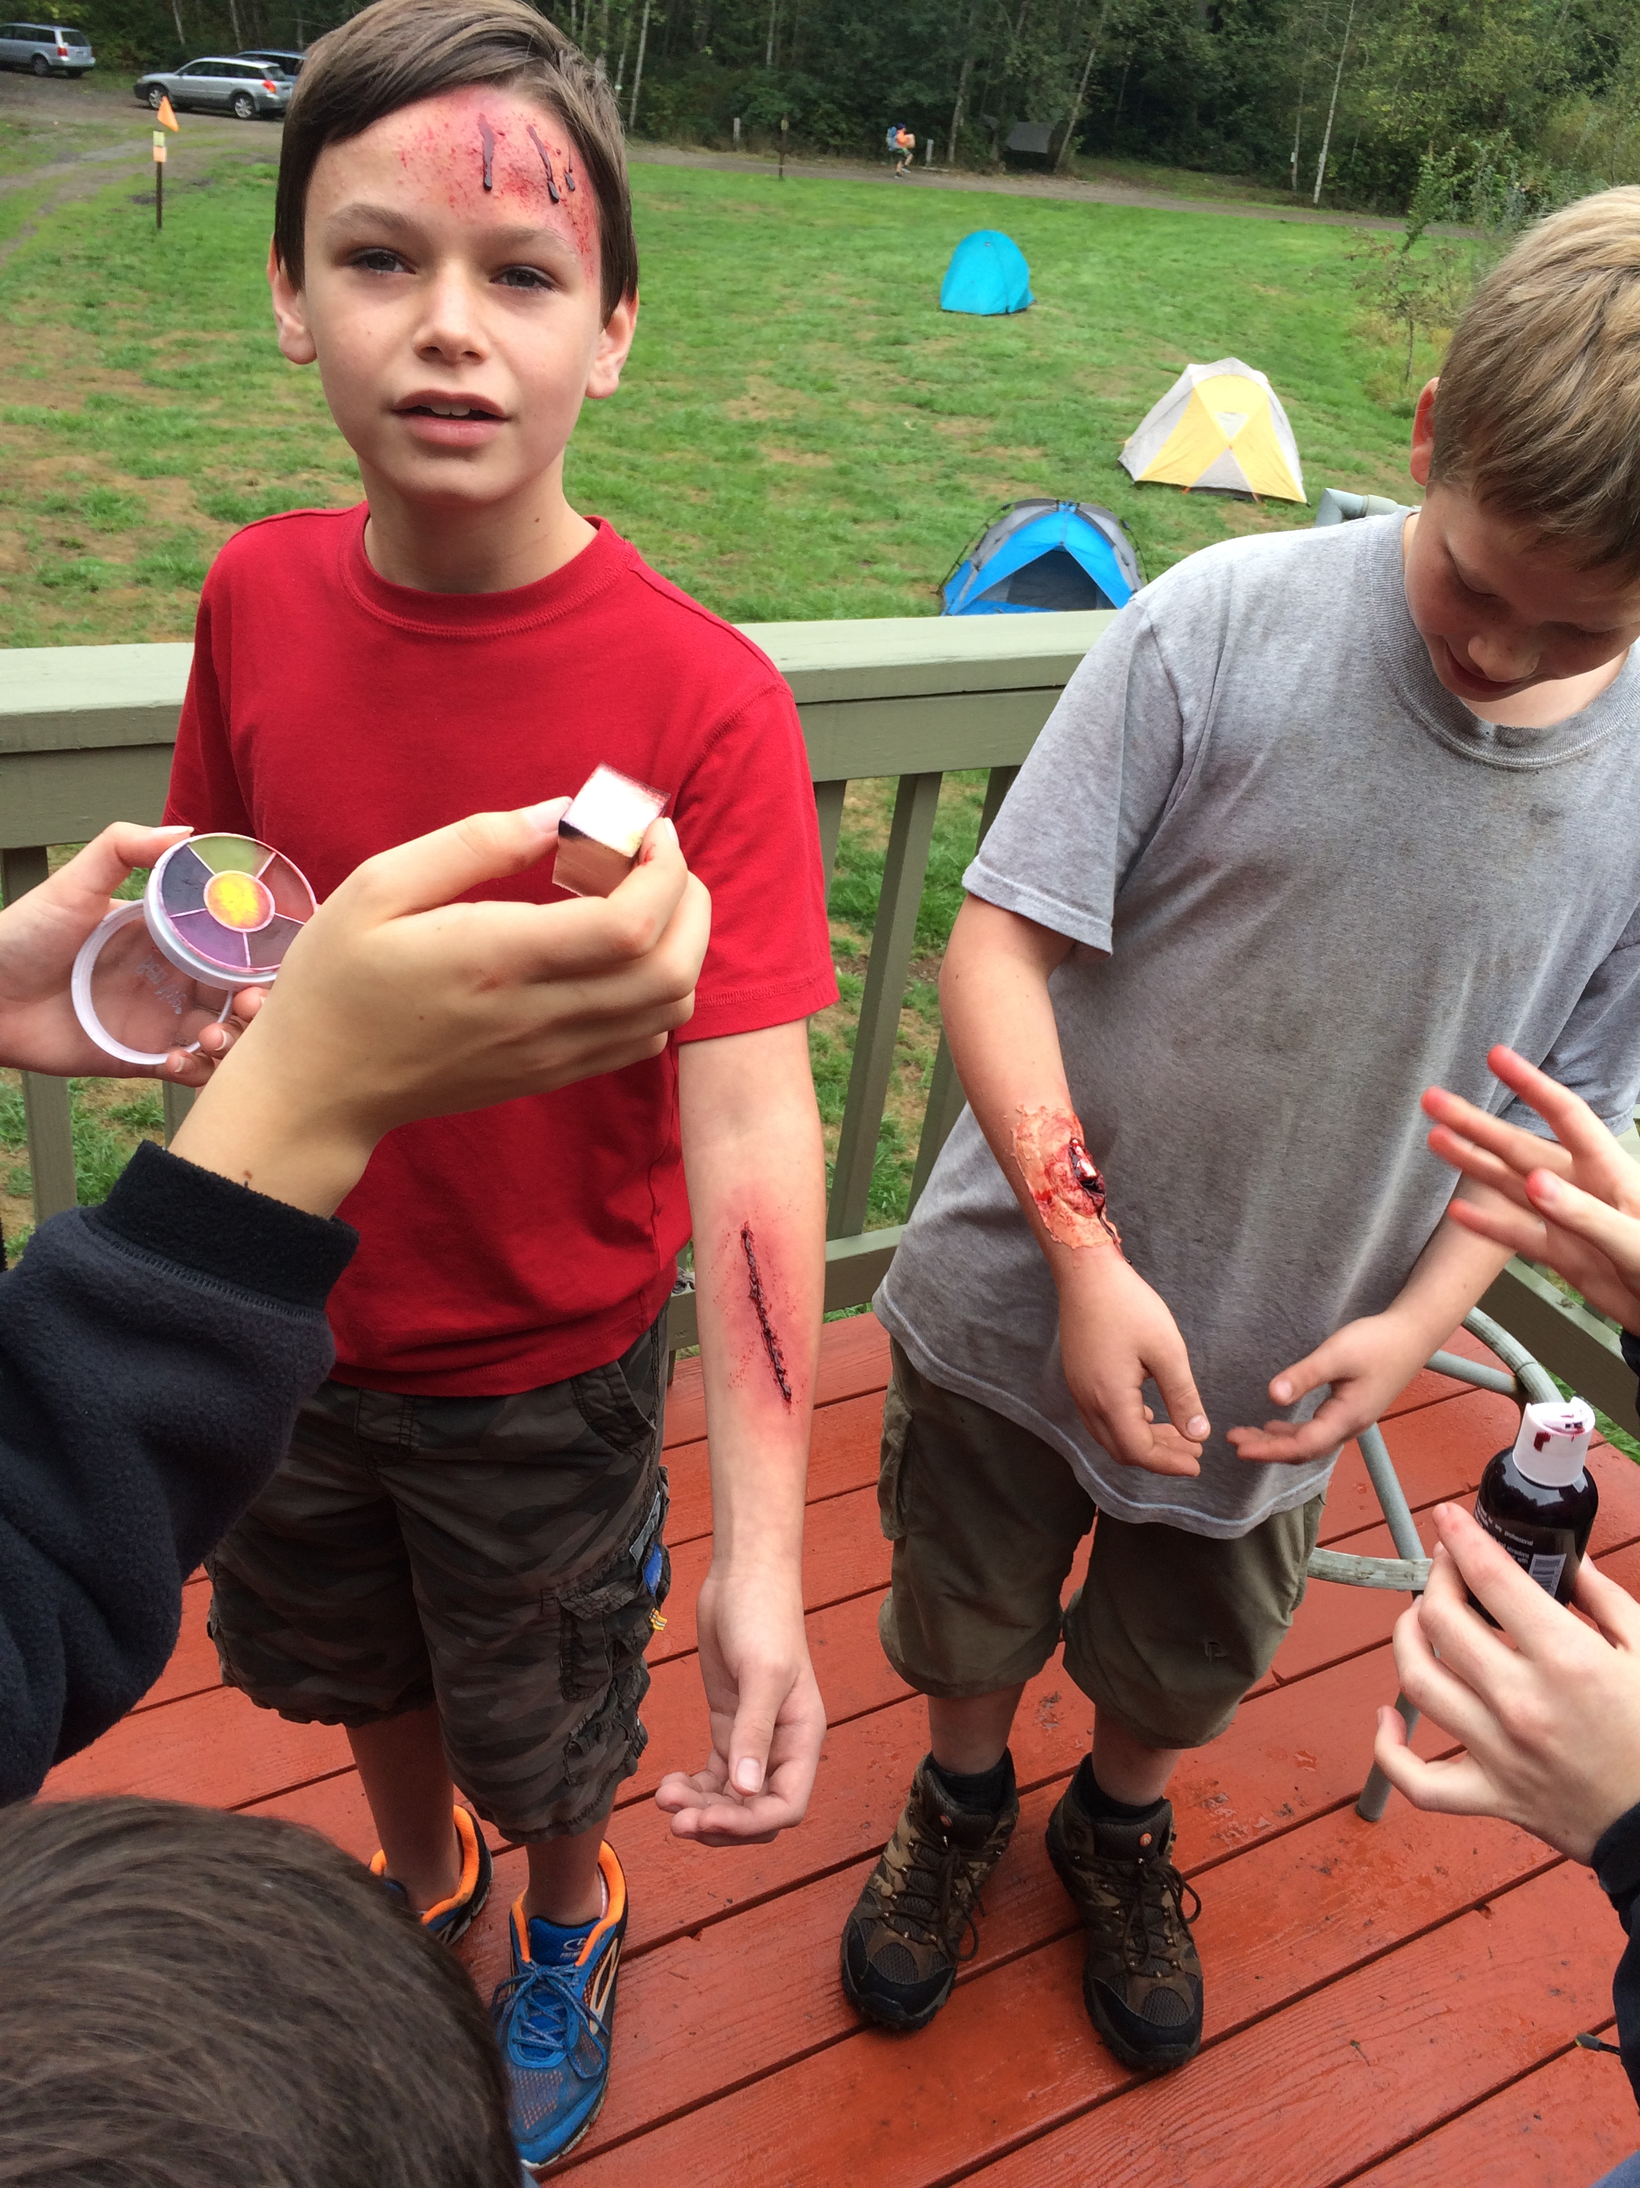
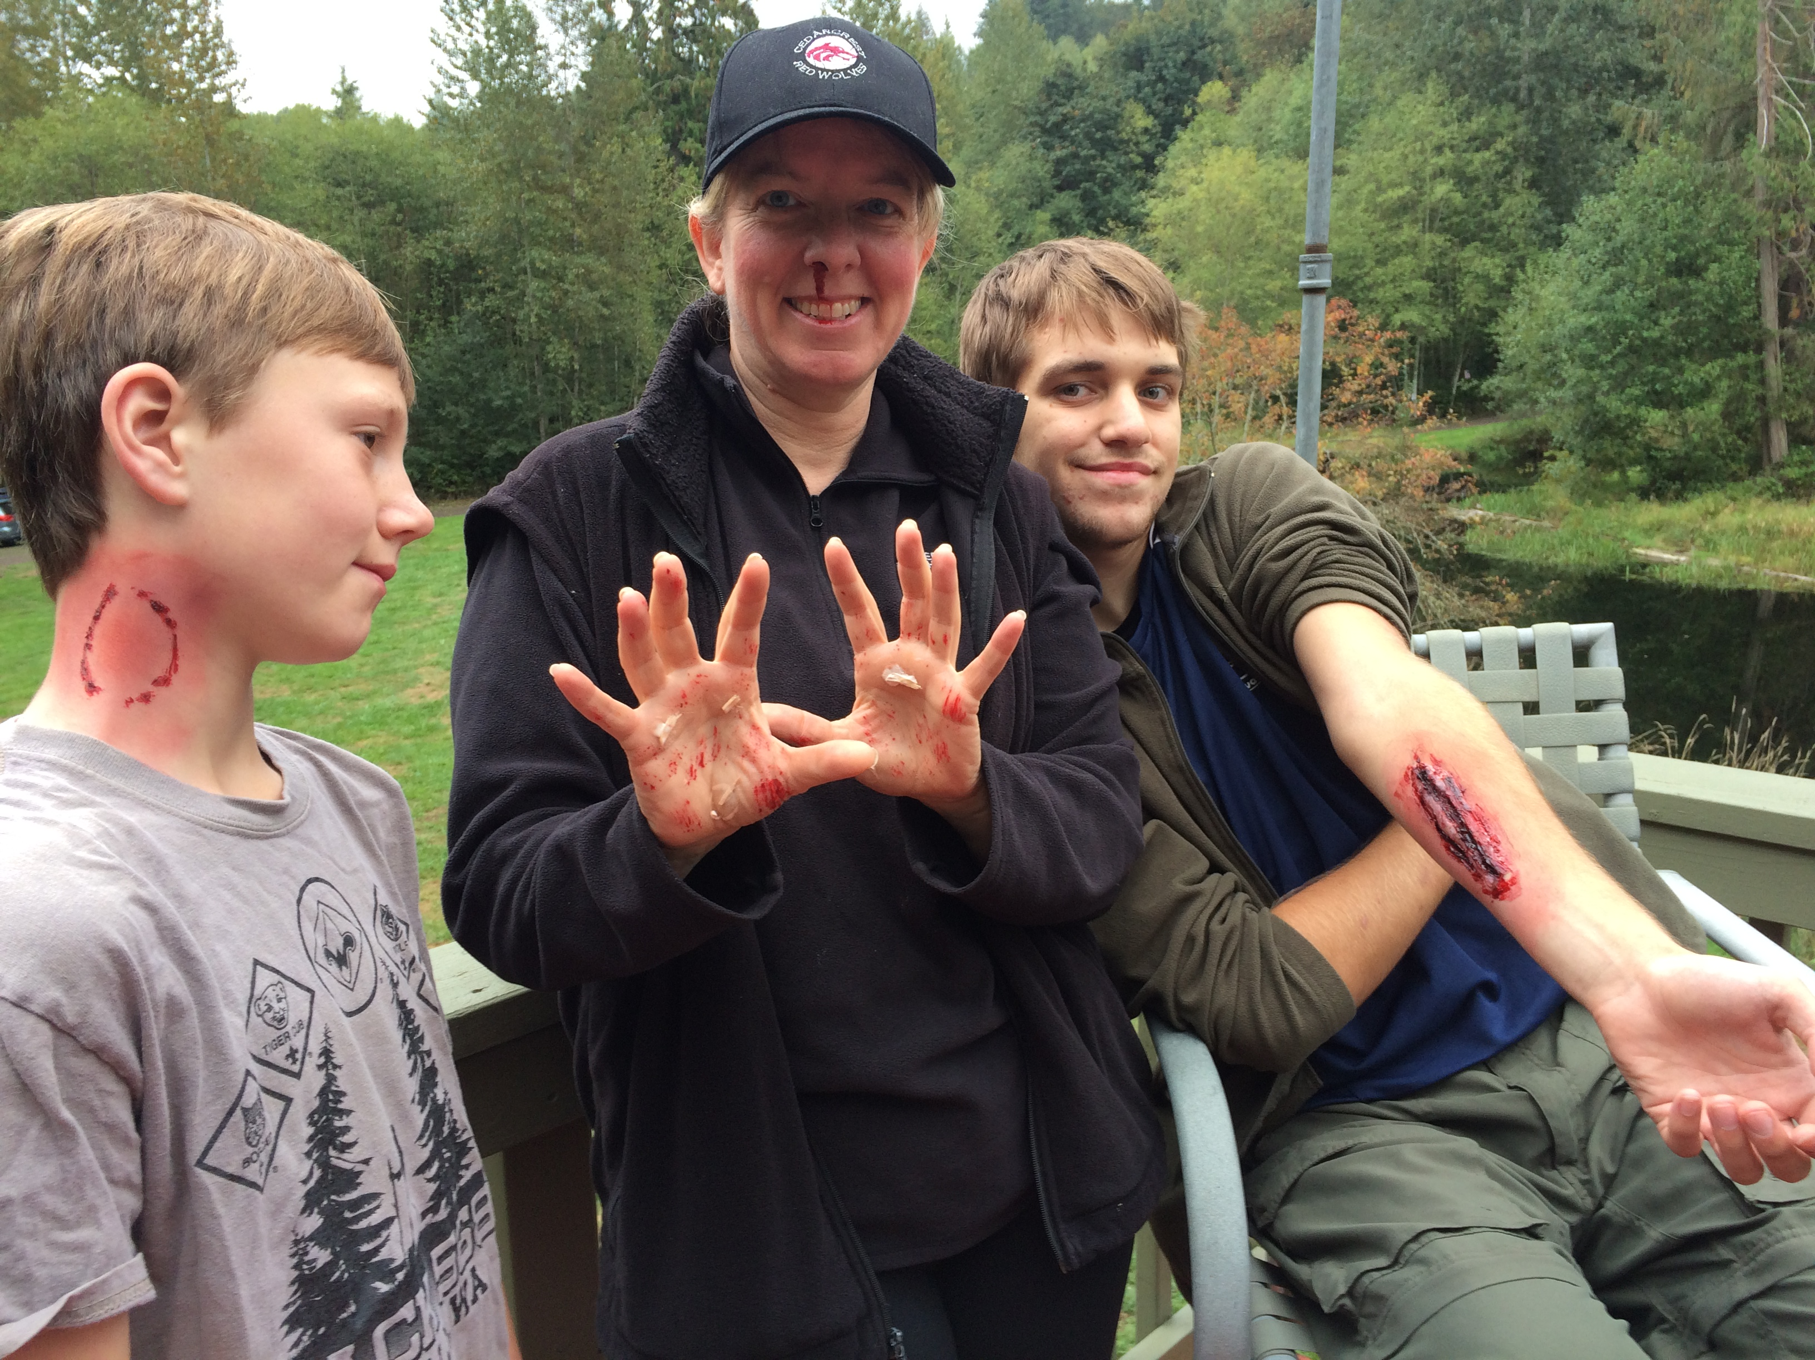
Making a cut & abrasions

Slide 7
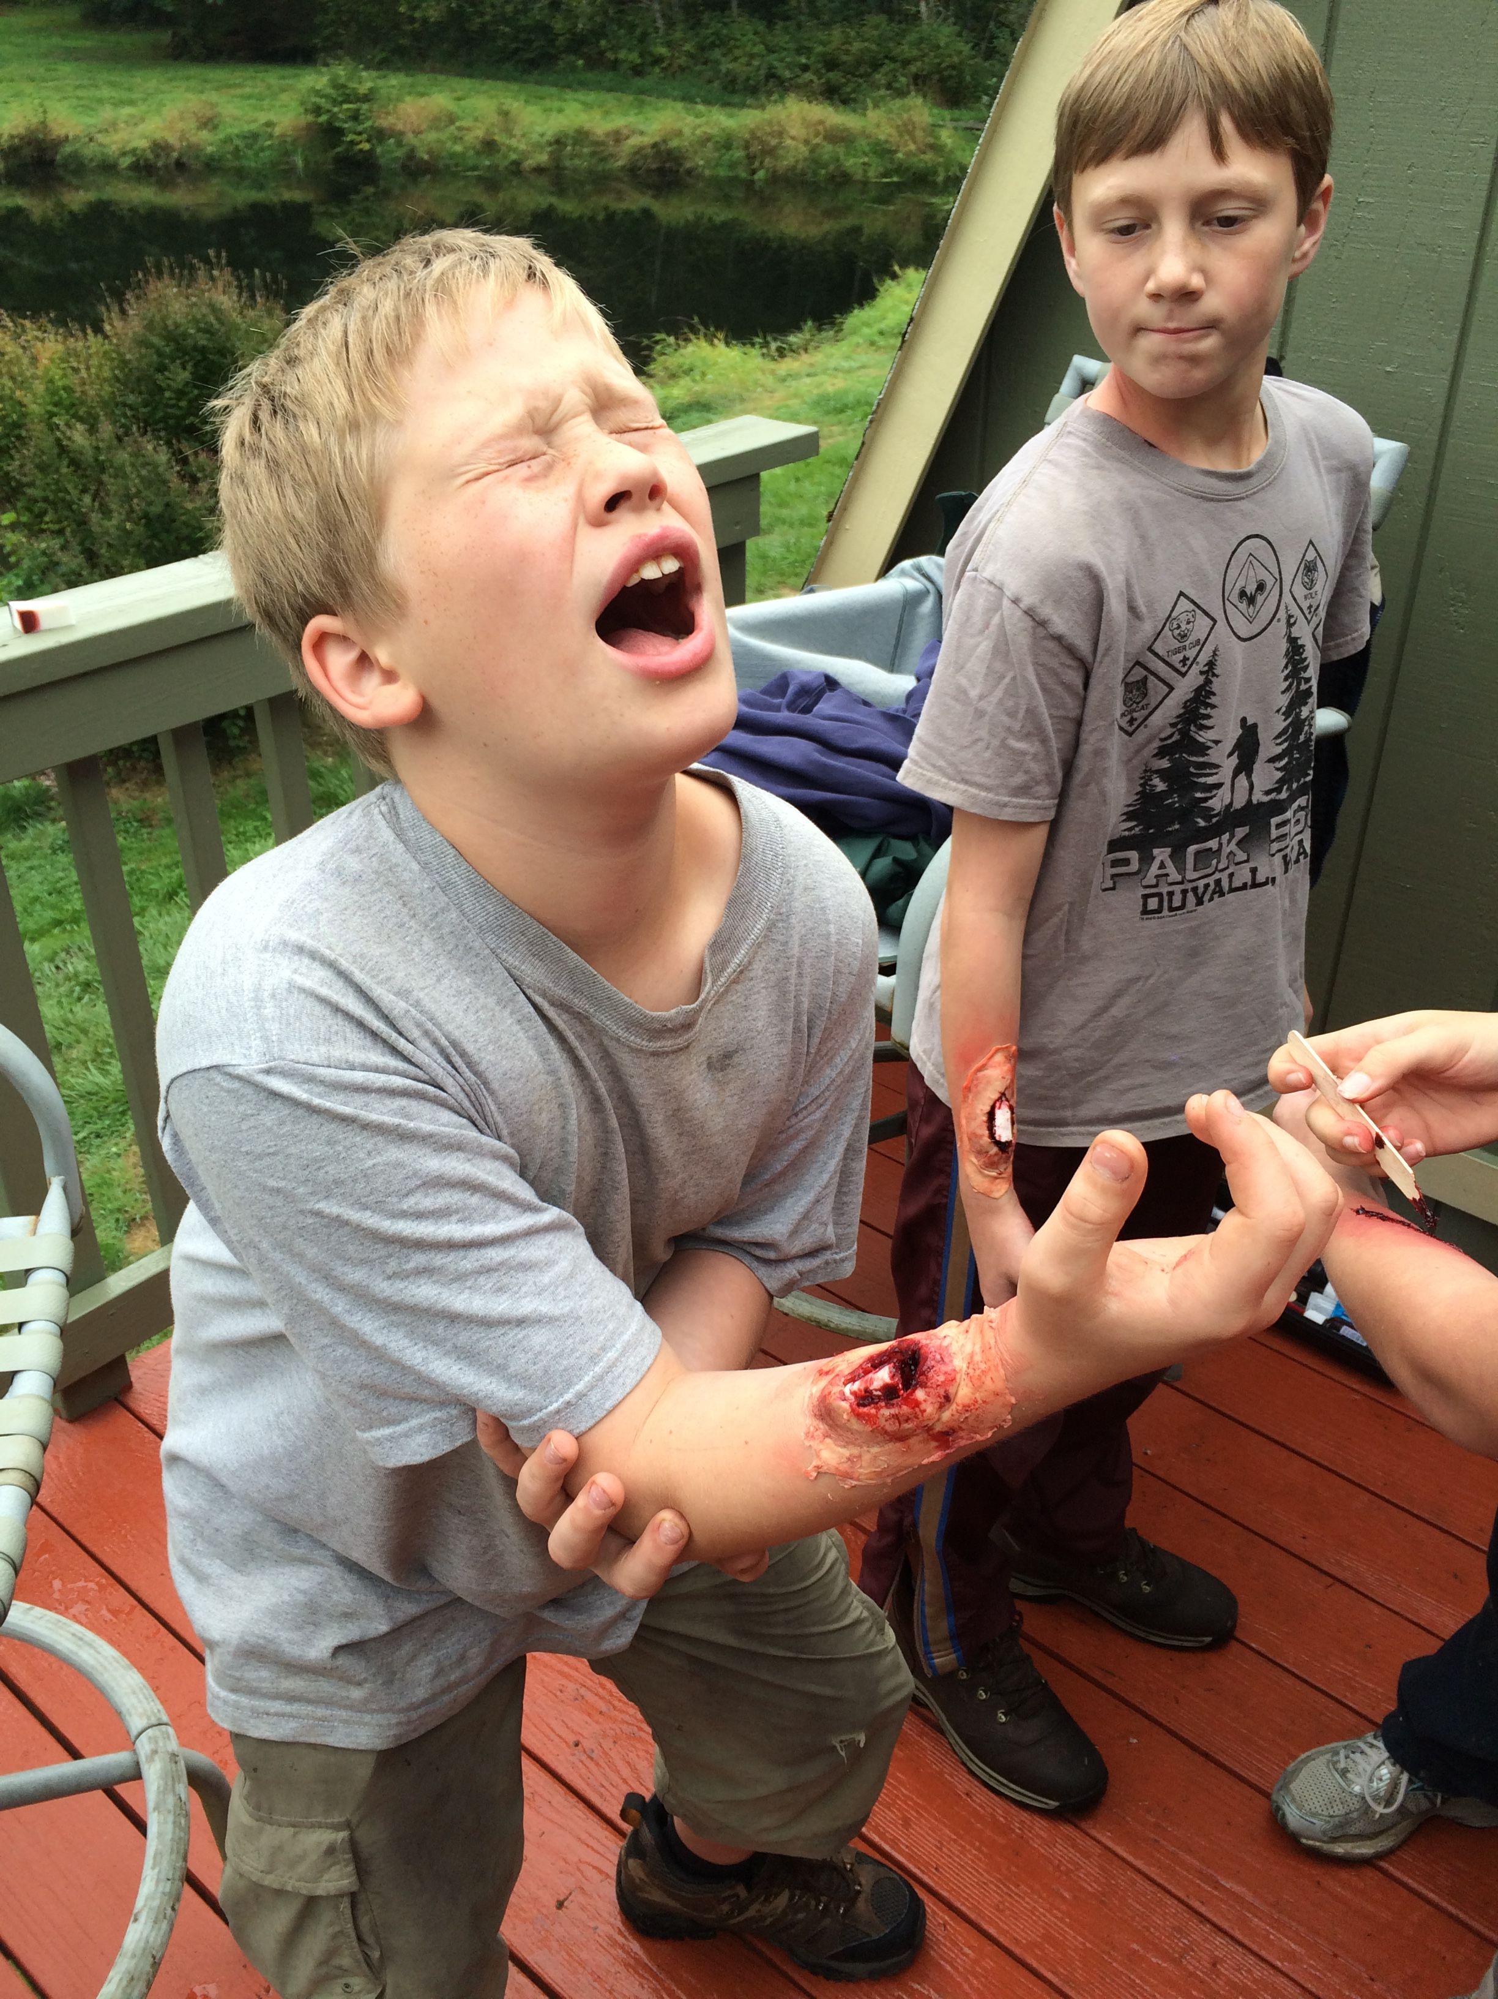
Making prosthetics

Slide 8
Making prosthetics
Make ahead
  These take time to create & cure
  To apply
    Shave/clean location
    Base layer of latex
    Apply prosthetic
    Apply wound coloring to match skin tone
Broken bones
  Base layer – latex
  Use wax to form the wound
  Straws make good “bones”
Abrasions
  Latex &
Burn sheets
  Layers of latex
  Bubbles of glycerin
Sucking chest wound
  Wax wound
  Tube
  Squeaker/bulb

