Slide 1

PTC 2021 – Session 408
Troop Committee Training

Slide 2
Welcome!
Purpose of this course today:
  To provide Scouts BSA Training: Troop Committee
  To learn the role of the Committee in a BSA Troop
  To learn about the different jobs on the Troop Committee
  To share with each other
    Best Practices
    Worst Practices?
    Ideas, Tips, Tricks
    Diversity of experiences across different Troops
    Make connections, keep the conversation going

Slide 3
Agenda
Introductions & Objectives
Aims & Methods of Scouting
The Chartered Organization
Troop Leadership
Troop Committee Organization and Responsibilities
Selecting and Retaining Adult Leaders
Open Discussion & Experience Sharing
Closing

Slide 4
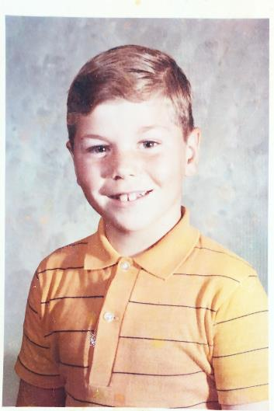
Introductions
Todd Brown – toddrbrown@comcast.net
  District Chair for Alpine (CSC)
  Assistant Scoutmaster for Troop 425 (Fall City)
  Scouter for 19 years
    Explorer Advisor (Post 61, New Jersey)
    Den Leader (Pack 425, Fall City)
    Scoutmaster (Troop 425)
    District Committee (Alpine)

Slide 5

Introductions
Who are you?
What is your current position in your Troop?
What is your level of experience in Scouting?
First time at PTC?
Activity - What do you hope to learn today?
  Topics for the discussion portion of the class?
  Problems in your unit?
  Questions about your role?
  Feel free to post questions or comments in the chat during the session

Slide 6


The Mission of Scouting
To prepare young people
to make ethical and moral choices
over their lifetimes
by instilling in them the values
of the Scout Oath and Scout Law.
Notes:
The mission statement has been updated to include female youth as well.
Young people have to make their own choices about their actions, behaviors, and words. Our job is not to make those choices for them, but to give them the tools to make informed decisions with a basis rooted in values that benefit our community, families, and country.

Slide 7
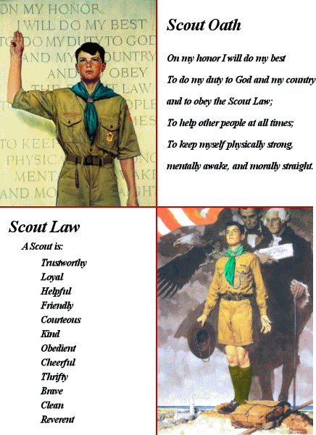
Scout Oath and Law
Notes:
Repeat the Scout Oath and Law.
These are not just hollow words that we repeat during each meeting – they are Values that are reinforced through our actions. Service to the community; welcoming new Scouts; listening to our leaders; learning and teaching new skills; testing ourselves in the face of difficult tasks; and reflecting on powers higher than ourselves.
The words of the Scout Oath and Law only hold meaning if we, ourselves, as their adult leaders, model the behaviors. Practice what you preach.

Slide 8
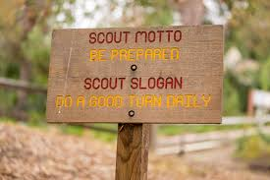
Motto and Slogan

Slide 9
The Aims of Scouting
Character Development
Leadership Development
Citizenship Training
Personal Fitness
Notes:
Ask the audience what they think each of these mean.
Character Development: Learning how to make moral and ethical choices in an ever changing world.
Leadership Development: Learning different leadership styles, and understanding servant-based leadership.
Citizenship: Recognizing what’s necessary and what benefits our community and country.
Personal fitness: Includes physical, emotional, and mental.
These aims are achieved through the Methods of Scouting

Slide 10
Methods of Scouting
Ideals
  Oath - Law - Motto - Slogan
Patrols
  Peer groups - Elected representation - Activities
Outdoors
  Fun - Excitement - Leadership laboratory
Advancement
  Self-reliance - Ability to help others - Challenge
Adult Association
  Image - Role model - Example
Personal Growth
  Good Turn - Service - Spirituality
Leadership Development
  Leadership instruction and practice
Uniform
  Commitment to aims - Identity
Notes:
Outdoors: gets them away from their home environments. Removes distractions of technology. In some cases, gets them outside of their comfort zone.
Advancement: Setting goals, developing a plan, and executing. Rewards are shown early. Progress at their own pace. Builds self-confidence.
Uniform: Not required, but encouraged. Shows the Scout’s progress through rank advancement. Differentiates Scouts from other youth.

Slide 11

Quiz Time
On your cell phone OR on your PC, open your browser and enter “kahoot.it” in the URL.

Slide 12
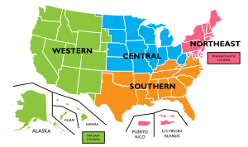



Structure of Scouting Organization
Administrative
National Council
  Chartered by Congress, four regions
  Professional staff – Volunteer directors
Local Council
  Chartered by the National Council
  A specific geographical area
  Professional staff – Volunteer Leaders
Scouting District
  A geographical area within the council
  Professional staff – Volunteer committee
  District Commissioner and Unit Commissioners
Chartered Organization
  Chartered by the local council
  “Owns” the troop, appoints a Chartered Org Rep
  Chartered Org Rep recruits the Troop Committee
  Troop committee recruits Scoutmaster and assistants
Notes:
Aside from the 4 national regions, there are also 16 Territories within the BSA.
The National Council sets policy of the BSA.
The local council administers the program for the units chartered within its boundaries.
Starting in 2021, the local council may charter units within its boundaries. Community organizations are preferred, but in the absence of a willing and able community institution, council may step into that role.

Slide 13

Troop Committee
Chartered Organization Representative
The Chartered Organization Representative is the direct contact between the Troop and the Chartered Organization.
This individual is also the organization's contact with the district committee and the Local Council.
The chartered organization representative may become a member of the district committee and is a voting member of the council executive board.
The Chartered Organization Representative appoints the Troop Committee Chair.
Notes:
The Charted Organization Representative may also be the Troop Committee Chair.

Slide 14

Structure of Scouting Organization
The Troop
THE SCOUT
A youth 11 to 17 years old.
A member of a patrol.
Elects Patrol Leader and Senior Patrol Leader

Slide 15
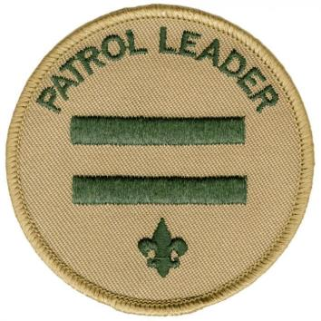
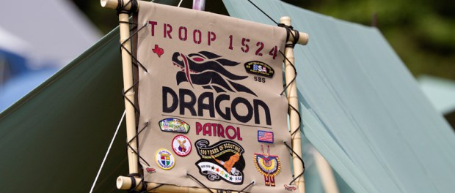
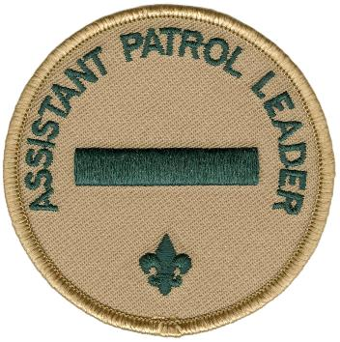
Structure of Scouting Organization
The Troop
THE PATROL
6 to 8 Scouts who work together.
Led by the Patrol Leader
Notes:
The Assistant Patrol Leader is appointed by the Patrol Leader.

Slide 16

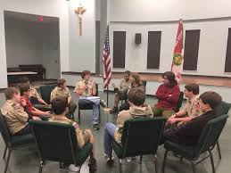
Structure of Scouting Organization
The Troop
PATROL LEADER’S COUNCIL
Assembly of patrol leaders
Senior Patrol Leader presides.
Plans troop activities.
Notes:
Notice that there is one adult present, likely the Scoutmaster, and he sits outside of the circle of youth leaders. He/she is there for advise and guidance.

Slide 17
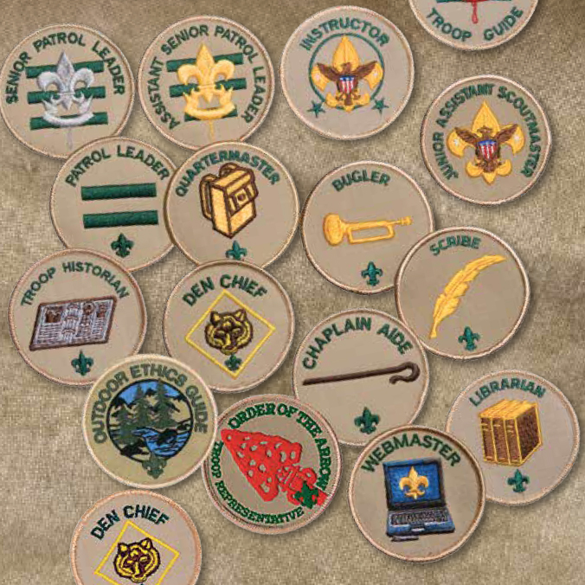
Structure of Scouting Organization
The Troop
YOUTH LEADERS
Senior Patrol Leader (+Asst), Patrol Leaders (+Asst), Junior Assistant Scoutmaster,
Scribe, Historian, Librarian, Webmaster, Outdoor Ethics Guide, Quartermaster, Troop Guide, Instructor, Chaplain's Aide, Den Chief, OA Rep.
Notes:
The variety of youth leadership positions ensures that every Scout who wishes to serve in a leadership position has an opportunity to do so.
The SPL appoints ALL youth leadership positions, with the exception of Patrol Leaders (who are elected), and JASM.
BTW – Asst Patrol Leaders and Buglers are not positions that qualify for rank advancement, per the Guide to Advancement.

Slide 18
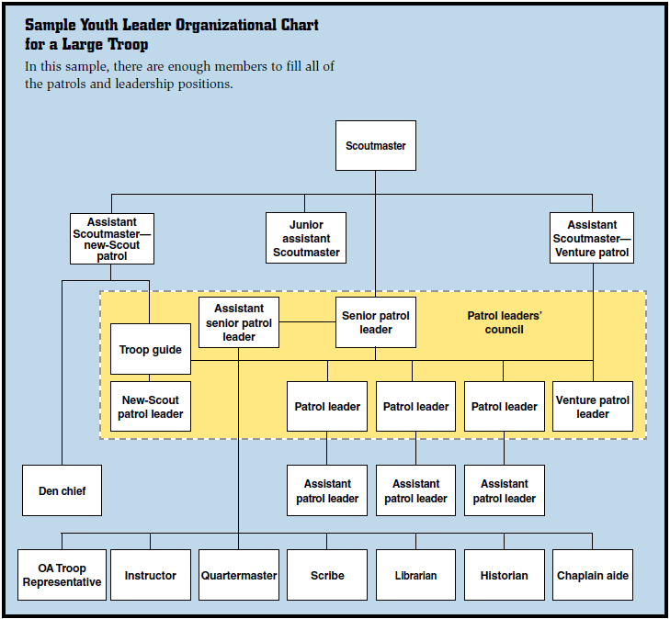
Structure of Scouting Organization
The Troop

Slide 19
Quiz Time
On your cell phone OR on your PC, open your browser and enter “kahoot.it” in the URL.

Slide 20
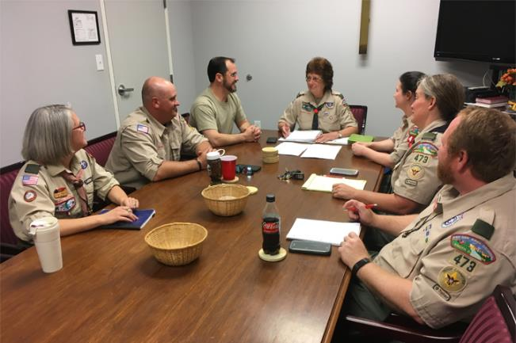
Role of the Troop Committee
The Troop Committee is the Troop's Board of Directors
Supports the Troop's Adult and Youth Leaders in Delivering a Quality Program to the Troop's Scouts

Slide 21
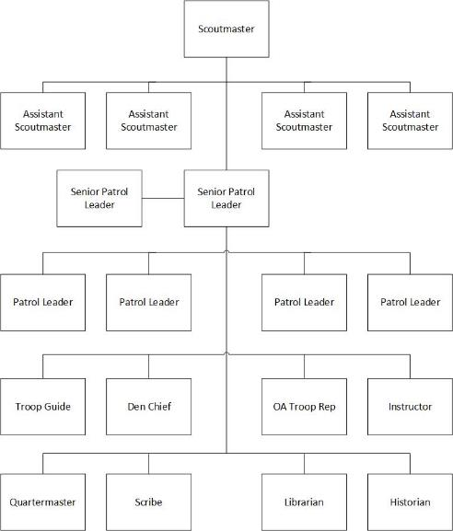
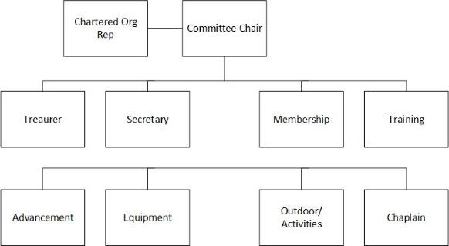
Role of the Troop Committee
Program
Administrative
Notes:
It’s important to recognize that the program side of the unit has a defined organizational structure that leverages the youth’s leadership, decision making, and skill development.
The administrative side supports the program side through the management of advancement records, finances, membership, transportation, and logistics.
Committee members can still have youth-facing interactions as merit badge counselors, board of review members, and outing coordinators.

Slide 22

Role of the Troop Committee
Committee can include parents, members of the chartered organization, or people recruited from the community at large.
  Most active committee members are parents
  The Scoutmaster and Assistants are not on the committee but should be included in meetings
Notes:
The SM and ASM’s are not voting members on the committee, but act as the liaison between the committee and youth leadership.

Slide 23
Troop Committee Ground Rules
Size: The minimum number is three adults
Age: Must be 21 or older
The first three positions are essential for quality Troop operations. Fill those positions first.
  Chairperson
  Treasurer
  Advancement
No maximum number of Troop committee members.

Slide 24

Troop Committee
Troop Committee Chairperson
The Troop Committee Chairperson is appointed by the Chartered Organization and registered as an adult leader of the BSA.
The Troop Committee Chairperson appoints and supervises the Troop Committee and Scoutmaster/Asst’s.

Slide 25
Troop Committee
Troop Committee Chairperson
Typical jobs for the Committee Chair
  Annual Recharter
  Recruit and appoint committee members
  Recruit and appoint unit leader and assistants
  Provide oversight of the troop program and leadership
  Submit adult applications
  Conduct periodic committee meetings

Slide 26

Troop Committee
Troop Committee Chairperson
Recruiting Strategies
Volunteers rarely volunteer!
  Sometimes the first volunteer isn’t the best volunteer
  Most people just want to be asked!
  Talk in-person, face-to-face
  Explain why you believe they will be successful in the role
  Provide clear direction for next steps
  Give them names of people who will help
Definition of a Leader? Someone to do the job when nobody else will!

Slide 27

Troop Committee
Troop Committee Chairperson
Committee Meetings
Schedule periodic meetings and put on troop calendar
  Some will choose monthly, others quarterly
  Zoom works great for some, but make some of them in-person as well
    A lot of important team building occurs before and after the meeting
  Invite all parents, not just the committee
    Provides a way to draw-in new committee members
  Create an agenda to control discussion
  Use active listening! Don’t be the only one talking!

Slide 28
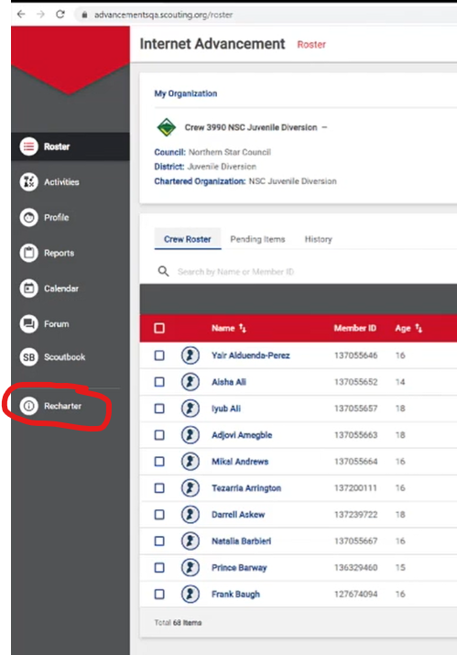
Troop Committee
Troop Committee Chairperson
Recharter
Recharter process is done online via a web-based tool
Access through Internet Advancement portal
  https://advancements.scouting.org
  Click on Recharter link
Walk-through video available at https://www.scouting.org/resources/internet-rechartering/

Slide 29

Troop Committee
Troop Committee Chairperson
Recharter
Tips:
  Don’t use a credit card to pay for recharter – there is a 3% transaction fee
    Use e-check instead ($1 fee), or pay by check at council
  YPT and background check authorization is still required for registered adults, but the tool allows recharter to be submitted without them

Slide 30

Troop Committee
Troop Secretary
The Troop Secretary is appointed by the Committee Chairman to keep minutes and records, send notices, and handle publicity.

Slide 31

Troop Committee
Troop Treasurer
The Troop Treasurer is appointed by the Committee Chairperson to handle troop funds, pay bills, maintain accounts, coordinate the annual Friends of Scouting (FOS) campaign, and supervise fundraising.

Slide 32
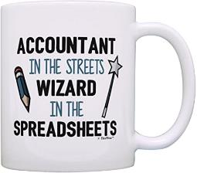


Troop Committee
Troop Treasurer
To spreadsheet or not to spreadsheet…
Many troops forego the expense or complexity of accounting software and just use spreadsheets
Size of the unit and methods already in place are going to be factors on what you do

Slide 33

Troop Committee
Troop Treasurer
Electronic payments
Ditch the paper checks
Over 900 banks and credit unions use Zelle
Transfers are free
Even if a parent’s bank is not a Zelle affiliate, they can still use the app
TIP: Consider establishing a ledger for individual scouts to accumulate funds from their participation in fundraisers.

Slide 34

Troop Committee
Troop Treasurer
Come up with a process for reimbursements (a paper form or email) that requires CC approval
Recipients of reimbursements should not be approving their own forms
Treasurer should present a financial report at each committee meeting showing expenditures and receipts

Slide 35


Troop Committee
Troop Advancement Chair
The Troop Advancement Chair is appointed by the Committee Chairperson to ensure that the troop has:
  At least monthly Boards of Reviews
  Periodic Courts of Honor (ex. quarterly)
  Award supplies on-hand
  Goals of helping each Scout advance a rank each year and for new Scouts to reach First Class rank during their first year
The Advancement Coordinator is also responsible for record keeping and submitting advancement reports.
  Scoutbook is your friend…

Slide 36
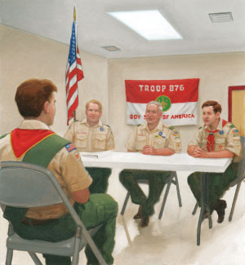
Troop Committee
Troop Advancement Chair
Boards of Review
  Includes 3-6 parents and/or committee members
  Parents and relatives may not serve on the board
  Scoutmasters/ASM’s may attend, but only as observers
  Not a test of the Scout’s knowledge or skill level
  Should be a celebration of accomplishment, a reflection, and a positive experience
  Good opportunity for committee members to assess the effectiveness of the unit leaders
  Board decision must be unanimous
  Board can reject candidates (rare), but should provide improvement plan
Unit Boards of Review (Tenderfoot Rank ➔ Life Rank)
  Organized by Troop Committee
Eagle Board of Review
  Organized by District or Council leadership

Slide 37
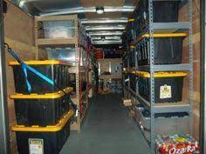
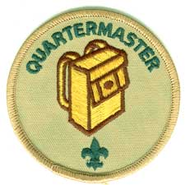
Troop Committee
Troop Equipment Coordinator
The Troop Equipment Coordinator is appointed by the Committee Chairman to work with the Scout Quartermaster and is responsible for inventory, storage, and maintenance of Troop equipment.

Slide 38


Troop Committee
Troop Equipment Coordinator
  Should not do the job of the quartermaster
  Should arrange for storage of equipment
  Assist quartermaster to:
    Develop policies regarding common equipment
      Standardize stoves? Fuel type?
      Should the Troop own their own tents?
      Cooking Gear?
      Patrol Boxes?
    Develop policies regarding use and maintenance of equipment
    Enforce these policies
    Develop budget for equipment purchases
    Select vendors and make purchases
    Ensure equipment is safe to use

Slide 39

Troop Committee
Troop Outdoor / Activities Chair
The Troop Outdoor / Activities Chair is appointed by the Committee Chairman to:
  Secure permits and permission to use camping sites
  Collect/maintain Annual Health and Medical forms
  Serve as transportation coordinator
  Support the outdoor program
TIP: Consider assigning coordinators for major activities like summer camp, Philmont, high adventure, etc

Slide 40
Troop Committee
Troop Membership Chair
The Troop Membership Chair is appointed by the Committee Chairman to help ensure a smooth transition of new Scouts into the Troop and provide orientation for new parents.
TIP: Develop a troop handbook for new members that includes key 3 contact information, meeting dates/places, equipment lists, website addresses, troop rules/policies, and other useful information.
TIP: Conduct a parent’s meeting on the first troop meeting after cross-over.

Slide 41
Troop Committee
Troop Training Chair
The Troop Training Chair is appointed by the Committee Chairman to ensure
  Training opportunities are available
  Training records are maintained
  BSA Youth Protection training is completed
  Position specific training is completed
Notes:
The recharter tool will check the training records of leaders you are registering against the training database to see if they are up to date on YPT.

Slide 42
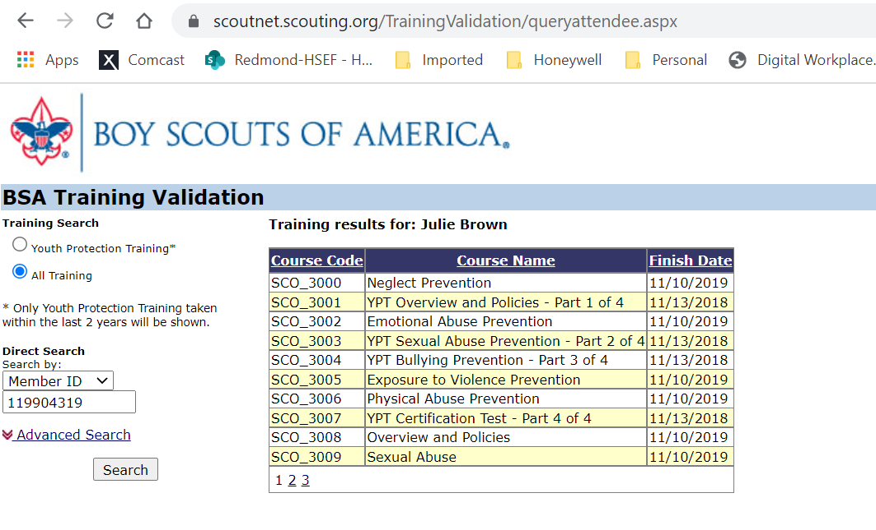
Troop Committee
Troop Training Chair
How to get training status
  Login to my.scouting.org
  Select “Training Validation”
Notes:
The recharter tool will check the training records of leaders you are registering against the training database to see if they are up to date on YPT.

Slide 43


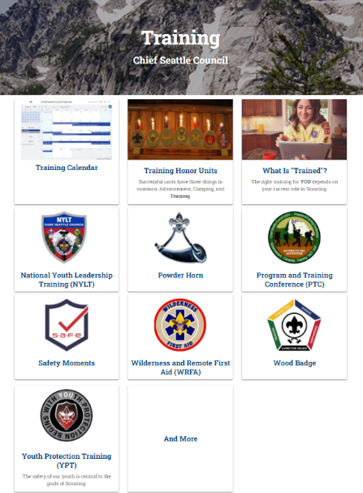


Troop Committee
Troop Training Chair
Training Resources
  Chief Seattle Council training website
  Your district training website
  District Roundtable
  Your Unit Commissioner
Notes:
The recharter tool will check the training records of leaders you are registering against the training database to see if they are up to date on YPT.

Slide 44
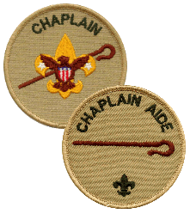
Troop Committee
Troop Chaplain
The Troop Chaplain is appointed by the Committee Chairman to:
  Provide a spiritual tone for troop/team meetings and activities.
  Give guidance to the chaplain aide.
  Promote regular participation of each member in the activities of the religious organization of his choice.
  Visit homes of the Scouts in time of sickness or need.
  Encourage Scouts to earn their appropriate religious emblems.

Slide 45

Troop Committee
Other Positions…
Troop Public Relations Chair
  Inform parents of their responsibilities in Scouting and with the chartered organization.
  Provide news and announcements about the troop to newspapers, bulletins of sponsors, web sites, etc.
  Promotes and stimulates service projects, Scouting Anniversary Week, Scout Sunday or Scout Sabbath, and family participation in troop events.
  Promotes new membership and lets people in the neighborhood know that Scouting is available.
Troop Friends of Scouting (FOS) Chair
  Work closely with the troop committee on public relations for FOS
  Conducts annual FOS campaign to enroll family members and adult leaders in FOS
  Gives recognition to contributors and enrollees.
Troop Scouting for Food Chair
  Coordinate an annual food drive for the troop and report the result to the district.
Troop Fundraising Chair
  Also called the "Popcorn Kernel" in some councils, supervises Fundraising and ensure that every youth member has the opportunity to participate in Popcorn sales or other council Fundraising events.
New Member Coordinator
  The New Member Coordinator shares the benefits of Scouting. Coordinates unit recruitment. Guides the joining and welcoming process for youth and their families.

Slide 46
Quiz Time
On your cell phone OR on your PC, open your browser and enter “kahoot.it” in the URL.

Slide 47
Selecting & Retaining
Adult Leaders
One of the most important responsibilities of the committee: Provide adequate adult leadership for the troop
What are the attributes of a good leader?
How do you find good leaders?
How do you keep good leaders?
How do you plan for turnover?

Slide 48

Don’t Forget about Self Care
Some committee members take on multiple jobs
  Sometimes seems easier to do it yourself than to delegate
  Procrastination feeds this behavior
Helpful tips to avoid burn-out and resentment
  Don’t be afraid to say “No”
  Ask for HELP
  Have some fun! Have a backyard BBQ committee meeting
  Don’t wait to start training your replacement
    Change roles when things get “stale”
  Recognize you are a volunteer
    You don’t have unlimited free time
    You will make mistakes
    You can’t make everyone happy

Slide 49
Q & A
Anything else you’d like to ask?

Slide 50

Congratulations!
You have successfully completed
the Troop Committee Training!
FACT: (in 2012…)
Nearly 1.2 million volunteers donate an average of 20 hours per month to the BSA, totaling 280 million hours of time during the year.
THANK YOU!

